Slide 1
Time Complexity - 2

Slide 2
Recurrence Relations
A recurrence is an equation or inequality that describes a function in terms of its values on smaller inputs. To solve a Recurrence Relation means to obtain a function defined on the natural numbers that satisfy the recurrence.
EX.
T (n) = T (n-1) +1 and T (1) = θ (1). ➔ O(n)
T (n) = T(n/2) + n ➔ O(log n)
T (n) = 2T(n/2) + n n>1 ➔ O(nlog(n))

Slide 3
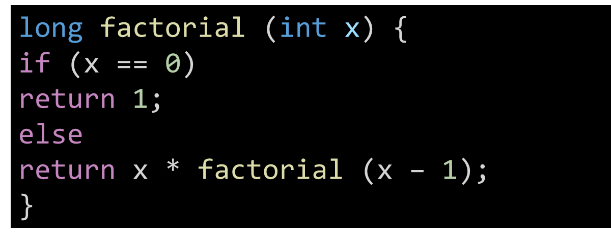
Factorial Recursive solution

Slide 4
Factorial Recursive solution
O(n)

Slide 5
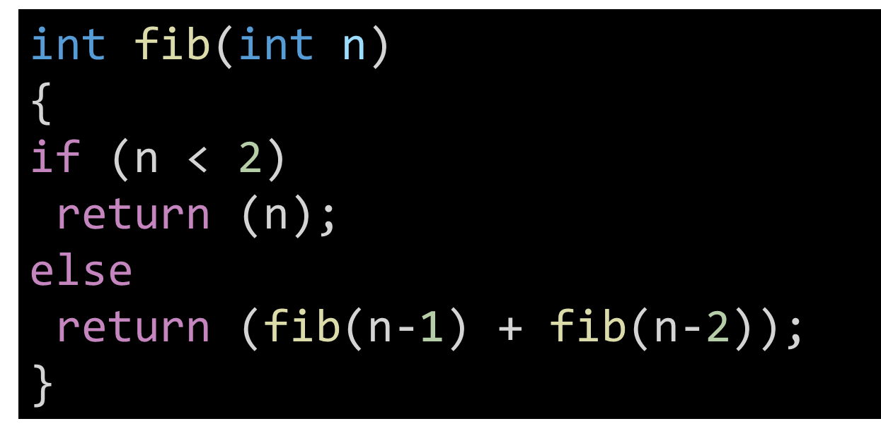
Fibonacci Recursive solution

Slide 6

Fibonacci Recursive solution
O(2^n)

Slide 7
Practice
Write a program in C to count the digits of a given number
using recursion.
Test Data :
Input a number: 50
Expected Output :
The number of digits in the number is: 2

Slide 8
Practice
Write a program in C to find the sum of digits of a number
using recursion.
Test Data:
Input any number to find the sum of digits: 25
3
Expected Output:
The Sum of digits of 25 = 7

Slide 9
Practice
Write a program in C to convert a decimal number to
binary using recursion.
Test Data:
Input any decimal number: 66
Expected Output :
The Binary value of decimal no. 66 is: 1000010

