Slide 1



Slide 2
In C, a string is a sequence of characters terminated by a null character („\0‟). Strings can create using string-literals, which are sequences of characters with double quotation marks; for example, a string of literal “Computer Notes.” The C library offers a wide array of functions for string operations.

Slide 3
Functions | Description
strcat() | Function to concatenate(merge) strings.
strcmp() | Function to compare two strings.
strcpy() | Function to copy a string to another string.
stricmp() | Function to compare two strings ignoring their case.
strlen() | Function to calculate the length of the string.
strlwr() | Converts the given string to lowercase.
strrev() | Function to reverse the given string.
strupr() | Converts the given string to uppercase.
strdup() | Duplicates a string.

Slide 4
Functions | Description
strnicmp() | Compares the first n characters of one string to another without being case-sensitive.
strncat() | Adds the first n characters at the end of second string.
strncpy() | Copies the first n characters of a string into another.
strchr() | Finds the first occurrence of the character.
strrchr() | Finds the last occurrence of the character.
strstr() | Finds the first occurrence of string in another string.
strset() | Sets all the characters of the string to a given character.
strnset() | Sets first n characters of the string to a given character.

Slide 5
We‟ll be covering the following topics in this Lecture:
The strlen() Function | The strupr() Function
The strcat() Function | The strdup() Function
The strcmp() Functions | The strnicmp() Function
The strcpy() Functions | The strncat() Function
The strchr(), strrchr() Functions | The strstr() Function
The stricmp() Function | The strset() Function
The strlwr() Function | The strnset() Function
The strrev() Function

Slide 6
Syntax : size_t strlen(const char *len);
The strlen() function is one of the inbuilt string function in c programming. It takes one argument len, which can be a string constant or a string variable. It returns the length of the string stored in the array len, i.e., the number of characters in the string excluding the null character(„\0‟). If the string is empty, it returns zero.

Slide 7
START
Step 1 → To use strlen(), we need to declare #include<string.h> header file.
characters.
STOP
Step | 2 | → | strlen() | accepts | only one parameter.
Step | 3 | → | strlen() | returns | the number of string

Slide 8
#include<stdio.h> #include<string.h> int main() {
char len[] = "<a href="https://ecomputernotes.com/fundamental/introduction-to- computer/what-is-computer" data- internallinksmanager029f6b8e52c="1">Computer</a> Notes"; printf("Length of String = %d ", strlen(len));
return 0;
}

Slide 9
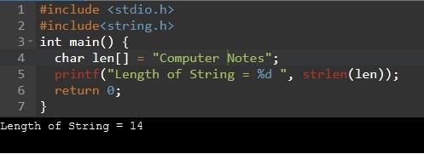

Slide 10
The strcat( ) function appends the src string at the end of the dest string, i.e., character arrays as arguments of which first argument dest is a string variable. The second argument src can be a string variable or string constant. This function appends a copy of src to the end of dest. The first character of src overwrites the terminating null character („\0‟) of dest. The length of the resulting string is strlen(dest)+ strlen(src).

Slide 11
In addition to appending string src to string dest, this function also returns dest. Its syntax is as follows,
Syntax : char *strcat(char *dest, const char *src); For example, the following program reads two strings of less than 100 characters and uses strcat() to combine them and bring the resulting string into an array.

Slide 12
START
Step 1 → To use strcat(), we need to declare #include<string.h> header file.
Step 2 → strcat() accepts two parameters. Step 3 → Both parameters must be a string. STOP

Slide 13
#include <stdio.h> #include<string.h> int main() {
char dest[100] = "Computer ", src[30] = "Notes";
strcat (dest, src);
printf("Combined Strings are : %s ", dest);
return 0;
}

Slide 14
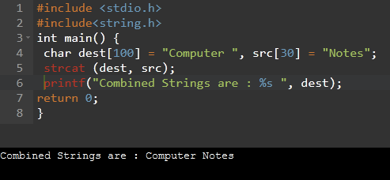

Slide 15
Syntax : int strcmp(const char *lhs, const char *rhs); The
strcmp() character
function compares two null-terminated arrays lexicographically. The strcmp ( )
function compares string lhs with the contents of string rhs by comparing successive corresponding characters,
starting with the first character in each string. This process
continues until either the corresponding
characters are formed to be different,
or the last
character in one or both strings is reached.

Slide 16
If strings are the same, strcmp() returns 0. If the first string is shorter than the second, strcmp() returns a negative value, while if it is larger, it returns a positive value.
if lhs < rhs returns a value < 0 if lhs == rhs returns 0
if lhs > rhs returns a value > 0
A string shorter than another if one of the following conditions is true:
The first n character of the string matches, but in the first string the value of the n+1 string is shorter than in the second string.
All character matches, but the first string is shorter than the second.

Slide 17
For example, the strcmp(“Notes,” “notes”) statement returns a negative value because the first non-matched ASCII code „N‟ is lower than the ASCII code of „n.‟ The strcmp(“w,” “more”) statement returns a positive value because the initial non- matched „w‟ code in ASCII is larger than the „m‟ ASCII code.
We‟ll implement the strcmp() function, to show you an implementation.

Slide 18
#include <stdio.h> #include <string.h> int main(void) {
char lhs[100] = "Notes", rhs[100] = "notes";
int result;
result = strcmp(lhs, rhs);
if(result == 0)
printf("The strings dest and src are same ");
else {
printf("Different texts\n");
}
return 0;
}

Slide 19
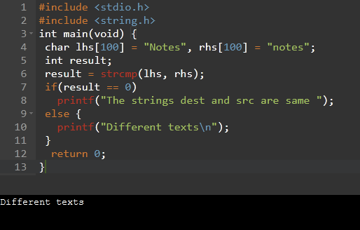

Slide 20
The strcpy ( ) function takes two arguments, of which first argument „dest‟ is a string variable and second argument
„src‟ can be a string variable or string constant. It copies the contents of string „src„, including the null character(„\0‟), replacing what was previously stored in the string „dest‟. You can use the == operator to copy integers, However, you can‟t use the = operator to copy the strings. Strings in C are represented as arrays of characters with a terminating null-character, so using the = operator will only save the address (pointer) of a string.

Slide 21
The = operator can be used to copy integer, However, you can‟t use the = operator to copy the strings. Strings in C represent character arrays with a terminating null character, so the = operator saves a string address.
For example,
char str[10];str = "Notes"; /* Wrong, since str is an array. */In fact, strcpy() function is available in string.h to copy strings. Sufficient space must be allocated before copying to the destination.

Slide 22
Syntax : char *strcpy(char *dest, const char *src); strcpy() copies the src string into the dest memory. After copying the null character, strcpy() ends and returns the dest pointer. strcpy() can‟t modify the string since src declare as const. The strcpy() and strncpy() behavior are undefined when the source and destination strings overlap. In the example below, strcpy() copies “Notes” in str.
char str[10];strcpy(str, "Notes");

Slide 23
#include <stdio.h> #include <string.h> int main(void) {
char lhs[100], rhs[100]; printf("Enter text: "); fgets(rhs, sizeof(rhs), stdin); strcpy(lhs, rhs);
printf("Copied text: %s\n", lhs);
return 0;
}

Slide 24
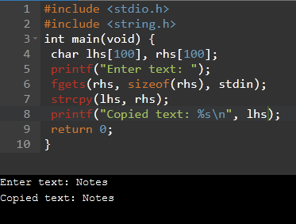

Slide 25
strchr and strrchr
The functions strchr and strrchr find a character in an array of characters that is NUL-terminated. Strchr returns the first occurrence pointer and strrchr the last occurrence.
Syntax : char *strrchr(const char *src, int chr);It scans a string src in the reverse direction, looking for a specific character chr.

Slide 26
#include <stdio.h> #include<string.h> int main() {
char src[] = "Computer Notes", chr = 't';
char *toSearchFor; toSearchFor = strchr(src, chr); if(toSearchFor)
printf("First position of : %s\n", toSearchFor); toSearchFor = strrchr(src, chr); if(toSearchFor)
printf("Last position of : %s", toSearchFor);
return 0;
}

Slide 27
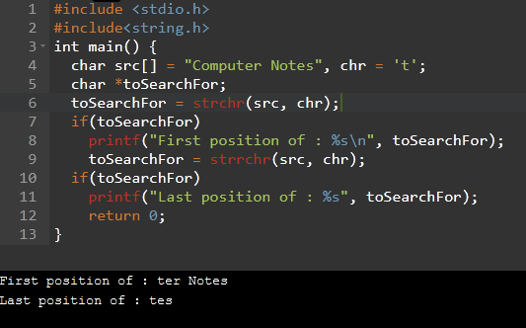
Outputs :

Slide 28
The stricmp() is one of the c programming string function in which two strings are compared, without distinction between uppercase and lowercase letters. If the strings are the same, 0 comes back. Otherwise, a non-zero value will return.
Syntax : stricmp(dest, src); Step by Step working of the below Program Code:
START
Step 1 → To use stricmp(), we need to declare #include<string.h> header file.
Step 2 → stricmp() accepts two parameters. Step 3 → Both parameters must be a string. STOP

Slide 29
#include <stdio.h> #include <stdlib.h> #include <string.h> int main(void) {
char dest[20] = "Computer Notes";
char src[20] = "COMPUTER NOTES";
int n;
n = stricmp(dest, src);
if( n == 0)
printf("The strings are same ");
else if(n == -1)
printf("The string dest is lesser than src");
else printf("The string dest is greater than src");
return 0;
}

Slide 30
The strlwr() is one of the c programming string functions used to convert the UPPERCASED characters to lowercase characters. It takes one argument str, which is a string variable. It takes the following form,
Syntax : strlwr(src);After converting the string into lowercase, it stores the result back in string str and returns string str. Consider an example where the contents of string variable str is “HELLO” then the function call strlwr(str); result in value “hello” being assigned to str.

Slide 31
START
Step 1 → To use strlwr(), we need to declare #include<string.h> header file.
Step 2 → strlwr() accepts one parameters. Step 3 → Parameter must be a string.
STOP

Slide 32
#include <stdio.h> #include<string.h> int main() {
char src[50] = "COMPUTER NOTES";
printf(" %s ", strlwr(src));
return 0;
}

Slide 33
The strrev( ) function is one of the c programming string function which is used to reverse a given string, except the terminating null character. It returns the pointer to a reversed string. So on using this function on the string “hello,” we get “olleh”.
Syntax : strrev(src);

Slide 34
START
Step 1 → To use strrev(), we need to declare #include<string.h> header file.
Step 2 → strrev() accepts one parameters. Step 3 → Parameter must be a string.
STOP

Slide 35
#include <stdio.h> #include<string.h> int main() {
char src[20] = "Notes"; printf(" %s ", strrev(src)); return 0;
}

Slide 36
The strupr() function is just the reverse of the strlwr () function. It is used to converts the lowercase characters to UPPERCASE characters. It takes one argument str, which is a string variable. Its takes the following form,
Syntax : strupr(src)Consider an example where the
contents function
of a string variable call strupr(str); result
str is “hello” then in value “HELLO”
being assigned to str.

Slide 37
START
Step 1 → To use strrev(), we need to declare #include<string.h> header file.
Step 2 → strrev() accepts one parameters. Step 3 → Parameter must be a string.
STOP

Slide 38
#include <stdio.h> #include<string.h> int main() {
char src[30] = "notes";
printf("The string in uppercase : %s ", strupr(src));
return 0;
}

Slide 39
strdup() is used to duplicate a given string.
Syntax : strdup(src) Step by Step working of the below Program Code:
START
Step 1 → To use strdup(), we need to declare #include<string.h> header file.
Step 2 → strdup() accepts one parameters. Step 3 → Parameter must be a string.
STOP

Slide 40
#include <stdio.h> #include<string.h> int main() {
char src[50] = "Computer Notes", *dest; dest = strdup(src);
printf("The Original string is : %s ", src);
printf("\nThe duplicated string is : %s ", dest);
return 0;
}

Slide 41
strnicmp() is used to compare the first n numbers of characters in a string src and dest.
Syntax : strnicmp(src, dest, n); Step by Step working of the below Program Code:
START
Step 1 → To use strnicmp(), we need to declare #include<string.h> header file.
Step 2 → strnicmp() accepts three parameters.
Step 3 → strnicmp() accepts the first two parameters are string, and the third parameter is an integer.
STOP

Slide 42
#include <stdio.h> #include<string.h> int main() {
char src[30] = "Computer Notes", dest[30] = "COMPUTER Notes";
if(strnicmp(src, dest, 8) == 0)
printf("The strings src and dest are same ");
return 0;
}

Slide 43
strncat() is used to combine two strings up to a specified length n.
Syntax : strncat(src, dest, n);
Step by Step working of the below Program Code:
START
Step 1 → To use strncat(), we need to declare #include<string.h> header file. Step 2 → strncat() accepts three parameters.
Step 3 → src is a string which is of character datatype. Step 4 → dest is also character datatype.
Step 5 → n is a number which is of integer datatype.
Step 6 → Here n describes, how much characters should we need to append from dest to src.
STOP

Slide 44
#include <stdio.h> #include<string.h> int main() {
char src[30] = "Computer "; char dest[30] = "Notes"; strncat(src, dest, 5);
printf("%s", src);
return 0;
}

Slide 45
strstr() function is used to return the first occurrence of the substring in another string.
Syntax : strstr(dest, src);
On success, strstr returns a pointer to the element in dest where src begins (points to src in dest).On error (if src does not occur in dest), strstr returns null. Step by Step working of the below Program Code:
START
Step 1 → To use strstr(), we need to declare #include<string.h> header file. Step 2 → strstr() accepts two parameters.
Step 3 → Both parameters are string.
STOP

Slide 46
//strstr() string function in C #include <stdio.h> #include<string.h>
int main() {
char src[30] = "Computer Notes
char str2 [15] = "N";
char *result;
result = strstr(src, dest); printf("%s", result); return 0;
}

Slide 47
Strset() is used to set a specific string character. strset() is most commonly used to hide the set of characters while the user uses a password.
Syntax : strset(src, chr);
Step by Step working of the below Program Code: START
Step 1 → To use strset(), we need to declare #include<string.h> header file. Step 2 → strset() accepts two parameters.
Step 3 → Fist parameter must be a string whereas second parameter must be a character.
STOP

Slide 48
//strset() string function in C #include <stdio.h> #include<string.h>
int main() {
char src[30] = "password";
char chr = '*' ; strset(src, chr);
printf("String: %s ", src);
return 0;
}

Slide 49
strnset() sets first n characters of a string to a given character.
Syntax : char *strnset(char *src, int ch, size_t n);

Slide 50
#include <stdio.h> #include <string.h> int main(void) {
char *src = "ecomputernotes.com";
char ch = '*';
printf("String before strnset(): %s\n", src); strnset(src, ch, 14);
printf("String after strnset(): %s\n", src);
return 0;
}

Slide 51
Output:
String before strnset(): ecomputernotes.com String after strnset(): **************.com

Slide 52
Practice
Write a program in C to find the length of a string without using the library function.
Write a program in C to separate the individual characters from a string.
Write a program in C to print individual characters of a string in reverse order.

Slide 53


