Slide 1
Function Pointer in C

Slide 2
Function Pointer in C
It is a pointers to functions.
Unlike normal pointers, a function pointer points to code, not data. Typically a function pointer stores the start of executable code.
Unlike normal pointers, we do not allocate de-allocate memory using function pointers.

Slide 3
Function Pointer in C
#include<stdio.h>
int function(int x)
{
return x-1;
}
int main()
{
int (*pt_fun)(int) = &function;
printf("%d",(pt_fun)(5));
return 0;
}

Slide 4
Function Pointer in C
A function’s name can also be used to get functions’ address. For example, in the below program, we have removed address operator ‘&’ in assignment. We have also changed function call by removing *, the program still works.

Slide 5
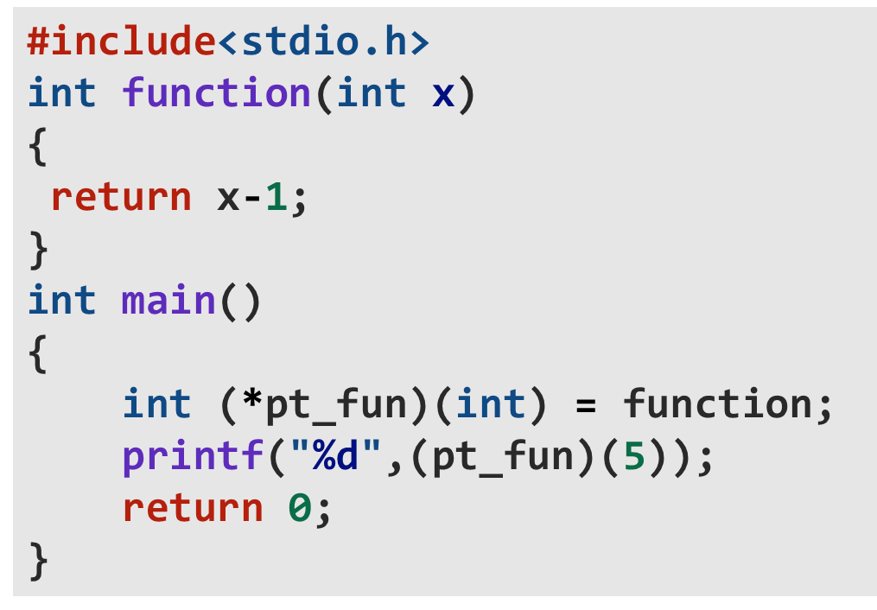
Function Pointer in C
A function’s name can also be used to get functions’ address. For example, in the below program, we have removed address operator ‘&’ in assignment. We have also changed function call by removing *, the program still works.

Slide 6
Function Pointer in C
Like normal pointers, we can have an array of function pointers.

Slide 7
Function Pointer in C
int a[10];
int* arr[10];
for(int i=0;i<10;i++)
{
a[i] = i;
}
for(int i=0;i<10;i++)
{
arr[i] = &a[i];
}
for(int i=0;i<10;i++)
{
printf("%d %d\n", arr[i], *arr[i]);
}
Like normal pointers, we can have an array of function pointers.

Slide 8
Function Pointer in C
int (*pt_fun[4])(int);
pt_fun[0]= function1;
pt_fun[1] = function2;
pt_fun[2] = function3;
pt_fun[3] = function4;
for(int i=0;i<4;i++)
{
printf("%d\n",(pt_fun[i])(5));
}
Like normal pointers, we can have an array of function pointers.

Slide 9
Function Pointer in C
Function pointer can be used in place of switch case. For example, in below program, user is asked for a choice between 0 and 2 to do different tasks.

Slide 10
Function Pointer in C
int function1(int x){return x-1;}
int function2(int x){return x+1;}
int function3(int x){return x-2;}
int function4(int x){return x+2;}
void fun(int (*ptr)(int))
{
printf("%d",ptr(5));
}
int main()
{
fun(function2);
return 0;
}
Function pointer can be used in place of switch case. For example, in below program, user is asked for a choice between 0 and 2 to do different tasks.

Slide 11
Let’s Revise
Write a program in ‘C” to rearrange the array as all positive terms placed after negative terms.
Test Case :
2 -1 3 -4 1
Output:
-1 -4 2 3 1

Slide 12
Let’s Revise
Write a program in ‘C” to Input 2 Binary Strings and Print their Binary SumTest Case :
Test Case:
100 110
Output:
1010

Slide 13
Let’s Revise
Write a program in ‘C” to Input 2 Binary Strings and Print their Binary SumTest Case :
Test Case:
100 110
Output:
1010

