Slide 1
ASCII Codes

Slide 2
ASCII?
ASCII (American Standard Code for Information Interchange) is a standard character encoding used in telecommunication. The ASCII pronounced ‘ask-ee’ , is strictly a seven bit code based on English alphabet. ASCII codes are used to represent alphanumeric data .
it is a seven bit code , it can at the most represent 128 characters. it currently defines 95 printable characters including 26 upper case letters (A to Z) , 26 lower case letters , 10 numerals (0 to 9) and 33 special characters including mathematical symbols, punctuation marks and space character.

Slide 3
In total, there are 256 ASCII characters, and can be broadly divided into three categories:
ASCII control characters (0-31 and 127)
ASCII printable characters (32-126) (most commonly referred)
Extended ASCII characters (128-255)
Below are the ASCII values of printable characters (33, 126):

Slide 4
Below are the ASCII values of printable characters (33, 126):
33-47 char
48-57 digits
58-64 conditional char and colon semicolon, @ ?
65- 90 (A-Z)
91-96([,\,],^,_, ‘,)
97-122(a-z)
123-126 ({,|,},~)

Slide 5
before 33 and beyond 126?
control characters : A character code is often used in in-band signaling as a reference point in a set of characters to avoid adding additional symbols to the text. From 0-32 we have control characters.
Ex. Start of text,esc,del,Backspace,space

Slide 6
before 33 and beyond 126?
control characters : A character code is often used in in-band signaling as a reference point in a set of characters to avoid adding additional symbols to the text. From 0-32 we have control characters.
Ex. Start of text,esc,del,Backspace,space
#include <stdio.h>
int main()
{
char ch = 8;
printf("hello theres%c how are you",ch);
return 0;
}

Slide 7
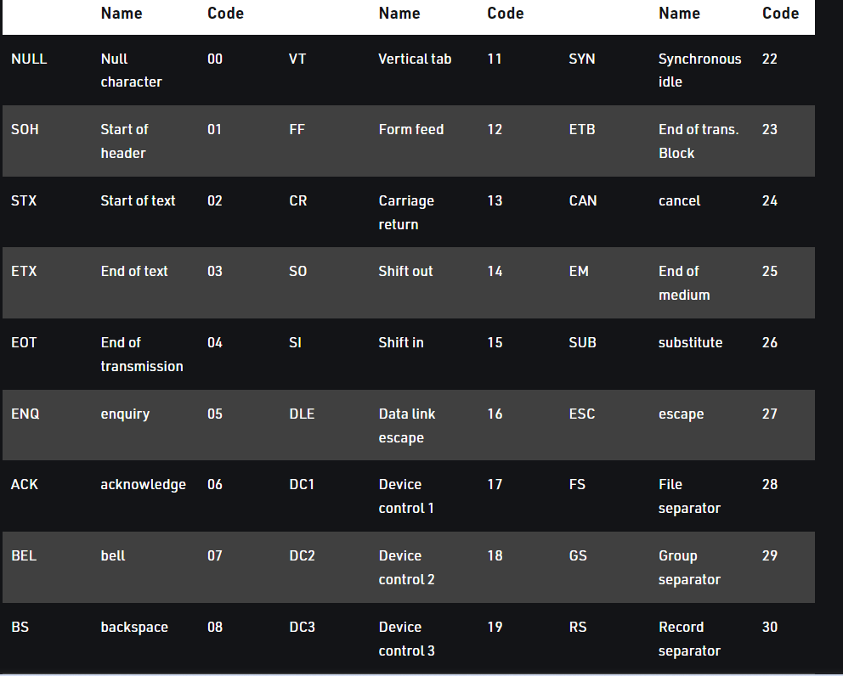

Slide 8
Between 33 and beyond 126?
At 32, we have space, it is included as printed characters, however, it’s not wrong to say space could also serve as a control character.
At 127, we have DEL (delete), which is a control character.
After 127, (128-255), we have Extended ASCII characters representing mathematical and other symbols that are not represented as keys and are not used in general.

Slide 9
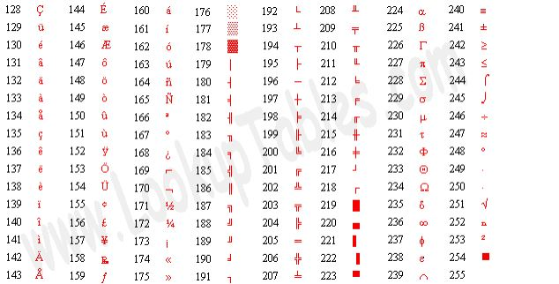
Between 33 and beyond 126?
After 127, (128-255), we have Extended ASCII characters representing mathematical and other symbols that are not represented as keys and are not used in general.

Slide 10
How to get Ascii Codes

Slide 11
How to get Ascii Codes
#include <stdio.h>
int main()
{
char ch = 'a';
printf("%d",ch);
return 0;
}

Slide 12
Storage Classes
Storage Classes are used to describe the features of a variable/function. These features basically include the scope, visibility and life-time which help us to trace the existence of a particular variable during the runtime of a program.

Slide 13
Storage Classes
Types of storage classes
Auto
Extern
Static
Register

Slide 14
AUTO
This is the default storage class for all the variables declared inside a function or a block.
Auto variables can be only accessed within the block/function they have been declared.
They are assigned a garbage value by default whenever they are declared.

Slide 15
AUTO
This is the default storage class for all the variables declared inside a function or a block.
Auto variables can be only accessed within the block/function they have been declared.
They are assigned a garbage value by default whenever they are declared.
#include <stdio.h>
int main()
{
int a; //auto
char b;
float c;
printf("%d %c %f",a,b,c);
return 0;
}

Slide 16
AUTO
#include <stdio.h>
int main()
{
int a; //auto
char b;
float c;
printf("%d %c %f",a,b,c);
return 0;
}
OUTPUT:
11867392 0.000000

Slide 18
EXTERN
Extern storage class simply tells us that the variable is defined elsewhere and not within the same block where it is used.
an extern variable is nothing but a global variable initialized with a legal value where it is declared in order to be used elsewhere.
It can be accessed within any function/block.
The default initial value of external integral type is 0 otherwise null.
An external variable can be declared many times but can be initialized at only once.

Slide 19
EXTERN
Extern storage class simply tells us that the variable is defined elsewhere and not within the same block where it is used.
an extern variable is nothing but a global variable initialized with a legal value where it is declared in order to be used elsewhere.
It can be accessed within any function/block.
The default initial value of external integral type is 0 otherwise null.
An external variable can be declared many times but can be initialized at only once.
#include <stdio.h>
extern int a;
int main()
{
printf("%d",a);
}

Slide 20
Static
Static variables have a property of preserving their value even after they are out of their scope! Hence, static variables preserve their previous value in their previous scope and are not initialized again in the new scope.

Slide 21
Static
The variables defined as static specifier can hold their value between the multiple function calls.
Static local variables are visible only to the function or the block in which they are defined.
A same static variable can be declared many times but can be assigned at only one time.
Default initial value of the static integral variable is 0 otherwise null.
The keyword used to define static variable is static.

Slide 22
Static
#include <stdio.h>
int fn()
{
static int a = 5;
a++;
return a;
}
int main()
{
int a = fn();
int b = fn();
int c = fn();
printf("%d %d %d", a,b,c);
return 0;
}
The variables defined as static specifier can hold their value between the multiple function calls.
Static local variables are visible only to the function or the block in which they are defined.
A same static variable can be declared many times but can be assigned at only one time.
Default initial value of the static integral variable is 0 otherwise null.
The keyword used to define static variable is static.

Slide 23
Register
The variables defined as the register is allocated the memory into the CPU registers depending upon the size of the memory remaining in the CPU.
The initial default value of the register local variables is 0.

Slide 24
Register
The variables defined as the register is allocated the memory into the CPU registers depending upon the size of the memory remaining in the CPU.
The initial default value of the register local variables is 0.
#include <stdio.h>
int main()
{
register int a;
printf("%d",a);
}

Slide 25
Programing
Take a string from the user and Print Ascii value of middle letter of string.

Slide 26
Programing
#include <stdio.h>
int main()
{
char* name;
scanf("%s",name);
printf("%d",name[2]);
return 0;
}
Print Ascii value of first letter of your name.

Slide 27
Programing
Print the ASCII values of all the characters currently present. [0 to 255]

Slide 28
Programing
#include <stdio.h>
int main()
{
int i;
for(i=0;i<=255;i++)
{
printf("The ASCII value of %c = %d\n",i,i);
}
return 0;
}
Print the ASCII values of all the characters currently present. [0 to 255]

Slide 29
#include< stdio.h>
int main()
{
static int a = 3;
printf(“%d”, a --);
return 0;
}

Slide 30
#include< stdio.h>
int main()
{
static int a = 3;
printf(“%d”, a --);
return 0;
}
OUTPUT: 3

Slide 31
#include< stdio.h>
void fun()
{
fun();
Return 0;
}
void fun()
{
auto int I = 1;
register char a = ‘D’;
static int p = 0;
printf(“%d %d %ld”, I, a, p);
}

Slide 32
#include< stdio.h>
void fun()
{
fun();
Return 0;
}
void fun()
{
auto int I = 1;
register char a = ‘D’;
static int p = 0;
printf(“%d %d %ld”, I, a, p);
}
OUTPUT: 1 68 0

