Slide 1
Introductions To Functions

Slide 2
What is Function?
Functions are sets of statements that take inputs, perform some operations, and produce results. The operation of a function occurs only when it is called. Rather than writing the same code for different inputs repeatedly, we can call the function instead of writing the same code over and over again. Functions accept parameters, which are data. A function performs a certain action, and it is important for reusing code. Within a function, there are a number of programming statements enclosed by {}.

Slide 3
What is Function?
datatype function()
{
//perform functionality
//----
//-----
//---
return datatype_value;
}
Functions are sets of statements that take inputs, perform some operations, and produce results. The operation of a function occurs only when it is called. Rather than writing the same code for different inputs repeatedly, we can call the function instead of writing the same code over and over again. Functions accept parameters, which are data. A function performs a certain action, and it is important for reusing code. Within a function, there are a number of programming statements enclosed by {}.

Slide 4
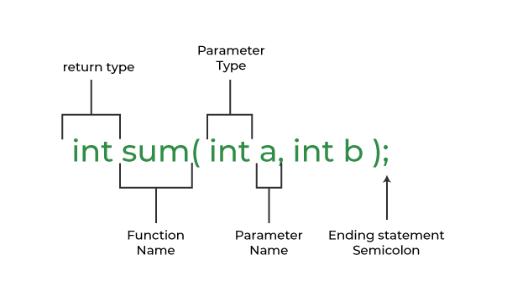
What is Function?
int sum(int a, int b);

Slide 5
Arguments Vs Parameters
An argument is referred to the values that are passed within a function when the function is called. These values are generally the source of the function that require the arguments during the process of execution.
The parameter is referred to as the variables that are defined during a function declaration or definition. These variables are used to receive the arguments that are passed during a function call. These parameters within the function prototype are used during the execution of the function for which it is defined.

Slide 6
#include <stdio.h>
int sum(int a, int b)
{
return a+b;
}
int main()
{
int num1 = 10, num2 = 20, res;
res = sum(num1, num2);
return 0;
}

Slide 7
Advantage of functions in C
There are the following advantages of C functions.
By using functions, we can avoid rewriting same logic/code again and again in a program.
We can call C functions any number of times in a program and from any place in a program.
We can track a large C program easily when it is divided into multiple functions.
Reusability is the main achievement of C functions.
However, Function calling is always a overhead in a C program.

Slide 8
Important Terms in Functions
Function Declarations
Function Definition
Function Call

Slide 9
Function Declarations
Function declarations tell the compiler how many parameters a function takes, what kinds of parameters it returns, and what types of data it takes. Function declarations do not need to include parameter names, but definitions must.

Slide 10
Function Declarations
return_type name_of_the_function (parameters);
int sum(int var1, int var2);
int sum(int, int);
Function declarations tell the compiler how many parameters a function takes, what kinds of parameters it returns, and what types of data it takes. Function declarations do not need to include parameter names, but definitions must.

Slide 11
Function Definition
A function definition consists function header and a function body.
Key points
Return_type: The function always starts with a return type of the function. But if there is no return value then the void keyword is used as the return type of the function.
Function_Name: Name of the function which should be unique.
Parameters: Values that are passed during the function call.

Slide 12
Function Call
To Call a function parameters are passed along the function name. In the below example, the first sum function is called and 10,30 are passed to the sum function. After the function call sum of a and b is returned and control is also returned back to the main function of the program.

Slide 13
Function Call
#include <stdio.h>
int sum(int a, int b)
{
return a + b;
}
int main()
{
int add = sum(10, 30);
printf("Sum is: %d", add);
return 0;
}
To Call a function parameters are passed along the function name. In the below example, the first sum function is called and 10,30 are passed to the sum function. After the function call sum of a and b is returned and control is also returned back to the main function of the program.

Slide 14
Types of Functions
1.User Defined Function
2. Library Function

Slide 15
User Defined Function
Functions that are created by the programmer are known as User-Defined functions or “tailor-made functions”. User-defined functions can be improved and modified according to the need of the programmer. Whenever we write a function that is case-specific and is not defined in any header file, we need to declare and define our own functions according to the syntax.

Slide 16
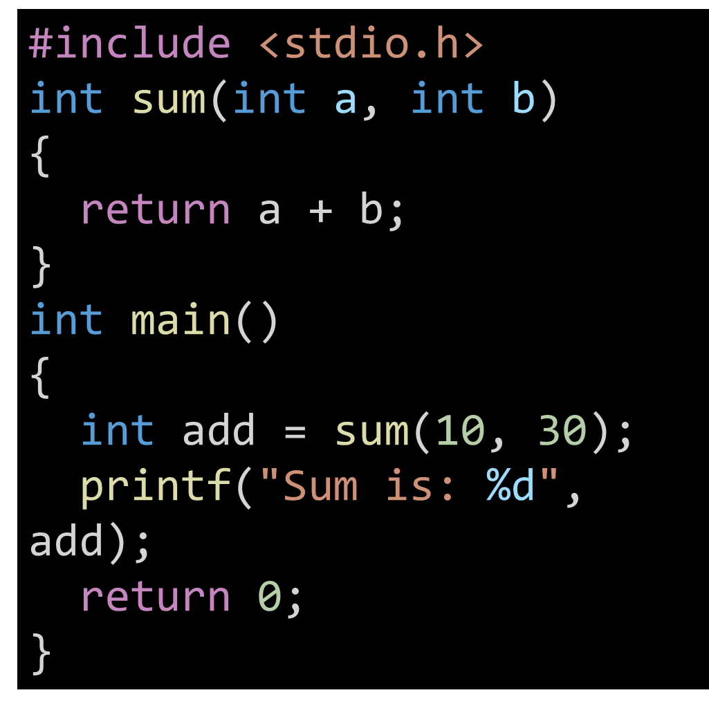
User Defined Function
Functions that are created by the programmer are known as User-Defined functions or “tailor-made functions”. User-defined functions can be improved and modified according to the need of the programmer. Whenever we write a function that is case-specific and is not defined in any header file, we need to declare and define our own functions according to the syntax.

Slide 17
User Defined Function
Advantages of User-Defined functions
Changeable functions can be modified as per need.
The Code of these functions is reusable in other programs.
These functions are easy to understand, debug and maintain.

Slide 18
Library Function
A library function is also referred to as a “built-in function”. There is a compiler package that already exists that contains these functions, each of which has a specific meaning and is included in the package. Built-in functions have the advantage of being directly usable without being defined, whereas user-defined functions must be declared and defined before being used.

Slide 19
Library Function
#include <math.h>
#include <stdio.h>
int main()
{
double Number;
Number = 49;
double squareRoot = sqrt(Number);
printf("The Square root of %lf = %lf",
Number, squareRoot);
return 0;
}
A library function is also referred to as a “built-in function”. There is a compiler package that already exists that contains these functions, each of which has a specific meaning and is included in the package. Built-in functions have the advantage of being directly usable without being defined, whereas user-defined functions must be declared and defined before being used.

Slide 20
Advantages of C library functions
C Library functions are easy to use and optimized for better performance.
C library functions save a lot of time i.e, function development time.
C library functions are convenient as they always work.

Slide 21
Passing Parameters to Functions
The value of the function which is passed when the function is being invoked is known as the Actual parameters. In the below program 10 and 30 are known as actual parameters.
Formal Parameters are the variable and the data type as mentioned in the function declaration. In the below program, a and b are known as formal parameters.

Slide 22
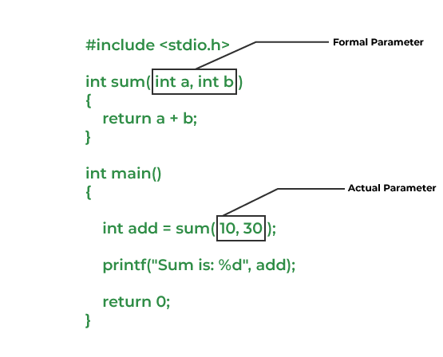
Passing Parameters to Functions
The value of the function which is passed when the function is being invoked is known as the Actual parameters. In the below program 10 and 30 are known as actual parameters.
Formal Parameters are the variable and the data type as mentioned in the function declaration. In the below program, a and b are known as formal parameters.

Slide 23
Passing Parameters to Functions
Pass by Value
Pass by Reference

Slide 24
Pass by value
Pass by Value: Parameter passing in this method copies values from actual parameters into function formal parameters. As a result, any changes made inside the functions do not reflect in the caller’s parameters.
Below is the C program to show pass-by-value:

Slide 25
Pass by value
void swap(int var1, int var2)
{
int temp = var1;
var1 = var2;
var2 = temp;
}
int main()
{
int var1 = 3, var2 = 2;
swap(var1, var2);
return 0;
}
Pass by Value: Parameter passing in this method copies values from actual parameters into function formal parameters. As a result, any changes made inside the functions do not reflect in the caller’s parameters.
Below is the C program to show pass-by-value:

Slide 26
Pass by Reference
Pass by Reference: The caller’s actual parameters and the function’s actual parameters refer to the same locations, so any changes made inside the function are reflected in the caller’s actual parameters.

Slide 27
Pass by Reference
#include <stdio.h>
void swap(int *var1, int *var2)
{
int temp = *var1;
*var1 = *var2;
*var2 = temp;
}
int main()
{
int var1 = 3, var2 = 2;
swap(&var1,&var2);
printf("%d %d",var1, var2);
return 0;
}
Pass by Reference: The caller’s actual parameters and the function’s actual parameters refer to the same locations, so any changes made inside the function are reflected in the caller’s actual parameters.

Slide 28
Function Arguments and Return values
Function Arguments and Return values
In C programming language, functions can be called either with or without arguments and might return values. They may or might not return values to the calling functions. Function with no arguments and no return value

Slide 29
Function Arguments and Return values
Function with no arguments and no return value
Function with no arguments and with return value
Function with argument and with no return value
Function with arguments and with return value
void mul()
{
printf("You entered this function");
return 1;
}

Slide 30
Function Arguments and Return values
Function with no arguments and no return value
Function with no arguments and with return value
Function with argument and with no return value
Function with arguments and with return value
int mul()
{
printf("You entered this function");
return 1;
}

Slide 31
Function Arguments and Return values
Function with no arguments and no return value
Function with no arguments and with return value
Function with argument and with no return value
Function with arguments and with return value
void mul(int l,int b)
{
printf("%d",l*b);
return ;
}

Slide 32
Function Arguments and Return values
Function with no arguments and no return value
Function with no arguments and with return value
Function with argument and with no return value
Function with arguments and with return value
int mul(int l,int b)
{
return l*b;
}

Slide 33
Function Arguments and Return values
Function with no arguments and no return value
Function with no arguments and with return value
Function with argument and with no return value
Function with arguments and with return value

Slide 34
Practical
Write a Program to calculate Area & perimeter of rectangle.

Slide 35
#include <stdio.h>
int calculate_area(int l,int b)
{
return l*b;
}
int calculate_perimeter(int l,int b)
{
return 2*(l+b);
}
int main()
{
int l,b;
scanf("%d %d",&l,&b);
int area = calculate_area(l,b);
int perimeter = calculate_perimeter(l,b);
printf("Area = %d\nPerimeter = %d\n",area,perimeter);
return 0;
}

Slide 36
Write a program in C to check a given number is even or odd using the function

Slide 37
#include <stdio.h>
bool numiseven(int num)
{
if(num%2 ==0)
{
return 1;
}
return 0;
}
int main()
{
int num;
scanf("%d",&num);
if(numiseven(num))
{
printf("%d is Even",num);
}
else
{
printf("%d is odd",num);
}
return 0;
}
Write a program in C to check a given number is even or odd using the function

Slide 38
Write a program in C to print all multiples of 7 in given range using the function.

Slide 39
#include <stdio.h>
void solve(int a,int b)
{
for(int i=a;i<=b;i++)
{
if(i%7 ==0)
{
printf("%d ",i);
}
}
}
int main()
{
int a,b;
scanf("%d %d",&a,&b);
solve(a,b);
return 0;
}

