Slide 1
Partitioning using parted
sudo parted -l

Slide 2
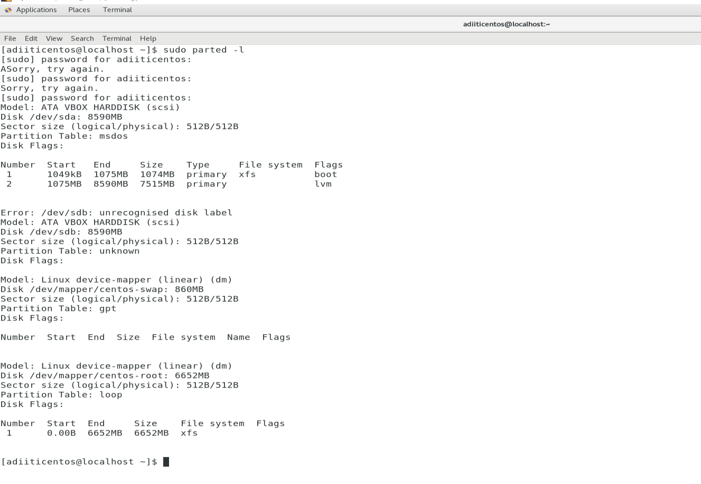

Slide 3
Partitioning using parted
sudo fdisk –l
sudo parted /dev/sdb

Slide 4
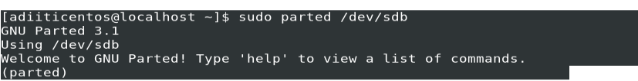
Partitioning using parted
sudo fdisk –l
sudo parted /dev/sdb

Slide 5
Partitioning using parted
sudo fdisk –l
sudo parted /dev/sdb
mklabel gpt

Slide 6
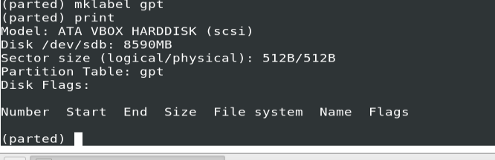
Partitioning using parted
sudo fdisk –l
sudo parted /dev/sdb
mklabel gpt

Slide 7
Partitioning using parted
sudo fdisk –l
sudo parted /dev/sdb
mklabel gpt
mkpart primary ext4 1MB 1855MB

Slide 8
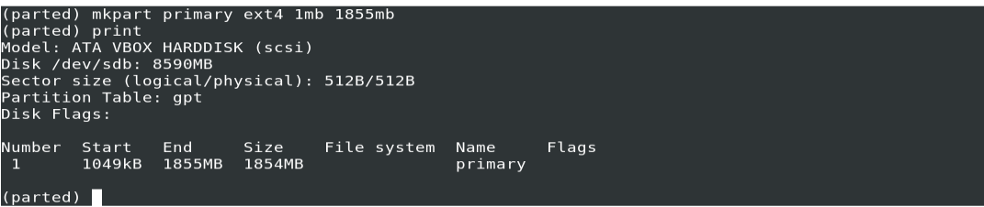
Partitioning using parted
sudo fdisk –l
sudo parted /dev/sdb
mklabel gpt
mkpart primary ext4 1MB 1855MB

Slide 9
Partitioning using parted
sudo fdisk –l
sudo parted /dev/sdb
mklabel gpt
mkpart primary ext4 1MB 1855MB
quit

Slide 10
Partitioning using fdisk
sudo fdisk –l

Slide 11
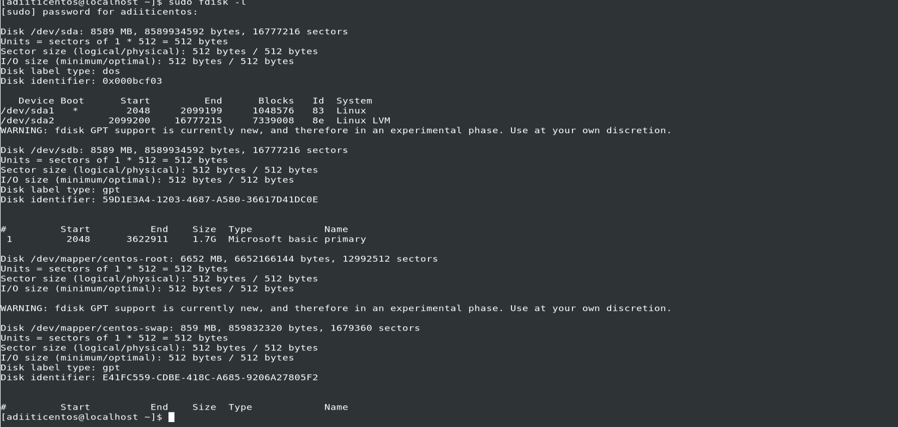
Partitioning using fdisk
sudo fdisk –l

Slide 12
Partitioning using fdisk
sudo fdisk –l
Sudo fdisk /dev/sdb

Slide 13
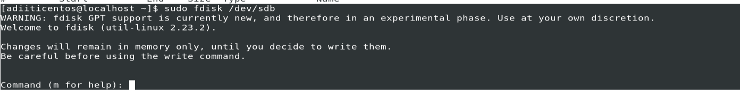
Partitioning using fdisk
sudo fdisk –l
Sudo fdisk /dev/sdb

Slide 14
Partitioning using fdisk
sudo fdisk –l
Sudo fdisk /dev/sdb
m

Slide 15
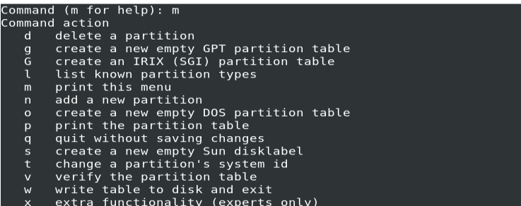
Partitioning using fdisk
sudo fdisk –l
Sudo fdisk /dev/sdb
m

Slide 16
Partitioning using fdisk
sudo fdisk –l
Sudo fdisk /dev/sdb
n

Slide 17
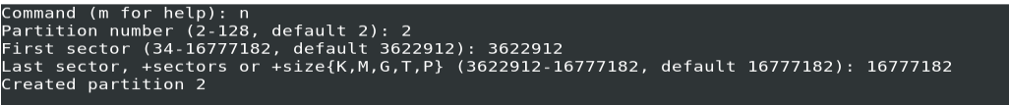
Partitioning using fdisk
sudo fdisk –l
Sudo fdisk /dev/sdb
n

Slide 18
Partitioning using fdisk
sudo fdisk –l
sudo fdisk /dev/sdb
n
sudo mkfs –t ext4 /dev/sdb1

Slide 19
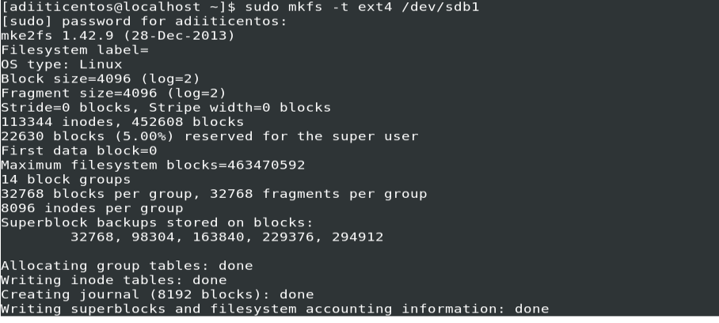
Partitioning using fdisk
sudo fdisk –l
sudo fdisk /dev/sdb
n
sudo mkfs –t ext4 /dev/sdb1

Slide 20
Mounting
1.sudo mkdir –p /mt/sdb1
2.sudo mount –t auto /dev/sbd1 /mt/sdb1
3.df -hT

Slide 21
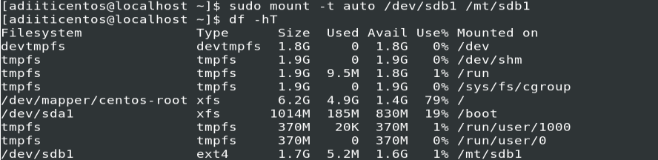
Mounting
sudo mkdir –p /mt/sdb1
sudo mount –t auto /dev/sbd1 /mt/sdb1
df -hT

