Slide 1

When talking about the differences between virtual and physical memory, the biggest distinction commonly made is to speed. RAM is considerably faster than virtual memory. RAM, however, tends to be more expensive.
When a computer requires storage, RAM is the first used. Virtual memory, which is slower, is used only when the RAM is filled.

Slide 2
Virtual Ram | Ram
Uses a segment of physical memory | Physical memory
Slower | Faster
Uses paging | Uses swapping techniques
Limited by the size of the physical memory | Limited to the size of the ram chip
Does not have direct access to the CPU | Can directly access the CPU
Limited by the size of the computer’s hard drive | Can add RAM by installing more RAM chips

Slide 3
Linux was traditionally designed for server systems. Server systems are designed to handle several tasks at the same time. Some processes may use more memory than planned. For example, a university website housed on a Linux server system may use more RAM on the day exam results are released. Memory spikes of this kind are fairly prevalent in server systems. During busy hours, any service may use more memory. To compensate for a lack of physical memory, Linux employs swap space. The swap space is hard drive space that may be utilized as memory.

Slide 4
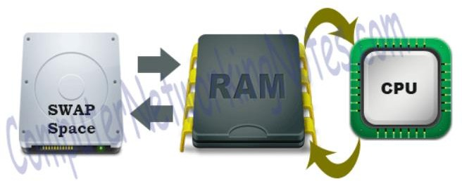
Let's take a closer look at it. RAM is divided into smaller bits known as memory pages by the system. Memory pages are allotted to services or processes that are operating in the CPU. The CPU performs round-robin processing of services or applications.

Slide 5
All processes are scheduled in a round-robin method in a queue based on the time-sharing approach. Each process is also given a quantum (allowed CPU Time slot). If the process is not completed within the time
limit, it will be canceled and restarted when the
For
process's next time slot becomes available.
example, if the time slot is 100 milliseconds and job1 takes a total of 250 milliseconds to complete, the round- robin scheduler will suspend the job after 100 ms and allocate CPU time to other tasks.

Slide 6
When all of the other tasks have received their fair share (100 ms each), job1 will be given another allotment of CPU time, and the cycle will begin again. This method is repeated until the work is completed and no more CPU time is required. Assume two processes are running. Memory pages are allotted to both processes. Process one is being processed by the CPU. This situation is shown in the image below.

Slide 7
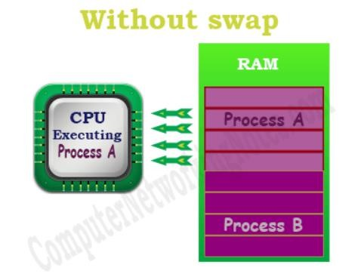
As seen in the diagram above, no memory pages are accessible for another process. The system will not begin a new process until any current processes are completed. This problem can be somewhat improved using swap space. Idle pages will be shifted into swap space if swap space is specified and RAM is full.

Slide 8
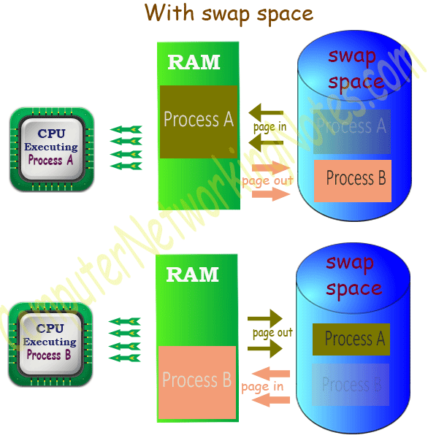
When process A is running, memory pages occupied by process B are relocated to swap space. When process B executes, memory pages held by process A are relocated to swap space. This allows Linux to run more processes using swap space while utilizing the same physical memory. A page out is the process of shifting idle memory pages from RAM to swap. A page in is the process of returning necessary memory pages from swap to RAM. This procedure is shown in the diagram below.

Slide 9

Swap space is hard drive space used to augment system RAM by storing idle memory pages.
Because swap space is stored on the hard drive, it is much slower than RAM.
Swap space is a critical component in Linux setup.
If swap space is enabled, a physical memory threshold value is also enabled. When physical memory is utilized over the threshold, swap space is used.
No swap space will be utilized as long as free memory stays below the threshold.
Swap utilization should be regularly checked. If swap becomes heavily utilized, the system's performance will suffer.

Slide 10
File System Structure,
Navigation Commands (cd, ls, and pwd)

Slide 11
The Linux File Hierarchy Structure or the Filesystem Hierarchy Standard (FHS) defines the directory structure and directory contents in Unix-like operating systems. It is maintained by the Linux Foundation.
In the FHS, all files and directories appear under the root directory /, even if they are stored on different physical or virtual devices.
Some of these directories only exist on a particular system if certain subsystems, such as the X Window System, are installed.
Most of these directories exist in all UNIX operating systems and are generally used in much the same way; however, the descriptions here are those used specifically for the FHS and are not considered authoritative for platforms other than Linux.

Slide 12
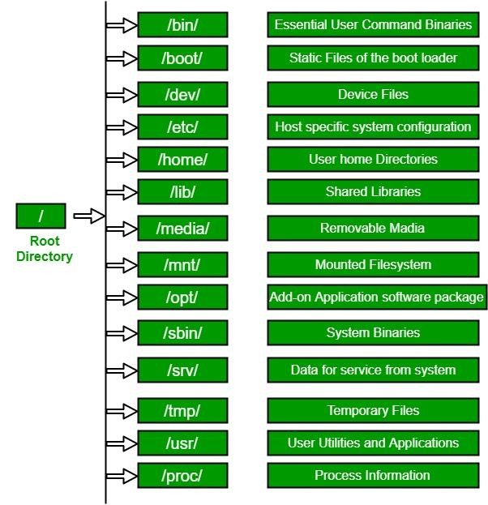

Slide 13
1. / (Root): Primary hierarchy root and root directory of the entire file system hierarchy.
Every single file and directory starts from the root directory
The only root user has the right to write under this directory
/root is the root user’s home directory, which is not the same as /

Slide 14
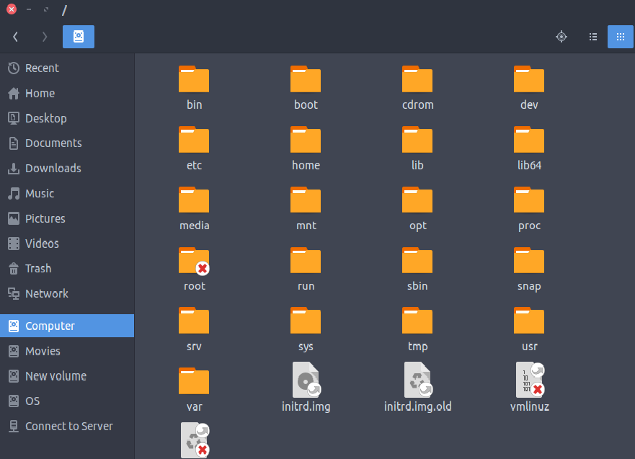

Slide 15
2. /bin : Essential command binaries that need to be available in single-user mode; for all users, e.g., cat, ls, cp.
Contains binary executables
Common linux commands you need to use in single-user modes are located under this directory.
Commands used by all the users of the system are located here e.g. ps, ls, ping, grep, cp

Slide 16
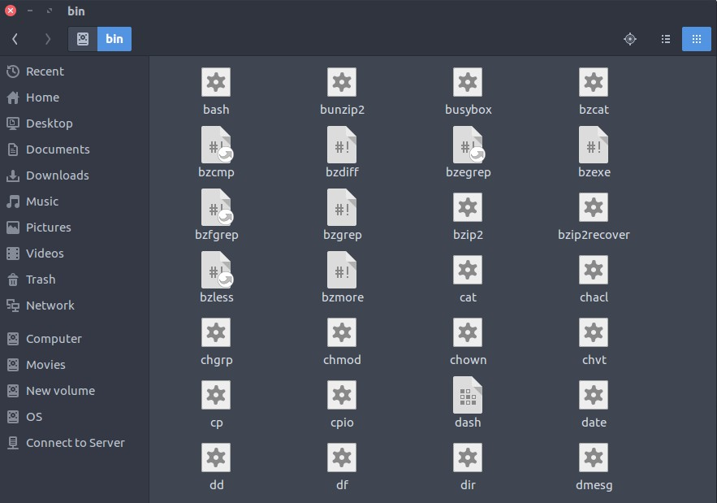

Slide 17
3. /boot : Boot loader files, e.g., kernels, initrd.
Kernel initrd, vmlinux, grub files are located under /boot
Example: initrd.img-2.6.32-24-generic, vmlinuz- 2.6.32-24-generic

Slide 18
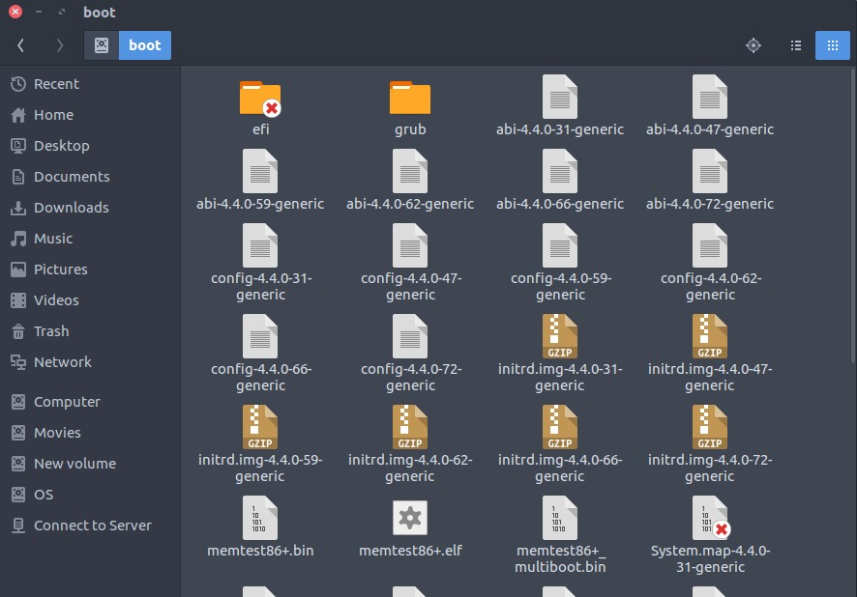

Slide 19
4. /dev : Essential device files, e.g., /dev/null.
These include terminal devices, usb, or any device attached to the system.
Example: /dev/tty1, /dev/usbmon0

Slide 20
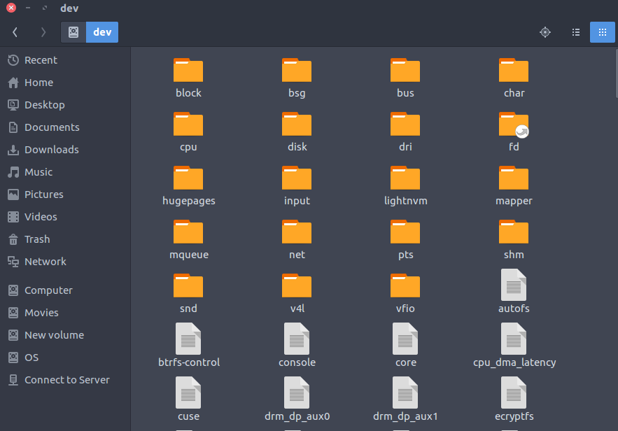

Slide 21
5. /etc : Host-specific system-wide configuration files.
Contains configuration files required by all programs.
This also contains startup and shutdown shell scripts used to start/stop individual programs.
Example: /etc/resolv.conf, /etc/logrotate.conf.

Slide 22
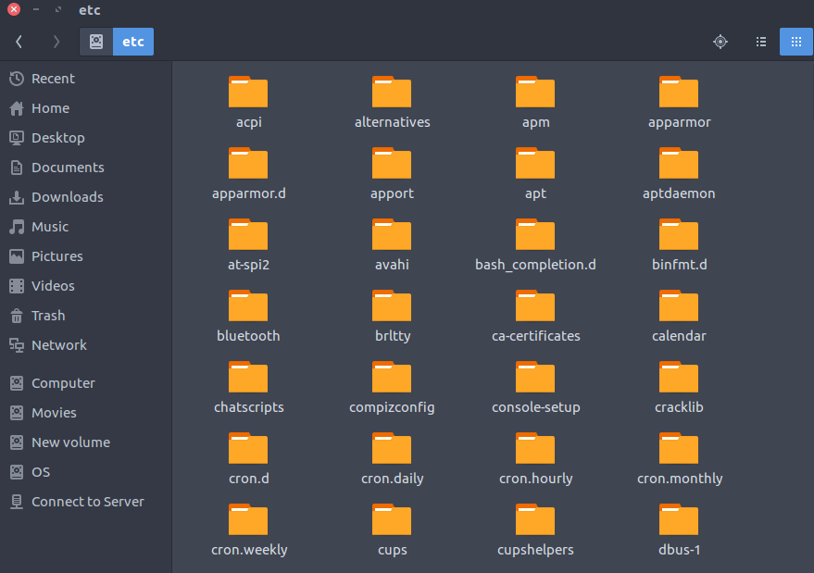

Slide 23
6. /home : Users’ home directories, containing saved files, personal settings, etc.
Home directories for all users to store their personal files.
example: /home/kishlay, /home/kv

Slide 24
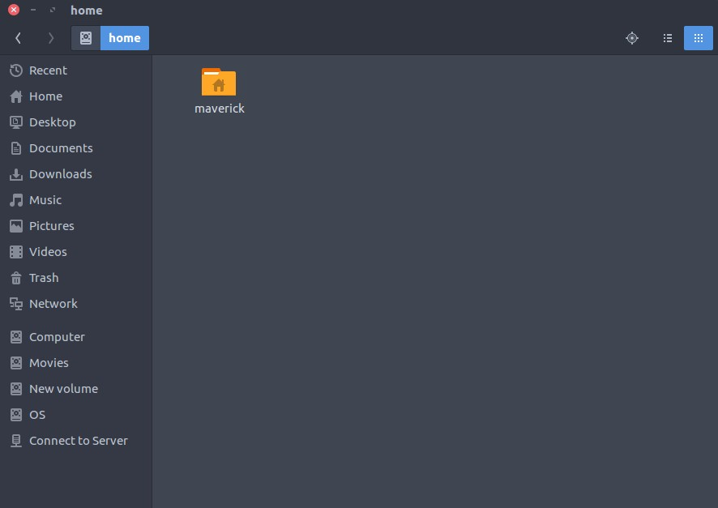
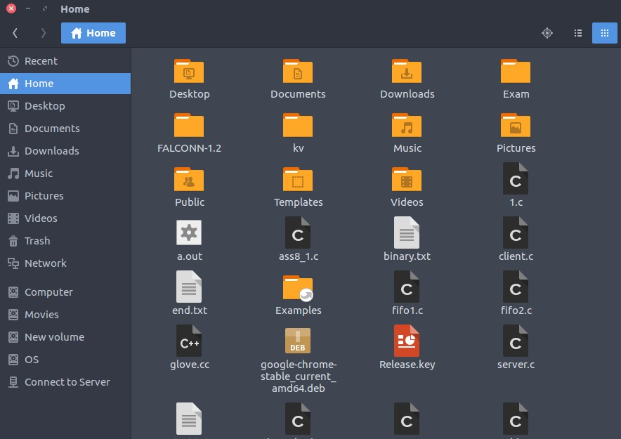

Slide 25
7. /lib : Libraries essential for the binaries in /bin/ and /sbin/.
Library filenames are either ld* or lib*.so.*
Example: ld-2.11.1.so, libncurses.so.5.7

Slide 26
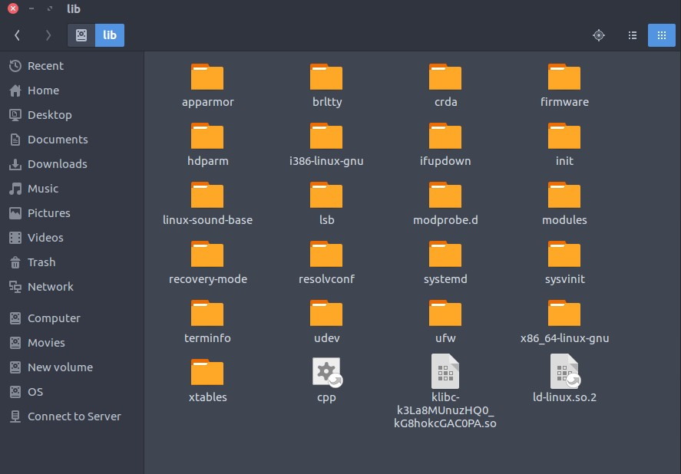

Slide 27
8. /media : Mount points for removable media such as CD-ROMs (appeared in FHS-2.3).
Temporary mount directory for removable devices.
Examples, /media/cdrom for CD-ROM;
/media/floppy for floppy drives;
/media/cdrecorder for CD writer

Slide 28
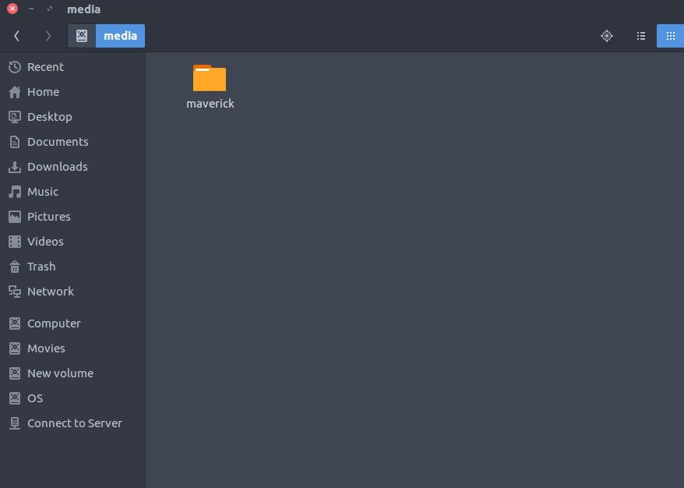

Slide 29
9. /mnt : Temporarily mounted filesystems.
Temporary mount directory where sysadmins can mount filesystems.

Slide 30
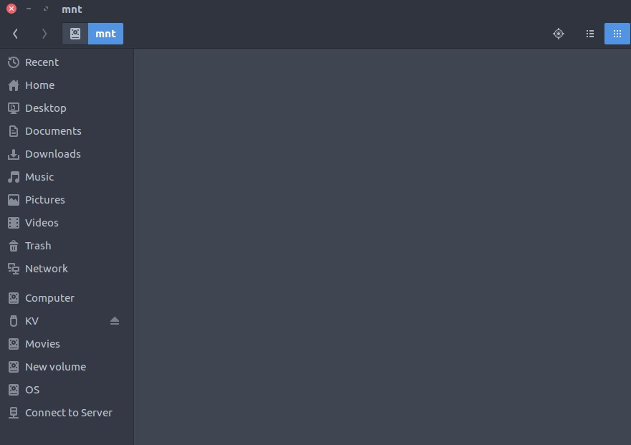

Slide 31
10. /opt : Optional application software packages.
Contains add-on applications from individual vendors.
Add-on applications should be installed under either /opt/ or /opt/ sub-directory.

Slide 32
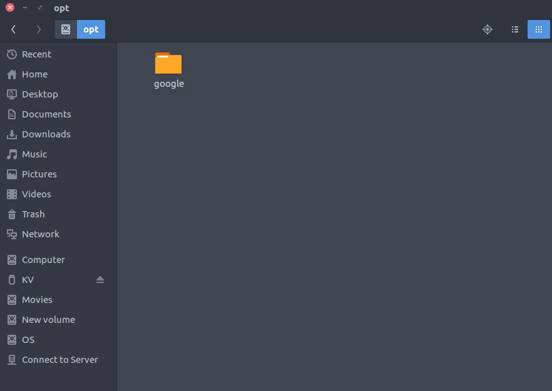

Slide 33
11. /sbin : Essential system binaries, e.g., fsck, init, route.
Just like /bin, /sbin also contains binary executables.
The Linux commands located under this directory are used typically by the system administrator, for system maintenance purpose.
Example: iptables, reboot, fdisk, ifconfig, swapon

Slide 34
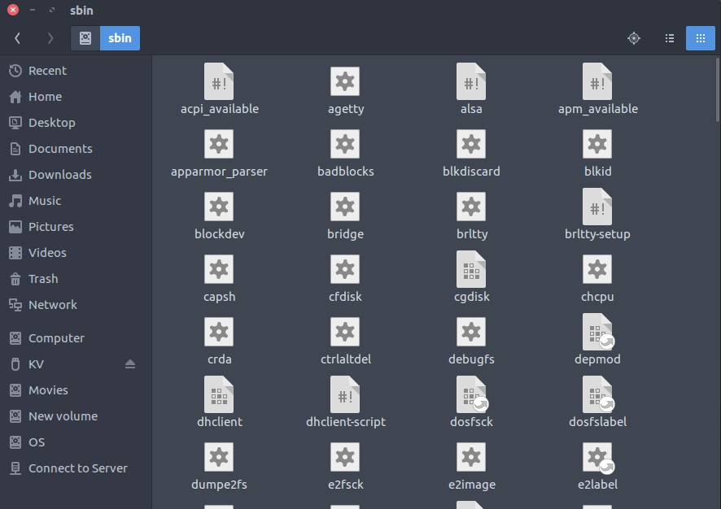

Slide 35
12. /srv : Site-specific data served by this system, such as data and scripts for web servers, data offered by FTP servers, and repositories for version control systems.
srv stands for service.
Contains server specific services related data.
Example, /srv/cvs contains CVS related data.

Slide 36
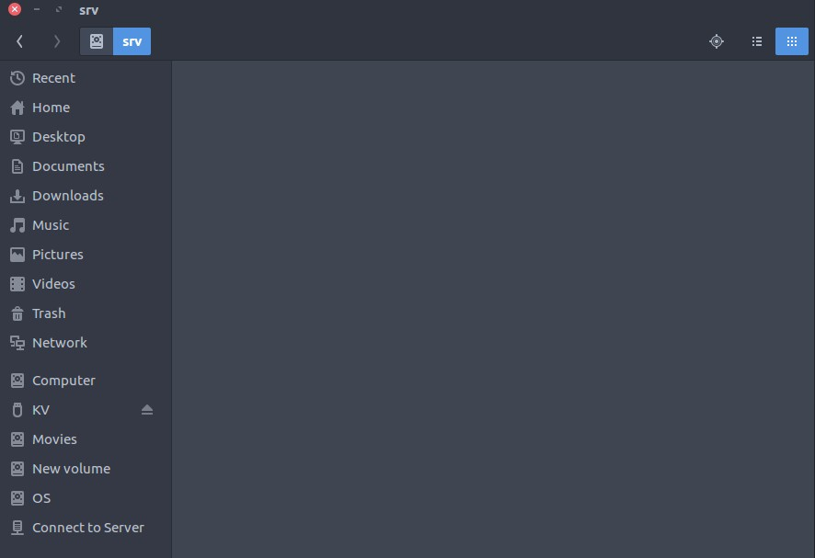

Slide 37
13. /tmp : Temporary files. Often not preserved between system reboots, and may be severely size restricted.
Directory that contains temporary files created by system and users.
Files under this directory are deleted when system is rebooted.

Slide 38
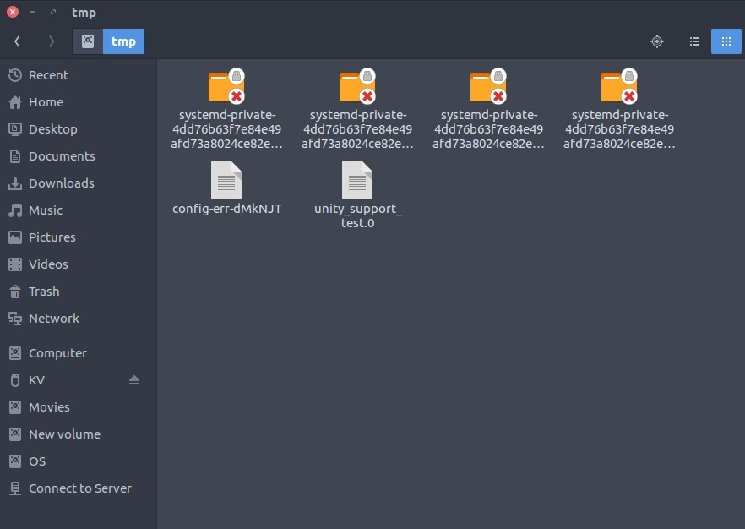

Slide 39
14. /usr : Secondary hierarchy for read-only user data; contains the
majority of (multi-)user utilities and applications.
Contains binaries, libraries, documentation, and source-code for second level programs.
/usr/bin contains binary files for user programs. If you can’t find a user binary under /bin, look under /usr/bin. For example: at, awk, cc, less, scp
/usr/sbin contains binary files for system administrators. If you can’t find a system binary under /sbin, look under /usr/sbin. For example: atd, cron, sshd, useradd, userdel
/usr/lib contains libraries for /usr/bin and /usr/sbin
/usr/local contains users programs that you install from source. For example, when you install apache from source, it goes under
/usr/local/apache2
/usr/src holds the Linux kernel sources, header-files and documentation.

Slide 40
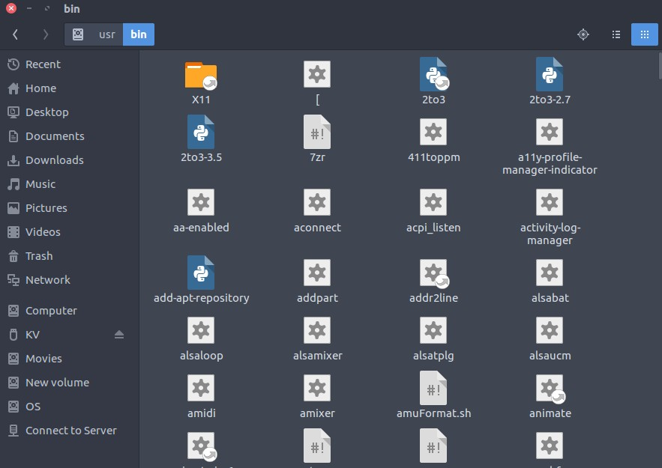
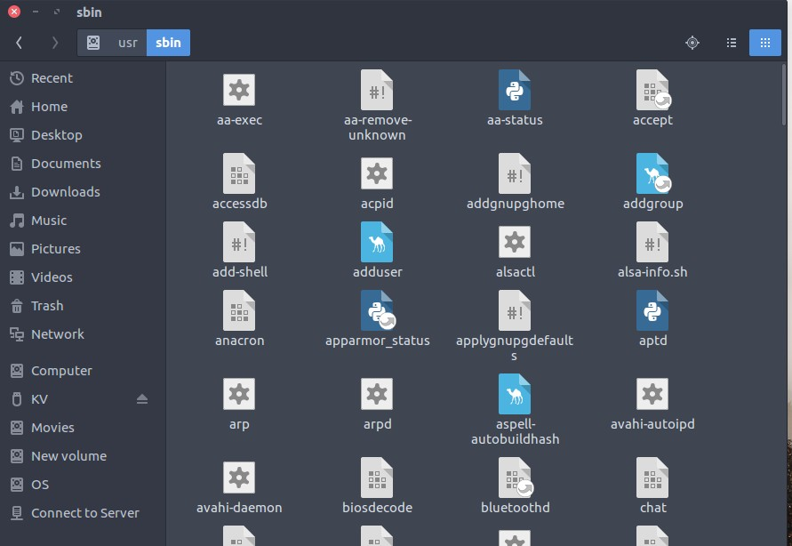

Slide 41
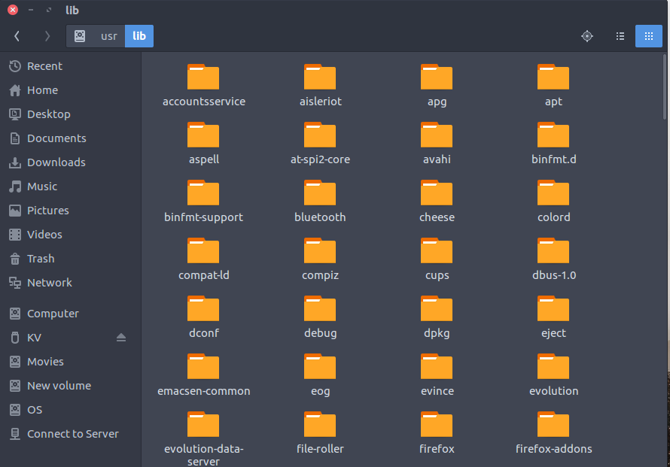
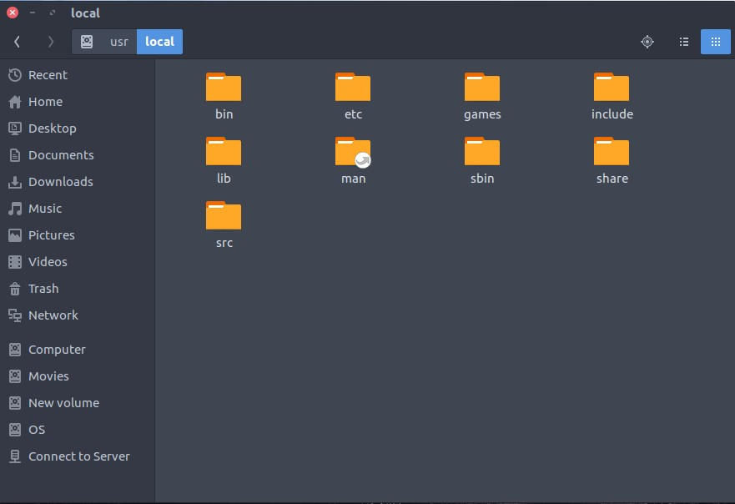

Slide 42
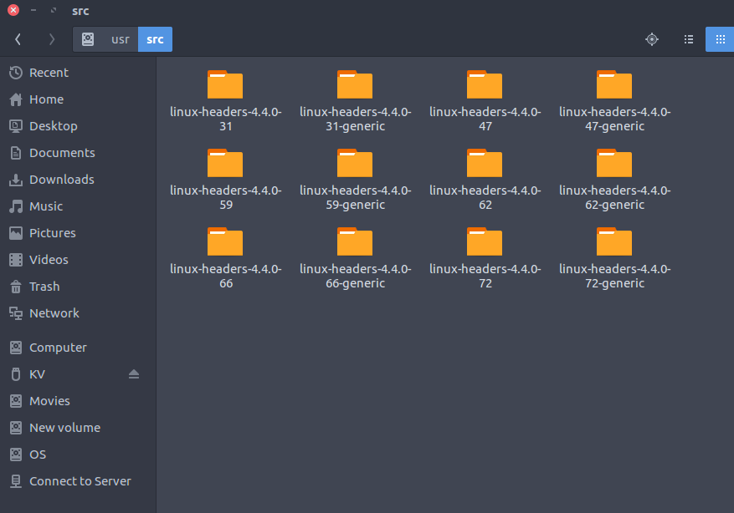

Slide 43
15. /proc : Virtual filesystem providing process and kernel information as files. In Linux, corresponds to a procfs mount. Generally automatically generated and populated by the system, on the fly.
Contains information about system process.
This is a pseudo filesystem contains information about running process. For example: /proc/{pid} directory contains information about the process with that particular pid.
This is a virtual filesystem with text information about system resources. For example: /proc/uptime

Slide 44
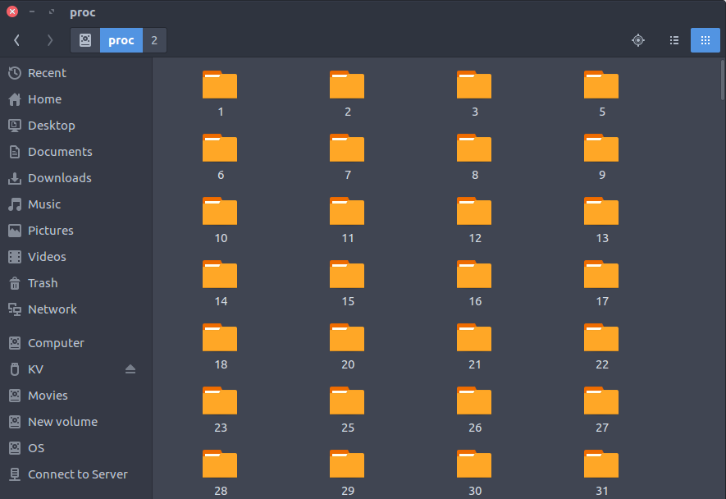

Slide 45
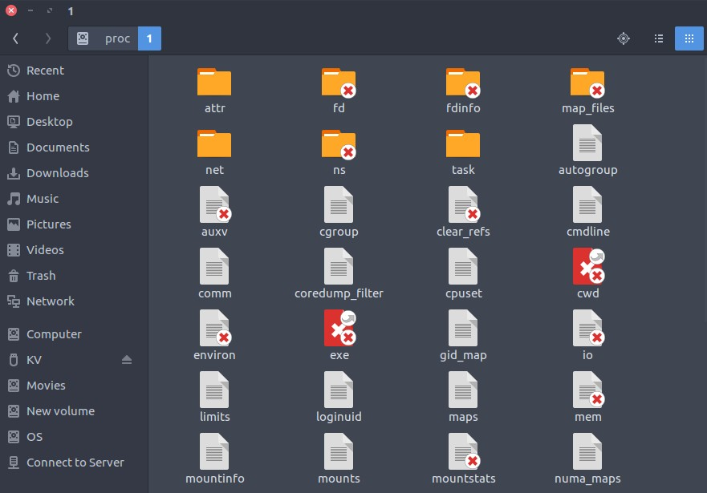

Slide 46
Modern Linux distributions include a /run directory as a temporary filesystem (tmpfs) which stores volatile runtime data, following the FHS version 3.0. According to the FHS version 2.3, such data were stored in /var/run but this was a problem in some cases because this directory is not always available at early boot. As a result, these programs have had to resort to trickery, such as using /dev/.udev,
/dev/.mdadm, /dev/.systems or /dev/.mount directories, even though the device directory isn’t intended for such data.Among other advantages, this makes the system easier to use normally with the root filesystem mounted read-only.

Slide 47
For example, below are the changes Debian made in its 2013 Wheezy release:
/dev/.* ? /run/*
/dev/shm ? /run/shm
/dev/shm/* ? /run/*
/etc/* (writable files) ? /run/*
/lib/init/rw ? /run
/var/lock ? /run/lock
/var/run ? /run

Slide 48
In this lesson, we will go through Linux
Navigation Commands (cd, ls, and pwd)
commands performing directories,
for managing directories and
actions such as printing the current
listing working
directory, creating and deleting directories, copying directories, transferring directories from one place to another, and renaming directories.

Slide 49
pwd.
The pwd(print working directory) command is used to print out the current directory we are in.
The syntax is as follows,
pwd
Output.
/home/user
The output states that we are currently in
the user directory which is the working directory.

Slide 50
ls.
The ls(list directory) command is used to list files and subdirectories within a directory.
The basic syntax is as follows,
ls
Commonly used options include,
ls -a, to print out all files including hidden files which are preceded with a period .
ls -l, to list files in a long list. Files are listed together with their permissions, ownership, time stamps.
ls -l --block-size=SIZE, to list files and directories while displaying their sizes.

Slide 51
for example to list files and show sizes in megabytes we write,
ls -l --block-size=M
We could also use G for gigabytes, K for kilobytes, T for terabytes, P for petabytes and so on.
ls -d */, to list only subdirectories, this command will exclude files in its listing.
ls -g, to exclude owner information in the listing. ls -lG, to exclude group information in the listing.
ls --color=COLOR, to add color, or remove color in the listing.

Slide 52
ls --color=never
To de-colorize the listing.
ls --color=auto
To color the listing.
ls -F, lists files and subdirectories with distinction, it shows differences between files, directories, and executables.
ls -R, to list subdirectories recursively.
ls -Rl, list subdirectories recursively and in a long list.

Slide 53
cd.
The cd(change directory) command is used to change the current working directory. This command enables users to navigate through the system's directories.
The syntax is as follows,
cd [DIRNAME]
To change from the current directory to another directory we write,
cd /home/user/Desktop
We could also write,
cd ~/Desktop
since the ~ character represents the home directory.
To change directory using an absolute path, we write the entire path starting from root / directory.

Slide 54
An example
cd /etc/network/
/etc/network/ is an absolute path.
To change a directory using a relative path, we write,
cd Desktop
Desktop is a relative path since it is relative to the current directory.
To change to the previous directory we use - character,
cd -
If we were in Documents directory and change to Downloads, executing the command will take us back to Documents, if we execute it again, we will go back to Downloads.

Slide 55
To change from the current directory to the parent directory of the working directory we write,
cd .
To change to another user's directory, we write,
cd ~username
We can also change into subdirectories as follows,
cd /home/user/Desktop/files/
We can also change directories as follows, user:~$ cd Documents/Dir1/Dir2/Dir3 user:~/Documents/Dir1/Dir2/Dir3$ cd .. user:~/Documents/Dir1/Dir2$ cd .. user:~/Documents/Dir1$ cd .. user:~/Documents$

Slide 56
mkdir.
The mkdir(make directory) command is used to create a new directory. The syntax is as follows,
mkdir [DIRNAME]
To create a single directory we write,
mkdir newDir
To create multiple directories we write,
mkdir newDir1 newDir2 newDir2
To print output of the command we use the -v option,
$ mkdir newDir
mkdir: created directory 'newDir'
To create new subdirectories inside a newly created directory or an existing one we use the -p option. If the directory exists, no error will be printed, otherwise, new subdirectories will be created inside the directory.

Slide 57
mkdir -p newDir/dir1 newDir/dir2
Create a directory while specifying permissions we use the -m, -- mode=MODE option,
An example
To create anew directory with full access(read, write, execute) we write,
mkdir -m 777 newDir rmdir.
The rmdir(remove directory) command is used to delete an empty directory.
The syntax is as follows,
rmdir [DIRNAME]
To remove a non-empty directory, that is a directory with files and subdirectories we use the rm -r dirname command.

Slide 58
mv.
The mv(move) command is used to move files and directories in Linux, it can also be used to rename files and directories.
The syntax is as follows,
mv [OLD] [NEW]
To change the name of NewDir to ChangedDir we write,
mv newDir ChangedDir
To move a directory/file we can write,
mv newDir ~/Documents/Dirs
This command will remove newDir from the current directory and move it to ~/Documents/Dirs.

Slide 59
cp.
The cp(copy) command is used to copy files or directories.
cp -r newDir ~/Documents/Dirs
The command will copy newDir directory
into ~/Documents/Dirs. Note that newDir will not be removed from where it is. It is only copied.
We use the -r to recursively copy files and subdirectories. To copy files we write,
cp file.txt ~/DocumentsDirs

Slide 60




