Slide 1
Linux File Types, find, locate, Changing Password

Slide 2
In Linux/UNIX, Files are mainly categorized into 3 parts
Regular Files
Directory Files
Special Files

Slide 3
Regular file The regular file is a most common file type found on the Linux system. It governs all different files such us text files, images, binary files, shared libraries, etc.
Can create it using touch command and remove using rm

Slide 4
Directory Files :- Folders are combinations of folders and files hence they are also a file.
Directory is second most common file type found in Linux. Directory can be created with the mkdir command, and to remove a empty directory we use rmdir. If directory is not empty we can use rm –rf or rm –r.

Slide 5
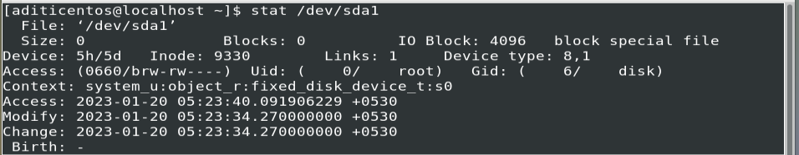
A special file is sometimes also called a device file.
The purpose of a special file is to expose the device as a file in the file system.

Slide 6
How to find file type
Command: file file_with_extention
Example: file file_name

Slide 7
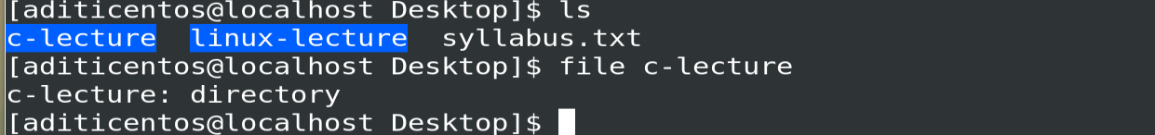
How to find file type
Command: file file_with_extention
Example file *

Slide 8
find command in linux
It can be used to find files and directories and perform subsequent operations on them. It supports searching by file, folder, name, creation date, modification date, owner and permissions.
Command
$ find [where to start searching from] [expression determines what to find] [-options] [what to find]
Example. find ./dir1 -name commands.txt

Slide 9
find command in linux
It can be used to find files and directories and perform subsequent operations on them. It supports searching by file, folder, name, creation date, modification date, owner and permissions.
Command
$ find [where to start searching from] [expression determines what to find] [-options] [what to find]

Slide 10
locate
locate command in Linux is used to find the files by name.Like find it also give options to get different info.
Syntax:
locate [OPTION]... PATTERN
Ex. locate sample.txt

Slide 11
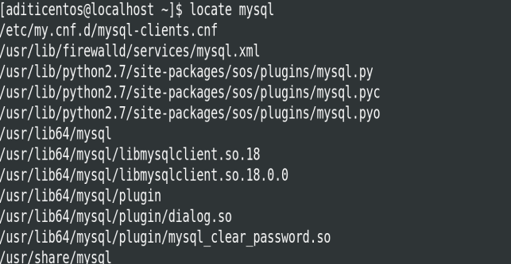
locate
locate command in Linux is used to find the files by name.Like find it also give options to get different info.
Syntax:
locate [OPTION]... PATTERN
Ex. locate sample.txt

Slide 12
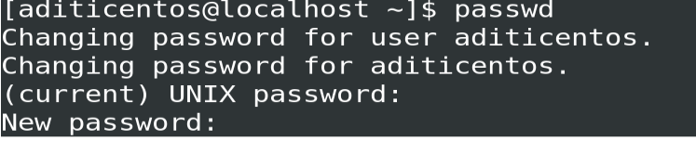
Changing Password
passwd command in Linux is used to change the user account passwords. The root user reserves the privilege to change the password for any user on the system, while a normal user can only change the account password for his or her own account.

Slide 13
File Display Commands and Redirection

Slide 14
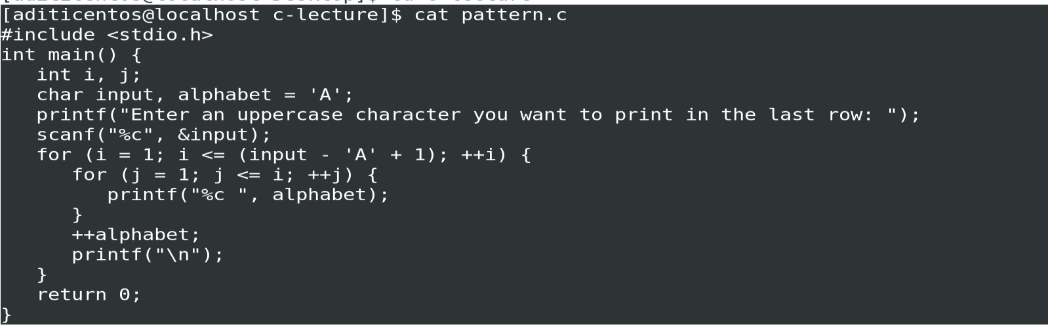
Cat

Slide 15
Head
Sometimes the information needed is in the first lines of a file. In that case, use the head command to view the first ten lines of a file in Linux.
For example, users can display basic information about the CPU used by viewing the beginning of the /proc/cpuinfo file.

Slide 16
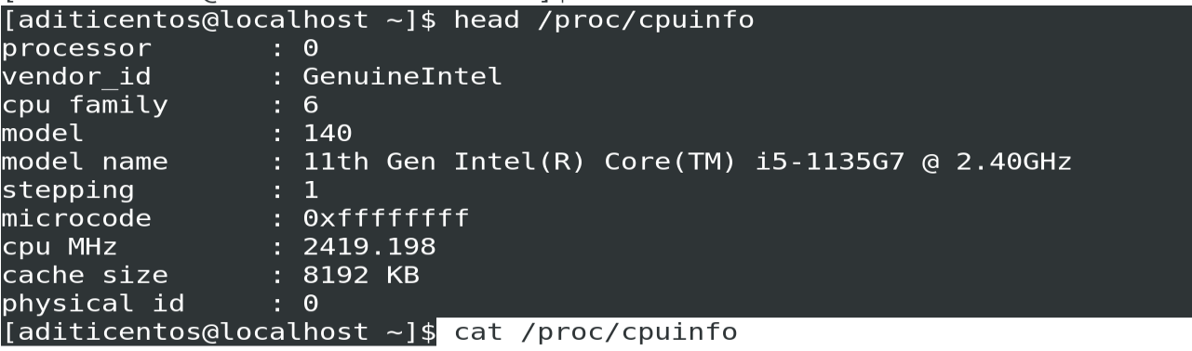
Head
Sometimes the information needed is in the first lines of a file. In that case, use the head command to view the first ten lines of a file in Linux.
For example, users can display basic information about the CPU used by viewing the beginning of the /proc/cpuinfo file.

Slide 17
Tail
The tail command allows viewing the last ten lines of a file by default instead of filling your terminal window with a wall of text, making it the perfect command to use if you want to check the last log entries.

Slide 18
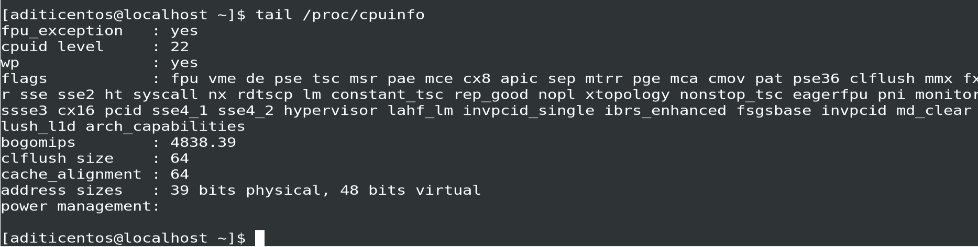
Tail
The tail command allows viewing the last ten lines of a file by default instead of filling your terminal window with a wall of text, making it the perfect command to use if you want to check the last log entries.

Slide 19
Flag
A user can select how many lines the command should display by passing the -n flag (where n is an integer). For example, the tail -15 command will output the last 15 lines on a given file.

Slide 20
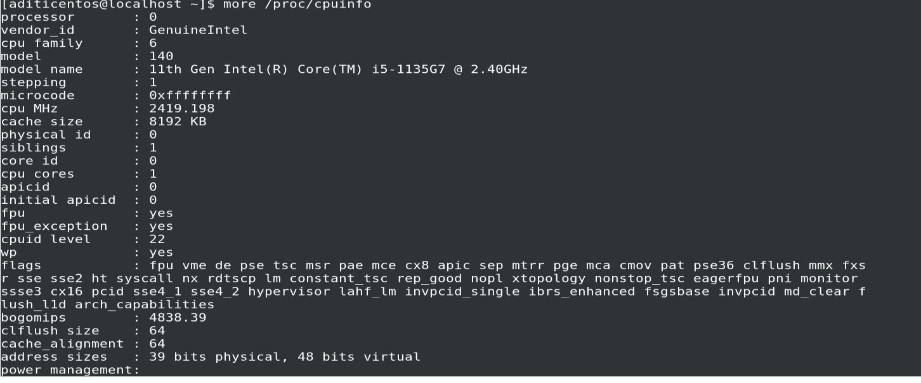
More

Slide 21
More
It displays a file in the terminal, one page at a time. While using the more command, the Enter key scrolls through the file line by line, or the Space key scrolls one full screen at a time. Finally, you can close the file by pressing the Q key.

Slide 22
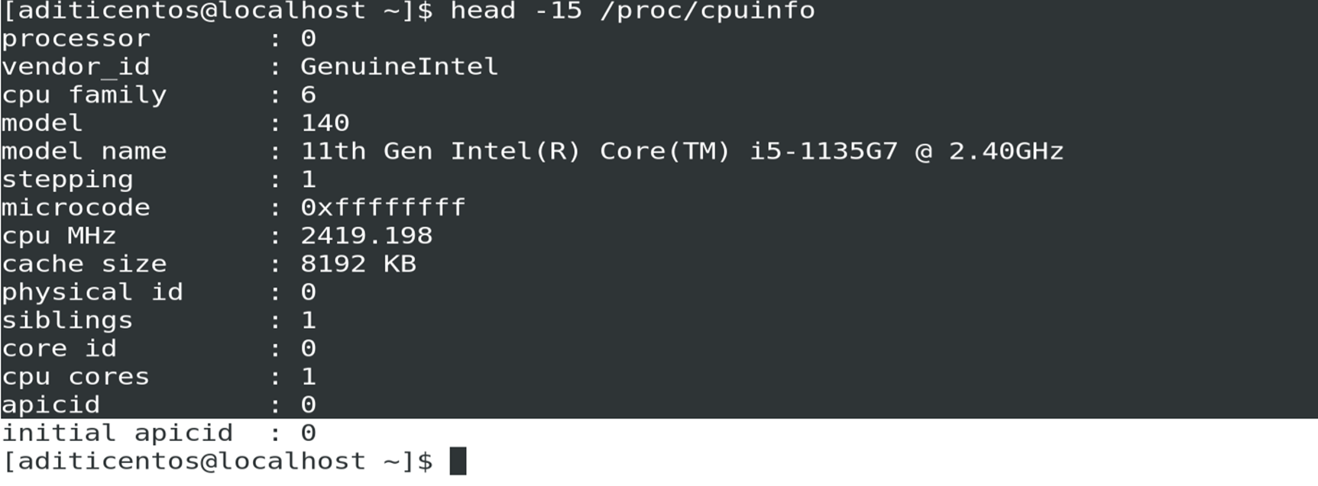
More
It displays a file in the terminal, one page at a time. While using the more command, the Enter key scrolls through the file line by line, or the Space key scrolls one full screen at a time. Finally, you can close the file by pressing the Q key.

Slide 23
Less
t’s very similar to more, but with the benefit of not keeping all the text in the terminal window. The less command also comes with a built-in search function, allowing you to highlight the parts of the file for which you are looking. To search with less, press the forward slash key followed by the text you want to search.

Slide 24
Tac
Another exciting way to display the contents of a file in Linux is in reverse order. To do so, use the tac command. It is similar to cat but reversed, reading and displaying the file starting from the last line. For example, here is what the output of tac looks like used to display the contents of the cpuinfo file.

Slide 25
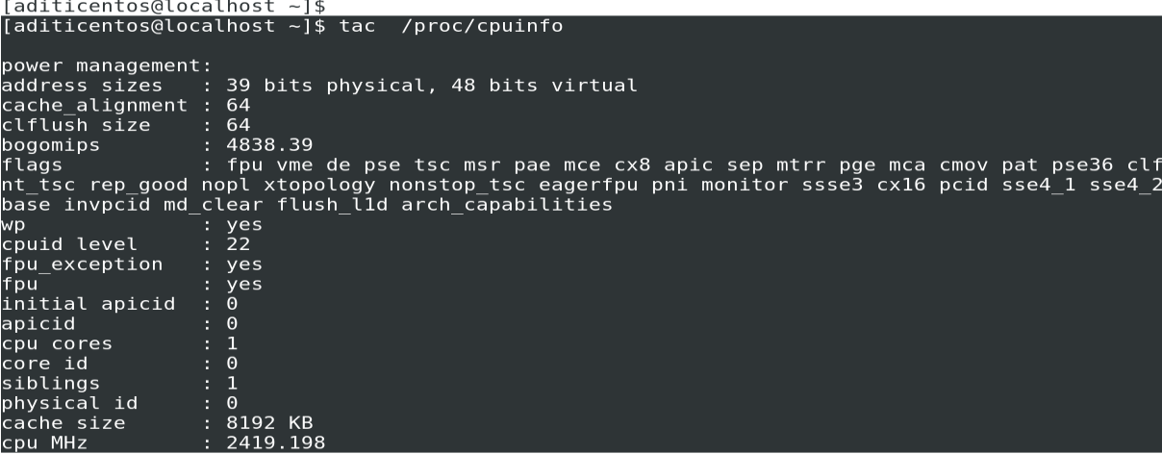
Tac
Another exciting way to display the contents of a file in Linux is in reverse order. To do so, use the tac command. It is similar to cat but reversed, reading and displaying the file starting from the last line. For example, here is what the output of tac looks like used to display the contents of the cpuinfo file.

Slide 26
Grep
While not used for displaying the contents of a file, the grep command is handy for filtering the output of commands. For example, grep works for searching for specific text in a file.

Slide 27
Redirection in Linux
Linux has some command or special character to redirect these input and output functionalities.
Either we write input in the form of command directly or redirect input from any other place or file. Suppose we have a file called “file.txt” to print the starting some lines of the file we could use the “head”.

Slide 28
Types of Redirection
1. Overwrite
“>” standard output
“<” standard input
2. Appends
“>>” standard output
“<<” standard input
3. Merge
“p >& q” Merges output from stream p with stream q
“p <& q” Merges input from stream p with stream q

Slide 29
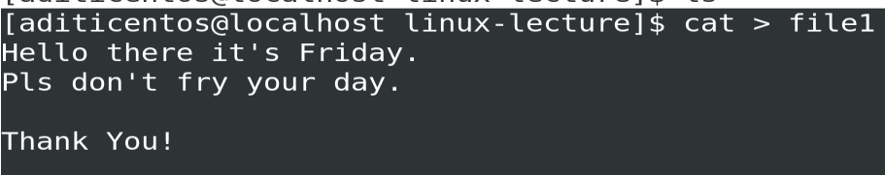
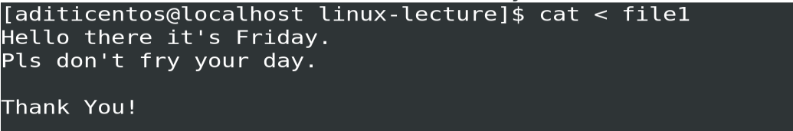
Types of Redirection
1. Overwrite
“>” standard output:
“<” standard input: cat command will take the input from “file1” and print it to the terminal screen.
2. Appends
“>>” standard output
“<<” standard input
3. Merge
“p >& q” Merges output from stream p with stream q
“p <& q” Merges input from stream p with stream q

Slide 30
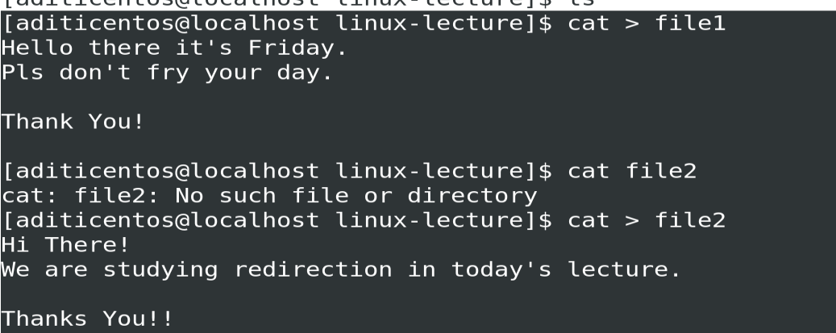


Slide 31
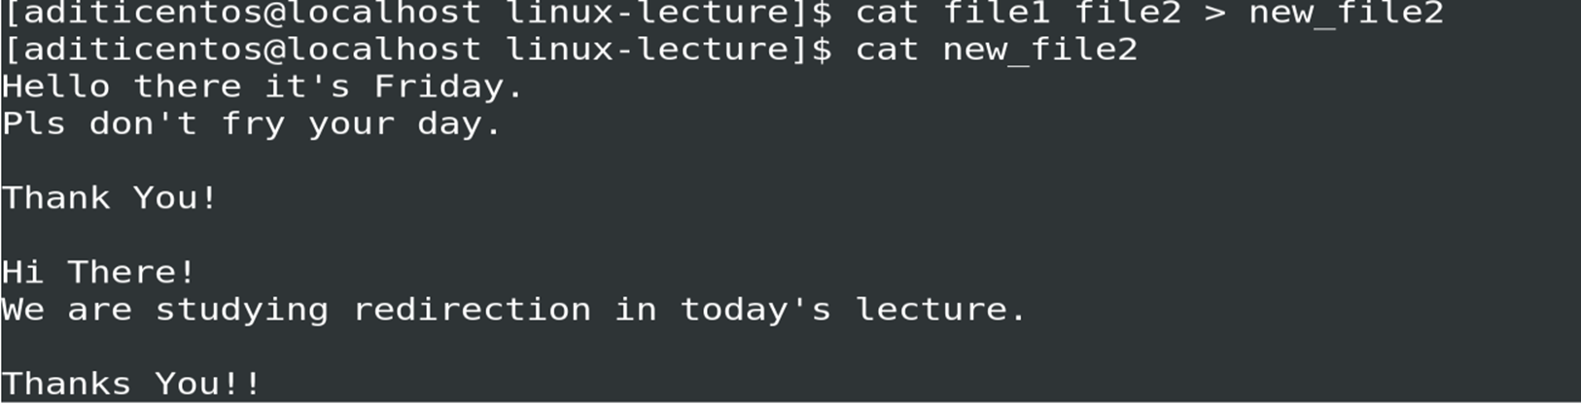

Slide 32
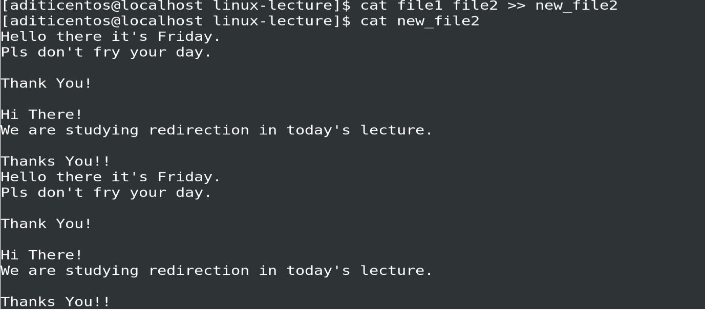

Slide 33
Practise
Print the path of commands file which we created in the class using find. Try to change password of user.

Slide 34
Practise
Print the path of commands file which we created in the class using find. Try to change password of user.
Use commands head, tail, more, less commands on any file which is already present on the system. (you can use /proc/cpuinfo)

Slide 35
Practise
Print the path of commands file which we created in the class using find. Try to change password of user.
Use commands head, tail, more, less commands on any file which is already present on the system. (you can use /proc/cpuinfo)
Make a new file today_commands and right the commands we have learnt today in it. Then print the content of the file.
a. Redirect this output to a file name temp.
b. concatenate this file to the commands file we created before using redirect.

