Slide 1
File Permissions in Linux – How to Use the chown and chgrp Commands

Slide 2
What are Group and Users in Linux?
A user is a regular entity that can manipulate files, directories, and perform various types of actions in a system. We can create any number of users in Linux.
A group contains zero or more users in it. Users in a group share the same permissions. The group allows you to set permissions on the group level instead of having to set permissions for individual users.

Slide 3
What are Primary and Secondary Groups in Linux?
primary group is a group that a user belongs to by default.
A secondary group is a group to which you can add any number of users.

Slide 4
How to Create a User
You can create a user by using the useradd command. Each user in a Linux system has a unique user id.
useradd [OPTIONS] <user_name>
Example: useradd developer

Slide 5
How to Create a Group
Groups are created by using the groupadd command. Similar to users, each group in a Linux system has a unique group id.
groupadd [OPTIONS] <group_name>
Ex. groupadd developers_group

Slide 6
How to Add a User to a Group
we created a user and a group. Let's add the user (developer) to the group (developers_group). The command to add a user to a group is usermod -aG.
Sudo usermod -aG <group_name> <user_name>
Example: sudo usermod -aG developers_group developer

Slide 7
How to List Out Groups
The list of groups and the users who have permissions in the group are stored in a file called group. It will be located under the /etc directory.
cat /etc/group

Slide 8
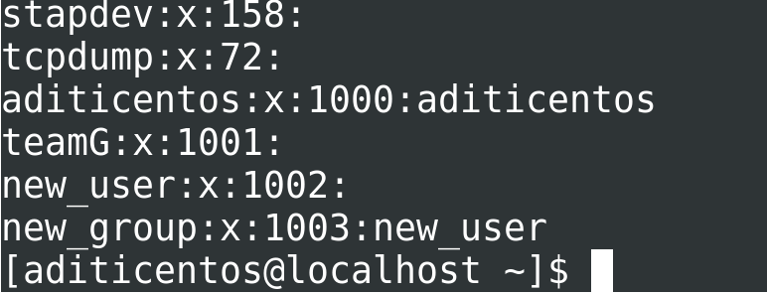
How to List Out Groups
The list of groups and the users who have permissions in the group are stored in a file called group. It will be located under the /etc directory.
cat /etc/group

Slide 9
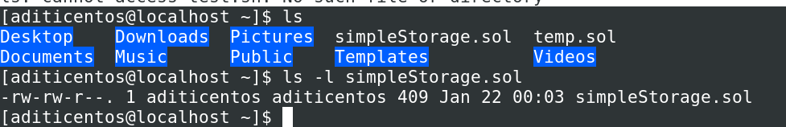
How to Find the Current Owner and Group Ownership of a File
There's a powerful – and likely familiar – command in Linux which shows the permissions involved in a file/directory. This is the ls -l command:
ls -l test.sh

Slide 10
How to Change the Owner of a File or Directory
You can use the chown command to change the ownership of a file. The chown command is abbreviated from "change owner".
chown <user_name> <file_name>

Slide 11
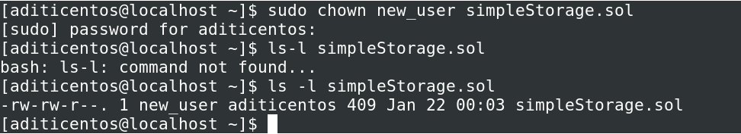
How to Change the Owner of a File or Directory
You can use the chown command to change the ownership of a file. The chown command is abbreviated from "change owner".
chown <user_name> <file_name>

Slide 12
How to Change Ownership of Multiple Files with a Single Command
You can do this by passing multiple file names to the chown command with one user name. This sets the ownership of all the given files to that particular user.
sudo chown <user_name> file1 file2 ...

Slide 13

How to Change the Group Ownership of a File
Almost all the operations related to groups can be achieved with chgrp command (an abbreviation of "change group"). It's pretty similar to the chown command.
Syntax of the chgrp command:
sudo chgrp <group_name> <file/dir_name>

Slide 14
How to Change the Group Ownership of a Directory
The same syntax for files is applicable to directories also. Here's a quick example:
sudo chgrp test group_test/
Change group ownership of group_test directory to test group.
To recursively change the group permissions of all the directories inside that directory, we have to add the -R flag to it like this:

Slide 15
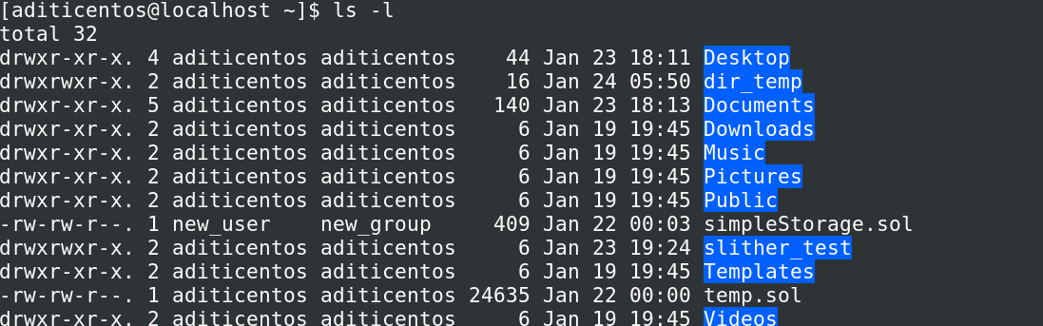
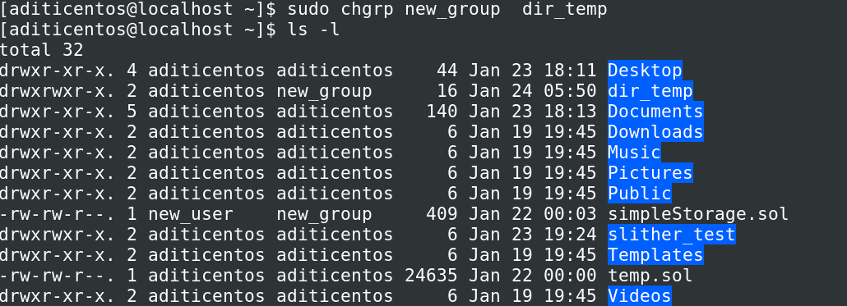
How to Change the Group Ownership of a Directory
The same syntax for files is applicable to directories also. Here's a quick example:
sudo chgrp test group_test/
Change group ownership of group_test directory to test group.
To recursively change the group permissions of all the directories inside that directory, we have to add the -R flag to it like this:
https://www.freecodecamp.org/news/file-permissions-in-linux-how-to-use-the-chown-chgrp-command-s/

Slide 16
How to Change the Group Ownership of a Directory
The same syntax for files is applicable to directories also. Here's a quick example:
sudo chgrp test group_test/
Change group ownership of group_test directory to test group.
To recursively change the group permissions of all the directories inside that directory, we have to add the -R flag to it like this:

Slide 17
How to Change the Group Ownership of a Directory
The same syntax for files is applicable to directories also. Here's a quick example:
sudo chgrp test group_test/
Change group ownership of group_test directory to test group.
To recursively change the group permissions of all the directories inside that directory, we have to add the -R flag to it like this:

Slide 18
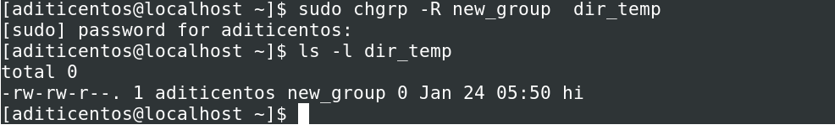
How to Change the Group Ownership of a Directory
The same syntax for files is applicable to directories also. Here's a quick example:
sudo chgrp test group_test/
Change group ownership of group_test directory to test group.
To recursively change the group permissions of all the directories inside that directory, we have to add the -R flag to it like this:

Slide 19
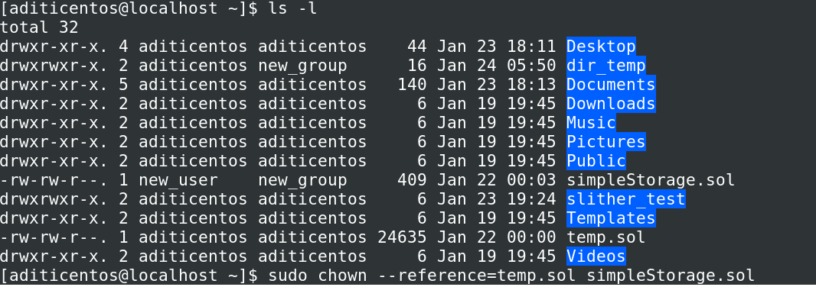
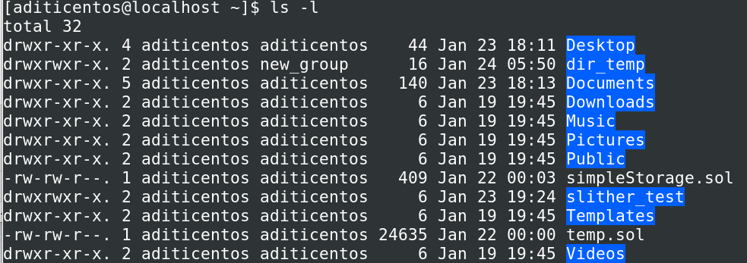
How to Copy Ownership from One File to Another
If we want to change the ownership of one file from as same as other file we can use reference flag to do so.
chown --reference=<source_file_name> <destination_file_name>

Slide 20
It’s your turn!!
Make a new user.
Make a new group
Make a new directory dir_temp inside user. Make new file inside dir_temp and change the group ownership of dir_temp to new_group.
Also change the user ownership of dir_temp to new_user.

Slide 21
reference
https://www.freecodecamp.org/news/file-permissions-in-linux-how-to-use-the-chown-chgrp-command-s/

