Slide 1
Linux File Editor (vi)

Slide 2
Vi is also a command line editor and is a very powerful one to boot. It is a plain text editor, like Notepad on Windows and, to use it, you use only your keyboard, not the mouse.
Vi has two operating modes – Insert or Input mode and Edit.
In the Insert mode, you can insert content into the current working file and in Edit mode, you navigate around the file, performing things like search,copy, delete, replace, save etc.

Slide 3
To run vi, simply type one command line argument containing the file name that you want to edit:
vi <name of file>
if you don’t specify a filename, you can open it from within but it is much easier to simply close vi down and start again.
Rather than going into reams of explanations about how vi works, I am going to simplify it with some instructions for things to type in. Go ahead and open the Linux stuff directory you created earlier.

Slide 4
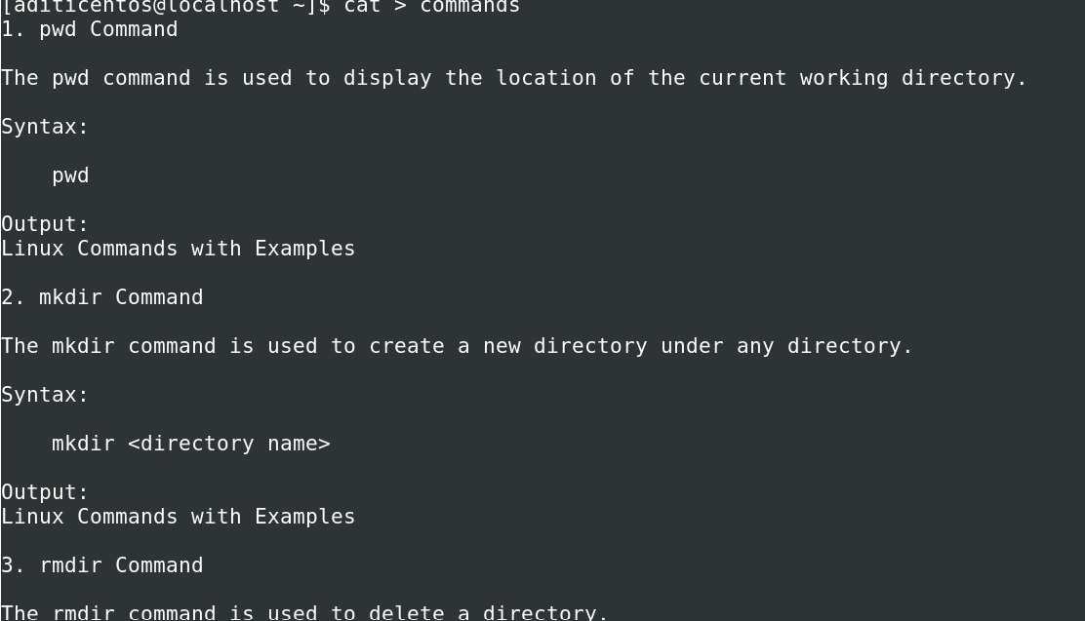
To run vi, simply type one command line argument containing the file name that you want to edit:
vi <name of file>
if you don’t specify a filename, you can open it from within but it is much easier to simply close vi down and start again.
Rather than going into reams of explanations about how vi works, I am going to simplify it with some instructions for things to type in. Go ahead and open the Linux stuff directory you created earlier.

Slide 5
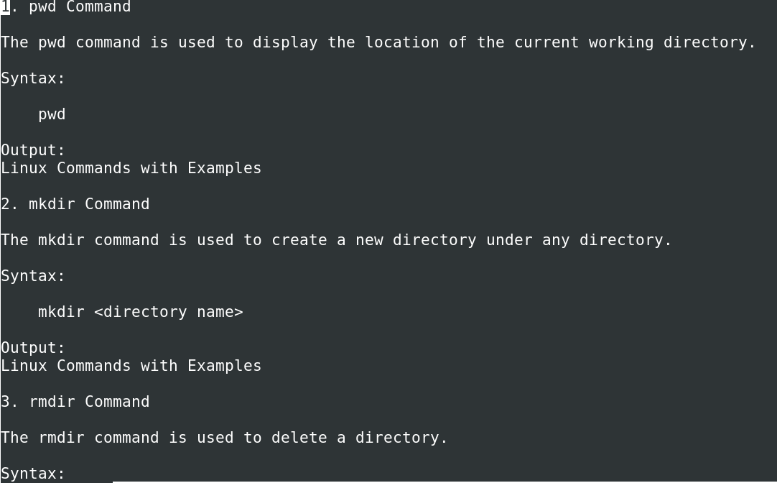

Slide 6
You will be in the edit mode.
you need to enter Insert mode, just by pressing i on your keyboard.
Type in a few lines of text and then press the Esc button this puts you back in Edit mode.

Slide 7
Save and Edit
You can do this in a few ways but they all do the same so go with what works for you. First, ensure you are still in Edit mode then use one of these:
ZZ (use capital letters) – save and exit:
:q! – exit, discarding any changes made since the file was last saved
:w – save but do not exit
:wq – save and exit
any command that starts with the colon requires that you press enter after inputting the command.

Slide 8
Viewing Files
vi is, essentially, a text editor but you can view files with it as well. However, there are two more commands that you can use which are better.
The first is cat, short for concatenate and it is used for joining files together; in its basic form, you can view files with it. Type in the following using the name of the file you just created.
This command is fine when you don’t have a large file but if you do, you won’t be able to read the contents very easily so we use a different command; less

Slide 9
less <filename>
This lets you move around a file using the up and down arrow keys or by using the spacebar to move on a page or pressing b to go back. Pressing q will exit you out of the file. Less allows you to move up and down within a file using the arrow keys. You may go forward a whole page using the Spacebar
or back a page by pressing b When you are done, you can press q for quit.

Slide 10
Navigating in vi
Open the file and go into insert mode. Enter a couple of paragraphs and then press Esc so you go back into edit mode. To navigate around the file, use the following commands. Do this now and see how they work.

Slide 11
Navigating in vi
The arrow keys – move the cursor
j – move the cursor down

Slide 12

The arrow keys – move the cursor
j – move the cursor down
k – move the cursor up

Slide 13
The arrow keys – move the cursor
j – move the cursor down
k – move the cursor up
h – move the cursor right

Slide 14
The arrow keys – move the cursor
j – move the cursor down
k – move the cursor up
h – move the cursor right
l – move the cursor left

Slide 15
The arrow keys – move the cursor
j – move the cursor down
k – move the cursor up
h – move the cursor right
l – move the cursor left
$ - move the cursor to the end of the line you are on

Slide 16
The arrow keys – move the cursor
j – move the cursor down
k – move the cursor up
h – move the cursor right
l – move the cursor left
$ - move the cursor to the end of the line you are on
^ - move the cursor to the start of the line you are on

Slide 17
The arrow keys – move the cursor
j – move the cursor down
k – move the cursor up
h – move the cursor right
l – move the cursor left
$ - move the cursor to the end of the line you are on
^ - move the cursor to the start of the line you are on
nG – move to the nth line, for example, 6G will take you to line 6

Slide 18
The arrow keys – move the cursor
j – move the cursor down
k – move the cursor up
h – move the cursor right
l – move the cursor left
$ - move the cursor to the end of the line you are on
^ - move the cursor to the start of the line you are on
nG – move to the nth line, for example, 6G will take you to line 6
G – move to the final line in the text

Slide 19
The arrow keys – move the cursor
j – move the cursor down
k – move the cursor up
h – move the cursor right
l – move the cursor left
$ - move the cursor to the end of the line you are on
^ - move the cursor to the start of the line you are on
nG – move to the nth line, for example, 6G will take you to line 6
G – move to the final line in the text
w – move to the start of the next word

Slide 20
The arrow keys – move the cursor
w – move to the start of the next word
nw – move forwards an amount of words, for example, 4w will move forward 4 words

Slide 21
The arrow keys – move the cursor
w – move to the start of the next word
nw – move forwards an amount of words, for example, 4w will move forward 4 words
b – go back to the start of the last word

Slide 22
The arrow keys – move the cursor
w – move to the start of the next word
nw – move forwards an amount of words, for example, 4w will move forward 4 words
b – go back to the start of the last word
nb – go back to the specified word

Slide 23
The arrow keys – move the cursor
w – move to the start of the next word
nw – move forwards an amount of words, for example, 4w will move forward 4 words
b – go back to the start of the last word
nb – go back to the specified word
{- - go back a paragraph

Slide 24
The arrow keys – move the cursor
w – move to the start of the next word
nw – move forwards an amount of words, for example, 4w will move forward 4 words
b – go back to the start of the last word
nb – go back to the specified word
{- - go back a paragraph
}- go forward a paragraph

Slide 25
The arrow keys – move the cursor
j – move the cursor down
k – move the cursor up
h – move the cursor right
l – move the cursor left
$ - move the cursor to the end of the line you are on
^ - move the cursor to the start of the line you are on
nG – move to the nth line, for example, 6G will take you to line 6
G – move to the final line in the text
w – move to the start of the next word
nw – move forwards an amount of words, for example, 4w will move forward 4 words
b – go back to the start of the last word
nb – go back to the specified word
{- - go back a paragraph
}- go forward a paragraph

Slide 26
Delete Content
There are loads of ways to navigate vi and some of then, the n commands, let you specify a number.
Deleting works the same way and there are a few delete commands that let us add in movement commands so that we can specify what is to be deleted.
Using your open file, play around with the following delete

Slide 27
commands and see how they work:
x – deletes one character
nx – deletes the number of characters specified
dd – deletes the line you are on
dn – delete to where the n command would take you, i.e. d6w will
delete 6 words

Slide 28
Undo
To undo a change in vi, including a deletion, is easy:
u (lower case) – undoes the previous action and you can keep pressing it to undo several actions
U (capital) – undoes all the changes to the line you are on

Slide 29
Exercises
1. Add all the commands we study in the commands file with their description.
2. Save the file and then try to view it using cat and less
3. Access the file in vi and add more content
4. Use all the movement commands to navigate around your file
5. Play with the delete commands, seeing how they all work
6. Undo one or more of the changes you have made

Slide 30
Lecture17 Test1 Test2

