Slide 1


nano, pico, and other Linux editors, “sed
Command

Slide 2
nano, pico, and other Linux editors,
“sed Command

Slide 3
Linux text editors are useful for a variety of tasks, including editing text files, creating code, updating user manuals, and more. Multiple text editors are supported on a Linux system. In Linux, there are two different categories of text editors, as follows:
Vi, nano, pico, and other command-line text editors.
GUI text editors, including Kwrite, gedit (for Gnome), and others.

Slide 4
Using a text editor is crucial while programming. Therefore, choosing the finest text editor is crucial. Not only should a text editor be easy to use, but it should also be practical and enjoyable to use. A text editor is regarded as being good if it has IDE features.
The top 20 Linux text editors will be covered in this section. We'll also discuss the most recent text editors and contrast them with more established ones like Vi and nano. Your choice of editor will be made easier with this advice.

Slide 5
Editors come in a variety of forms:
Vi/VIM editor | Kate/Kwrite
Nano editor | Notepad ++
Gedit editor | Eclipse
Sublime text editor | gVIM editor
VSCode | Jed editor
GNU emacs | Geany editor
Atom editor | Leaf Pad
Brackets editor | Light Table
Pico editor | Medit text editor
Bluefish | CodeLite

Slide 6
Some of the important editors we will used in this lecture:
1.Vi/VIM editor
Vim editor is one of the most used and powerful command-line based editor of the Linux system. By default, it is supported by most Linux distros. It has enhanced functionalities of the old Unix Vi editor. It is a user-friendly editor and provides the same environment for all the Linux distros. It is also termed as programmer's editor because most programmers prefer Vi editor.

Slide 7
Vi editor has some special features such as Vi modes and syntax highlighting that makes it powerful than other text editors. Generally, it has two modes:
Command Mode: The command mode allows us to perform actions on files. By default, it starts in command mode. In this mode, all types of words are considered as commands. We can execute commands in this mode.
Insert Mode: The insert mode allows to insert text on files. To switch from command mode to insert mode, press the Esc key to exit from active mode and 'i' key.

Slide 8
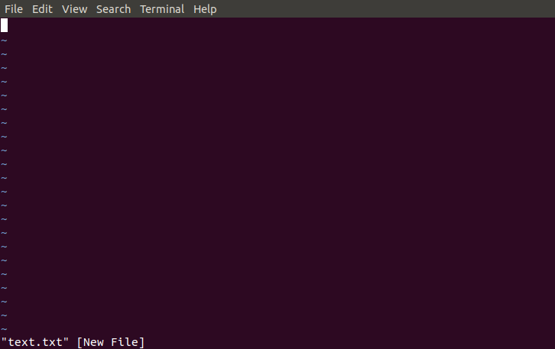
To invoke the vi editor, execute the vi command with the file name as follows:
vi <file name>
It will look like below image:

Slide 9
2. Nano editor
Nano is a straight forward editor. It is designed for both beginners and advanced users. It has many customization features. Some advanced features of a nano text editor are as following:
It has highly customizable key bindings
It supports syntax highlighting
It has undo and redo options
It provides full line display on the standard output
It has pager support to read from standard input

Slide 10
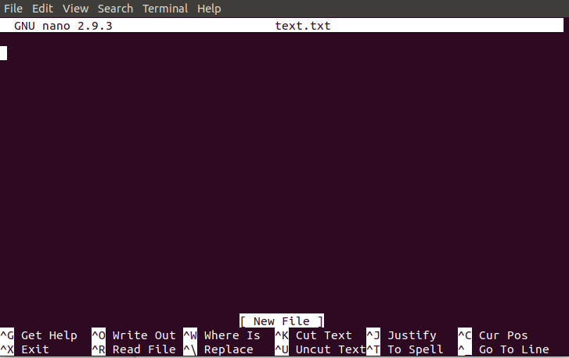
To open file with nano editor, execute the command as follows:
nano <file name>
The nano editor looks like:

Slide 11
In the nano editor, the useful options are given at the bottom, use the CTRL+ option to perform an operation. For example, to exit from the editor, use CTRL +X keys.

Slide 12
3. Gedit editor
Gedit editor is the default editor for the GNOME desktop environment. When we open a file, it will open
with the Gedit editor.
It provides
straightforward
functionalities like lightweight editor
any basic text with a straight
editor. It is a forward user
interface. It was publicly released in the year 2000 with a GNOME desktop environment. It is developed using the C programming language and supports all font family.

Slide 13
Some key features of the gedit text editor are as following:
It provides syntax highlighting.
It supports internationalized text.
It supports several programming languages.

Slide 14
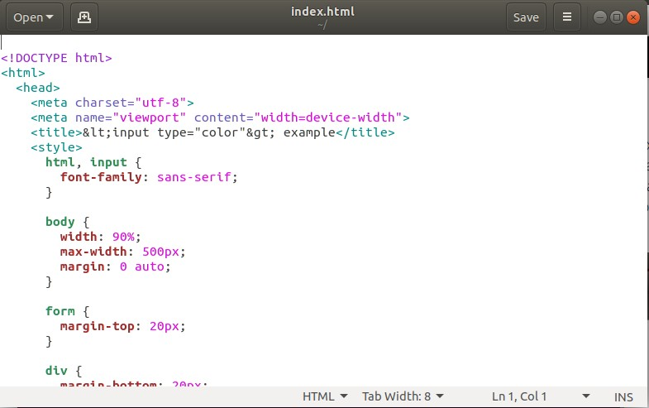
To invoke the gedit editor from the terminal, execute the below command
gedit <file name> It looks like:

Slide 15
4. Sublime Text
The sublime text editor is also one of the most popular IDE-based text editors. It is used as a development environment tool more than a text editor. It has several features to support many programming and mark-up languages. Further, it supports numerous plugins to make it more than a text editor.

Slide 16
Some key features of a sublime text editor are as following:
It has an excellent Command Palette.
It is a python-based plugin API.
It supports parallel editing of code.
It provides project-specific preferences.

Slide 17
Execute the following commands to install the sublime text editor:
wget -qO - https://download.sublimetext.com/sublimehq- pub.gpg | sudo apt-key add -
sudo apt-add-
repository "deb https://download.sublimetext.com/ apt/st able/"
sudo apt install sublime-text
To learn more about installation, visit Install sublime text editor on ubuntu. We can open the sublime editor by browsing applications. Also, we can open it from the terminal.

Slide 18
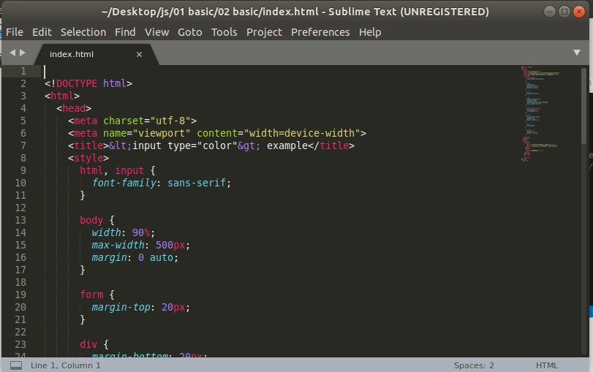
To access the sublime editor from the terminal, execute the below command:
subl
It will look like below image:

Slide 19
5. VSCode Editor
VSCode editor is a modern and widely used text editor. It is built by Microsoft and has support for Linux, Mac and Windows OS. It facilitates with many powerful features to support many programming languages and markup language. To install the VSCode, download the binary package from Here. And, execute the below command for Debian and Ubuntu-based systems:
sudo apt install ./<file>.deb

Slide 20
Some key features of VSCode editor are as following:
It has full support for debugging with an interactive console, breakpoints, call stacks and more.
It has built-in support for Git and Git commands.
It facilitates with IntelliSense.
It provides many customization options.
It has massive support for languages.
It supports togglable layouts.
It provides a built-in terminal.

Slide 21
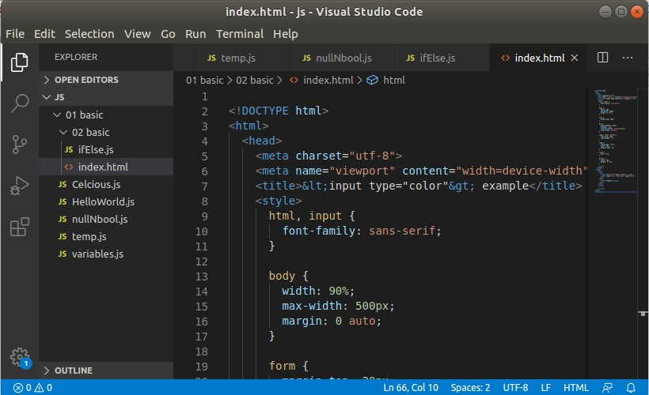
The VSCode editor looks like the below image:

Slide 22
6. VSCode Editor
GNU Emacs is the oldest and simplest text editor for the Linux system. It is a part of the GNU project. It is still a popular text editor used by thousands of users because of its simplicity. It is written in C and LISP programming languages. Some key features of GNU Emacs are as following:
It has mail and News options.
It provides a debugger interface extension.
It has extensive documentation and support.

Slide 23
Execute the following commands to install GNU Emacs:
sudo apt-get update
sudo apt-get install emacs
To access it from the terminal, execute the below command:
emacs <file name>

Slide 24
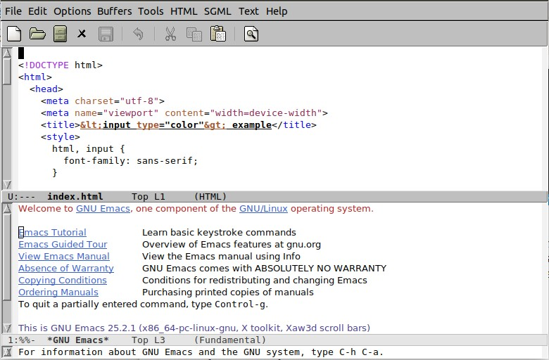
It will look like below image:

Slide 25
7. Atom Editor
GitHub Inc. created Atom, a free and open-source
code editor. In addition
to supporting it
several
programming languages,
is cross-platform. A
is
"hackable another
text name
editor for
for the 21st century"
it. It was created with
development in mind. Using online technologies like HTML and JavaScript, it is totally editable. It makes use of Git control and Node.js-based plugins to simplify.

Slide 26
Some key features of Atom Editor are as follows:
It is open source.
It has a modern, customizable layout.
It facilitates with attractive themes.
It provides embedded Git support.
It provides real-time collaboration with Telesync.
It has smart auto-complete and IntelliSense.
It has a built-in package manager.

Slide 27
To install Atom, download the binary package from the official site of Atom, and execute the below command:
sudo dpkg -i Downloads/atom-amd64.deb

Slide 28
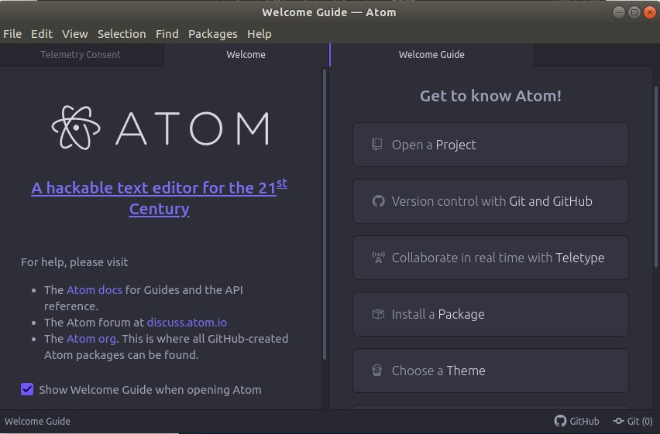
It will look like below image:

Slide 29
8. Brackets Editor
Adobe created the free and open-source text editor known as Brackets. It is mostly concerned with web development. With a variety of free extensions, it offers a comprehensive code editing experience. HTML, CSS, and JS were used in its creation.

Slide 30
Some key features of Brackets editor are as following:
It provides an attractive User Interface.
It has pre-processor support for SCSS and LESS.
It facilitates with inline editors.
It provides a live preview.
It has support for multiple tabbed editing.
It has PHP support.
It supports Language Server Protocol.
It supports plugin extensions.

Slide 31
To install Brackets editor, execute the following commands:
sudo add-apt-
repository ppa:webupd8team/brackets
sudo apt-get update
sudo apt-get install brackets

Slide 32
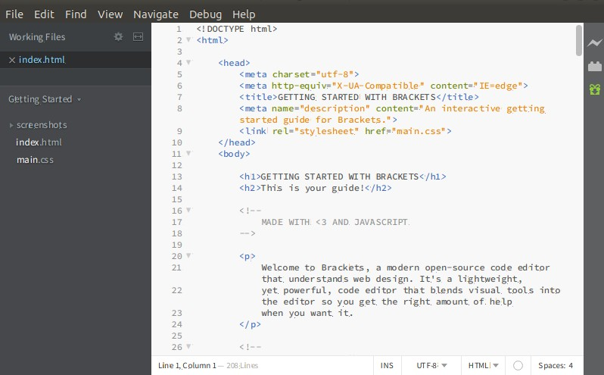
It will look like:

Slide 33
9. Pico Editor
The Pico editor is a terminal-based Linux text editor. It has built-in support for pine news and email client. It is very straight forward to use and facilitates with some useful features such as justification, cut/paste, spell checker, and more. However, it is just a simple text editor, so it does not offer many features like other Linux text editors. It is not purely free text editor, so most Linux distributions do not provide pico as a text editor. It does not support working with multiple files simultaneously. Also, it cannot perform find and replace operation across multiple files.

Slide 34
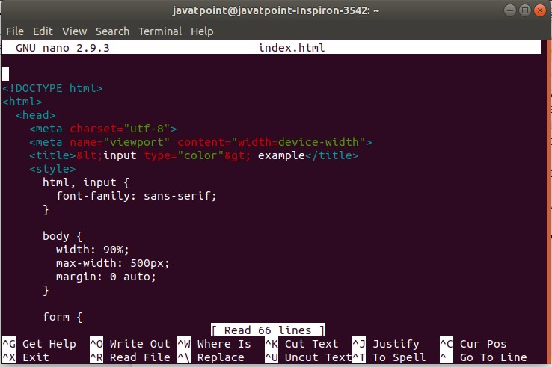
To open a file with a pico text editor, execute the command as follows:
pico <file name>
It will look like below command:

Slide 35
10. Bluefish
Bluefish is a free and open-source text editor for the Linux system. It is an advanced text editor having plenty of tools for programming. It is good for developing dynamic websites. It supports several languages and tools such as PHP, C, C++, JavaScript, Java, Google Go, and many more.

Slide 36
Some key features of Bluefish text editor are as following:
It is lightweight and fast.
It allows integration with external Linux programs such as make, sed, awk, lint, weblint, and many more.
It facilitates with the spell checker.
It allows us to work on multiple projects.
It has remote file editing.
It provides a find and replace feature.
It has undo and redo option.
It provides auto-recovery of modified files.

Slide 37
To install Bluefish, execute the following commands:
sudo add-apt-repository ppa:klaus-vormweg/bluefish
sudo add-apt-repository ppa:klaus-vormweg/bluefish-gtk2
sudo apt-get update
sudo apt-get install bluefish
To open file with bluefish, execute the below command:
bluefish <file name> it will look like:

Slide 38
11. Leafpad
Leafpad is a straight forward GTK based text editor. It is a popular text editor among Linux users due to its simplicity and lightness. The key features of Leafpad are as following:
It provides a codeset option.
It provides auto codeset detection (UTF-8 and some codesets).
It facilitates unlimited Undo/Redo operations.
It provides Auto/Multi-line Indent.
It displays the current line number.
It provides drag and drop feature.
It allows print files.

Slide 39
the following
To install Leafpad, execute commands:
sudo apt-get update -y
sudo apt-get install -y leafpad

Slide 40
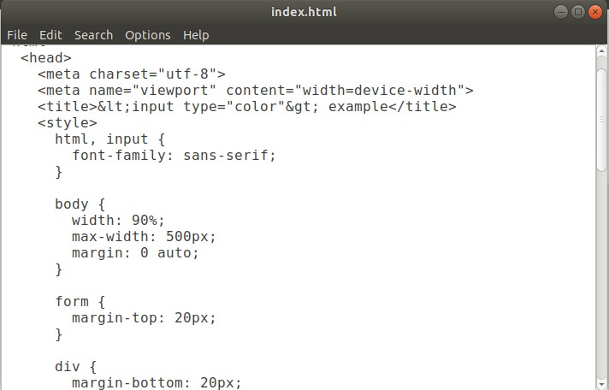
It will look like the below command:

Slide 41
SED command in UNIX stands for stream editor and it can perform lots of functions on file like searching, find and replace, insertion or deletion. Though most common use of SED command in UNIX is for substitution or for find and replace. By using SED, you can edit files even without opening them, which is much quicker way to find and replace something in file, than first opening that file in VI Editor and then changing it.

Slide 42
SED is a powerful text stream editor. Can do insertion, deletion, search and replace (substitution).
SED command
in unix
supports allows it perform
regular complex
expression which pattern matching.

Slide 43
Nano, Pico and other Linux editors,"sed" Command

Slide 44
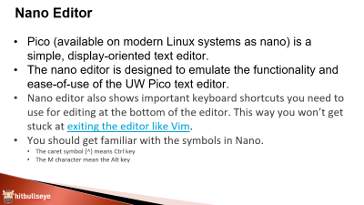
Nano Editor
Pico (available on modern Linux systems as nano) is a simple, display-oriented text editor.
The nano editor is designed to emulate the functionality and ease-of-use of the UW Pico text editor.
Nano editor also shows important keyboard shortcuts you need to use for editing at the bottom of the editor. This way you won’t get stuck at exiting the editor like Vim.
You should get familiar with the symbols in Nano.
The caret symbol (^) means Ctrl key
The M character mean the Alt key

Slide 45
Nano Editor
You can open a file for editing in Nano like this:
nano my_file
There are no special insert mode or anything of that sort. It is almost like using a regular text editor, at least for writing and editing.
Mouse click doesn’t work here. Use the arrow keys to move up and down, left and right.
Keys to navigate
^A -> move to the beginning of a line
^E -> move to the end of a line
^Y -> Page Up
^V -> Page Down keys

Slide 46
Nano Editor
Copy paste
MA -> set the mark
M6 -> copying
^U -> pasting
Cut paste
^K -> copy and cut
^U -> pasting
Undo or redo
MU
ME

Slide 47
Nano Editor
Search and replace
^W -> search for the word
MW -> to move to the next matching word
^\ ->Search and replace
Y or N -> will move to the next match
A -> to replace all the matches
Save your file while editing
^O -> save the changes
Save and exit Nano editor
^X -> it will ask for saving the file

Slide 48
Nano Editor
Universal solution type ^G
If you are using Nano, you’ll notice that it displays important information at the bottom. This includes the keyboard shortcuts that will be used in the scenario. It also shows the last action you performed.

Slide 49
Make a file geekfile.txt with the content.
unix is great os. unix is opensource. unix is free os.
learn operating system.
unix linux which one you choose.
unix is easy to learn.unix is a multiuser os.Learn unix .unix is a powerful.

Slide 50
Sed Command in Linux
sed is a stream editor that works on piped input or files of text. It doesn’t have an interactive text editor interface.
With sed you can do all of the following:
Select text
Substitute text
Add lines to text
Delete lines from text
Modify (or preserve) an original file
The pattern matching and text selection functionalities of sed rely heavily on regular expressions (regexes).

Slide 51
Syntax:
sed OPTIONS... [SCRIPT] [INPUTFILE...]
Example:
Consider the below text file as an input.
$cat > geekfile.txt
unix is great os. unix is opensource. unix is free os.

Slide 52
Sample Commands
1. Replacing or substituting string : Sed command is mostly used to replace the text in a file. The below simple sed command replaces the word “unix” with “linux” in the file.
$sed 's/unix/linux/' geekfile.txt Output :
linux is great os. unix is opensource. unix is free os.

Slide 53
learn operating system.
linux linux which one you choose.
linux is easy to learn.unix is a multiuser os.Learn unix
.unix is a powerful.
Here the “s” specifies the substitution operation. The “/” are delimiters. The “unix” is the search pattern and the “linux” is the replacement string.
By default, the sed command replaces the first occurrence of the pattern in each line and it won’t replace the second, third…occurrence in the line.

Slide 54
2. Replacing the nth occurrence of a pattern in a line : Use the /1, /2 etc flags to replace the first, second occurrence of a pattern in a line. The below command replaces the second occurrence of the word “unix” with “linux” in a line.
$sed 's/unix/linux/2' geekfile.txt Output:
unix is great os. linux is opensource. unix is free os.
learn operating system.
unix linux which one you choose.
unix is easy to learn.linux is a multiuser os.Learn unix .unix is a powerful.

Slide 55
3. Replacing all the occurrence of the pattern in a line : The substitute flag /g (global replacement) specifies the sed command to replace all the occurrences of the string in the line.
$sed 's/unix/linux/g' geekfile.txt Output :
linux is great os. linux is opensource. linux is free os.
learn operating system.
linux linux which one you choose.
linux is easy to learn.linux is a multiuser os.Learn linux
.linux is a powerful.

Slide 56
4. Replacing from nth occurrence to all occurrences in a line : Use the combination of /1, /2 etc and /g to replace all the patterns from the nth occurrence of a pattern in a line. The following sed command replaces the third, fourth, fifth… “unix” word with “linux” word in a line.
$sed 's/unix/linux/3g' geekfile.txt Output:
unix is great os. unix is opensource. linux is free os.
learn operating system.
unix linux which one you choose.
unix is easy to learn.unix is a multiuser os.Learn linux
.linux is a powerful.

Slide 57
5. Parenthesize first character of each word : This sed example prints the first character of every word in parenthesis.
$ echo "Welcome To The Geek Stuff" | sed 's/\(\b[A-Z]\)/\(\1\)/g'
Output:
(W)elcome (T)o (T)he (G)eek (S)tuff

Slide 58
6. Replacing string on a specific line number : You can restrict the sed command to replace the string on a specific line number. An example is
$sed '3 s/unix/linux/' geekfile.txt Output:
unix is great os. unix is opensource. unix is free os.
learn operating system.
linux linux which one you choose.
unix is easy to learn.unix is a multiuser os.Learn unix .unix is a powerful.
The above sed command replaces the string only on the third line.

Slide 59
7. Duplicating the replaced line with /p flag : The /p print flag prints the replaced line twice on the terminal. If a line does not have the search pattern and is not replaced, then the /p prints that line only once.
$sed 's/unix/linux/p' geekfile.txt Output:
linux is great os. unix is opensource. unix is free os.
linux is great os. unix is opensource. unix is free os.
learn operating system.
linux linux which one you choose.
linux linux which one you choose.
linux is easy to learn.unix is a multiuser os.Learn unix .unix is a powerful.
linux is easy to learn.unix is a multiuser os.Learn unix .unix is a powerful.

Slide 60
8. Printing only the replaced lines : Use the -n option along with the /p print flag to display only the replaced lines. Here the -n option suppresses the duplicate rows generated by the
/p flag and prints the replaced lines only one time.
$sed -n 's/unix/linux/p' geekfile.txt Output:
linux is great os. unix is opensource. unix is free os.
linux linux which one you choose.
linux is easy to learn.unix is a multiuser os.Learn unix .unix is a powerful.
If you use -n alone without /p, then the sed does not print anything.

Slide 61


