Slide 1


Shell Scripting Basics, Types of Shells

Slide 2
Shell Scripting Basics
Types of Shells

Slide 3
The tutorial for shell scripting explains both the fundamental and more complex ideas. Our training on shell scripting is intended for both experts and beginners. An open-source operating system is Shell Scripting. Our Shell Scripting lesson covers
all scripting-related
subjects, parameters for scripts,
such shifting
as loops, through
parameters, source, getopts, case, eval, and let statements.

Slide 4
In Linux, shells
like bash and Korn support
programming constructs which are saved as scripts. These scripts become shell commands and hence many Linux commands are scripts. A system administrator should have a little knowledge about scripting to understand how their servers and applications are started, upgraded, maintained or removed and to understand how a user environment is built.

Slide 5

You can get the name of your shell prompt, with the following command:
Syntax: echo $SHELL
Look at the above snapshot, with the help of the above command we got the name of our shell which is 'bash'. The $ sign stands for a shell variable; echo will return the text whatever you typed in.

Slide 6

Linux comes with several different shells. Although a distribution has a default shell, users can change to another type or install a new one. This Lecture showcases the importance and features of eight different Linux shells.

Slide 7

A shell is a command-line interpreter program that parses and sends commands to the operating system. This program represents an operating system's interactive interface and the kernel's outermost layer (or shell). It allows users and programs to send signals and expose an operating system's low-level utilities.

Slide 8
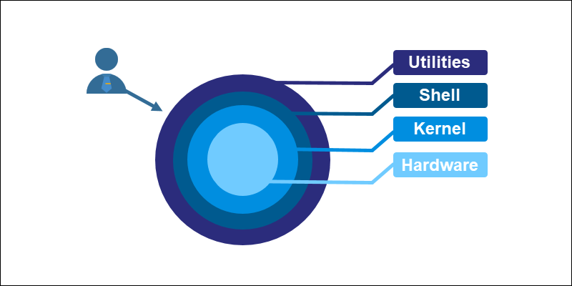
The terminal program (or terminal emulator) enables interaction with the system's utilities. When we run any command in the terminal, such as ls or cat, the shell parses, evaluates, searches for, and executes the corresponding program, if found.

Slide 9
Linux offers different shell types for addressing various problems through unique features. The shells developed alongside Unix often borrowed features from one another as development progressed.
Below is a brief overview of different shell types and their features.

Slide 10
1. Bourne Shell (sh)
The Bourne shell was the first default shell on Unix systems, released in 1979. The shell program name is sh, and the traditional location is /bin/sh. The prompt switches to $, while the root prompt is #.

Slide 11
2. C Shell (csh)
The C shell (csh) is a Linux shell from the late 1970s whose main objective was to improve interactive use and mimic the C language. Since the Linux kernel is predominantly written in C, the shell aims to provide stylistic consistency across the system.
The path to the C shell executable is /bin/csh. The prompt uses % for regular users and # for the root user

Slide 12
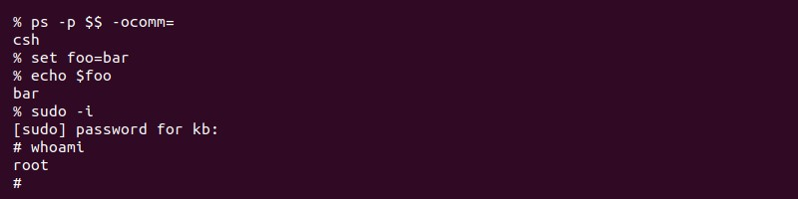

Slide 13
New interactive features included:
History of the previous command.
User-defined aliases for programs.
Relative home directory (~).
Built-in expression grammar.

Slide 14
The main drawbacks of the C shell are:
Syntax inconsistencies.
No support for standard input/output (stdio) file handles or functions.
Not fully recursive, which limits complex command handling.
The C shell improved readability and performance compared to the Bourne shell. The interactive features and innovations in csh influenced all subsequent Unix shells.

Slide 15
The TENEX C shell (tcsh) is an extension of the C shell (csh) merged in the early 1980s.
The shell is backward compatible with csh, with additional features and concepts borrowed from the TENEX OS.
3. TENEX C Shell (tcsh)
The TENEX C shell executable path is in /bin/tcsh. The user prompt is hostname: directory> while the root prompt is hostname:directory#.

Slide 16
Additional features of the shell include:
Advanced command history.
Programmable autocomplete.
Wildcard matching.
Job control.
Built-in where command.
Since tcsh is an extension of the C shell, many drawbacks persist in the extended version.

Slide 17
The KornShell (ksh) is a Unix shell and language based on the Bourne shell (sh) developed in the early 1980s.
The location is in /bin/ksh or /bin/ksh93, while the prompt is the same as the Bourne shell ($ for a user and # for root).
4. KornShell (ksh)

Slide 18
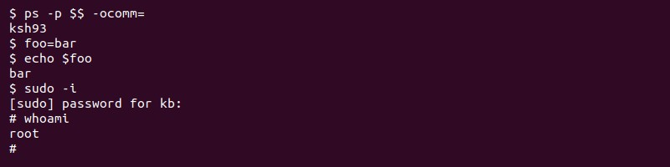

Slide 19
The shell
implements feature from the C shell and
Bourne shell, aiming to focus on both interactive commands and programming features. The KornShell adds new features of its own, such as:
Built-in mathematical functions and floating-point arithmetic.
Object-oriented programming.
Extensibility of built-in commands.
Compatible with the Bourne shell.
The shell is faster than both the C shell and the Bourne shell.

Slide 20
5. Debian Almquist Shell (dash)
The Debian Almquist Shell (dash) is a Unix shell developed in the late 1990s from the Almquist shell (ash), which was ported to Debian and renamed. Dash is
famous for being Debian. The shell
the default is minimal
shell for Ubuntu and and
POSIX compliant,
making it convenient for OS startup scripts.
The executable path is /bin/dash, in addition to /bin/sh pointing to /bin/dash on Ubuntu and Debian. The default and root user prompt is the same as in the Bourne shell.

Slide 21
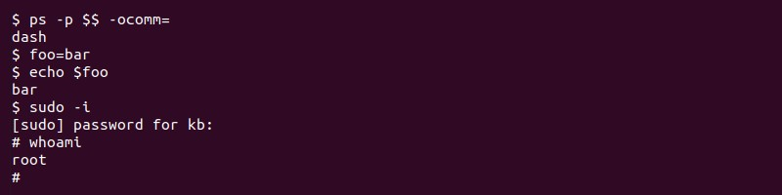

Slide 22
Dash features include:
Execution speeds up to 4x faster than bash and other shells.
Requires minimal disk space, CPU, and RAM compared to alternatives.
The main drawback is that dash is not bash- compatible. The features not included in dash are known as "bashisms." Therefore, bash scripts require additional reworkings of bashisms to run successfully.

Slide 23
6. Bourne Again Shell (bash)
The Bourne Again shell is a Unix shell and command language created as an extension of the Bourne shell (sh) in 1989. The shell program is the default login shell for many Linux distributions and earlier versions of macOS.
The shell name shortens to bash, and the location is /bin/bash. Like the Bourne shell, the bash prompt is $ for a regular user and # for root.

Slide 24
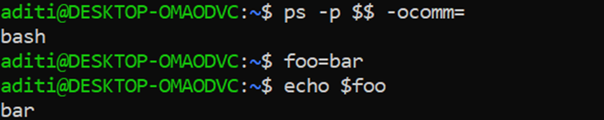


Slide 25
Bash introduces features not found in the Bourne shell, some of which include:
Brace expansion.
Command completion.
Basic debugging and signal handling.
Command history.
Conditional commands, such as the bash if and bash case statements.
Heredoc support.

Slide 26
7. Z shell(zsh)
The Z shell (zsh) is a Unix shell created as an extension for the Bourne shell in the early 1990s. The feature-rich shell borrows ideas from ksh and tcsh to create a well-built and usable alternative. The executable location is in /bin/zsh. The prompt is user@hostname location % for regular users and hostname# for the root user. The Z shell is the default shell of Kali Linux and Mac OS.

Slide 27
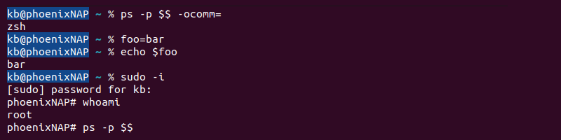

Slide 28
Some new features added to the zsh include:
Shared history among all running shell sessions.
Improved array and variable handling.
Spelling corrections and command name autofill.
Various compatibility modes.
Extensibility through plugins.
The shell is highly configurable and customizable due to the community-driven support through the Oh My Zsh framework.

Slide 29
8 . Friendly Interactive Shell(fish)
The Friendly Interactive Shell (fish) is a Unix shell released in the mid-2000s with a focus on usability. The feature-rich shell does not require additional configuration, which makes it user-friendly from the start. The de_{Frie}f_{nd}a_{ly In}u_{terac}l_{ti}t_{ve She}e_{ll (fis}x_{h)} ecutable path is /usr/bin/fish. The user prompt is user@hostname location>, while the root prompt is root@hostname location#.

Slide 30
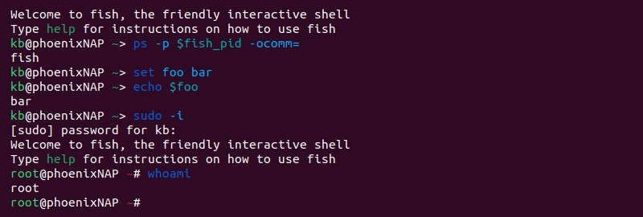

Slide 31
Features in the shell include:
Advanced suggestions/tab completion based on the current directory history.
Helpful syntax highlighting and descriptive error messages.
Web-based configuration.
Command history with search options.
The main drawback
However,
of fish is non-POSIX the developers aim to
compliance.
improve flawed designs from POSIX.

Slide 32


