Slide 1



Shell script examples

Slide 2
Shell script examples

Slide 3
This will produce the following result. It is important to note how echo -n works here. Here -n option lets echo avoid printing a new line character.
0
1 0
2 1 0
3 2 1 0
4 3 2 1 0
5 4 3 2 1 0
6 5 4 3 2 1 0
7 6 5 4 3 2 1 0
8 7 6 5 4 3 2 1 0
9 8 7 6 5 4 3 2 1 0

Slide 4
Here is a simple
#!/bin/sh
for var1 in 1 2 3 do
for var2 in 0 5 do
if [ $var1 -eq 2 -a $var2 -eq 0 ] then
break 2 else
echo "$var1 $var2"
fi done
done
example of nested for loop. This script breaks out of both loops if var1 equals 2 and var2 equals 0 −

Slide 5
Upon execution, you will receive the following result. In the inner loop, you have a break command with argument 2. This indicates that if a condition is met you should break out of the outer loop and ultimately from the inner loop as well.
1 0
1 5

Slide 6
Bash scripts may be used for many different things, such as running many commands at once, changing administrative tasks, automating procedures, etc. As a result, every Linux user should be knowledgeable about the basics of bash programming. You may learn the basics of bash programming from this lecture. Here, most of the commonly used bash scripting operations are shown using very simple examples.

Slide 7
#!/bin/bash valid=true count=1
while [ $valid ] do
Create a bash file with the name,
„while_example.sh‟, to know the use of the while loop. In the example, while loop will iterate 5 times. The value of the count variable will increment by 1 in each step. When the value of count variable will 5 then the while loop will terminate.
echo $count
if [ $count -eq 5 ]; then
break fi
((count++)) done

Slide 8

Run the file with the bash command.

Slide 9

The basic for loop declaration is shown in the following example. Create a file named „for_example.sh‟ and add the following script using for loop. Here, for loop will iterate for 10 times and print all values of the variable, counter in
single line.
#!/bin/bash
for (( counter=10; counter>0; counter-- )) do
echo -n "$counter "
done printf "\n"

Slide 10

Run the file with the bash command.
$ bash for_example.sh

Slide 11

„read‟ command is used to take input from the user in bash. Create a file named „user_input.sh‟ and add the following script for taking input from the user. Here, one string value will be taken from the user and display the value by combining other string value.
#!/bin/bash
echo "Enter Your Name" read name
echo "Welcome $name to LinuxHint"

Slide 12
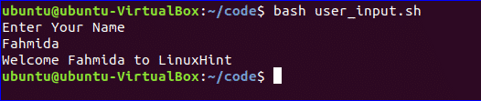
Run the file with the bash command.
$ bash user_input.sh

Slide 13
You can use if condition with single or multiple conditions. Starting and ending block of this statement is define by „if‟ and „fi‟. Create a file named „simple_if.sh‟ with the following script to know the use if statement in bash. Here, 10 is assigned to the variable, n. if the value of $n is less than 10 then the output will be “It is a one digit number”, otherwise the output will be “It is a two digit number”. For comparison, „-lt‟ is used here. For comparison, you can also use „-eq‟ for equality, „-ne‟ for not equality and „-gt‟ for greater than in bash script.

Slide 14


#!/bin/bash
n=10
if [ $n -lt 10 ]; then
echo "It is a one digit number" else
echo "It is a two digit number"
fi
$ bash simple_if.sh

Slide 15
Different types of logical conditions can be used in if statement with two or more conditions. How you can define multiple conditions in if statement using AND logic is shown in the following example. „&&‟ is used to apply AND logic of if statement. Create a file named
„if_with_AND.sh‟ to check the following code. Here, the value of username and password variables will be taken from the user and compared with „admin‟ and „secret‟. If both values match then the output will be “valid user”, otherwise the output will be “invalid user”.

Slide 16
#!/bin/bash
echo "Enter username" read username
echo "Enter password" read password
if [[ ( $username == "admin" && $password == "secret" ) ]]; then echo "valid user"
else
echo "invalid user" fi

Slide 17
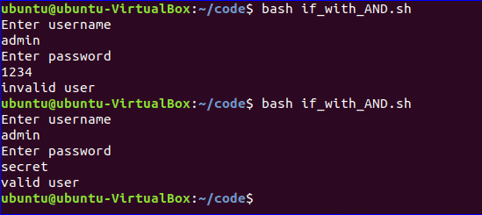
bash if_with_AND.sh

Slide 18
„||‟ is used to define OR logic in if condition. Create a file named „if_with_OR.sh‟ with the following code to check the use of OR logic of if statement. Here, the value of n will be taken from the user. If the value is equal to 15 or 45 then the output will be “You won the game”, otherwise the output will be “You lost the game”.

Slide 19
#!/bin/bash
echo "Enter any number" read n
if [[ ( $n -eq 15 || $n -eq 45 ) ]] then
echo "You won the game" else
echo "You lost the game" fi

Slide 20
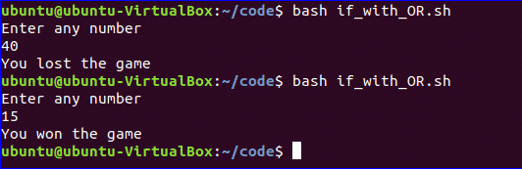
$ bash if_with_OR.sh

Slide 21
The use of else if condition is little different in bash than in other programming languages. „elif‟ is used to define else if condition in bash. Create a file named,
„elseif_example.sh‟ and add the following script to check how else if is defined in bash script.

Slide 22
#!/bin/bash
echo "Enter your lucky number" read n
if [ $n -eq 101 ];
then
echo "You got 1st prize"
elif [ $n -eq 510 ]; then
echo "You got 2nd prize"
elif [ $n -eq 999 ]; then
echo "You got 3rd prize"
else
echo "Sorry, try for the next time" fi

Slide 23
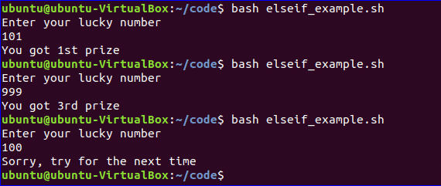
$ bash elseif_example.sh

Slide 24
Case statement is used as the alternative of if-else if- else statement. The starting and ending block of this statement is defined by „case‟ and „esac‟. Create a new file named, „case_example.sh‟ and add the following script. The output of the following script will be same to the previous else if example.

Slide 25
#!/bin/bash
echo "Enter your lucky number" read n
case $n in 101)
echo echo "You got 1st prize" ;;
510)
echo "You got 2nd prize" ;; 999)
echo "You got 3rd prize" ;;
*)
echo "Sorry, try for the next time" ;; esac

Slide 26
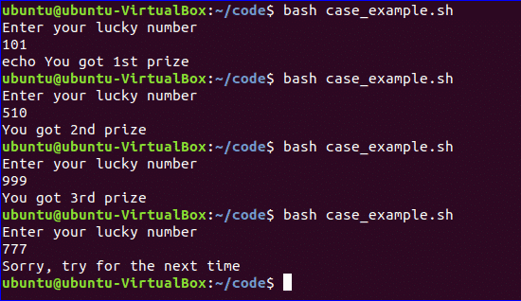
$ bash case_example.sh

Slide 27
Bash script
can read input from
command line languages. For
arguments like other programming
example, $1 and $2 variables are used to read first and second command line arguments. Create a file named “command_line.sh” and add the following script. Two argument values are read by the following script and print the total number of arguments and the argument values as output.

Slide 28

#!/bin/bash
echo "Total arguments : $#" echo "1st Argument = $1" echo "2nd argument = $2"
$ bash command_line.sh Linux Hint

Slide 29
How you can read command line arguments with names is shown in the following script. Create a file named, „command_line_names.sh‟ and add the following code. Here, two arguments, X and Y are read by this script and print the sum of X and Y.

Slide 30

#!/bin/bash
for arg in "$@" do
index=$(echo $arg | cut -f1 -d=) val=$(echo $arg | cut -f2 -d=) case $index in
X) x=$val;;
$ bash command_line_names X=45 Y=30
Y) y=$val;;
*) esac done
((result=x+y))
echo "X+Y=$result"

Slide 31
You can easily combine string variables in bash. Create a file named “string_combine.sh” and add the following script to check how you can combine string variables in bash by placing variables together or using „+‟ operator.

Slide 32

#!/bin/bash
string1="Linux" string2="Hint"
echo "$string1$string2" string3=$string1+$string2 string3+=" is a good tutorial blog site"
echo $string3
$ bash string_combine.sh

Slide 33
Like other programming languages, bash has no built- in function to cut value from any string data. But you can do the task of a substring in another way in bash which is shown in the following script. To test the script, create a file named „substring_example.sh‟ with the following code. Here, the value, 6 indicates the starting point from where the substring will start and 5 indicates the length of the substring.

Slide 34

#!/bin/bash
Str="Learn Linux from LinuxHint" subStr=${Str:6:5}
echo $subStr
$ bash substring_example.sh

Slide 35
You can do the arithmetical operations in bash in different ways. How you can add two integer numbers in bash using double brackets is shown in the following script. Create a file named „add_numbers.sh‟ with the following code. Two integer values will be taken from the user and printed the result of addition.

Slide 36
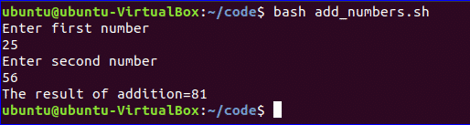
#!/bin/bash
echo "Enter first number" read x
echo "Enter second number"
read y
(( sum=x+y )) echo "The result of addition=$sum"
$ bash add_numbers.sh

Slide 37


