Slide 1
AWK Variables
Other available built-in awk variables are:
NR. Counts the number of input records (usually lines). The awk command perform the pattern/action statements once for each record in a file.
awk '{print NR,$0}' employees.txt

Slide 2
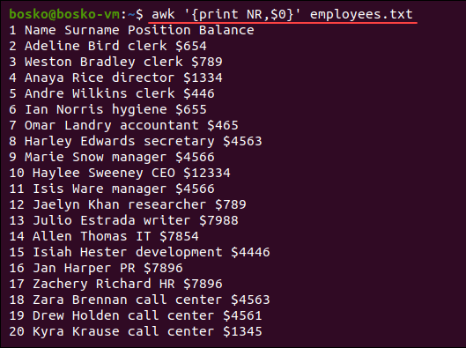
AWK Variables
Other available built-in awk variables are:
NR. Counts the number of input records (usually lines). The awk command perform the pattern/action statements once for each record in a file.
awk '{print NR,$0}' employees.txt

Slide 3
The command displays the line number in the output.
NF. Counts the number of fields in the current input record and displays the last field of the file.
For example:
awk '{print $NF}' employees.txt

Slide 4
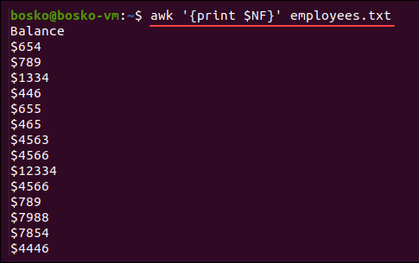
The command displays the line number in the output.
NF. Counts the number of fields in the current input record and displays the last field of the file.
For example:
awk '{print $NF}' employees.txt

Slide 5
FS. Contains the character used to divide fields on the input line. The default separator is space, but you can use FS to reassign the separator to another character (typically in BEGIN).
For example, you can make the etc/passwd file (user list) more readable by changing the separator from a colon (:) to a dash (/) and print out the field separator as well:
awk -FS 'BEGIN{FS=":"; OFS="-"} {print $0}' /etc/passwd

Slide 6
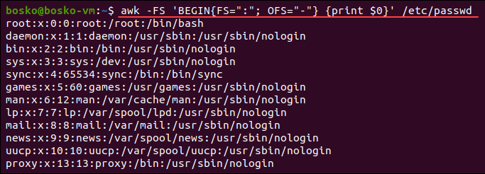
FS. Contains the character used to divide fields on the input line. The default separator is space, but you can use FS to reassign the separator to another character (typically in BEGIN).
\

Slide 7
RS. Stores the current record separator character. The default input line is the input record, which makes a newline the default record separator. The command is useful if the input is a comma- separated file (CSV).
awk 'BEGIN {FS="-"; RS=","; OFS=" owes Rs. "} {print $1,$2}'
debtors.txt

Slide 8
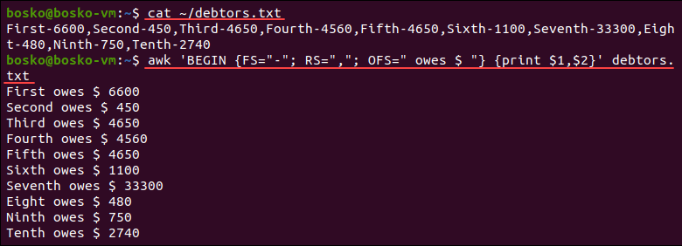
RS. Stores the current record separator character. The default input line is the input record, which makes a newline the default record separator. The command is useful if the input is a comma- separated file (CSV).
awk 'BEGIN {FS="-"; RS=","; OFS=" owes Rs. "} {print $1,$2}'
debtors.txt

Slide 9
grep & grep. The primary distinction between grep and egrep is that grep is a command that searches for content based on a provided regular expression and displays the matching lines, whereas egrep is a variation of grep that searches for content by using extended regular expressions to display the machining lines.

Slide 10
What is grep
The grep command allows the users to scan the documents and to display the result according to the given regular expression.
grep “test” example1.txt
This command displays all the lines that start with the word test, in the example1.txt file.

Slide 11
What is grep
grep “test” example1.txt example2.txt
This command will search the word test in both files and display the result.
grep “test” example1.*
This will find the example1 files with any format.

Slide 12
Following command display 2 lines after the given string “test”.
grep -A 2 “test” file1.txt
Similarly, the following command displays 3 lines before the given string “test”.
grep – B 3 “test” file1.txt
Those are few examples of grep command.
Overall, grep command allows searching the given regular expression and displaying the matching lines.

Slide 13
What is egrep
There are various grep implementations available in many operating systems. egrep is one of them. This variant uses extended regular expressions.
egrep “ab | bc” test1.txt.
This command will search the patterns ab, bc in the file test1.txt.

Slide 14
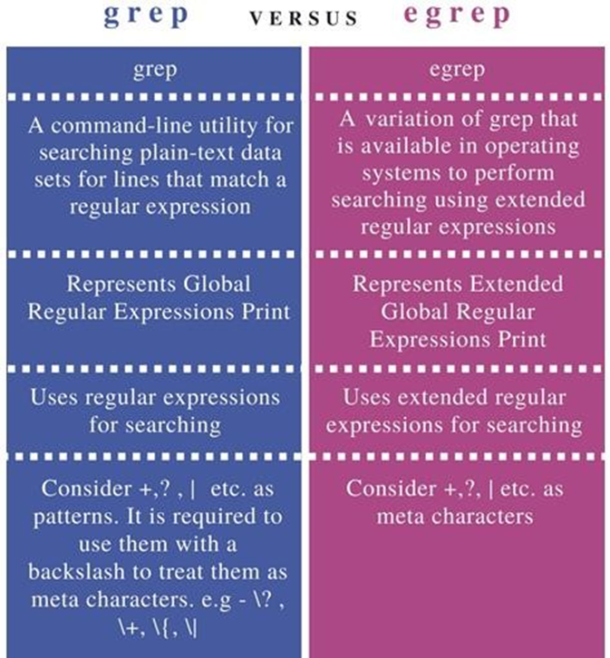

Slide 15
Sort uniq, wc, diff, cmp with Examples
Let's see the following examples of the sort and uniq command:
Remove repeated lines
count the number of occurrences of a word using(-c)
Display the duplicate using (-d) lines

Slide 16
Examples of uniq Command
Display the unique lines
Ignore characters in comparison (-s)
Ignore fields in comparison(uniq –f 2 file)

Slide 17
Examples of the cmp Command
Simple Comparison of Two Files.
Comparing Files after Skipping a Specified Number of Bytes.(-i)
Comparing the First “n” Number of Bytes of the Files.

Slide 18
Examples of the diff Command
Let's see the following examples of the diff command:
Using the “diff” Command without any Options
Using the “diff” Command to Produce the Output in the Context Mode(-c)
Using the “diff” Command to Produce the Output in the Unified Mode(-u)

Slide 19
Examples of the wc Command
Let's see the following examples of the wc command:
Display count information of a file
Display count information of multiple files
Display the number of lines in a file
Display the number of characters in a file

