Slide 1
Compress and uncompress (tar, gzip,
gunzip) with Examples

Slide 2
Compress and uncompress (tar, gzip, gunzip) with Examples

Slide 3
Compress - The compress tool will make an effort to make the named files smaller. A file with the extension will take its place. whereas maintaining the same ownership modes, change times, and modification times.
Uncompress- After files have been compressed using the compress tool, they can be returned to their original condition using the uncompress tool.

Slide 4
The most popular archiving tool in Linux systems is the GNU tar command (short for Tape ARchiver). The tar command can be used to create, extract, and list archive contents straight from the terminal. The tool is easy to use and offers a lot of beneficial features for managing backups, compressing data, and extracting a raw installation.
Tar Command Syntax
The tar command’s general syntax is:
tar <operation mode> <option(s)> <archive> <file(s) or location(s)>

Slide 5
Operation mode indicates which operation executes on the files (creation, extraction, etc.). The command allows and requires only one operation.
Options modify the operation mode and are not necessary. There is no limit on the number of options.
The archive is the file name and extension.
The file name(s) is a space-separated list for extraction or compression or wildcard matched name.

Slide 6
to use the
style, clustered together without any
There are
three possible syntax styles
operations and options:
1. Traditional dashes.
For example:
tar cfv <archive> <file(s) or location(s)>
2. UNIX short option style, using a single dash and clustered options:
tar -cfv <archive> <file(s) or location(s)>

Slide 7
Alternatively, a dash before each option:
tar -c -f -v <archive> <file(s) or location(s)>
3. GNU long-option style with a double-dash and a descriptive option name:
tar --create --file <archive> --verbose <file(s) or
location(s)>

Slide 8
All three styles can be used in a single tar command. Tar Command Examples
The examples below have the following requirements:
1. Create a directory named tar_examples and navigate to the directory:
mkdir tar_examples && cd tar_examples
2. Make another directory called files in tar_examples and enter that directory:
mkdir files && cd files

Slide 9
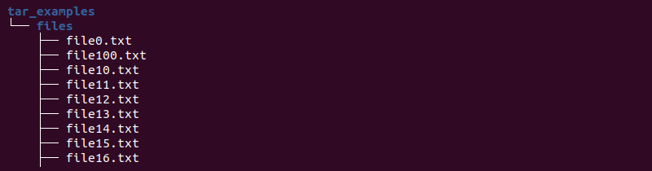
touch file{0..100}.txt
3. Create files to populate the files directory:
To return to the parent directory, use:
cd ..

Slide 10
gzip: The gzip utility will attempt to reduce the size of the named files. The file will be replaced by one with the extension .gz, while keeping the same ownership modes, change times and modification times.
gunzip: The gunzip utility will restore files to their original state after they have been compressed using the gzip utility.

Slide 11
$ls alert_CHECK.log
$gzip alert_CHECK.log
$ ls alert_CHECK.log.gz
$ls alert_CHECK.log.gz
$gunzip alert_CHECK.log.gz
$ ls alert_CHECK.log

Slide 12

The gzip command can be used with the tar command also to gzip the tar files. An example is shown below
tar gzip command
tar -cvf - file1 file2 | gzip > file.tar.gz

Slide 13

A similar gunzip command can be used with the tar command also to unzip the tar files. An example is shown below
tar gunzip command gunzip -c file.tar.gz|tar -xvf -

Slide 14
Both the utility compress and gzip compress the file i.e serve the same purpose
In general Compress will run faster and use less memory, but gzip will generally reach significantly higher levels of compression.
Compress is an old algorithm while gzip is the new one

Slide 15

Example-1:
To Decompress A File Using The "gunzip" Command:
$ gunzip myfilename.gz
output:
$ ls
myfilename.gz
$ gunzip myfilename.gz
$ ls
myfilename

Slide 16
Example-2:
Force A File To Decompress:
$ gunzip -f myfilename.gz
output:
$ ls
myfilename.gz
$ gunzip myfilename.gz
$ ls
myfilename

Slide 17
Example-3:
To keep both the compressed and decompressed file:
$ gunzip -k myfile.gz
output:
$ ls myfilename.gz
$ gunzip -k myfilename.gz
$ ls
myfilename myfilename.gz

Slide 18
Example-4:
To display compressed output:
$ gunzip -l myfile.gz
output:
$ gunzip -l myfilename.gz
compressed uncompressed_name
31
uncompressed ratio
0 0.0% myfilename

Slide 19
Example-5:
Decompressing Lots Of Files Recursively:
$ gunzip -r /tmp
output:
$ ls /tmp/
myfilename1.gz myfilename.gz
$ gunzip -r /tmp/
$ ls /tmp/
myfilename myfilename1

Slide 20
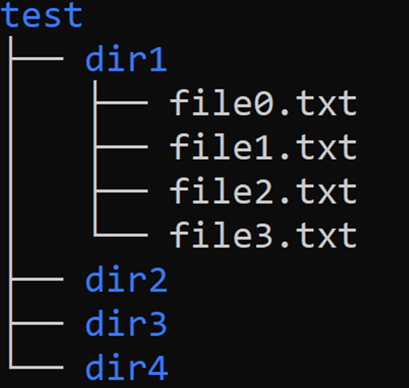
Practise:
Currently you are in the /home/usr perform the following task:
Print the content of file “file1.txt”.
Give execute permission of file3 to user
Read 3 lines of bottom of “file3.txt”
Write commands to open the empty file “file0.txt” in vi editor. And write the
difference between vi and vim editor on it.

Slide 22




