Slide 1
Discover New Actors in Politics
Group Members : Aditi Ghamandi (axg165830)
Nishigandha Rane (nnr160030)
Nilesh Pharate (nxp161330)
Nikita Kothari (nrk160530)
Devendra Lad (dvl160030)

Slide 2
Motivation & Challenges
New political actor discovery and updating into the dictionary is tedious task.
This work is usually done by humans, which is costly.
If actor discovery part is automated and its output is provided to humans, it will improve the processing in terms of time.
Set of actions or words is finite and can be easily matched to a fixed ontology.
The set of Source/Target Actors could be large and constantly increasing with rise in new political actors around the globe.
This led us to implement a framework which could consume latest events happening around the globe, filter political events, perform a semantic analysis and get new political actor recommendations out of it and re-verify the probability of actor being political using Machine Learning.

Slide 3
Problem statement
To implement a framework which will use Big Data getting produced worldwide and create new political actor discoveries.
We have implemented a system using existing paper of Prof Dr. Latifur Khan in which news produced all around the world are streamed into a framework and strongly ranked political actors are generated and recommended as a feedback to a human.
As an addition, we also implemented a double verification using Bag of Words, Naïve Bayes approach to increase the quality of actor predictions the framework makes.

Slide 4
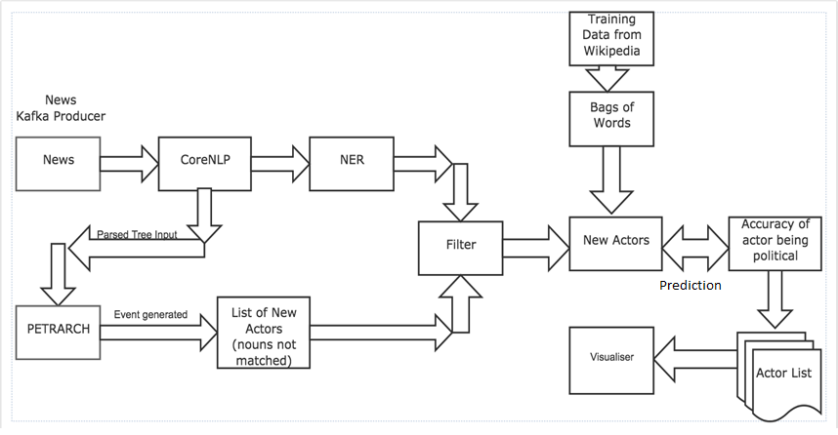
Framework Architecture

Slide 5
Spark Streamed- Petrarch, NLP Model
Approach
News articles are captured in real time using the Spark setup with Kafka consumer.
These news articles are then sent over to Stanford CoreNLP to give us the parsed tree representation and NER (Named Entity Relationship).
The parsed tree representation is then sent over to Petrarch which would generate events and then generate nouns (actors). These nouns are compared with the ones already present in CAMEO dictionary to now return those nouns not contained in CAMEO.
These nouns and NER are then filtered to get our final list of actors.
This list of newly found political actors will then be sent for secondary actor verification (Machine Learning module) using external knowledge base (Wiki data).

Slide 6
Machine Learning Module
Approach
We are using external knowledge base Wikipedia for strengthening the prediction given to us by Petrarch.
We built Naïve Bayes model using existing Political/ Non-political actors from the CAMEO dictionary.
We collect information like career, posts, organizations, political parties for the known actors. Then, we use Bag of Words approach to compute TF/IDF vector, which in turn fed to strengthen Naïve Bayes model.
Whenever a new actor is predicted, we make TF/IDF vector of his/her wiki data and try to get the probability score from our Naïve Bayes Model.
If actor isn’t present on Wikipedia, the module will not contribute to his score.

Slide 7
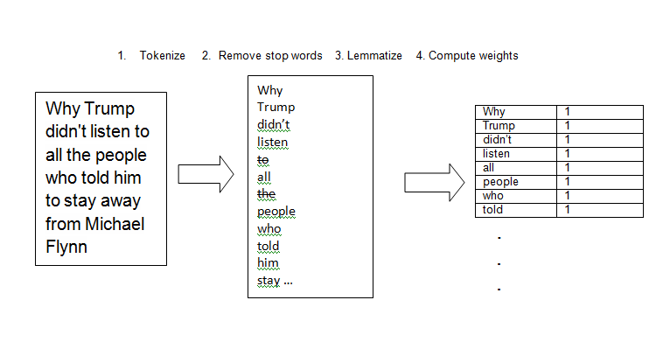
Bag of Words

Slide 8
Experiments and Results
Secondary Actor Verification (Machine learning System)
We built model with Wikipedia data of 100 actors with a blend of political and non-political
We tested built model using K-fold cross validation with different K and the results were as follows
Even though the Accuracy for Actors with Wiki page is high, this method will not be valid for actors who don’t have wiki page created with their name yet.
Train/Test Split | Accuracy
90:10 | 100
80:20 | 100
70:30 | 96.66
60:40 | 97.5

Slide 9
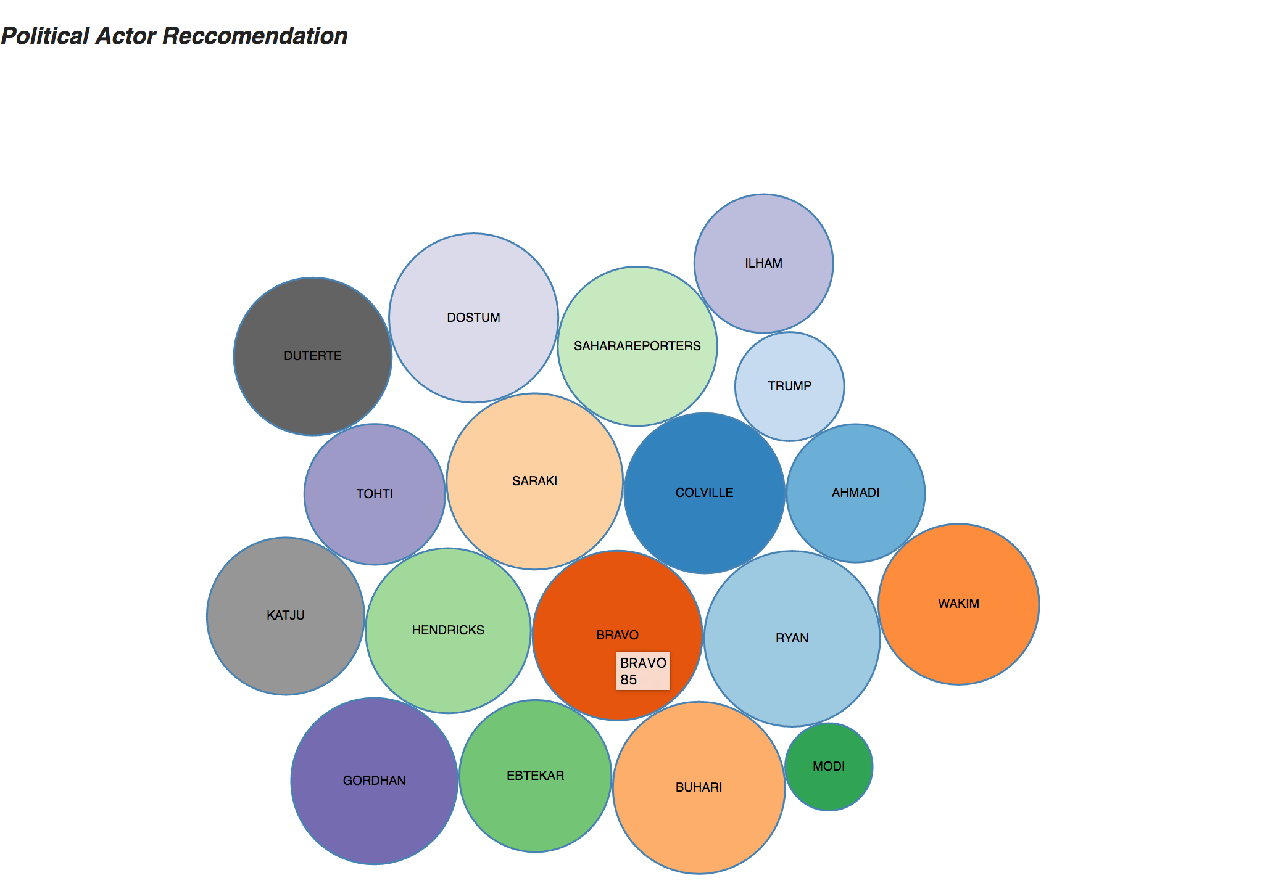
Visualization Results (Bubble Chart)

Slide 10
Future Work and Conclusion
The project can be extended for actors in other fields as well; e.g.: movies, education, sports, etc.
Currently we are using wiki as external knowledge base, more credible source relevant to field could be added to the framework
Currently we are building Naïve Bayes classifier but we can experiment and choose different classifiers for secondary Actor verification.
We can also use bagging and try to increase the accuracy in secondary Actor verification system.

Slide 11
Thank you.

