Slide 1




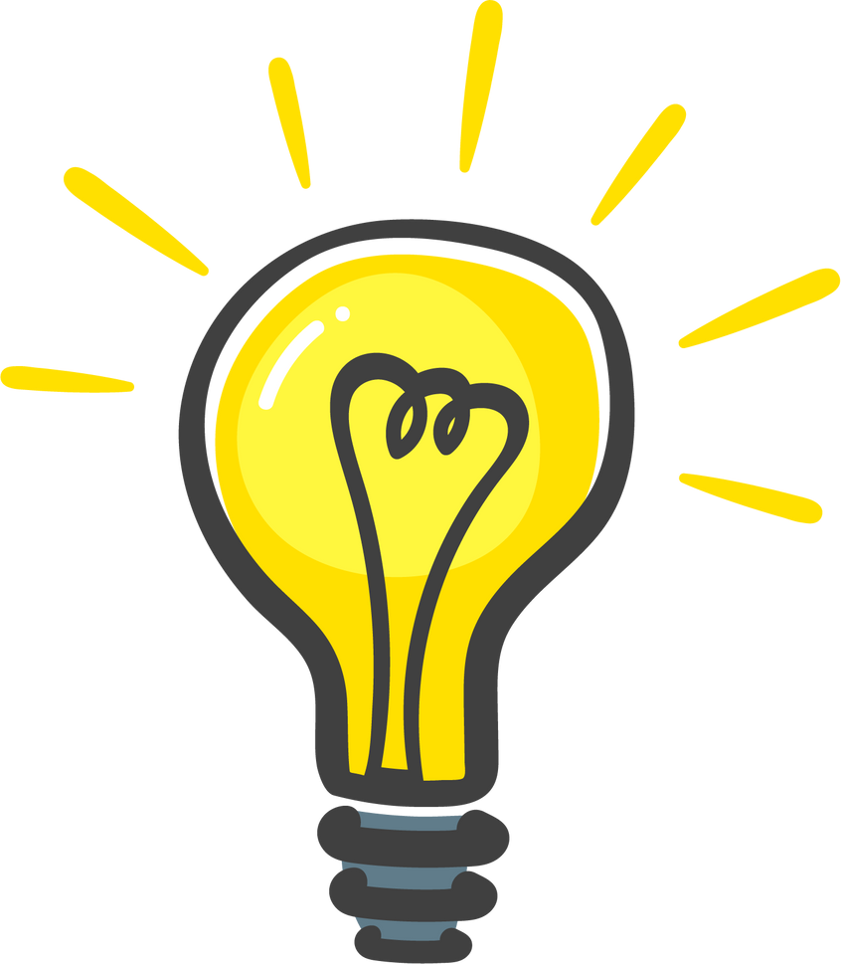


Digital Brainstorm
Singular not Plural
(Aditi Goyal)

Slide 2

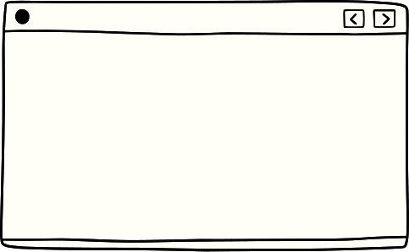



Contents
01
02
03
Introduction
The Problem
Idea/Solution
04
05
06
Business/ Revenue model
Uniqueness
Tech Stacks

Slide 3

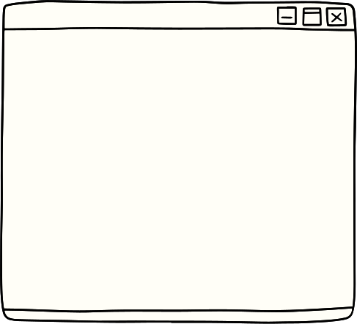


Introduction
Greetings everyone, I'm Aditi Goyal, a new comer to the world of hackathons but bursting with enthusiasm & creativity. I've recently became a part of KRMU family in the field of Btech in CSE with AI ML, and I'm excited to immerse myself in this incredible learning experience. While I may not be a coding expert, I've dipped my toes into the world of coding & have managed to pick up a few basics along the way with the help of my mentor and chatgpt. I'm here to learn and explore more about coding, collaborate with talented individuals & contribute my unique perspective to our projects.

Slide 4
In today's fast-paced world finding time for self-care can be a challenge with busy schedules and numerous responsibilities. However, even small, regular self-care practices can make a significant difference in maintaining your well-being. It might help to schedule specific moments for self-care and prioritize activities that rejuvenate you. Remember, taking care of yourself is essential for your overall health and productivity. So, I have come up with an idea which can make this really important task easy for you without making any burden on you!
Problem which is often ignored but essential

Slide 5
I'm thrilled to share my very 1st project idea with you. I've come up with an idea that aims to make self-care a priority. Imagine an app that sends you gentle reminders anytime throughout the day, encouraging you to take just 15 to 30 minutes for yourself. Whether it's a moment of mindfulness, a short walk, a quick creative break, you can listen to music, dance, you can pursue any of your hobby, or you can do an important task that was on a pause for a very long time. This app is designed to help us all find those precious moments for self-renewable. I'm excited to delve into this project& create a tool that promotes well- being in our busy lives. I know it's not a very out of the box type of idea but for a start I think it's commendable ! Thank you for your attention and I'm looking forward to your thoughts & feedbacks!!
The Idea/ Solution

Slide 6
It's Uniqueness
The uniqueness of the app lies in its proactive approach towards promoting self-care and mindfulness. By sending regular reminders throughout the day, it encourages users to prioritize their well-being and take breaks, which can lead to reduced stress, increased productivity, and improved mental health. Additionally, the app could offer personalized suggestions for activities based on the user's preferences and interests, making it a tailored and adaptable tool for enhancing daily life.

Slide 7

Business/
Revenue Model
04. Data Analytics: If users opt-in, you could gather anonymized data about their self-care habits and preferences. This data could be valuable to researchers or wellness organizations, who might be willing to pay for insights.
05. Premiumn Content: Create premium self-care content like in-depth articles, expert interviews, or exclusive video content. Offer this content through a subscription model or one-time purchases.
06. Branded Partnerships: Collaborate with influencers, therapists, or wellness experts to offer their services directly through the app. Users could book virtual sessions or access exclusive content for a fee.
07. White Labeling: If the app gains popularity, you could license its technology and branding to other wellness-related companies, allowing them to offer a similar app under their own branding.
08. Donations: Include a donation feature where users can contribute to support the app's development and maintenance. This could work particularly well if your app aligns with a cause.
01
Freemium Model: Offer a basic version of the app for free, with limited features and a certain number of reminders. Then, provide a premium version with advanced features, customization options, and unlimited reminders at a monthly or yearly subscription fee.
02
Affiliate Partnerships: Partner with wellness and self-care brands to promote their products or services through your app. You could earn a commission for every user who makes a purchase through your app's affiliate links.
03
Corporate Partnerships: Collaborate with companies to offer your app as part of their employee wellness programs. They could sponsor the app for their employees, creating a revenue stream for you while providing a valuable tool for employee well-being.

Slide 8
Tech Stacks
-User Interface design: dobe XD, Figma, or Sketch for designing app interfaces.
CSS frameworks like Bootstrap or Material-UI for styling.
-Local Data Storage: SQLite for storing data locally on the device.
SharedPreferences (Android) or UserDefaults (iOS) for simple key-value storage.
-Synchronization and Backend Communication:
RESTful APIs for communication between the app and backend. GraphQL for efficient data fetching and updates.
-Location Services: Integration with the device's GPS for location-based reminders.Google Maps API or Mapbox for mapping functionalities.
-Calendar Integration: Google Calendar API or Apple CalendarKit for integrating with users' existing calendars.
-Task Management: Libraries like Moment.js for handling date and time calculations. Trello-like board views for managing tasks.
-Analytics and Monitoring: Google Analytics or Firebase Analytics for tracking user interactions. Crashlytics or Sentry for monitoring app crashes and errors.
-Payment Integration: Stripe or PayPal for in-app payments and subscriptions.
-Accessibility: Implement accessibility features for users with disabilities.
-Frontend: React Native or Flutter for cross-platform mobile app development.
Swift (iOS) and Kotlin (Android) for native app development.
-Backend: Node.js with Express.js for a lightweight backend.
Ruby on Rails for rapid development
Django or Flask (Python) for a robust backend.
01
02
-Database: PostgreSQL for relational data.
MongoDB for NoSQL data.
-Authentication: Firebase Authentication for an easy and secure authentication solution.
-Push Notifications: Firebase Cloud Messaging (FCM) for push notifications.
Apple Push Notification Service (APNs) for iOS.
03
-Cloud Hosting: Amazon Web Services (AWS) or Google Cloud Platform (GCP) for scalable infrastructure.
-Version Control: Git and platforms like GitHub or GitLab for version control.

Slide 9


Thank you

