Slide 1


Banking Loan & Financial Transaction Automation Testing
CAPSTONE PROJECT

Slide 2


OBJECTIVES
User Login
Loan Application
Transfer of Funds between Accounts.
Transaction History

Slide 3
PROBLEM STATEMENT
Manual verification of banking transactions, EMI schedules, and loan approvals is not scalable. A well-structured automation testing framework is required to validate loan applications, EMI generation, interest calculations, and fund transfers.

Slide 4
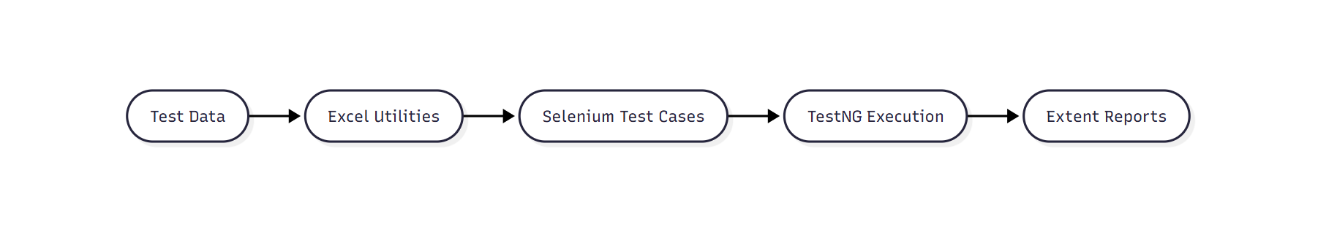
IMPLEMENTATION FLOW

Slide 5
TEST CASES

Slide 6
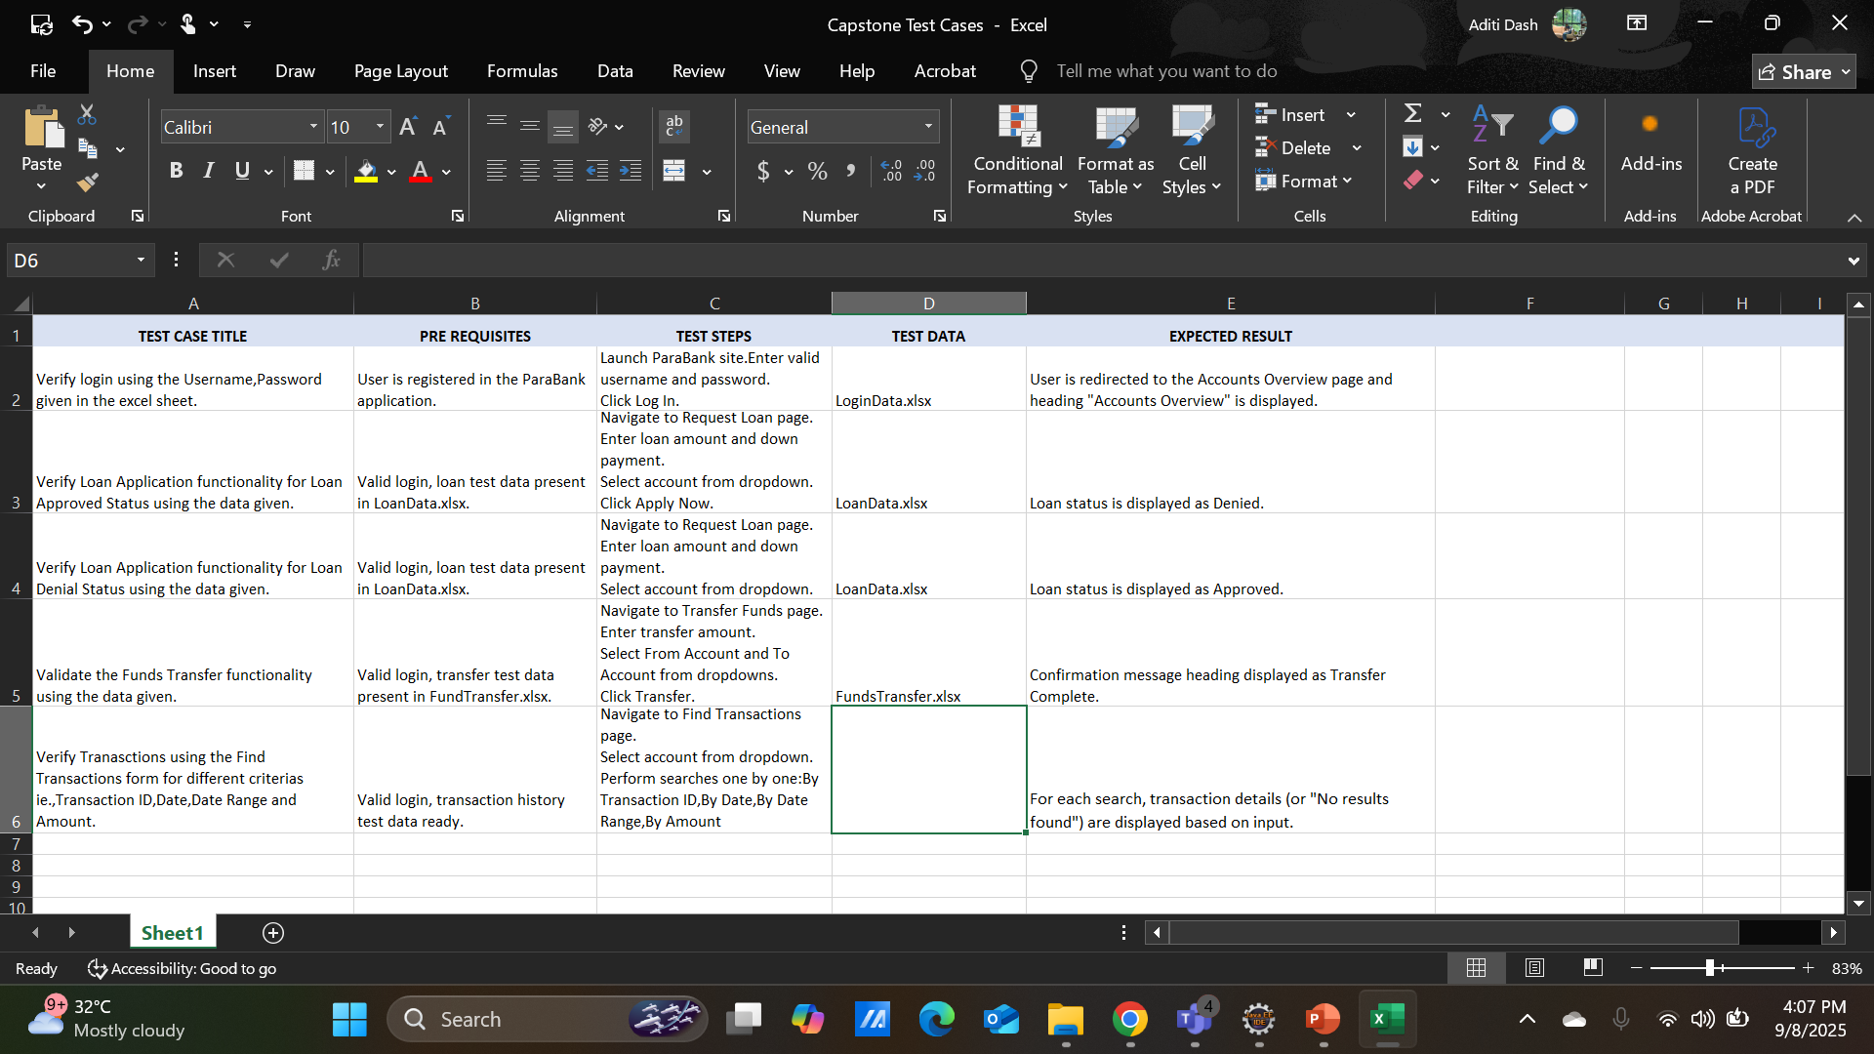

Slide 7
RESULTS
Automation significantly reduced execution time.
Achieved higher test coverage for repetitive workflows.
Identified gaps in data stability for Parabanks demo site.

