Slide 1
CONVERTING SHAPES INTO LOOP

Slide 2
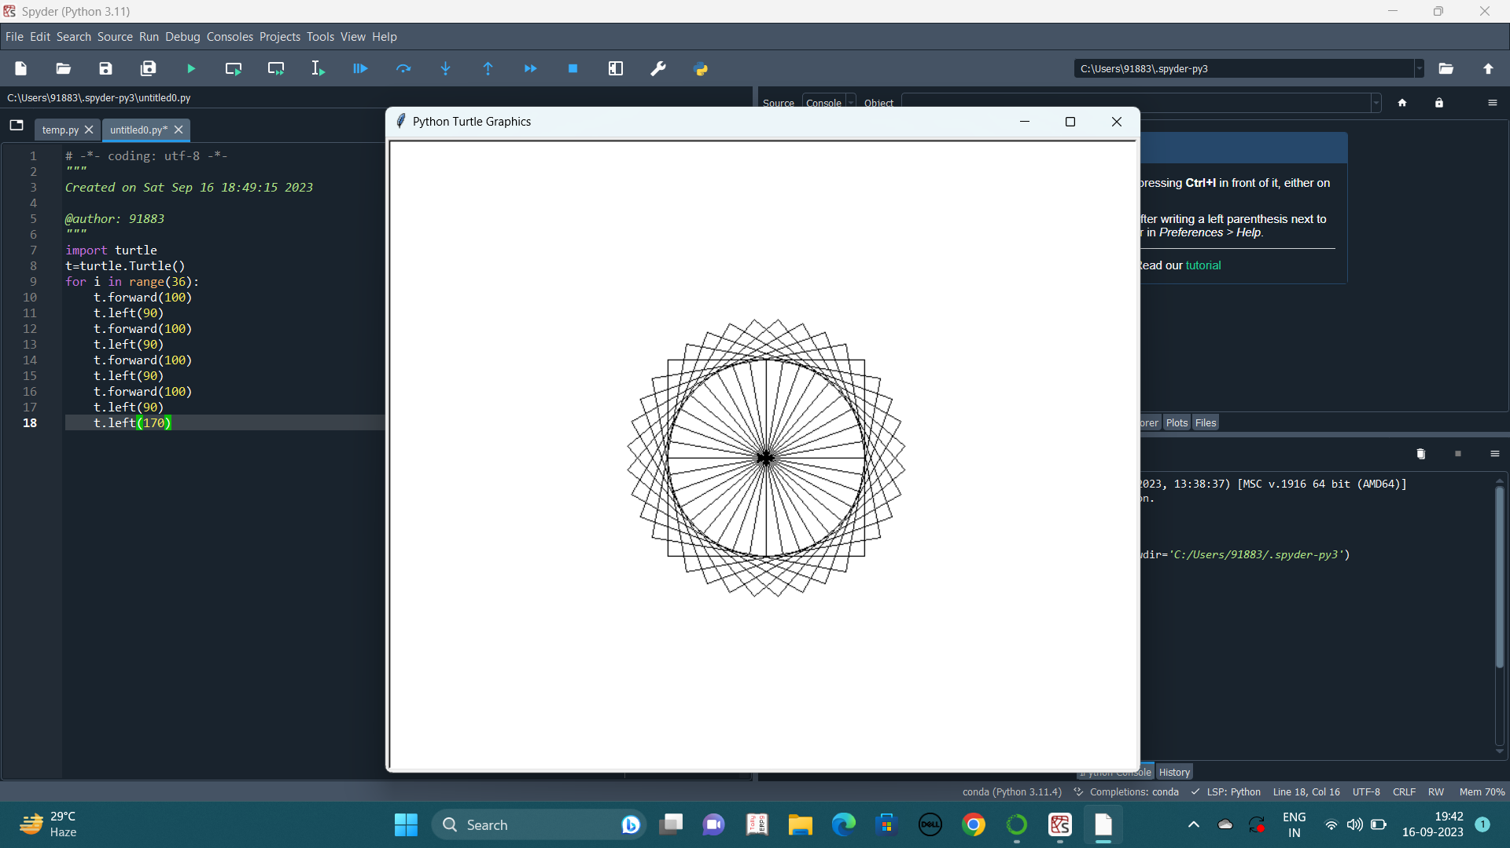
SQUARE LOOP

Slide 3
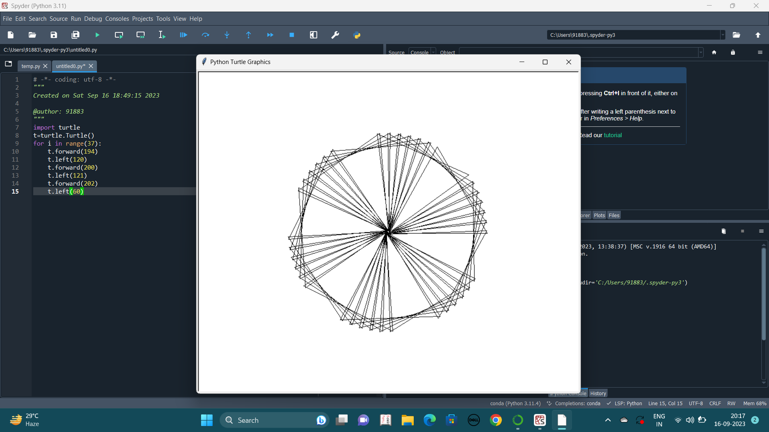
TRIANGLE LOOP

Slide 4
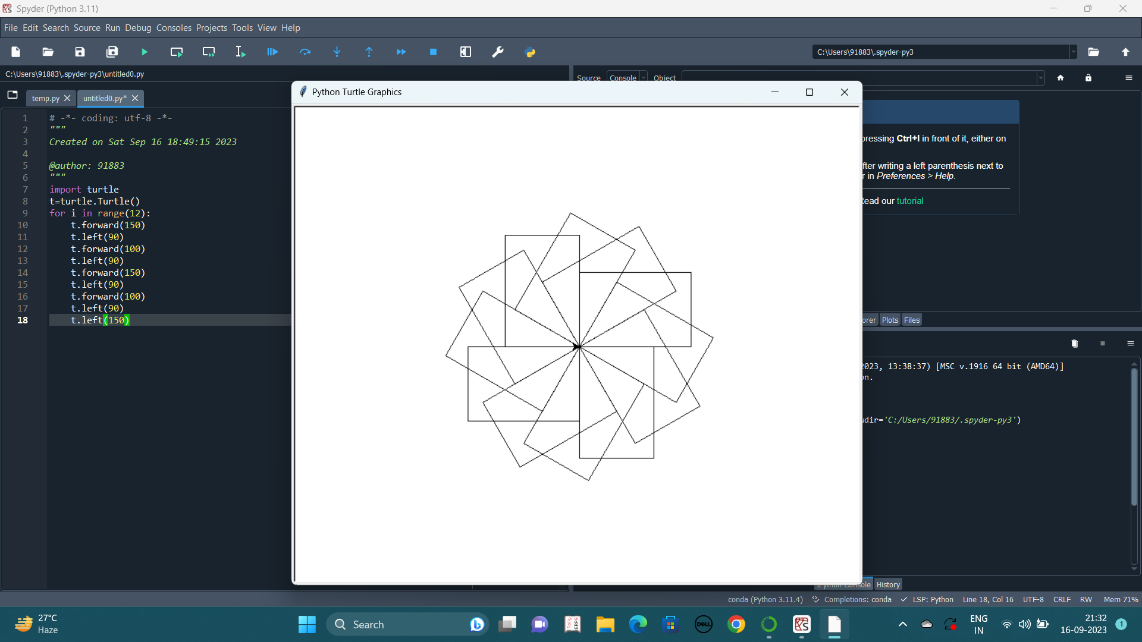
RECTANGLE LOOP

Slide 5
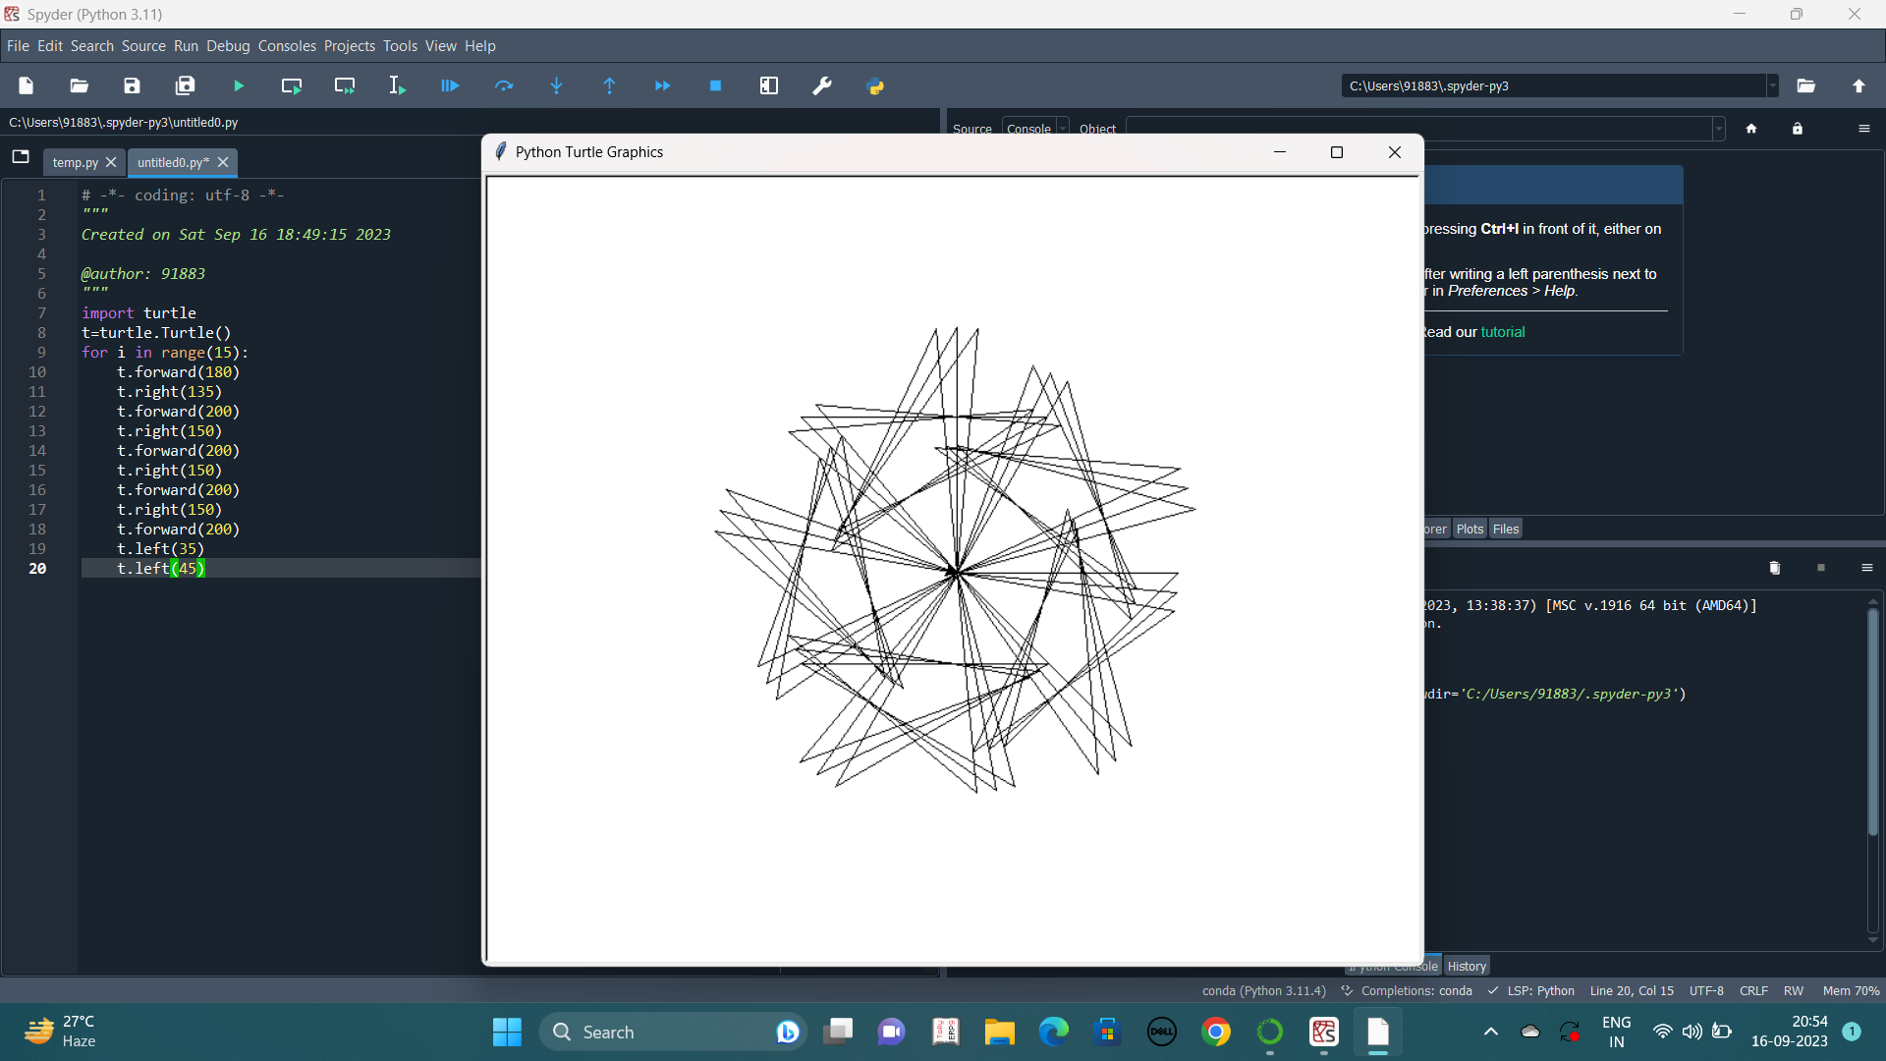
STAR LOOP

Slide 6
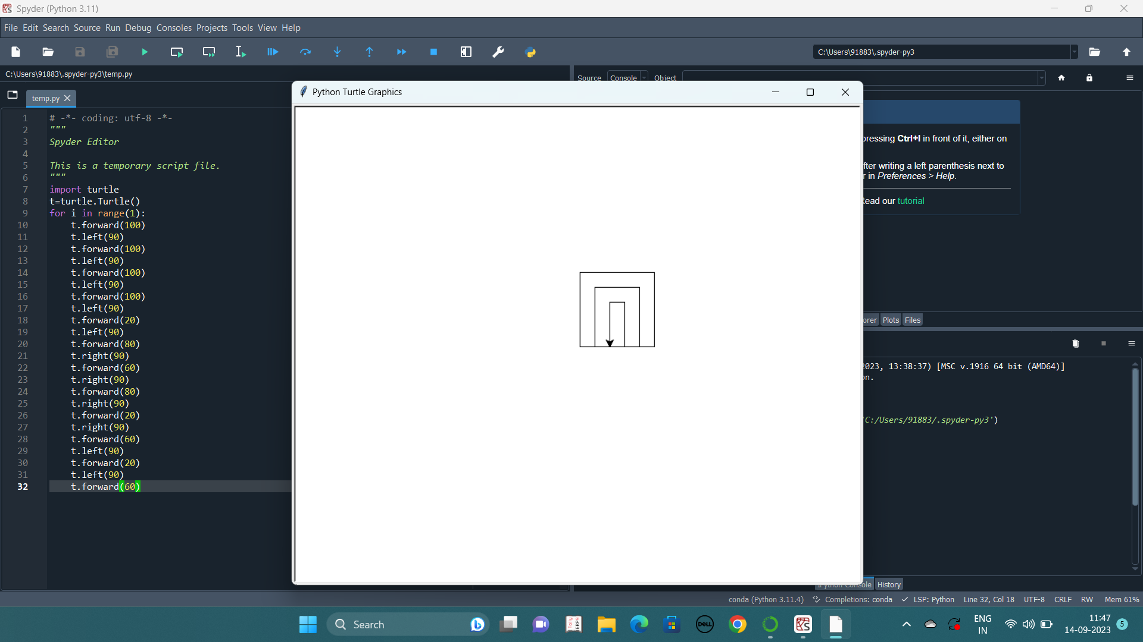
ARCHWAY LOOP

