Slide 1
MAKING SHAPES BY USING PYTHON CODING

Slide 2
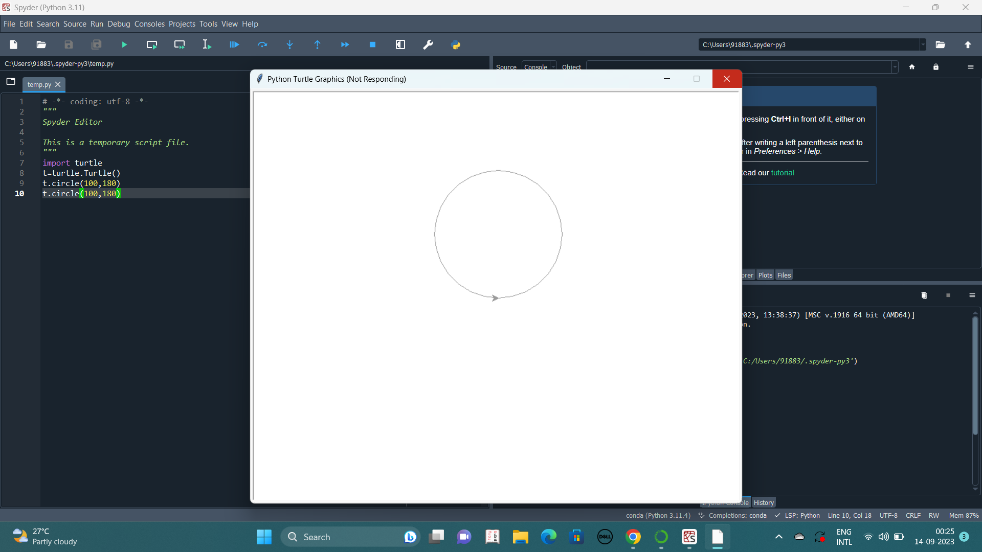
CIRCLE

Slide 3
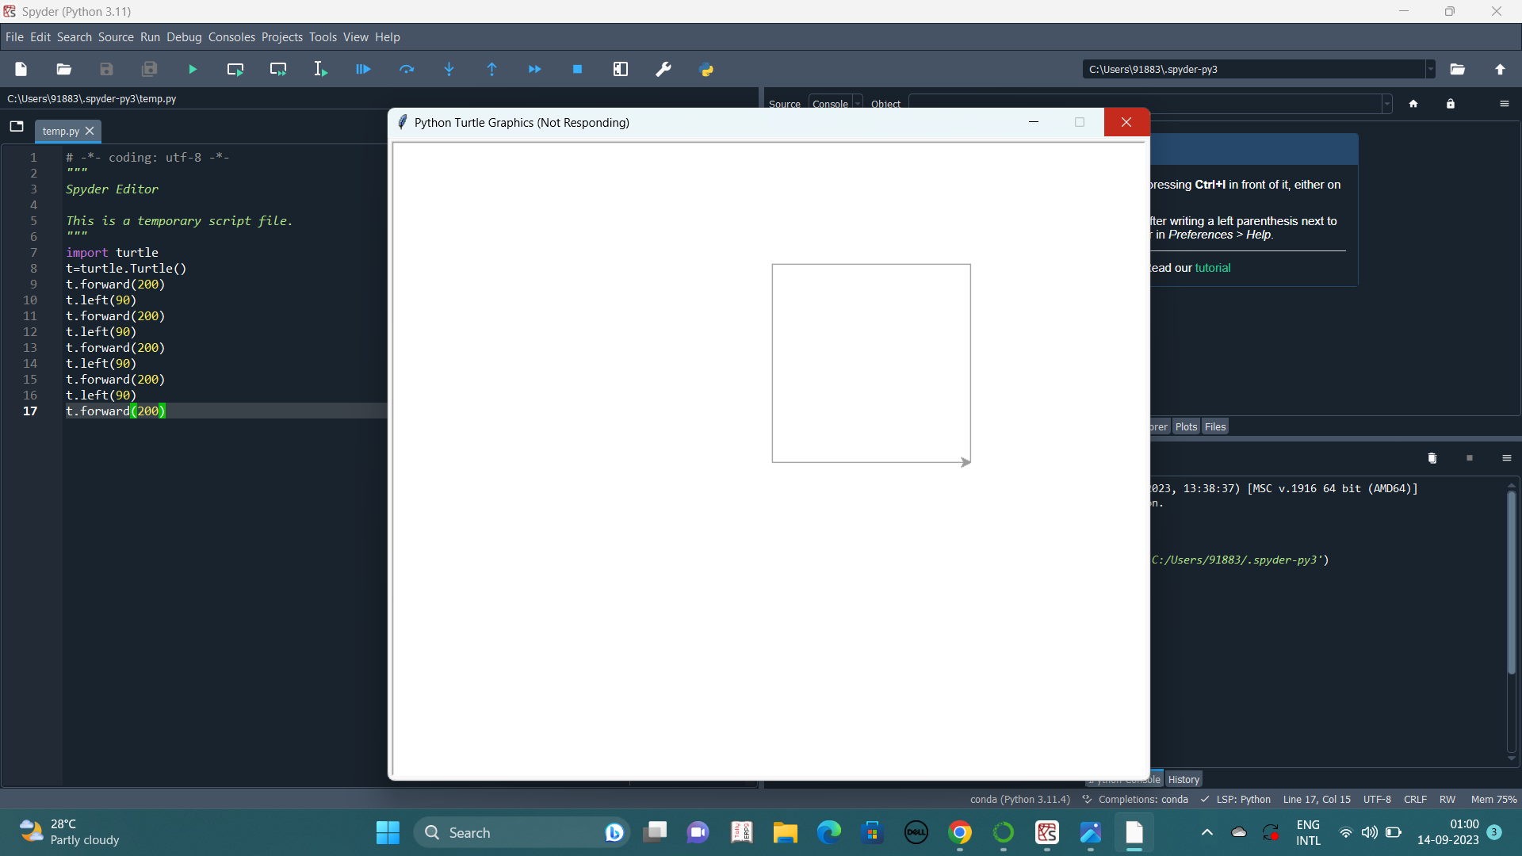
SQUARE

Slide 4

RECTANGLE

Slide 5
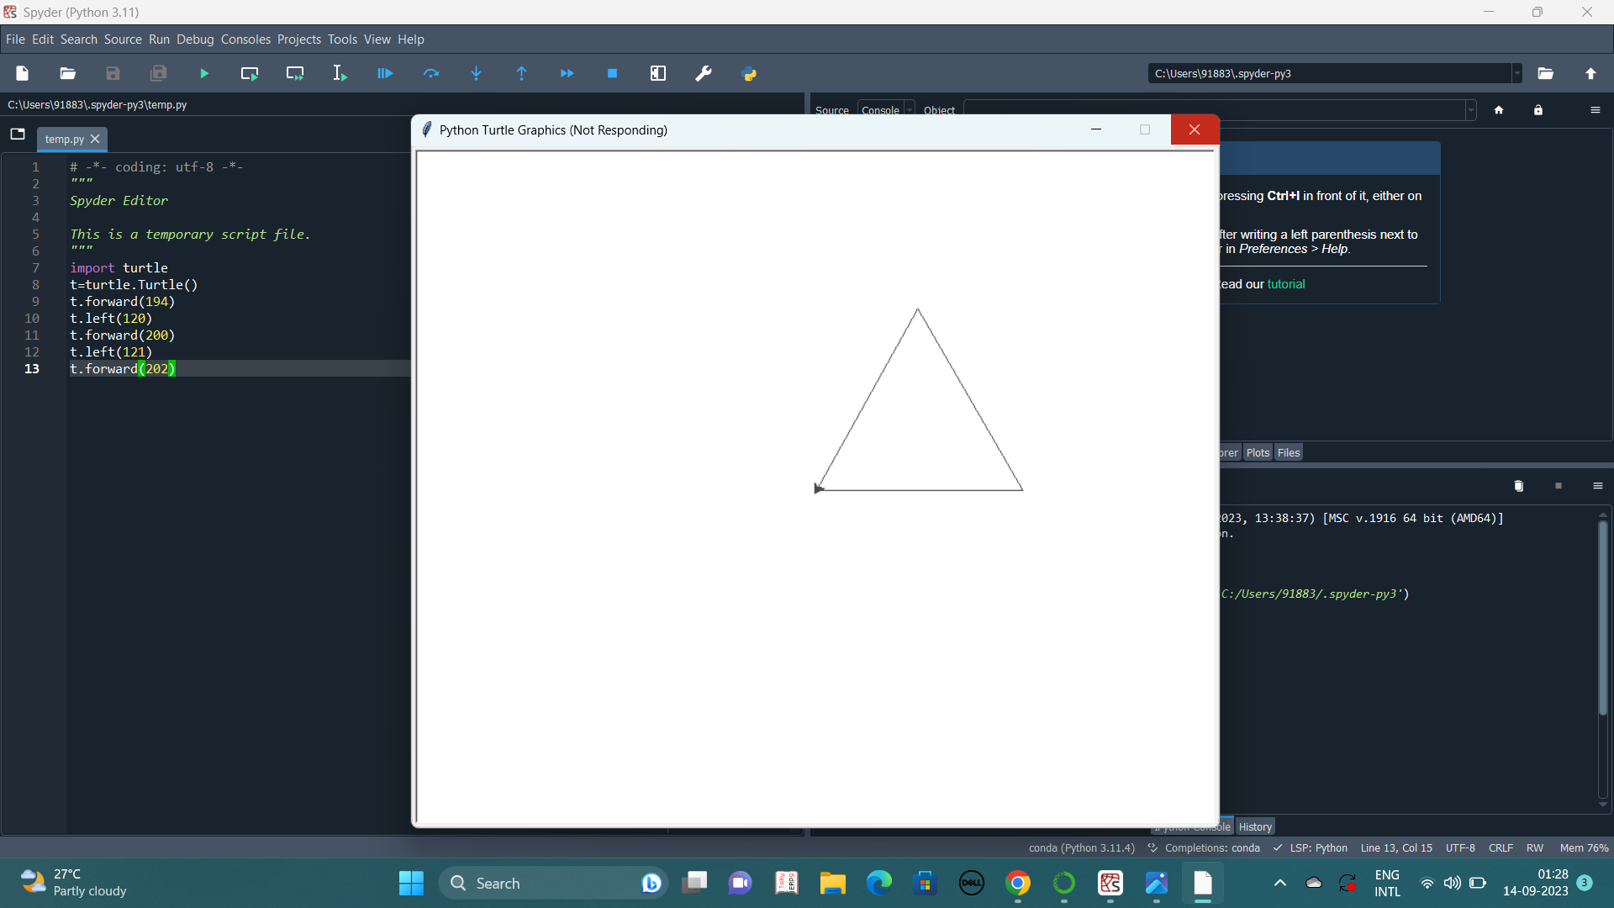
TRIANGLE

Slide 6

RIGHT ANGLE TRIANGLE

Slide 7

STAR

Slide 8

TRIANGLE UNDER CIRCLE

Slide 9
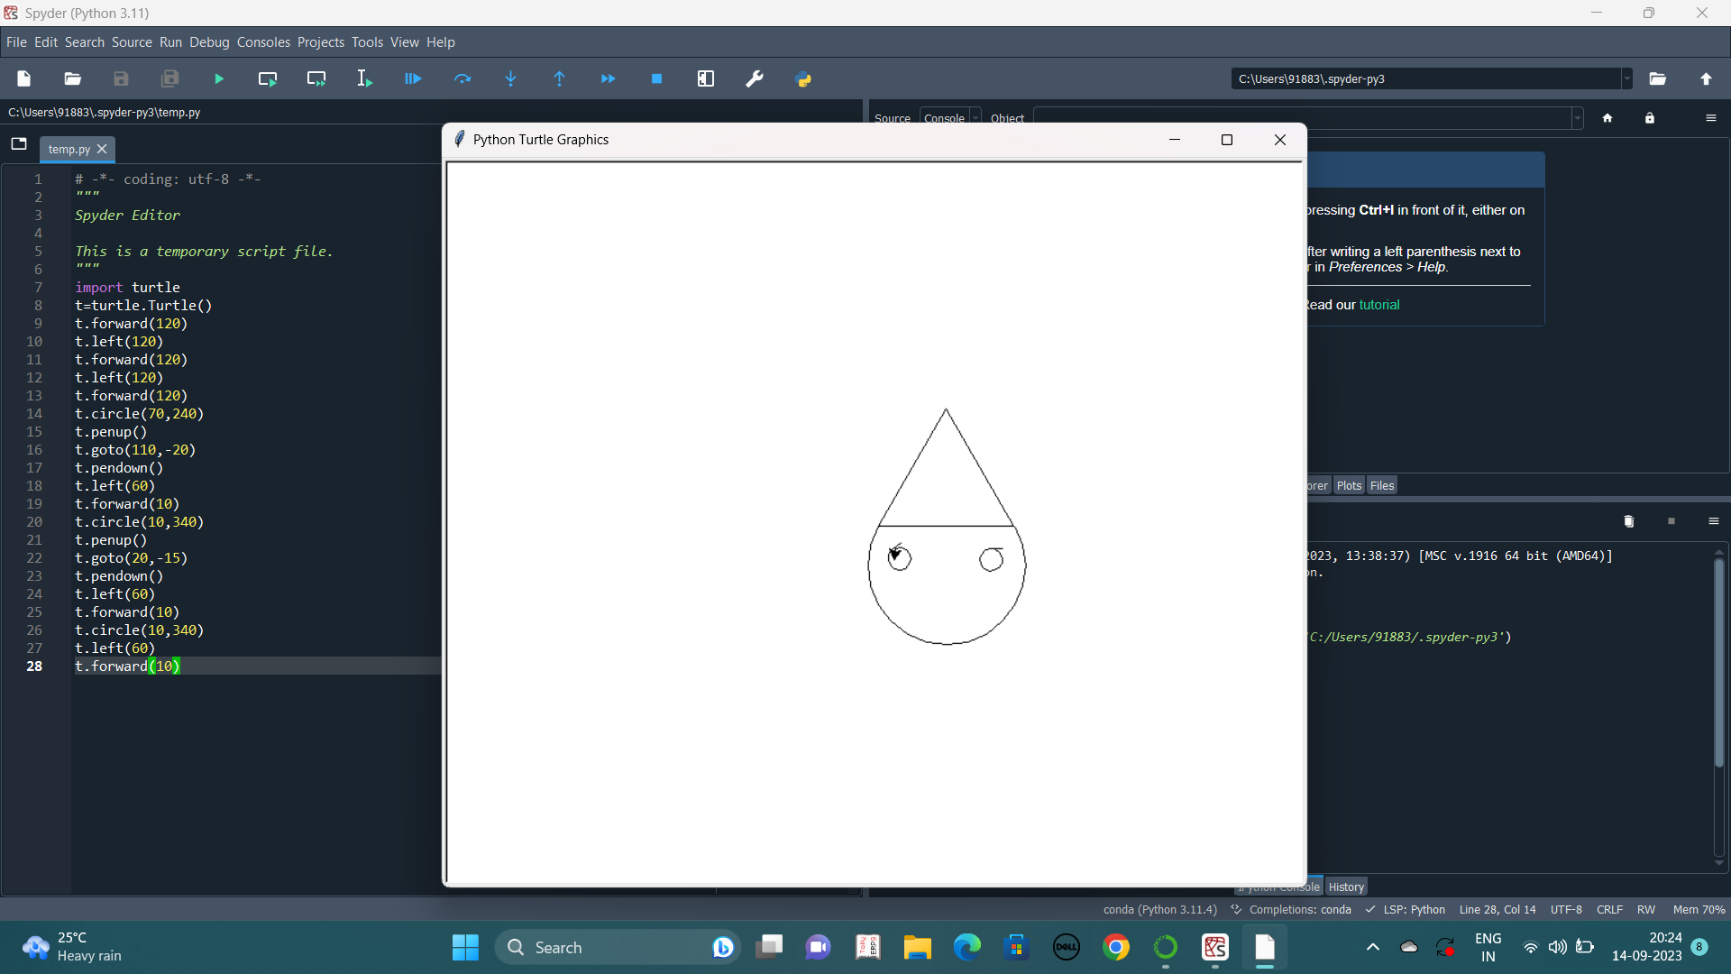
CONE

Slide 10
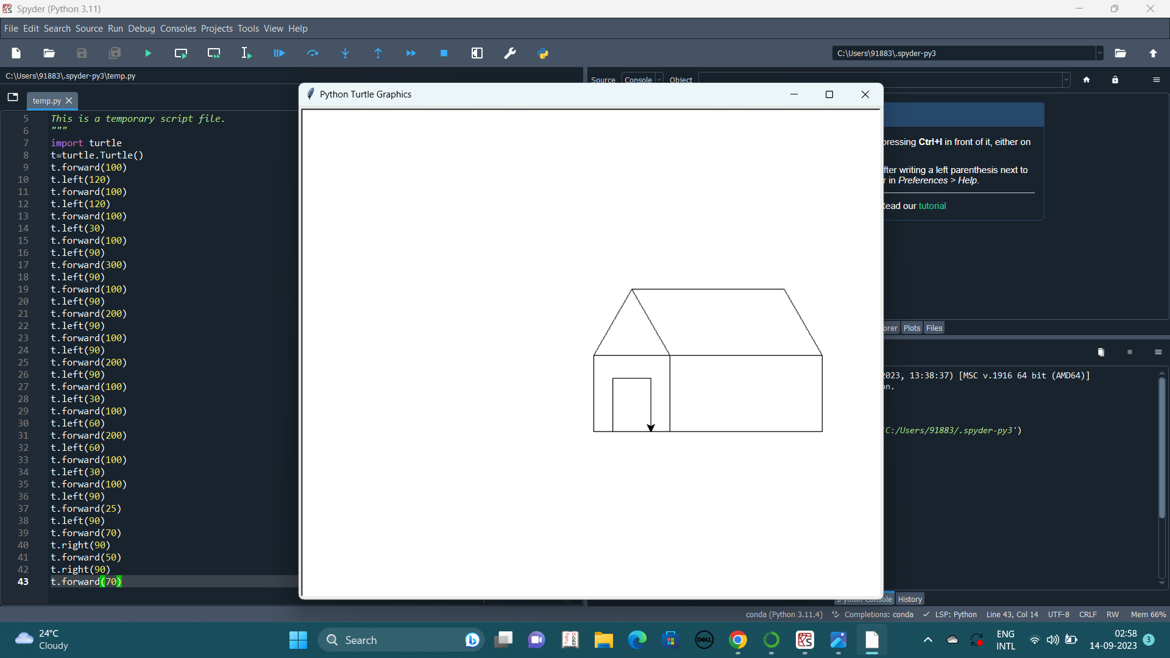
HUT

Slide 11

PENTAGON

Slide 12
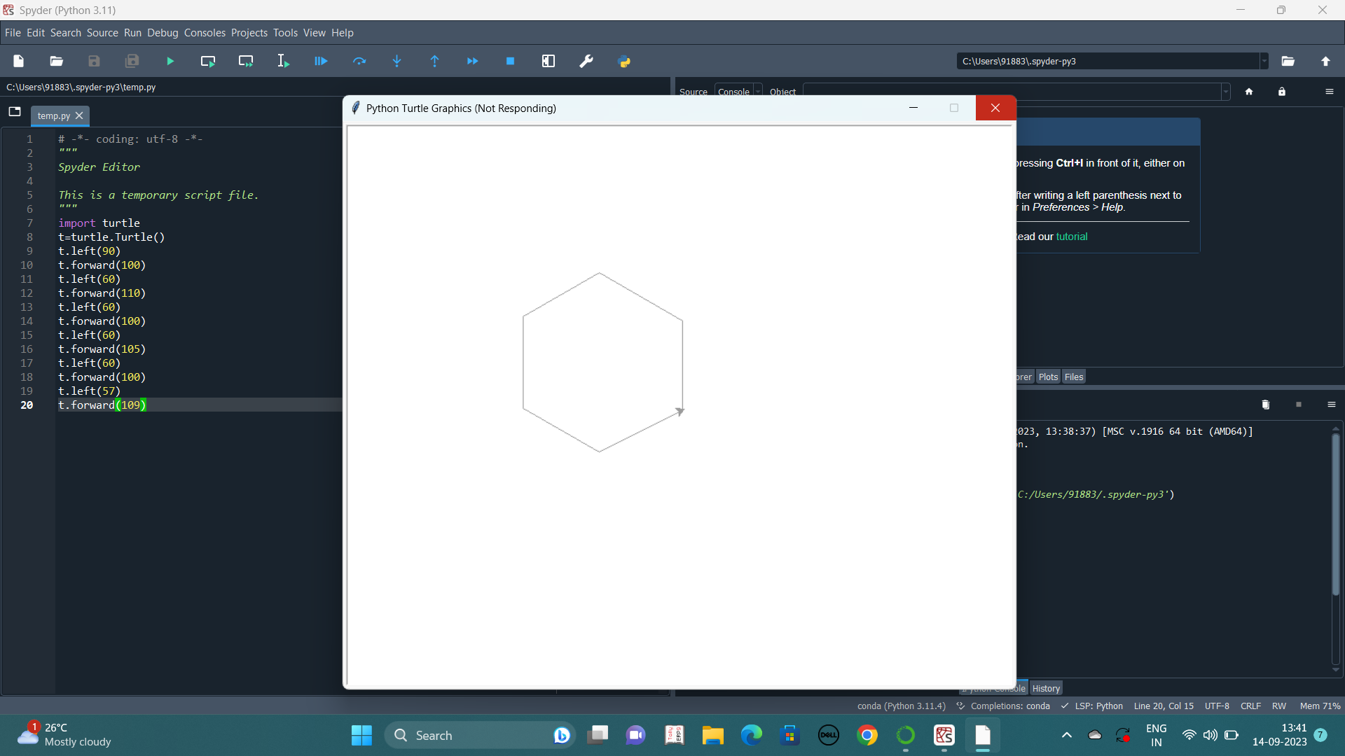
HEXAGON

Slide 13
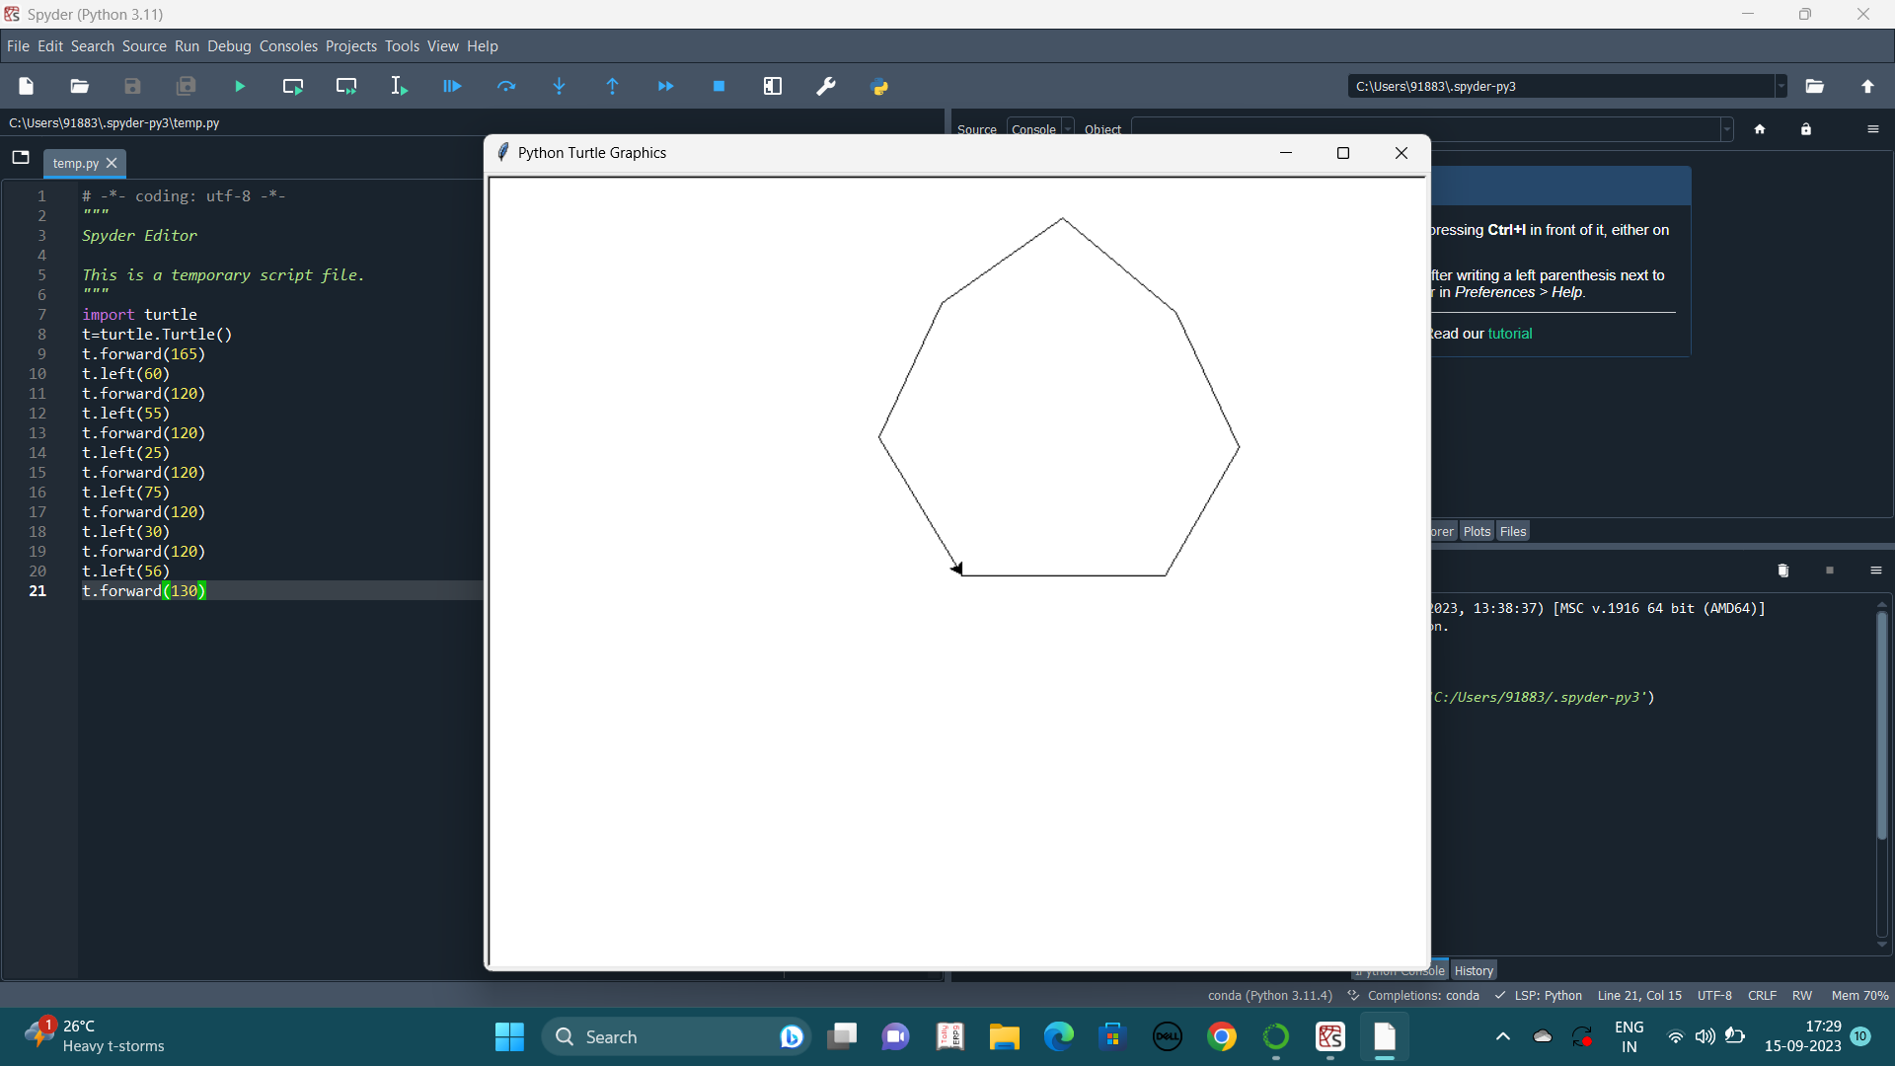
HEPTAGON

Slide 14

OCTAGON

