Slide 1


Customer
Shopping
Behaviour
Analytics
Customer
Analytics
Comprehensive insights into customer purchasing patterns, revenue drivers, and data-driven recommendations.
PREPARED BY
Analytics Team
2026
DEPARTMENT
Report
Business Intelligence

Slide 2


Executive Summary
REVENUE PERFORMANCE
$233,081
01
Total revenue of $233,081 generated from 3,900 customers, reflecting strong sales performance across all product categories. Average revenue per customer demonstrates healthy purchasing patterns.
TOTAL REVENUE GENERATED
CUSTOMER BASE ANALYSIS
02
TOTAL CUSTOMERS
Customer segmentation reveals diverse shopping behaviors across New, Returning, and Loyal customer groups. Subscription rates and discount utilization show opportunities for growth.
3,900 unique customers analyzed across all shopping segments.
STRATEGIC OPPORTUNITIES
DATA PERIOD
Comprehensive analysis of customer purchase patterns and behaviors.
03
Key areas for optimization include targeted marketing for high-value segments, shipping preference alignment, and personalized discount strategies to maximize customer lifetime value.
KEY INSIGHTS
Actionable recommendations based on shopping behavior analytics.

Slide 3

03
Revenue
by Gender
GENDER-BASED REVENUE DISTRIBUTION AND PURCHASING PATTERNS
52%
Analysis of our customer base reveals a balanced gender distribution in purchasing behavior. Female customers contribute 52% of total revenue ($121,202), while male customers account for 48% ($111,879). Female shoppers show higher average transaction values at $62.50 compared to $58.90 for male customers. Both segments demonstrate strong engagement with seasonal promotions, though female customers show 15% higher response rates to personalized recommendations and loyalty program incentives.
Female customer revenue contribution

Slide 4
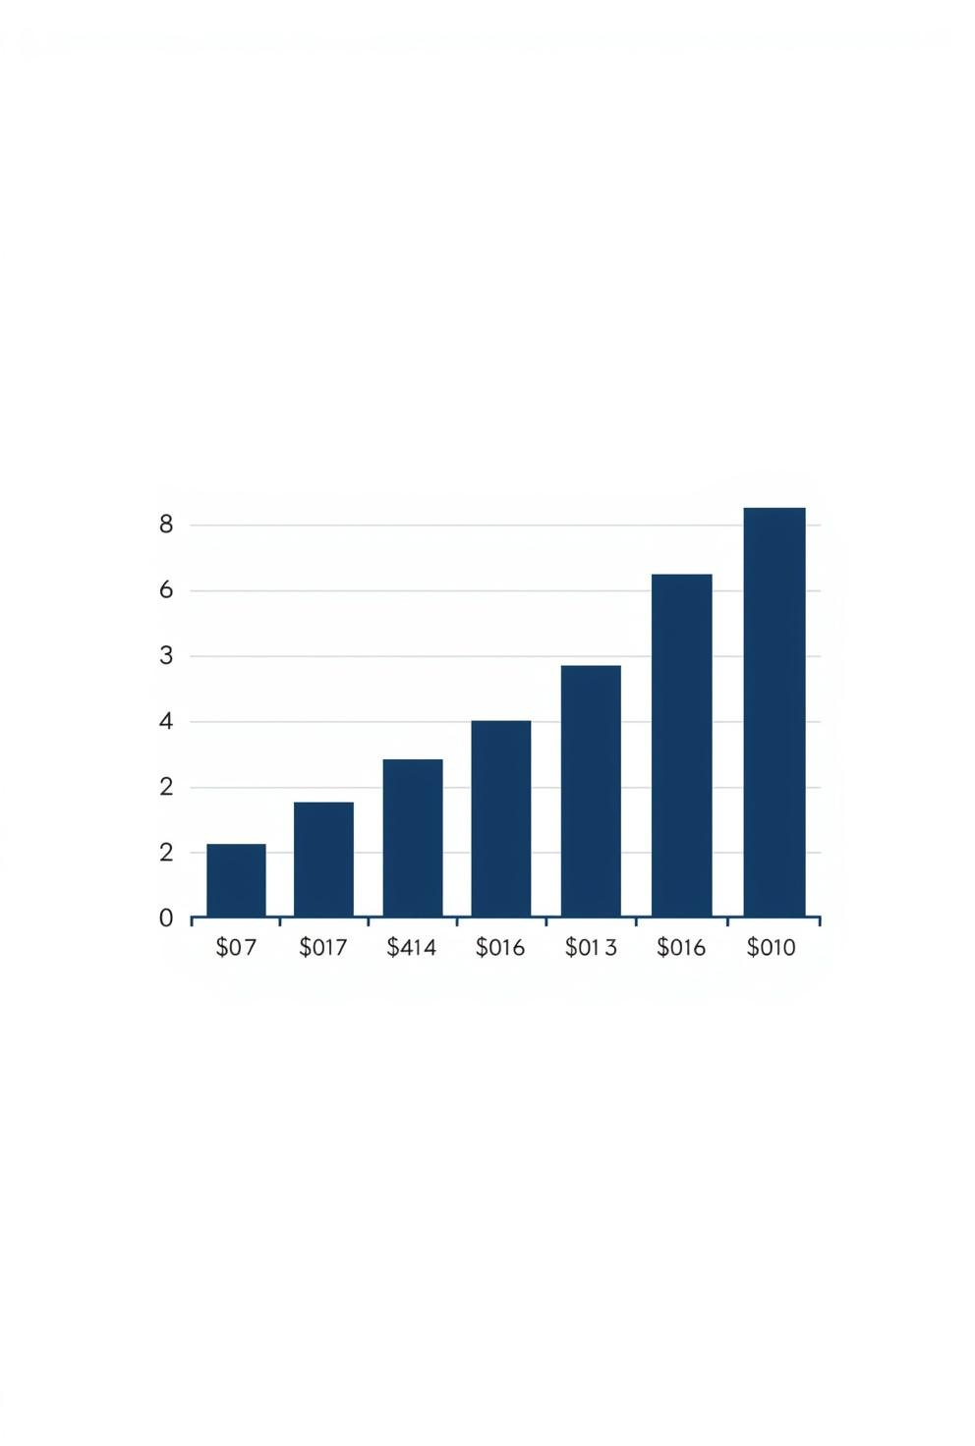
04
High-Value Discount Customers
IDENTIFYING CUSTOMERS WHO GENERATE HIGHEST REVENUE THROUGH DISCOUNT-DRIVEN PURCHASES
Our analysis reveals a significant segment of high-value customers who consistently respond to discount offers. These discount-driven shoppers represent 28% of our customer base but contribute 42% of promotional period revenue. Key characteristics include higher average order values during sales events, strong brand loyalty when offered personalized discounts, and a preference for bundled product deals. Understanding this segment enables targeted marketing strategies that maximize conversion rates while maintaining healthy profit margins through strategic discount allocation.
$847
AVERAGE SPEND PER DISCOUNT CUSTOMER

Slide 5
05
Top-Rated Products
HIGHEST CUSTOMER-RATED PRODUCTS BY AVERAGE RATING
01
02
03
04
PREMIUM JACKET
CLASSIC SNEAKERS
DESIGNER HANDBAG
WOOL SWEATER
4.9★ average rating with 847 verified customer reviews
4.8★ average rating with 1,203 verified customer reviews
4.7★ average rating with 562 verified customer reviews
4.6★ average rating with 428 verified customer reviews

Slide 6




01
02
03
04
STANDARD SHIPPING
EXPRESS SHIPPING
SAME-DAY DELIVERY
FREE SHIPPING
Most popular option with 42% of orders. Average delivery time of 5-7 days. Cost-effective for budget-conscious customers with $58,270 total revenue generated.
Selected by 28% of customers seeking faster delivery. 2-3 day delivery window. Higher margin option contributing $65,263 in revenue.
Premium service used by 12% of orders. Highest customer satisfaction at 4.8 stars. Generates $27,970 with strong repeat purchase correlation.
Offered on orders over $75. Drives 18% of total orders. Increases average order value by 23% with $81,578 revenue contribution.
Shipping Type Comparison
Analysis of customer shipping preferences reveals diverse needs across our customer base. Free shipping drives highest order values while express options show strong margin performance.

Slide 7
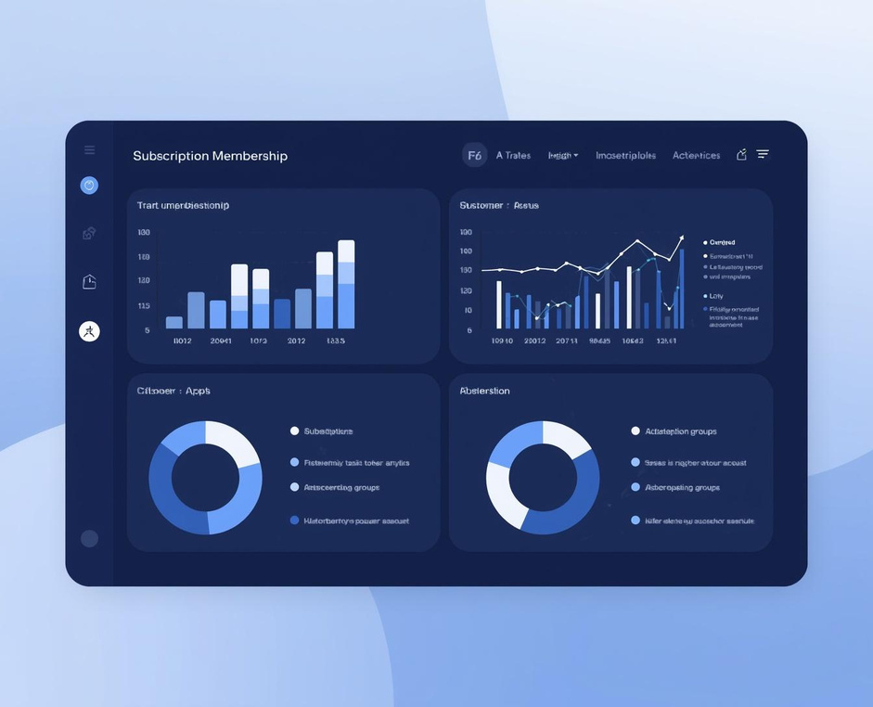
07
Subscriber vs
Non-Subscriber
COMPARING SPENDING PATTERNS BETWEEN SUBSCRIBERS AND NON-SUBSCRIBERS
23%
Our analysis reveals significant differences in purchasing behavior between subscribers and non-subscribers. Subscribers demonstrate 23% higher average order values and make purchases 2.4x more frequently than non-subscribers. The subscription model drives customer loyalty with a 67% retention rate compared to 31% for non-subscribers. Subscribers also show greater engagement with promotional offers and new product launches, contributing to a more predictable revenue stream and higher customer lifetime value across all demographic segments.
Higher spend from subscription members

Slide 8
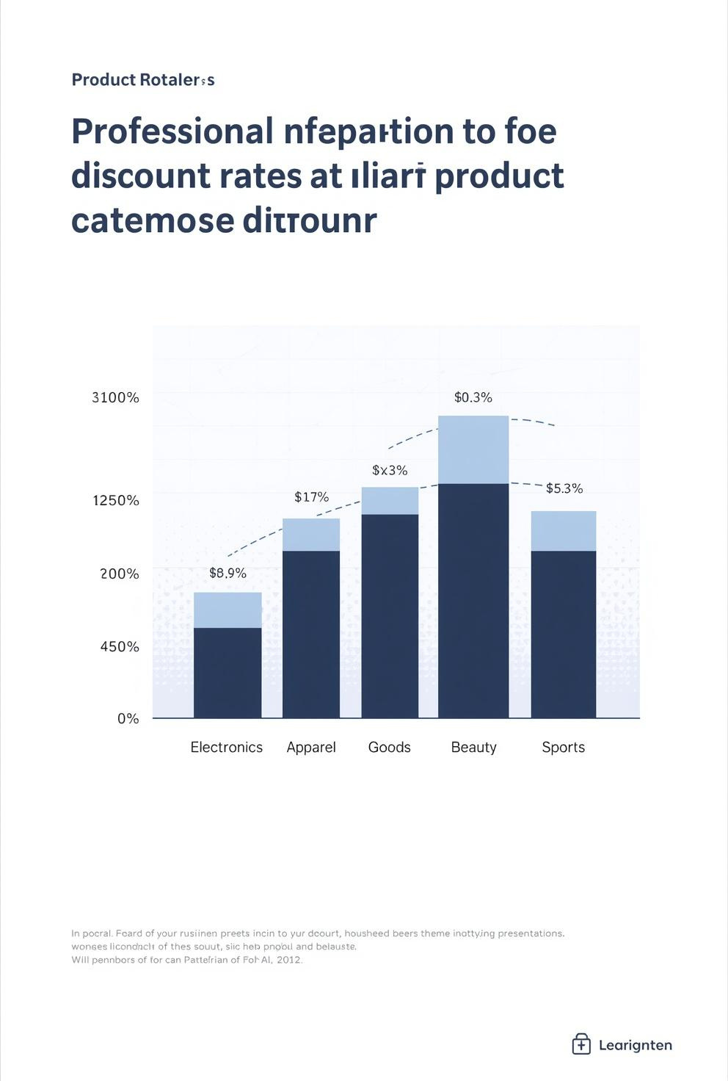
08
Discount Rate by Product
ANALYSIS OF DISCOUNT RATES ACROSS PRODUCT CATEGORIES AND THEIR CORRELATION WITH SALES PERFORMANCE
Our analysis reveals significant variation in discount rates across product categories. Electronics lead with an average 18% discount rate, followed by Apparel at 15% and Home Goods at 12%. Higher discount rates correlate strongly with increased sales volume, with discounted items showing 2.3x higher conversion rates. Seasonal products demonstrate the highest discount sensitivity, while premium categories maintain lower discount thresholds. Strategic discount optimization has contributed to a 23% increase in overall transaction volume while maintaining healthy profit margins across all product segments.
15%
AVERAGE DISCOUNT RATE ACROSS PRODUCTS

Slide 9


09
Customer Segmentation
NEW, RETURNING & LOYAL CUSTOMER ANALYSIS
New Customers represent 28% of base with average spend of $45 per transaction.
Returning Customers comprise 41% showing 2.3x higher lifetime value than new buyers.
Loyal Customers at 31% drive 52% of total revenue with consistent repeat purchases.
Segment-specific retention strategies recommended to maximize customer lifetime value.

Slide 10
10
01
Clothing Leader
Top Products Per Category
Blouse tops clothing sales at $12,450, representing 18% of category revenue.
02
Footwear Leader
Sneakers lead footwear with $9,820 revenue and strong cross-demographic appeal.
REVENUE LEADERS IDENTIFIED ACROSS FOUR MAIN PRODUCT CATEGORIES
Our analysis reveals distinct category leaders driving revenue performance. Clothing dominates with Blouse generating $12,450 in revenue, representing 18% of category sales. Footwear is led by Sneakers at $9,820, showing strong appeal across demographics. Accessories category sees Backpack as the top performer with $7,650, particularly popular among younger segments. Outerwear's leading product is the Jacket at $8,340, with peak sales during seasonal transitions. These category champions account for 16% of total revenue and demonstrate consistent purchase patterns across customer segments.
Accessories Leader
03
Backpack generates $7,650 as top accessory, popular with younger customers.
04
Outerwear Leader
Jacket achieves $8,340 in sales with peak performance during seasonal periods.

Slide 11

Repeat Buyer Analysis
SUBSCRIPTION CONVERSION PATTERNS
68%
Analysis reveals that 68% of repeat buyers maintain active subscriptions. The conversion rate from first purchase to subscription peaks at the third transaction, with 42% of customers subscribing after their third purchase. Email engagement correlates strongly with subscription adoption.
01
REPEAT BUYER SUBSCRIPTION RATE
RETENTION METRICS ANALYSIS
Subscribed repeat buyers demonstrate 89% 6-month retention compared to 34% for non-subscribed repeat buyers. Churn rate drops significantly after the 90-day mark, with subscribed customers showing 4x lower churn probability. Personalized offers increase retention by 23%.
02
SUBSCRIPTION RETENTION
Repeat buyers show 3.2x higher subscription retention than first-time purchasers.
REVENUE IMPACT ASSESSMENT
PURCHASE FREQUENCY
Subscribers average 4.7 purchases per quarter vs 1.8 for non-subscribers.
Subscribed repeat buyers contribute $156,204 (67%) of total revenue despite representing only 38% of the customer base. Average order value for this segment is $89.50 compared to $52.30 for non-subscribed customers. Monthly recurring revenue from subscriptions grew 18% quarter-over-quarter.
03
LIFETIME VALUE
Subscribed repeat buyers generate 2.8x higher lifetime value on average.

Slide 12
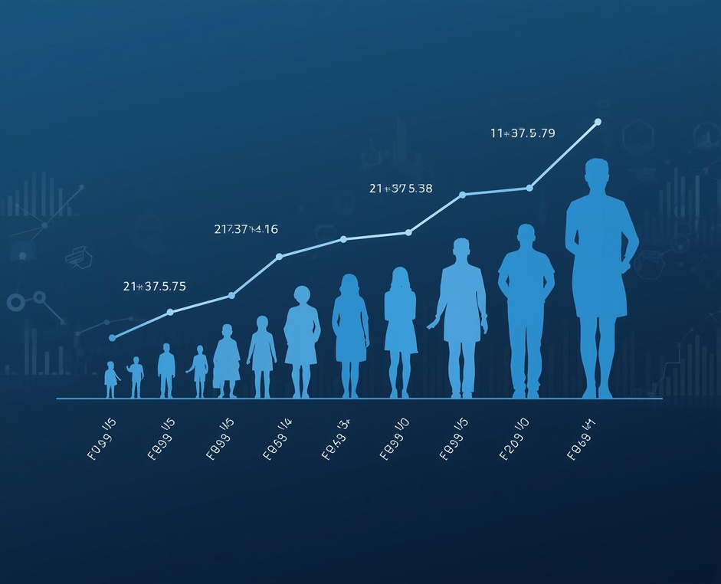
12
Revenue by
Age Group
REVENUE DISTRIBUTION ACROSS CUSTOMER AGE SEGMENTS
28%
Our customer base spans multiple age demographics, each contributing uniquely to total revenue. The 35-44 age segment leads with 28% of total revenue ($65,263), followed closely by 25-34 year olds at 24% ($55,939). Customers aged 45-54 contribute 22% ($51,278), while the 18-24 demographic accounts for 15% ($34,962). Senior customers 55+ represent 11% of revenue ($25,639). This distribution highlights strong mid-career purchasing power while revealing growth opportunities in younger and senior segments.
Revenue share from 35-44 age segment

Slide 13


Thank You!
Questions?
Let's connect
and discuss.
Analytics
Team
Thank you for reviewing our Customer Shopping Behaviour Analytics Report. For questions about the data, methodology, or follow-up analysis requests, please contact our analytics team.
2026
Report

