Slide 1
Theme:
Waste Generation & Alternative Waste Management
Solution:
Segro(So that we can “SAY GROW” to our environment and community.)

Slide 2
Problem Statement:
Problem Factor:
One third of the total food that is produced is wasted and still there are people who suffer from food scarcity.We consider this as one of the major problems and aim at developing a solution where the left out food is managed properly and delivered to those who are in need for it.Also food waste contributes to greenhouse effect therefore leading to deprecation of our environment.Therefore we propose “SEGRO”.
One of the major reasons food waste is generated is because the manufacturers of packaged food have been generating food in quantities which are larger than the market requirement.
Also the left over food instead of being given out to the needed people is dumped in the landfills leading to pollution.
Absence of such a system where the left-over food from people’s house get distributed to the nearby NGO’s,community fridge, langar’s ,Dabbawala’s .

Slide 3
Our Approach:Tackling 2 problems in one go
Reducing Food wastage
In order to forecast the raw food demand,we propose to add camera’s to the bins that collect the waste.The camera clicks the pictures of leftovers. These photographs are later examined with the help of a CNN model. This will help in identifying the patterns in leftovers which were not possible.
The CNN Model will be trained previously on images of various food items and it can help in determining the patterns in the demand of different food items based on the pictures of waste food.
Since the collection of waste will be locality wise,it will help us in recognizing the demand for a food item in a particular area thus enabling reduced wastage of food by reducing food supply of that particular item in the area.
Ensuring the leftover food reaches in the hands of a needy person.
Collaborate with the local NGO’s and communities to keep them updated whenever there is a substantial amount of leftover food to be given out.
Pairing up with the dabbawalas , as a part of their roti bank initiative, we can alert the dabbawalas of the availability of leftover food near them using google location API.
All this will ensure that the leftover food does not go waste and it reaches the needy people.
There will be a web interface with minimal UI so that people not comfortable with smartphones will also be able to use them.
Also , messaging service would be used to ensure non-smartphone users are not left out

Slide 4
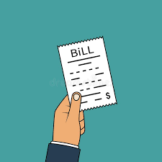
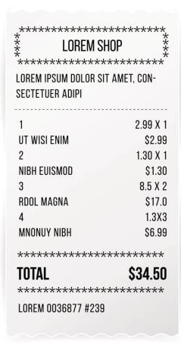
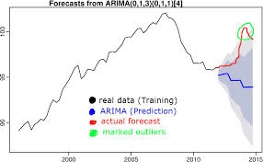
Reducing Food Wastage
Getting the bills from local restaurants
Forecasting the demand of that particular food in the market.
Time series using the ARIMA (Auto Regressive Integrated Moving Average) Model.
Fed with the demands from the past years according to which it will forecast the future demand.The data for this will be obtained from the bills of that restaurant and a dedicated database which will store all the ingredients and amounts of each required in the recipe.
Extracting data from the bills such as item name, quantity
Applying ARIMA to extract information
Forecasting the future need for an item based on the previous use

Slide 5
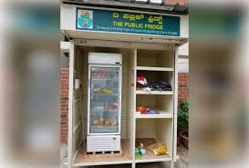
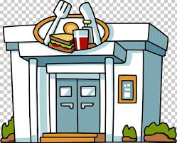
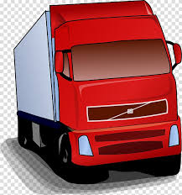
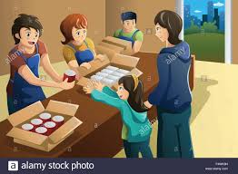


Ensuring the leftover food reaches in the hands of a needy person.
Community fridges: for leftovers to be put in by the local communities. These will have sensors which keep sending out status updates on the websites about the amount and type of food ( each will have a camera attached for detection) that they hold so that the concerned truck or authority can come and pick it up.
Why the Shortest Path?
Since the trucks will take trips to multiple places ,it is important to ensure that it is efficient
Traveling Salesman approach finds the optimal path, thus satisfying our need.
Trucks collecting leftover food:these will be refrigerated trucks which will pick up food from the restaurants which want to handover the food. Since there would be places where distribution of leftover food can be done regularly, these places will be labelled as hot spots and the trucks can be directed to deliver food there.ALso local NGO’s and langars are the places where the leftover food would be delivered. We shall implement a Travelling Salesman Problem type algorithm to optimise the food delivery system so that little fuel is wasted by the truck.

