Slide 1


SMART INDIA HACKATHON 2024
TITLE PAGE
Problem Statement ID – SIH 1605
Problem Statement Title- Women Safety Analytics – Protecting Women from safety threats.
Theme- Miscellaneous
PS Category- Software
Team ID- 44946
Team Name (Registered on portal)- Team4AM

Slide 2
Stand With Her
Team4AM
IDEA AND SOLUTIONS
Allow users to add multiple emergency contacts who will receive the SOS message.
User Authentication: Allow users to register and log in.
Google Maps API: For live location tracking and safe route suggestions.
Use React Native Push Notification to send push notifications to the user when an emergency alert is sent.
A prominent button that, when pressed, sends an emergency alert with the user’s live location to selected contacts
UNIQUE VALUE PROPOGATIONS
StandWithHer is not just another safety app—it’s a complete safety companion. It uniquely offers real-time audio and video recording, live location tracking, and one-tap SOS calling to offer immediate assistance in critical moments. With StandWithHer, help is always just a click away, giving users the peace of mind they deserve.

Slide 3
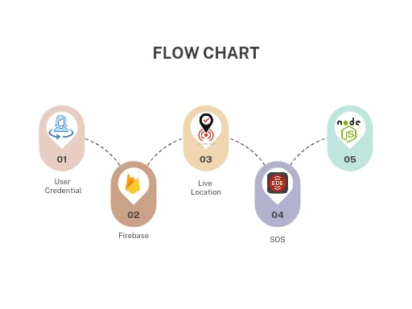
TECHNICAL APPROACH
Team4AM
Technologies to be used :
Programming languages (Js)
Designing interface (Figma)
Cloudinary (Storing videos and audios)
Firebase
Email.Js
Apache kafka
Zego cloud
Multer

Slide 4
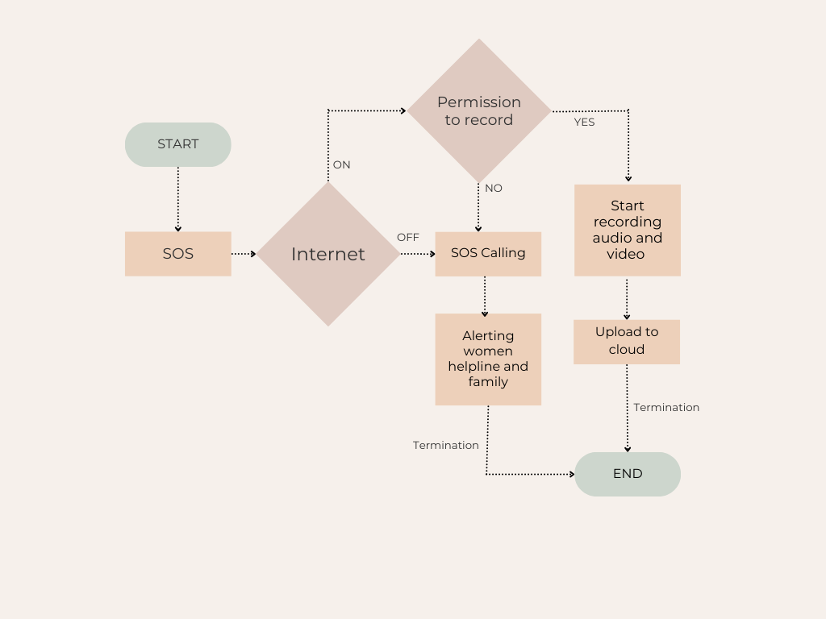
FEASIBILITY AND VIABILITY
Team4AM
FEASIBILTY:
1.Market Demand: Growing awareness and demand for safety solutions for women.
2. User Experience: Simple, intuitive design to encourage usage; voice activation and discreet alerts can enhance safety.
VIABILITY:
1.Technology Integration: GPS, mobile network, and Real-time tracking, panic alerts, and threat analysis.
2. Unique Features:
SOS button for immediate alerts to trusted contacts.
Live location sharing and tracking.
Community support (Women helpline centres, verified users).

Slide 5
IMPACT AND BENEFITS
Team4AM
Potential impact on the target audience:
1.POSITIVES: Enhanced security, Increased educational awareness, Women empowerment, equality, new opportunities, community support , enhanced personal safety, Data collection.
2.NEGATIVES : Cost, technology adoption issues.
Benefits:
Real time alerts | Location | Quick access
Resource information | User friendly interface | Anonymity and Privacy

Slide 6
RESEARCH AND REFERENCES
Team4AM
https://www.mha.gov.in/en
https://nodejs.org/en
https://www.sih.gov.in/
https://indianexpress.com/

