Slide 1
POWER SYSTEM FAULT DETECTION AND CLASSIFICATION
CAPSTONE PROJECT
Presented By:
Aditi Karpe - K. K. Wagh Institute of Engineering Education & Research- M.C.A.

Slide 2
OUTLINE
Problem Statement
Proposed System/Solution
System Development Approach
Algorithm & Deployment
Result
Conclusion
Future Scope
References

Slide 3
Problem Statement
Design a machine learning model to detect and classify different types of faults in a power distribution system. Using electrical measurement data (e.g., voltage and current phasors), the model should be able to distinguish between normal operating conditions and various fault conditions (such as line-to-ground, line-to-line, or three-phase faults). The objective is to enable rapid and accurate fault identification, which is crucial for maintaining power grid stability and reliability.

Slide 4
Proposed Solution
Develop a machine learning model that classifies different power distribution system faults using voltage and current phasor data. The model will distinguish between normal conditions and fault types. This classification enables rapid and accurate fault detection, improving response time and ensuring grid stability.
Key Components:
Data Source: Kaggle power system faults dataset
Preprocessing: Cleaning, normalization, and feature engineering
Modeling: Used Random Forest, Snap Logistic Regression, and SVM
Platform: IBM Cloud (Watsonx.ai Studio + Cloud Object Storage)
Evaluation Metrics: Accuracy, precision, recall, F1-score

Slide 5
System Approach
System requirements Data Collection: Dataset from Kaggle with various fault scenarios and phasor measurements.
Preprocessing:
Null value removal, normalization. Splitting dataset into train/test sets.
Model Building:
Implemented multiple ML algorithms using IBM Watsonx.ai Studio. Random Forest gave highest accuracy : 0.409
Model Evaluation:
Compared performance of Random Forest, SVM, and Snap Logistic Regression. Evaluated using confusion matrix and classification report.
Deployment:
Trained model deployed using IBM Watsonx.ai Studio. Storage handled via IBM Cloud Object Storage. Model ready to classify faults on new input data.

Slide 6
Algorithm & Deployment
Algorithm Selection:
Used Random Forest, SVM, and Snap Logistic Regression. Random Forest was chosen for its better performance and handling of multi-class fault types.
Data Input:
Voltage and current phasor values from the Kaggle power system fault dataset.
Training Process:
Supervised Learning using labelled fault types. Models were trained in IBM Watson Studio.
Prediction Process:
The model predicts the type of fault based on new phasor inputs.

Slide 7
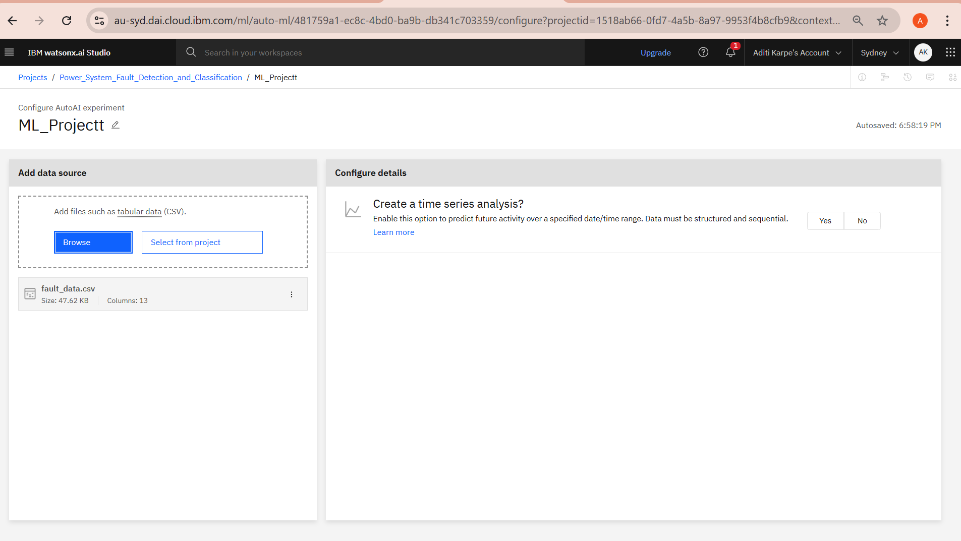
Result
Step 1: Uploaded fault_data.csv as the dataset in IBM Watsonx.ai Studio.

Slide 8
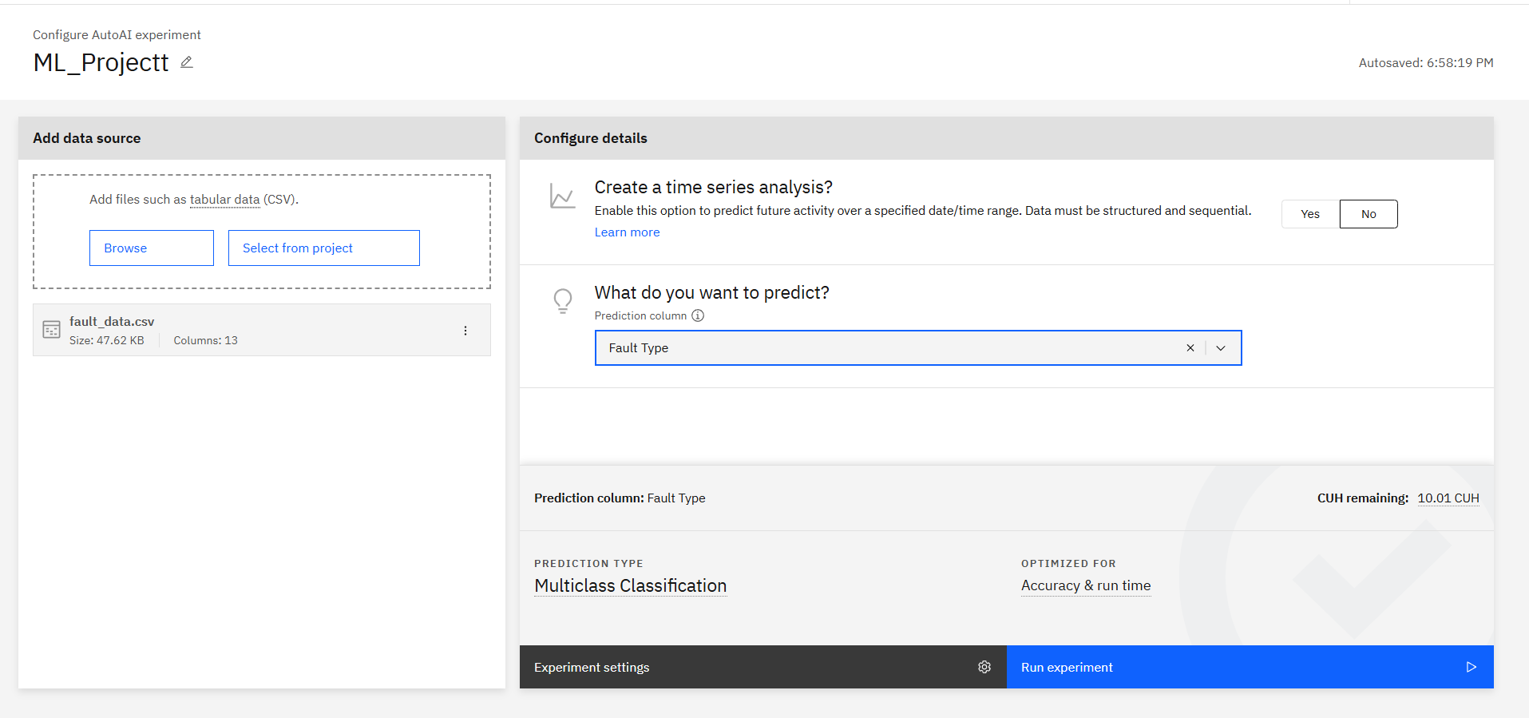
Result
Step 2: Selected Fault Type as the prediction column and initialized the AutoAI experiment for multiclass classification.

Slide 9
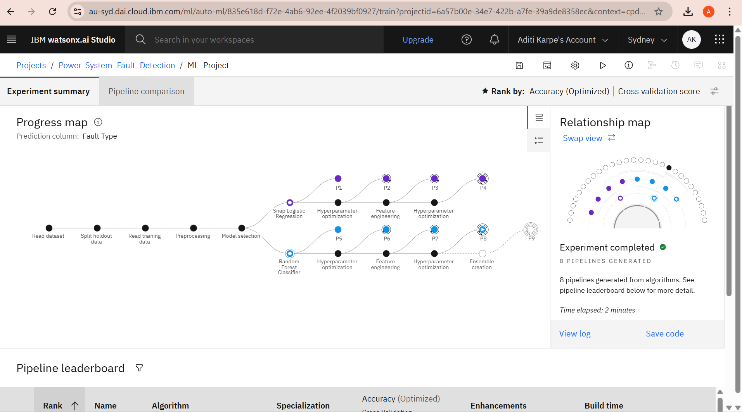
Result
Step 3: AutoAI generated 8 machine learning pipelines using different algorithms and feature transformers.

Slide 10
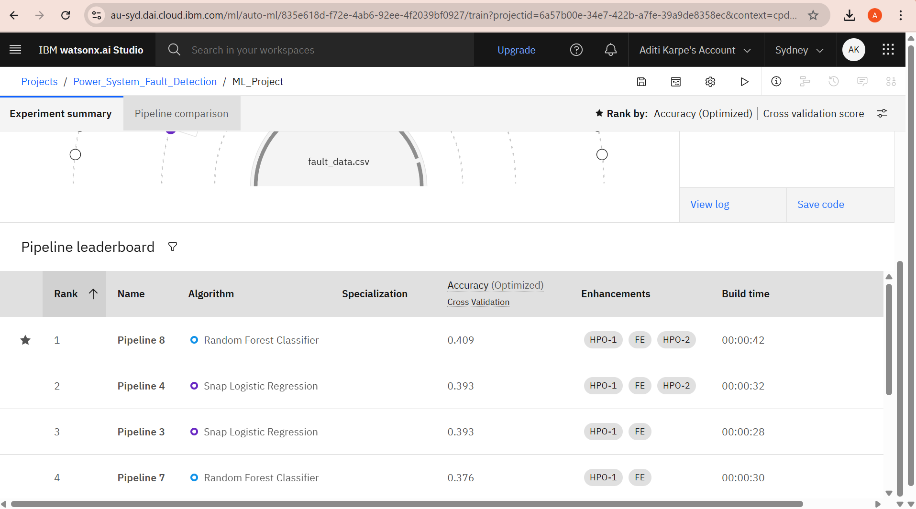
Result
Step 4: Pipelines were ranked based on optimized accuracy using cross-validation.

Slide 11
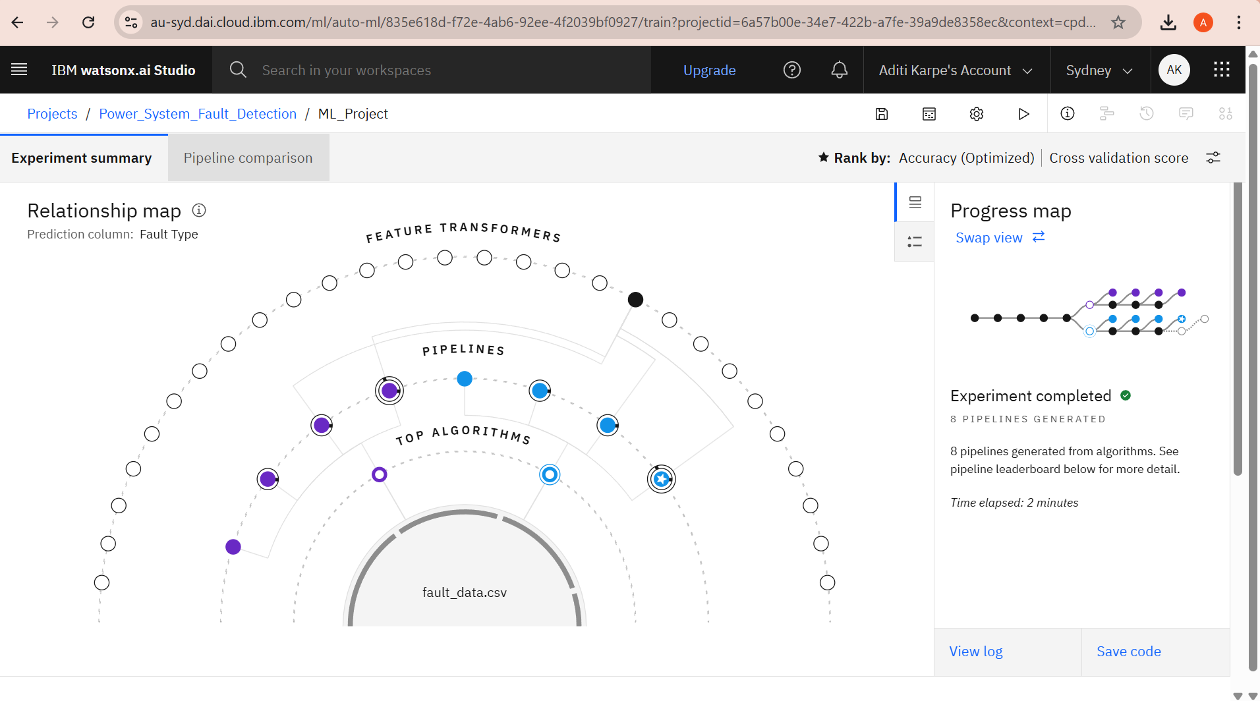
Result
Step 5: Visualized the relationship map showing connections between the dataset, algorithms, and transformers.

Slide 12
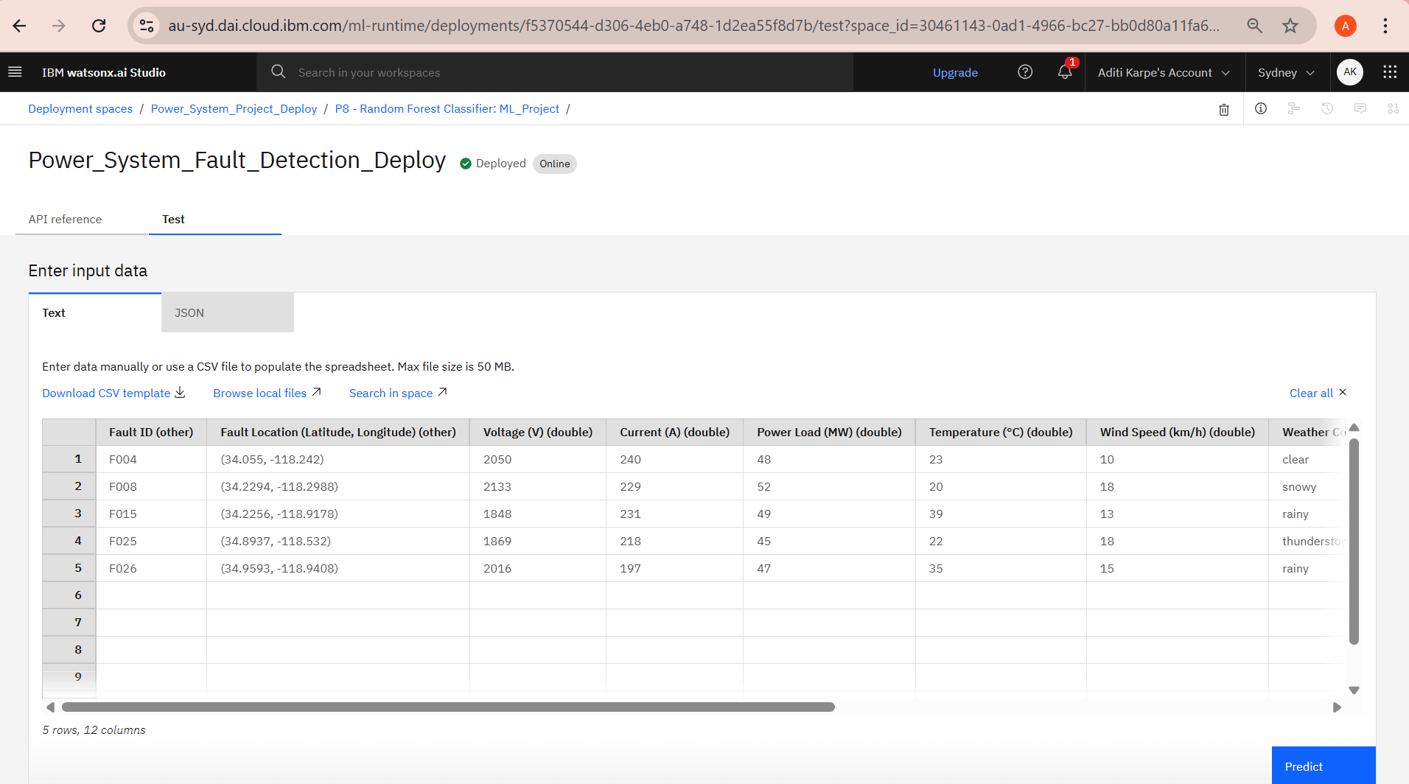
Result
Step 6: After completing the experiment, input data was provided to the best-performing pipeline for prediction.

Slide 13
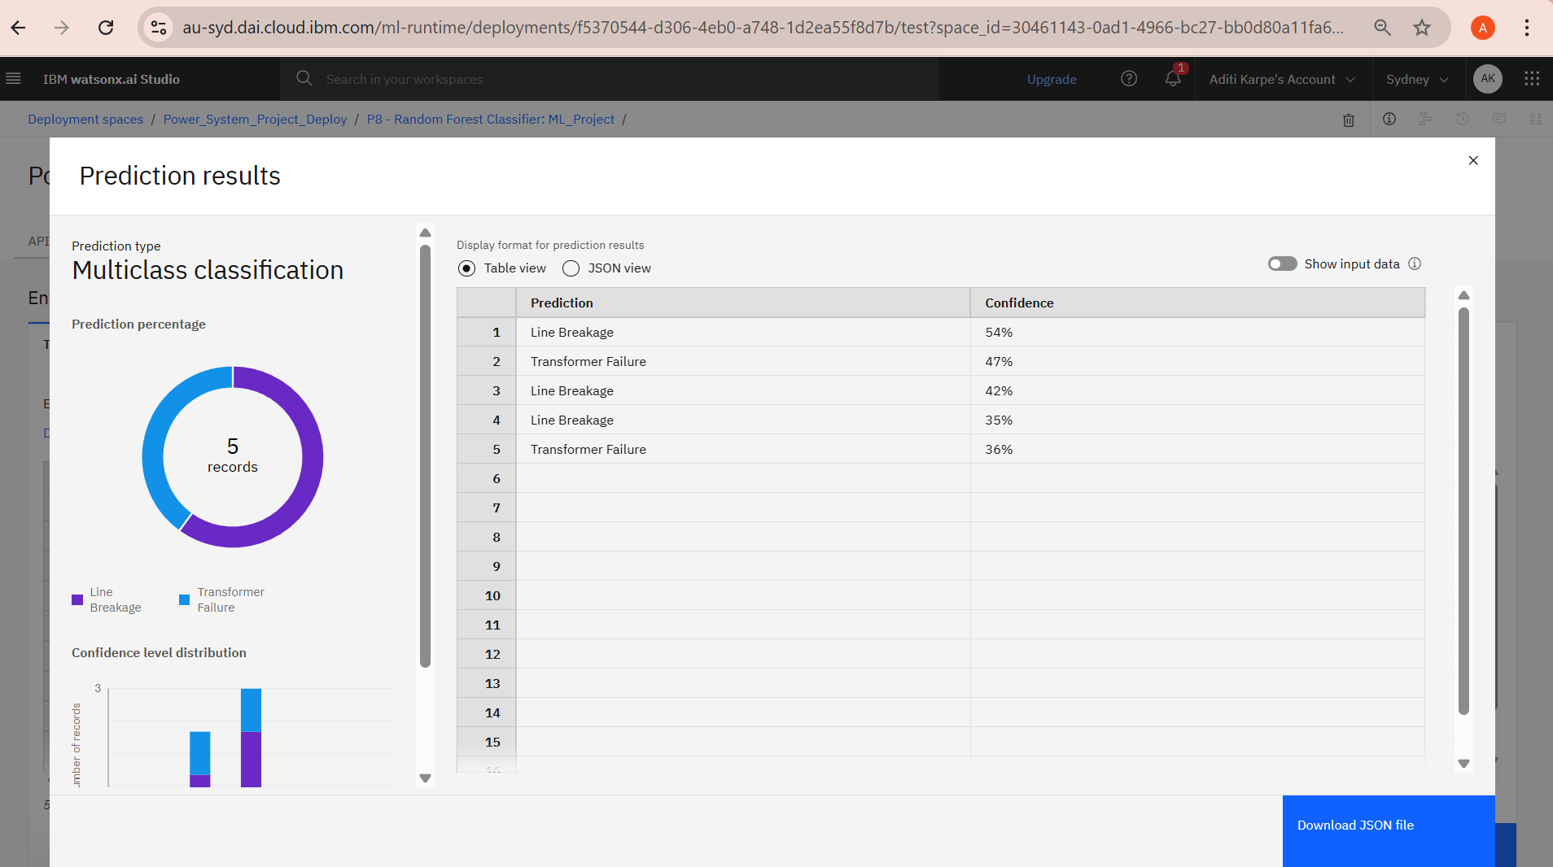
Result
Step 7: The system successfully predicted the Fault Type based on the input data using the trained model.

Slide 14
Conclusion
Successfully implemented a fault detection system using ML on IBM Cloud.
Implemented multiple ML algorithms using IBM Watsonx.ai Studio.
The models identifies fault types with moderate accuracy and serves as proof-of-concept.
Demonstrates the potential of ML in real-time power system monitoring and fault classification.

Slide 15
Future scope
Incorporate data from IoT sensors, smart meters, and SCADA systems to enhance fault detection accuracy.
Extend to include fault location and severity prediction.
Use deep learning models (e.g., LSTM, CNN) to improve performance and accurately analyze complex fault patterns.
Improve model accuracy using Deep Learning (e.g., LSTM for time-series data).
Develop a web-based dashboard to display real-time fault detection, sensor data, and fault insights in a user-friendly format.

Slide 16
References
Kaggle Dataset : Power System Faults Dataset
IBM Cloud Documentation : https://cloud.ibm.com/docs

Slide 17
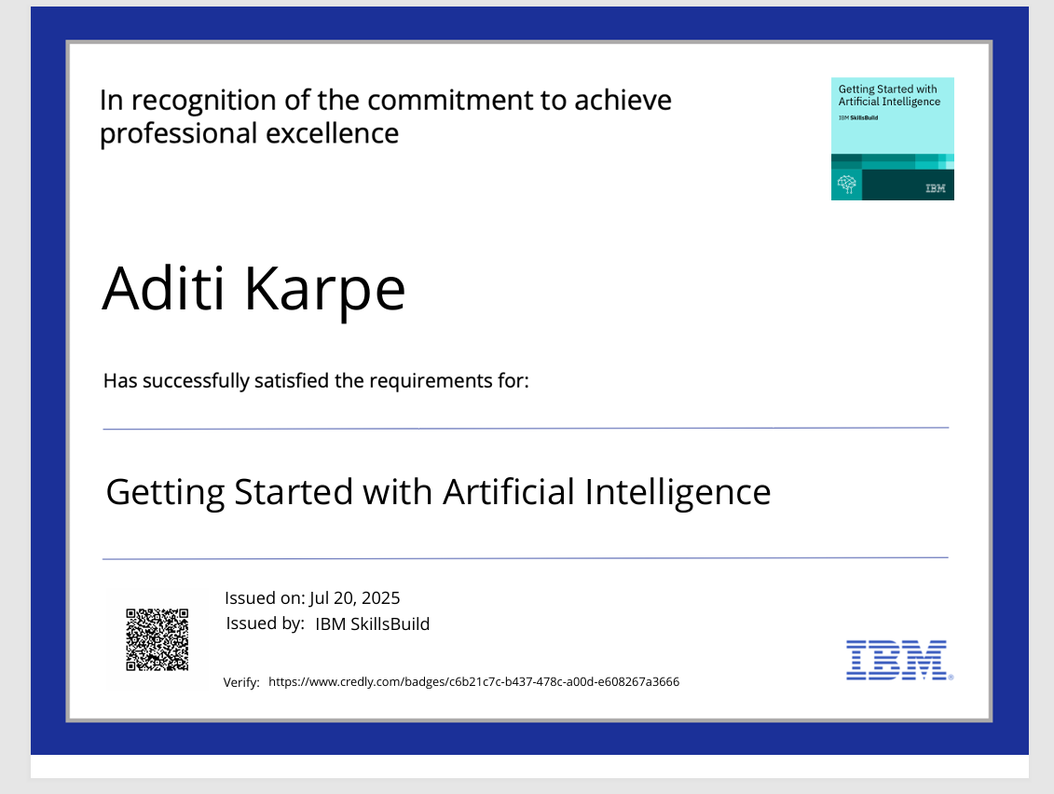
IBM Certifications

Slide 18
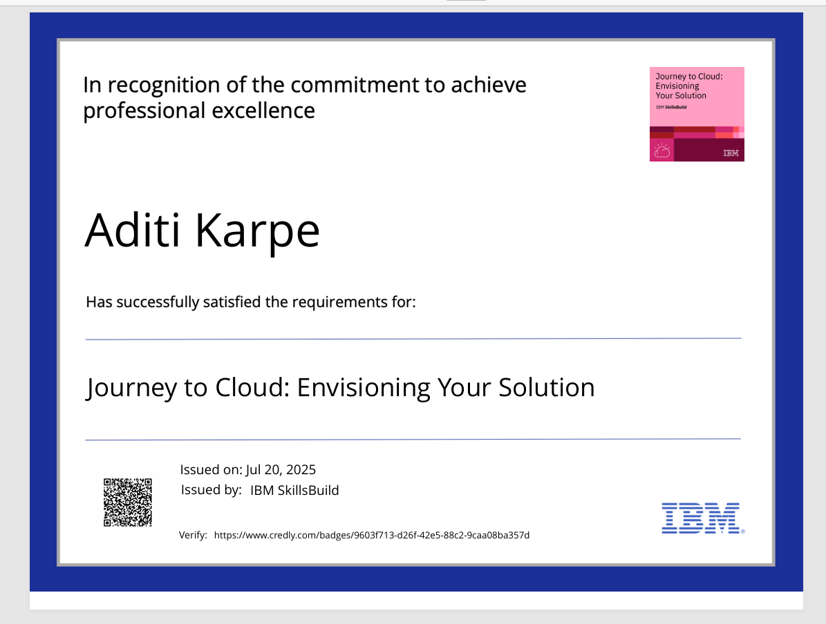
IBM Certifications

Slide 19
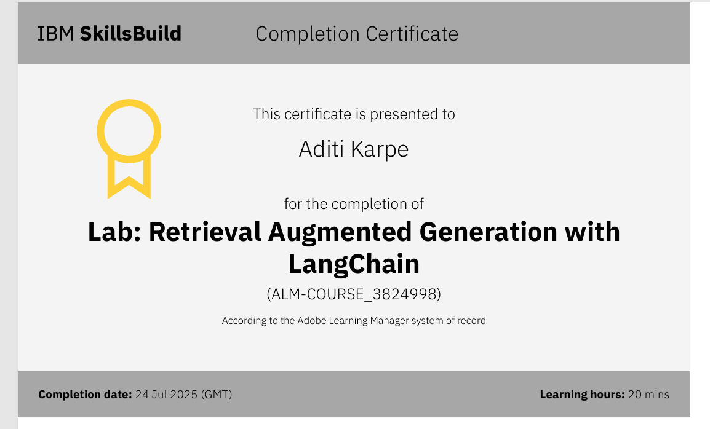
IBM Certifications

Slide 20
THANK YOU

