Slide 1
DIRECT METHANOL FUEL CELLS (DMFC) IN TRANSPORTATION
AND ITS APPLICATIONS IN INDIA

Slide 2
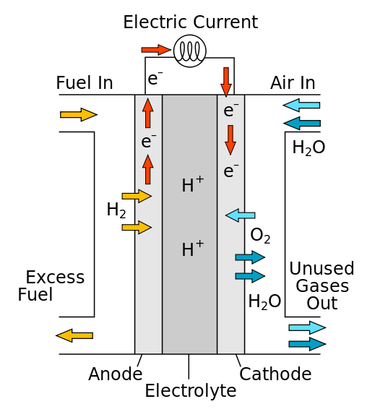
FUEL CELLS
A fuel cell is an electrochemical cell that converts the chemical energy from a fuel into electricity through an electrochemical reaction of hydrogen fuel with oxygen or another oxidizing agent.

Slide 3
FUEL CELLS
Fuel cells are different from batteries in requiring a continuous source of fuel and oxygen (usually from air) to sustain the chemical reaction, whereas in a battery the chemical energy comes from chemicals already present in the battery.
There are many types of fuel cells, but they all consist of an anode, a cathode, and an electrolyte that allows positively charged hydrogen ions (protons) to move between the two sides of the fuel cell.
Fuel cells are classified by the type of electrolyte they use and by the difference in startup time ranging from 1 second for proton exchange membrane fuel cells (PEM) to 10 minutes for solid oxide fuel cells(SOFC).
Individual fuel cells produce relatively small electrical potentials, about 0.7 volts, so cells are "stacked", or placed in series, to create sufficient voltage.
In addition to electricity, fuel cells produce water, heat and, depending on the fuel source, very small amounts of nitrogen dioxide and other emissions.

Slide 4
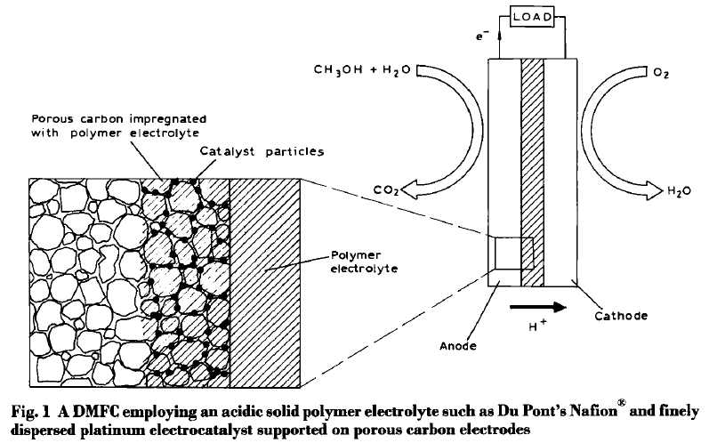
DIRECT METHANOL FUEL CELLS

Slide 5
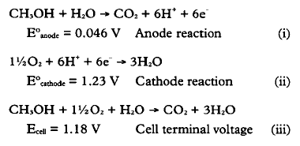
DIRECT METHANOL FUEL CELLS

Slide 6
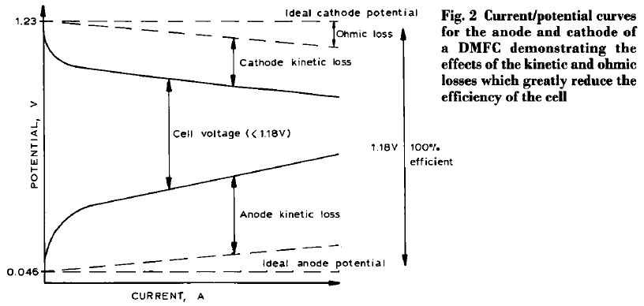
KINETIC LIMITATIONS
The poor electrode kinetics at the anode and cathode result from the electrochemical processes being much more complex than Equations (i) and (ii) suggest.
Each oxygen molecule requires the transfer of four electrons for complete reduction.
The simultaneous transfer of these electrons is difficult to achieve, and infact only partial electron transfer takes place, leading to the formation of surface intermediates, such as superoxide.

Slide 7
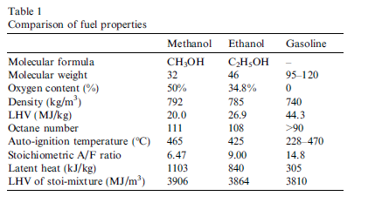
COMPARITIVE STUDY
Thought the latent heat of methanol is higher, measures are not necessary for the mixture preparing due to lower fraction, while it may increase engine volumetric efficiency and thus increase engine power.
Methanol has a higher laminar flame propagation speed, which may make combustion process finish earlier and thus improve engine thermal efficiency.
The standard spark plugs were replaced by colder ones to avoid pre-ignition issues from hydrogen and methanol.

Slide 8
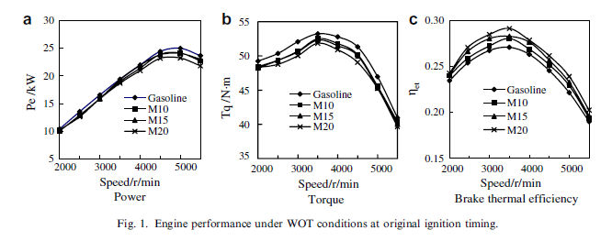
ENGINE POWER AND FUEL ECONOMY

Slide 9
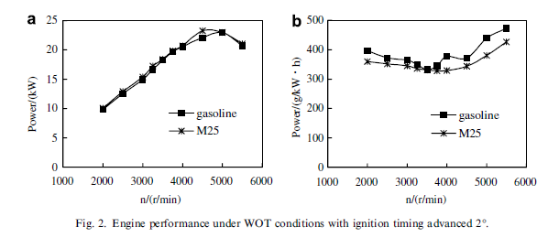
ENGINE POWER AND FUEL ECONOMY

Slide 10
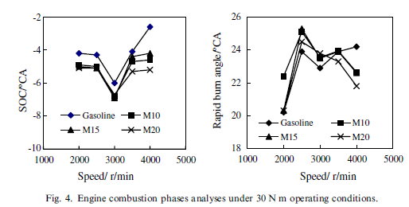
ENGINE COMBUSTION CHARACTERISTICS

Slide 11
EFFECTS ON REGULATED EMISSIONS AND CONVERSION
The regulated gaseous emissions include CO, HC and NOx. W
When methanol is added into gasoline, the fuel blend contains more oxygen, which reduces CO and HC emissions.
The effect on NOx emission is ignorable, neither prior to nor post the TWC.
Therefore, methanol used in SI engine can reduce regulated emissions of HC and CO in this study.

Slide 12
EFFECTS ON NON-REGULATED EMISSIONS AND CONVERSION
Unburned methanol and formaldehyde are generally called to be non-regulated emissions.
Formaldehyde emission of M20 is about 10 times as high as gasoline; however, the total concentration is still within 200 ppm.

Slide 13
IMPORTANCE OF DMFCs IN TRANSPORT
Drivers for a long-term secure and sustainable energy supply are: (1) security of energy supply, (2) reduction of CO2 (Kyoto) emissions and (3) pollution abatement.
We have come to the end of oil discoveries. During the decade 1990–2000 new oil discoveries amounted to only 25% of those during the period 1950–1960
According to an article in the Journal Of Applied Electrochemistry 26 (1996) many researchers and officials globally believe that it should take an important role in automobile industry development and petroleum fuel substitute.

Slide 14
SUMMARY
The DMFC has always been considered as the ideal fuel cell.
Its simplified system design and direct use of liquid fuel have in the past been outweighed by the very low power densities achievable.
The poor performance of the cell was due to the poor kinetics of the anode reaction and fuel cross-over.
Although performance levels are not yet sufficient for commercial application, if the progress made over the past two to three years is continued, then this fuel cell could emerge from the shadows of its hydrogen-fuelled counterparts.

Slide 15
THANK YOU

