Slide 1
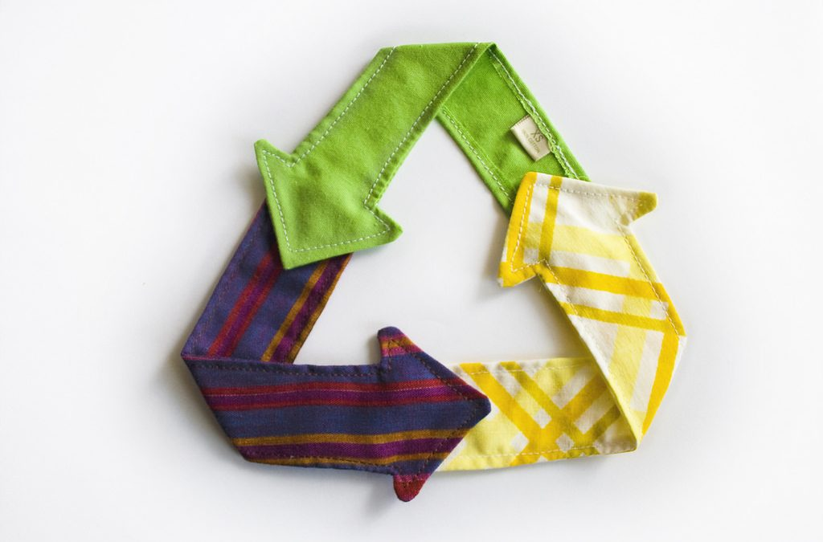
ONLINE
RECYCLING SERVICE
Aditi Namdev

Slide 2
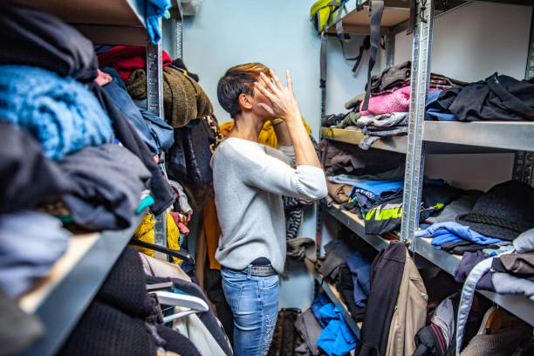



PROBLEM?

Slide 3


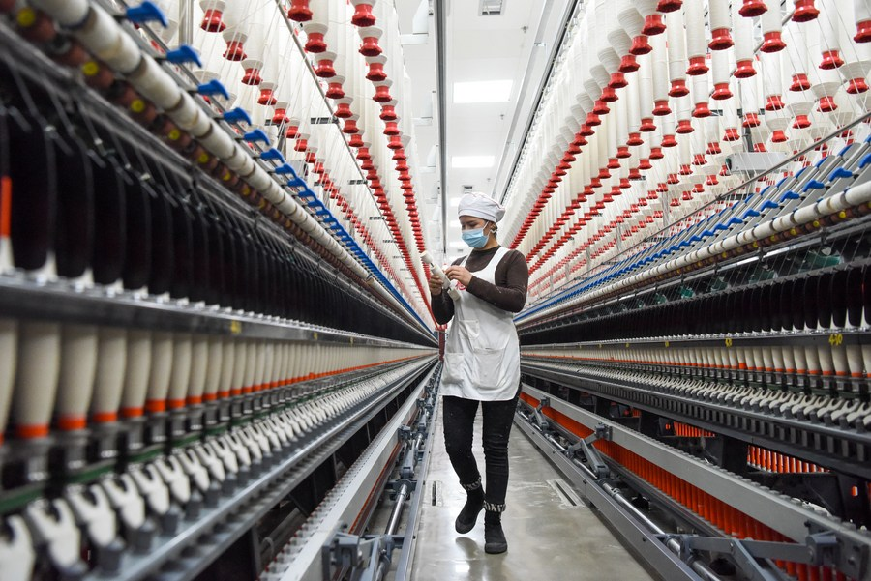
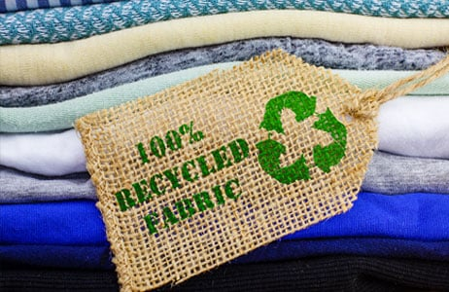

SOLUTION

Slide 4




HOW?

Slide 5


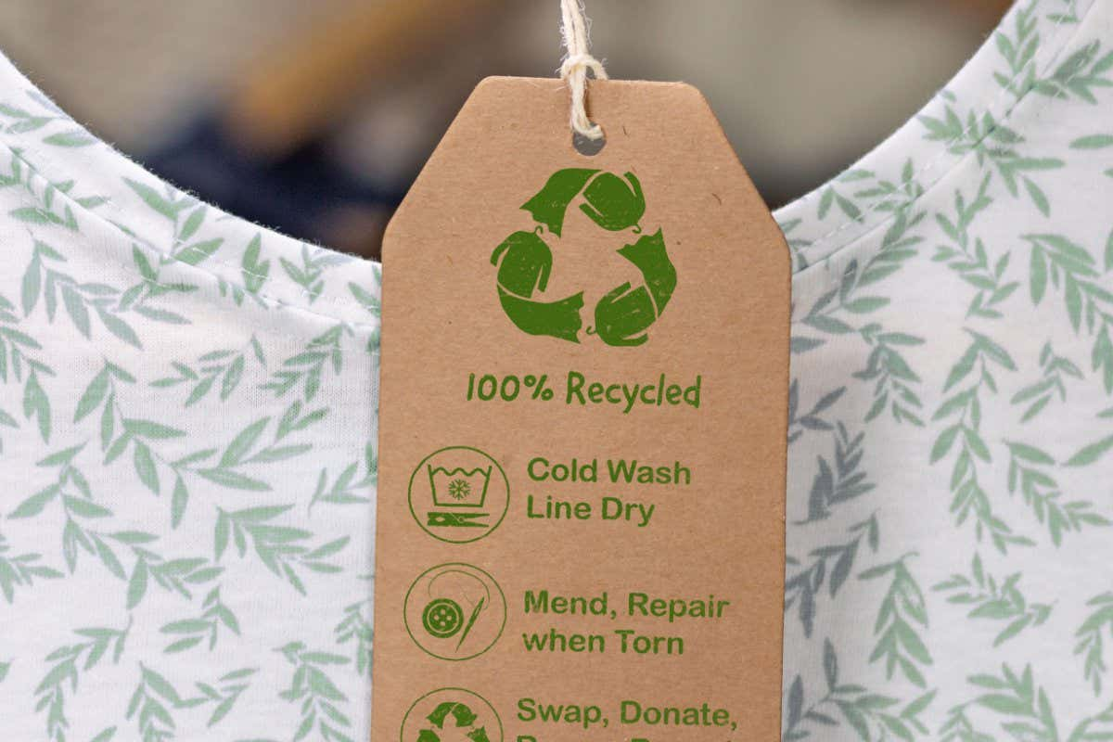

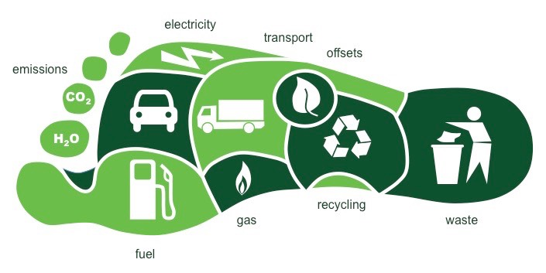
SUCCESS FACTORS
😇

Slide 6

QUESTIONS?
THANK YOU!

