Slide 1
NYC Taxi Analysis
Team 2:
Pankaj Yadav
Aditi Pala
Kartik Kaul
Shubh Mody

Slide 2
Outline
Project Overview
Analysis Approach
Dataset
Data Cleaning
QUESTIONS
EDA
Conclusions
Questions?

Slide 3
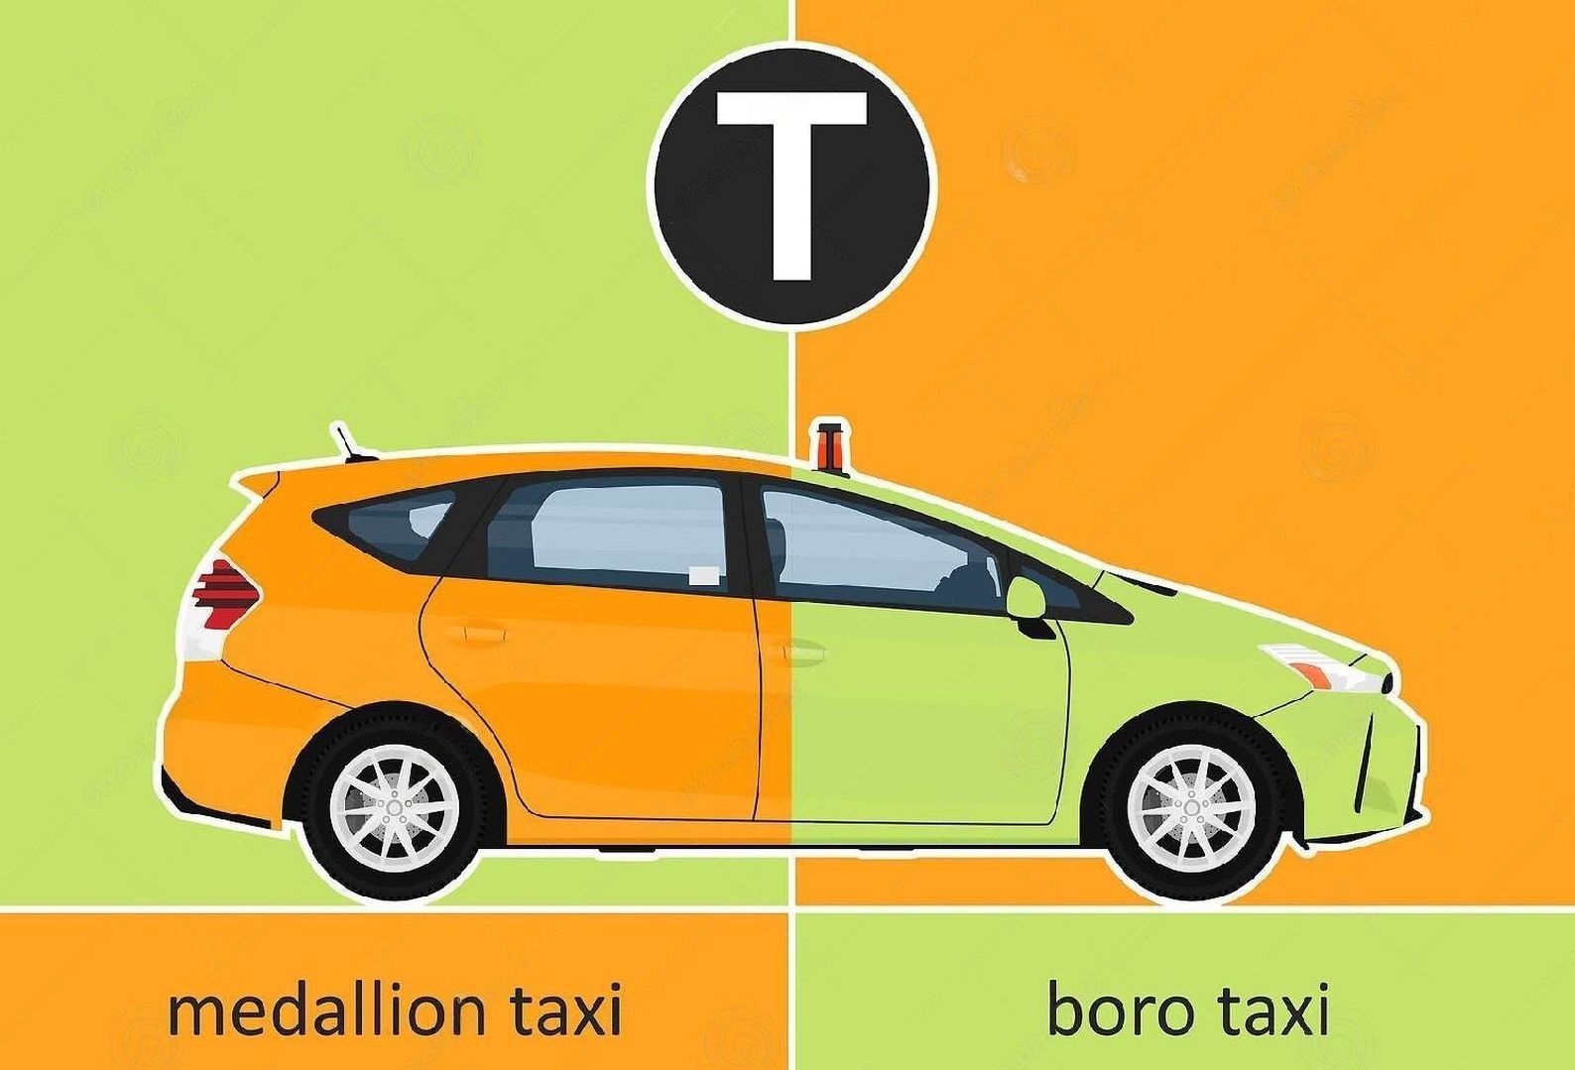
Project Overview:
Medallion (yellow) cabs are concentrated in the borough of Manhattan but can be hailed anywhere throughout the five boroughs of New York City and may be hailed with a raised hand or by standing at a taxi stand. New York City is arguably the taxi capital of America and home of the classic yellow taxicab.
Introduced in 2013,Boro Taxis in "apple green" colour can be hailed only in the outer boroughs (except at the airports) and in the northern part of Manhattan, specifically above 96th street on the east side and above 110th street on the west side.
Post six years of Green Taxi’s launch, It would be interesting to know how the Green And Yellow Taxis are performing based on Taxi Trip Records in New York before, during and after COVID-19.
Notes:
Green taxi NYC: Green cabs, are For-Hire Vehicles that are permitted to accept street-hails. Yellow cabs are the official, and iconic, taxis in NYC. Green cabs are new to the city, since 2013, and the program was created to serve areas of New York not commonly served by yellow medallion cabs. Yellow taxis swarm Manhattan. Go to Brooklyn or Queens, it is not likely you will see any yellow taxis.

Slide 4
Analysis Approach:
Objective
Understanding Data
Data Cleaning and Transformation
EDA
Data Visualization

Slide 5
Dataset Characteristics:
Number of Datasets: 6
Number of Columns: 21 (Green), 19 (Yellow)
Dataset observations:
Green Taxi 2019 : 6 Million
Green Taxi 2020 : 1.8 Million
Green Taxi 2021 : 1.1 Million
Yellow Taxi 2020: 25 Million
Yellow Taxi 2021: 31 Million
Taxi Zones : 263

Slide 6
QUESTIONS
Research Questions:
Analyse trends on payment methods during and after COVID-19 pandemic.
Density of ride bookings during different times of the day and the corresponding distances covered?
How much do the passengers prefer to tip based on their metered fare amount?
Analysing Airport Trips.
Analysing trips based on Location Type for different boroughs (Comparative Analysis)
Finding patterns in the surcharge amount based on different boroughs. (Comparative Analysis)
Density of rides going to different boroughs (drop-offs).
Hourly Analysis of Inter-Borough Vs Total trips. (Comparative Analysis)

Slide 7
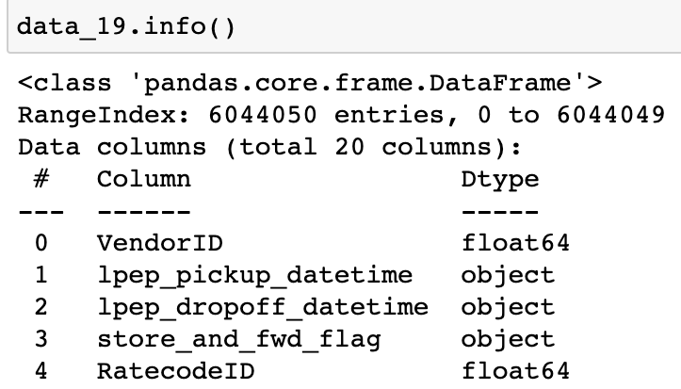
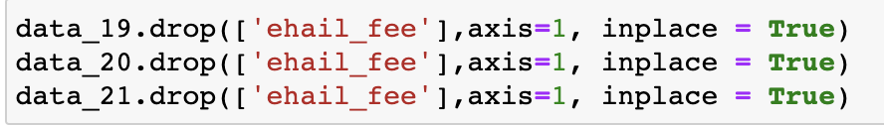
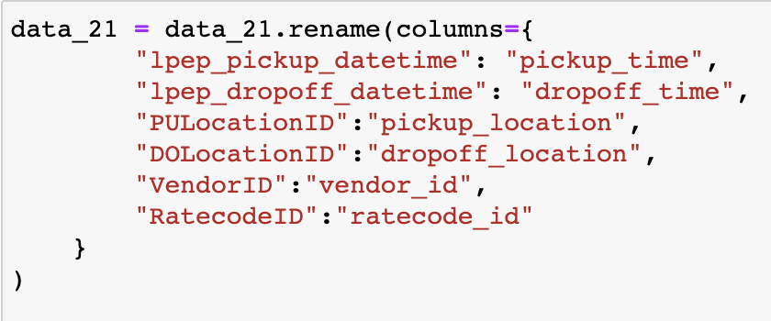
Data Cleaning:
Performed initial data analysis to check the data types of each column
Drop redundant columns
Rename columns as per data requirements
Merging all three datasets
Notes:
No Column of ehail in Yellow -> doesn’t take online ride bookings.

Slide 8
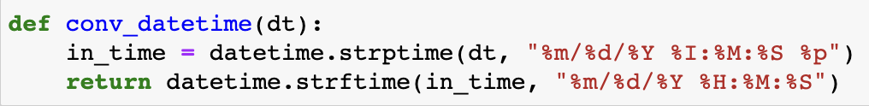
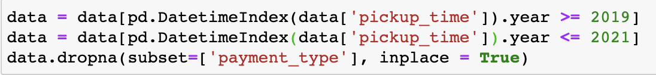
Data Cleaning
Creating Functions to efficiently convert dates into datetime datatypes
Removing negative outliers by considering data where dropoff_time > pickup_time
Fetching data between 2019 to 2021 and dropping NA values from payment type

Slide 9
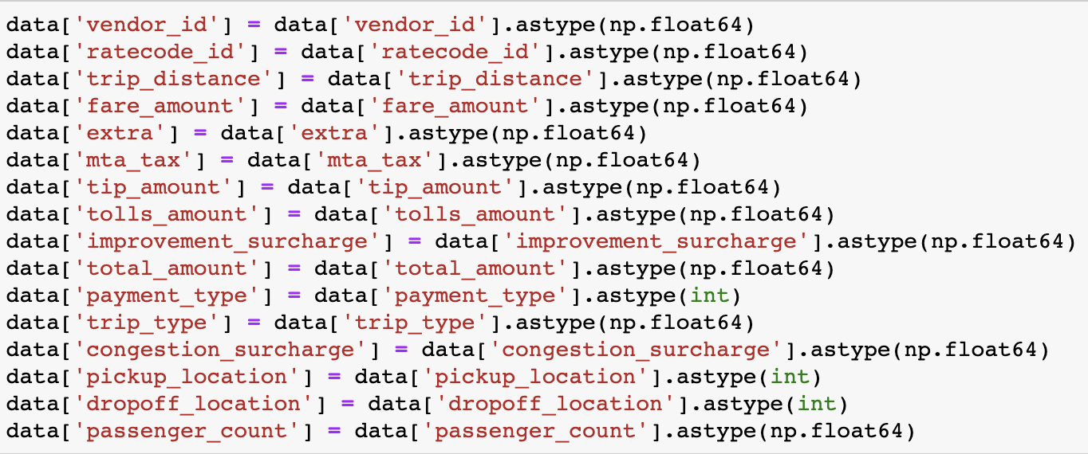
Data Cleaning
Data transformation

Slide 10
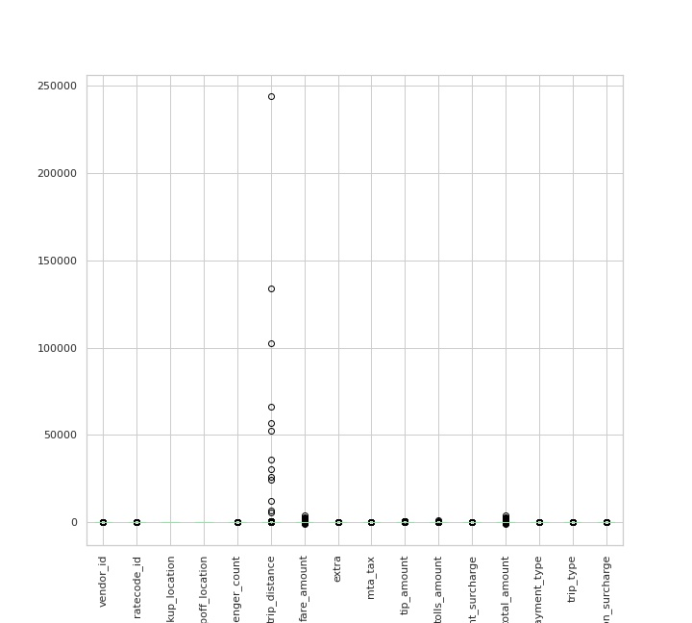
Data Cleaning
Box plot of dataset with outliers

Slide 11
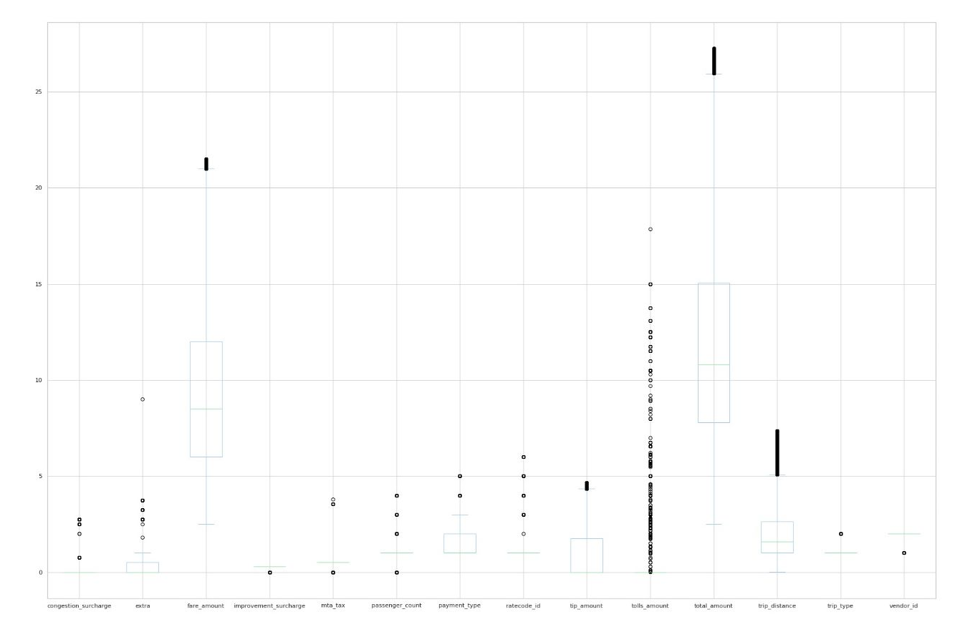
Data Cleaning
Box plot of dataset after removing outliers

Slide 12
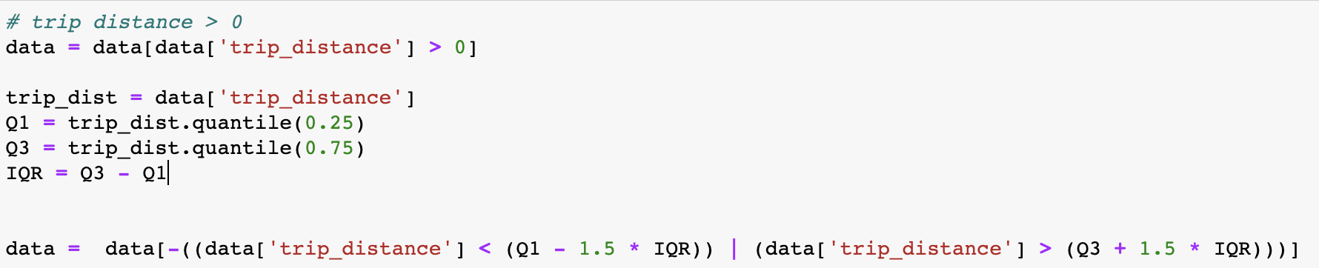
Data Cleaning: Removing outliers from dataset
For Trip distance, tip amount:
Checking where trip distance is more than 0
Using InterQuartile Range concept to remove outliers

Slide 13
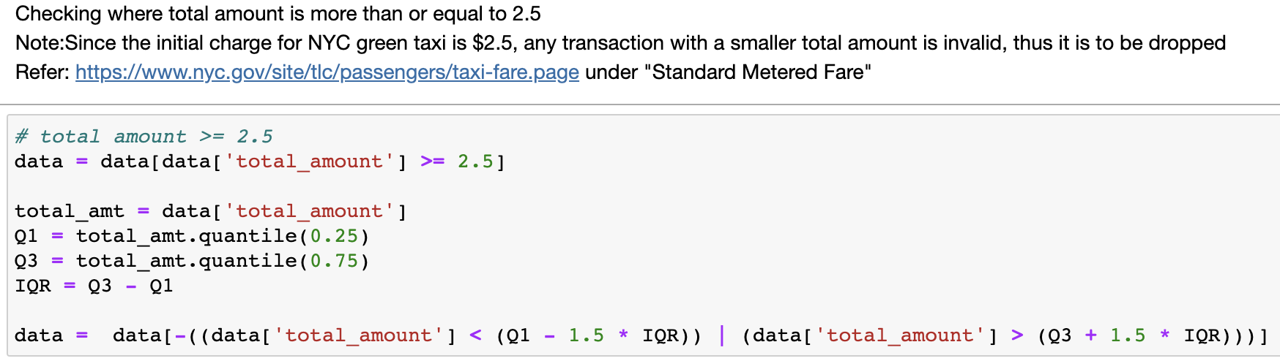
Data Cleaning: Removing outliers from dataset
For total_amount, tip_amount
Checking where Total_amount is more than $2.5
Using InterQuartile Range concept to remove outliers

Slide 14
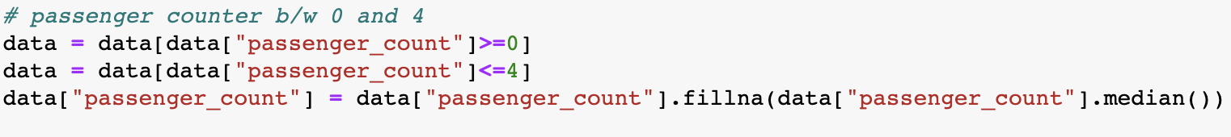
Data Cleaning: Removing outliers from dataset
For Passenger count:
Consider passengers between 0 to 4
Note: Why are we taking 0 passengers? Because Green taxis can also deliver packages, hence passengers are 0!

Slide 15
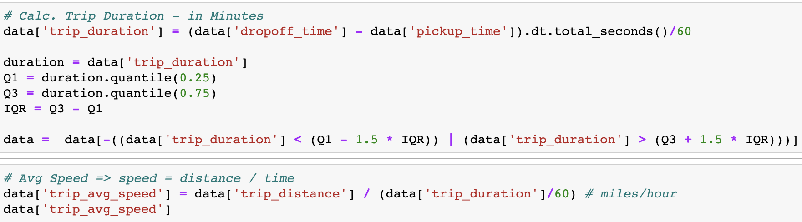
Data Cleaning:
Calculate tip percent based on tip_amount and total_amount
Create new columns based on data requirements
Calculate trip in minutes and average speed

Slide 16
Exploratory Data Analysis

Slide 17
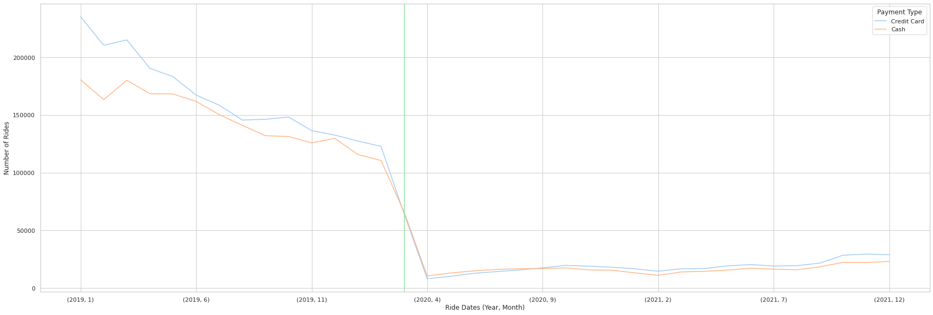
Analysis of Payment Methods from 2019 -2021:
Credit Cards and Cash were the two preferred methods of payment.
There is a sharp decline in the graph which directly corresponds to the decline in the number of trips starting March 2020.
The green vertical line signifies the official date of lockdown. This implies that COVID-19 was the cause of the down trend, and it started even before the official lockdown announcement was made.
Notes:
This basically shows the awareness amongst people that they started avoiding travelling in cabs (social distancing) even before the lockdown was announced.

Slide 18
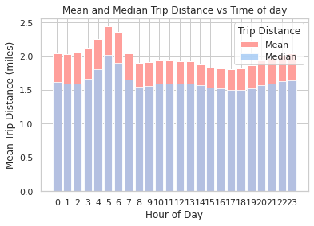
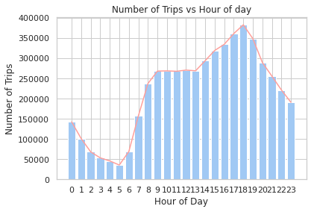
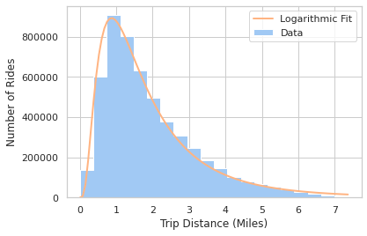
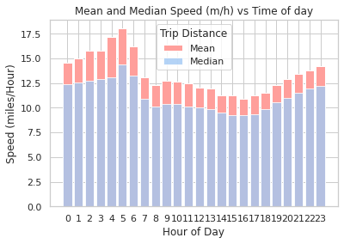
Analysis of Taxi Trips throughout the Day.
Trips that occur in early morning hour relatively cover longer distances than those happening in the rest of the day.
In contrast, we see that the number of trips gradually increases as the day progresses.
Most trips are happening between 0 to 2 miles of distance
Notes:
Hence, we can conclude that there are fewer passengers travelling in the morning, but they travel longer distances. While there are higher number of passengers who travel during the evening hours but cover relatively shorter distance.

Slide 19
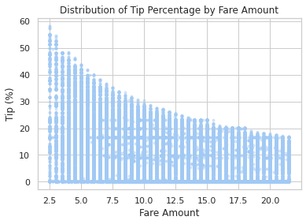
Analysis of Tip amount based on Fare Prices
The percentage of the tip amount goes on decreasing as the Fare amount of the trip ride increases.
Notes:
One of the reasons could be people not bothering asking back for lower denomination of change. Hence, we could see tips as higher as 60%. For example, a fare amount of $2.5 would be tipped $1.5 which is a result of a $4 payment and not asking for change.

Slide 20
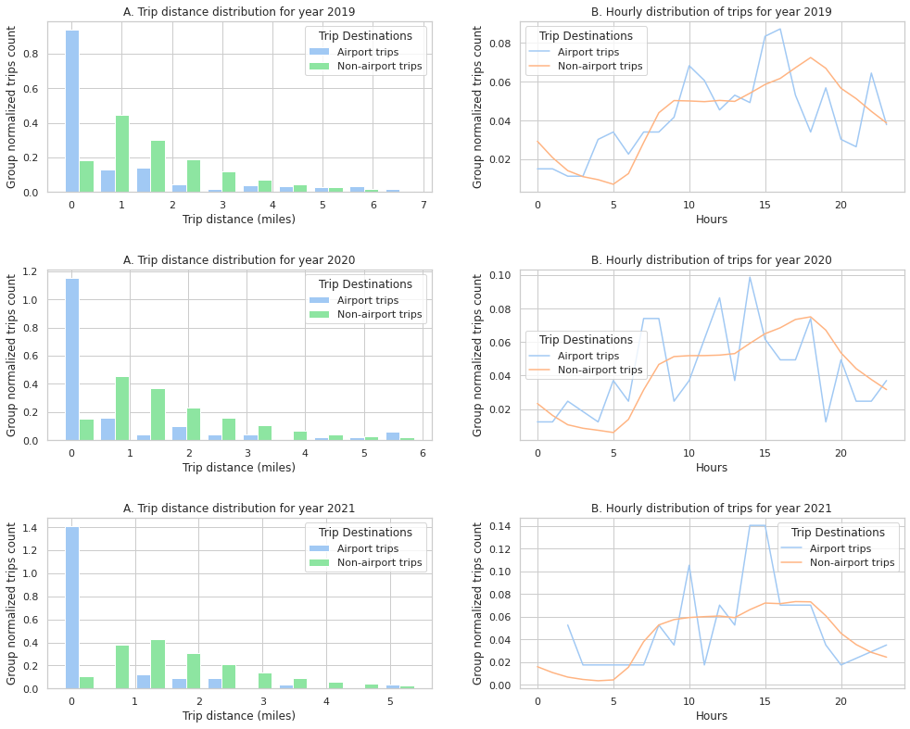
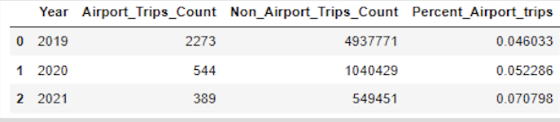
Analyzing Airport Trips
As we can observe, the airport trips usually happen in the close vicinity and during the daytime.
And as the number of non-airport trips are significantly higher than that of airport trips, we can observe that they follow the similar trend of the population data i.e the total number of trips throughout the day.
Although the number of airport trips for green taxi are not very high, we can still observe a 50% increase in airport trips by the end of 2021.

Slide 21
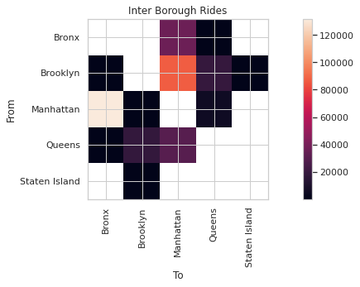
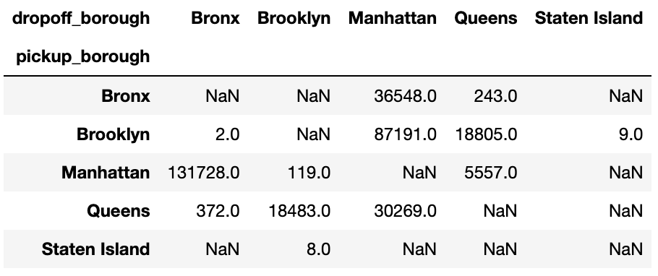
Analysis of Trips based on Location for Green Taxi.
The 2D raster image represents the pivot table shown below. It signifies the number trips from and to a particular borough.
The highest number of inter-borough trips are happening from Manhattan to Bronx, followed by Brooklyn to Manhattan and then Bronx & Queens to Manhattan.
There is a gap in data for Staten Island because people usually prefer travelling to Staten Island via the ferries.

Slide 22
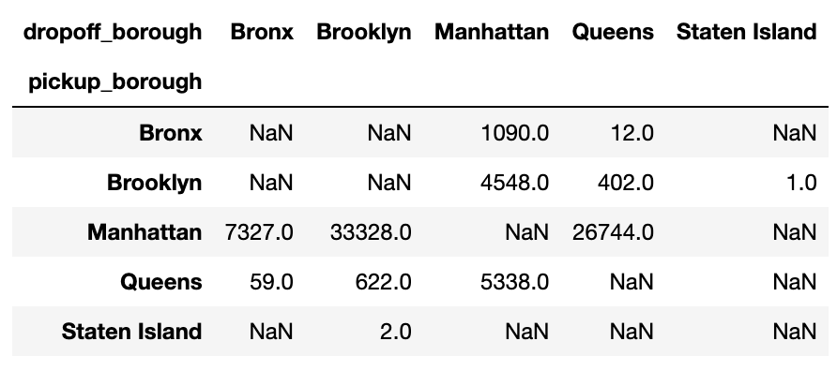
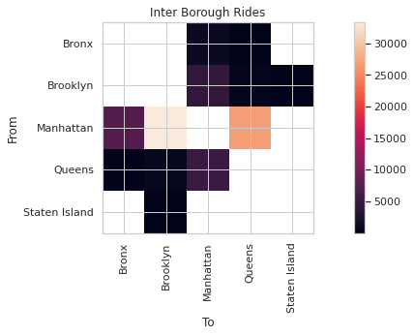
Analysis of Trips based on Location for Yellow Taxi.
The highest number of trips for yellow taxi according to the data are originating from Manhattan as it should be because Yellow taxi is local to Central New York, in contrast to Green taxi which originates from multiple Boroughs.

Slide 23
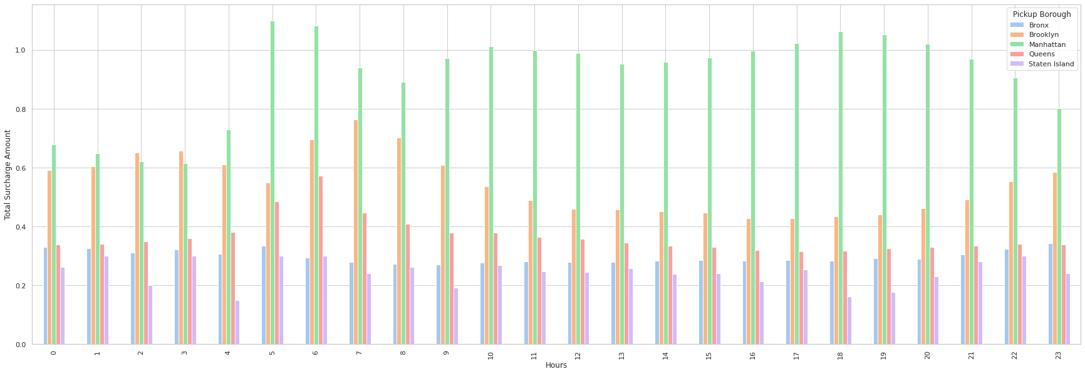
Surcharge Amount Analysis for Green Taxi
The average surcharge amount is consistently higher for Manhattan than any other Borough
Maximum surcharge amount is charged in the early morning hours and again during the evening hours.
Notes:
The reason for surcharge being highest in Manhattan was probably due to Manhatten being considered as a congestion zone. Which adds adds congestion surcharge to the fare.

Slide 24
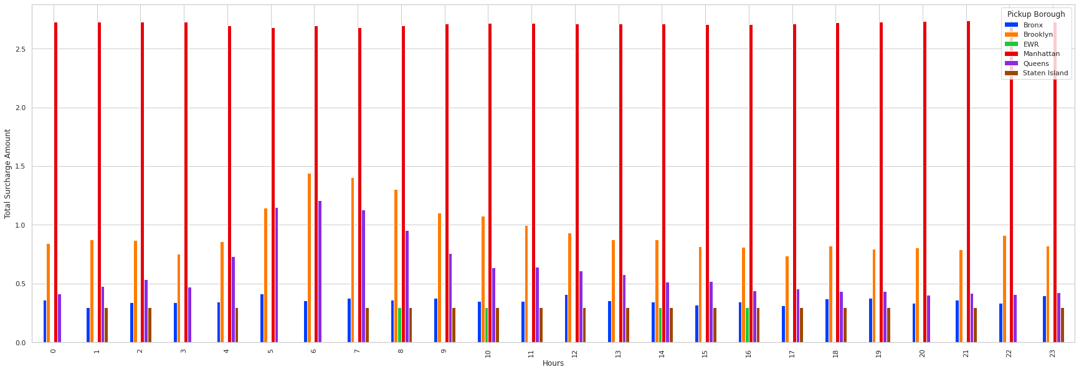
Comparison with Yellow Taxi
The total surcharge amount for yellow taxi is greater than the surcharge amount of green taxi for all the boroughs with Manhattan having the highest and constant surcharge of $2.75.
Notes:
Plus New York State Congestion Surcharge of $2.50 (Yellow Taxi) or $2.75 (Green Taxi and FHV) or 75 cents (any shared ride) for all trips that begin, end or pass through Manhattan south of 96th Street.

Slide 25
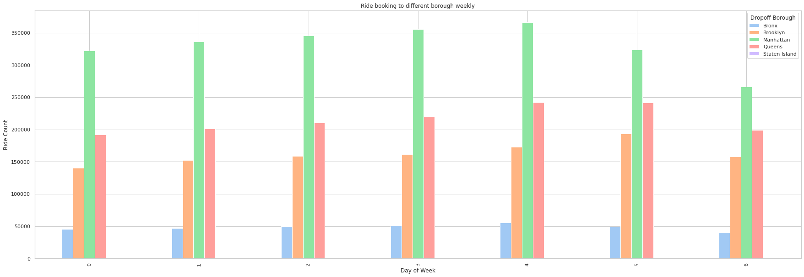
Analysis of Ride Bookings To Different Boroughs
The borough that most people travel within or travel to in Green taxis is Manhattan followed by Queens, Brooklyn and Bronx.
Notes:
Staten island is not visible in the graph as there are hardly any green taxi rides that got to Staten Island and people might be leveraging the free Staten Island ferry instead.

Slide 26
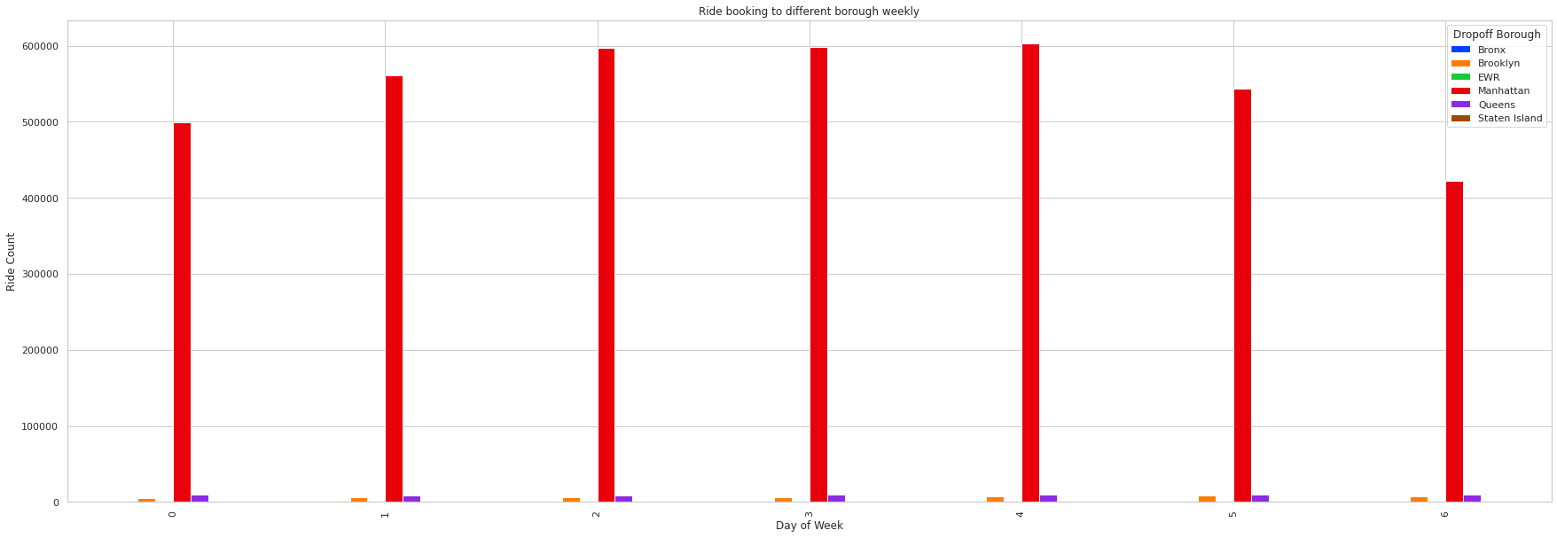
Comparison with Yellow Taxi
Trips in Manhattan are highly dominant in case of yellow taxis as compared to green taxis. The reason could be that yellow taxis are local to southern Manhattan.
Notes:
Staten island is not visible in the graph as there are hardly any green taxi rides that got to Staten Island and people might be leveraging the free Staten Island ferry instead.

Slide 27
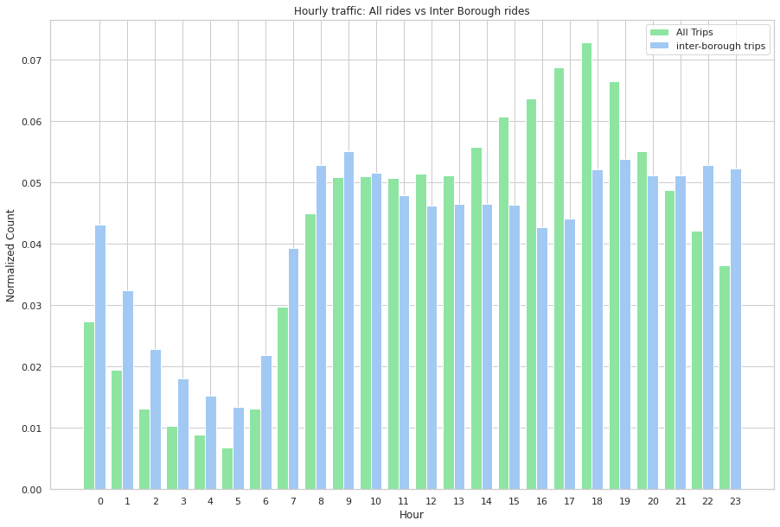
Hourly Analysis of Inter-Borough Trips Vs All Trips
The frequency of green taxi trips for inter-borough commute stays high from 7am to 12am with only minor fluctuation in between from 11am to 4pm.

Slide 28
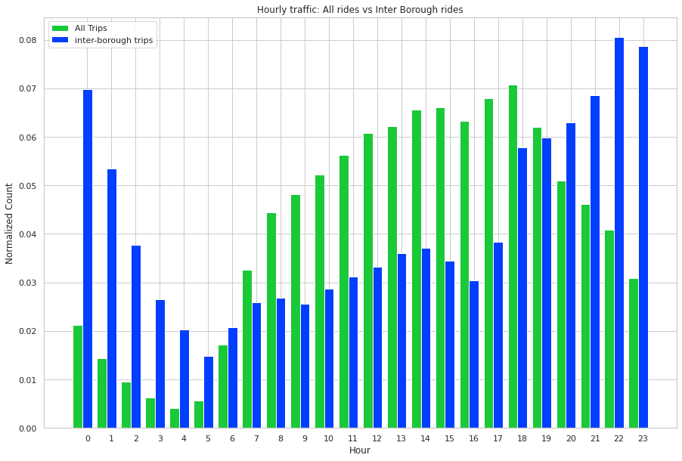
Comparing Hourly Inter-Borough & Total Trips with Yellow Taxi
For Yellow Taxi, the number of interborough trips show an up trend starting from 5pm and peak during late night hours from 10pm – 1am.
While the number of total trips are higher during morning and afternoon. (8am – 4pm)

Slide 29
Conclusion
Credit Cards and Cash were the two preferred methods of payment where people with credit cards pay higher tips more frequently.
Green Taxis, cover very a smaller number of fares during late night hours, which indicates people prefer to pre book their cabs with regards to safety concern.
There is a sharp decline in the number of trips starting February 2020 even though the official lockdown date was mid-March 2020 which is represented by green vertical line. This implies that COVID-19 was the cause of the down trend, and it started even before the official lockdown announcement was made.
Trips that occur in early morning hours relatively cover longer distances than those happening in the rest of the day.
Majority of the bookings begin to start early morning during office hours and there is a spike in number of cabs booked around 5pm and 6pm as the offices close and people rush towards home.
In contrast, we see that the number of trips gradually increases as the day progresses.
Most rides occur between 0 to 2 miles.

Slide 30
Thank You

Slide 31

Questions

