Slide 1
Supply Chain Optimisation Considerations for Power Inverter
Authored & Presented by
ADITI OAK

Slide 2

Presenter Bio
3rd year E&TC student at Cummins College of Engineering, Pune
Department topper for 3 consecutive years
Avid hackathon participant
Previously an Intern at Twintech Control Systems Pvt Ltd, Pune
Incoming Software Engineering Intern at Microsoft India
Represented India in a space, engg and leadership camp at NASA’s US Space and Rocket Centre, Alabama, USA
National level swimmer and water polo player
https://github.com/aditioak
aditioak02@gmail.com / aditi.oak@cumminscollege.in

Slide 3
Problem Statement
Lead Time, Safety Stock, Minimum Order Quantities and ABC classification are key part parameters which form the basis of Materials Planning. Create a model which
  Takes into account the various factors in Supply Planning which contribute to these parameters
  Identifies the right method to re-calculate these parameters assuming there is current value of these parameters already defined but needs evaluation and optimization based on parameters identified in point(1) above
  Simulates the impact of the re-calculated parameters on Inventory levels
The model can be built in excel or other analysis and visualization tools as per convenience, but should clearly outline the input, calculation process, simulation capabilities and stage wise output

Slide 4
The Market
The market research and analysis by marketing dept. suggests demand for two models with estimated volumes, features & target prices. Company initially considering Standard Model, Premium Model
Standard Model
Category workhorse budget model
Quasi-sine-wave inverter
Capacity = 900 VA
Est. demand per month = 500
Target price = Rs 10500
Premium Model
Feature-rich top-tier model
True-sine-wave inverter
Capacity = 900 VA
Est. demand per month = 100
Target price = Rs 15000

Slide 5
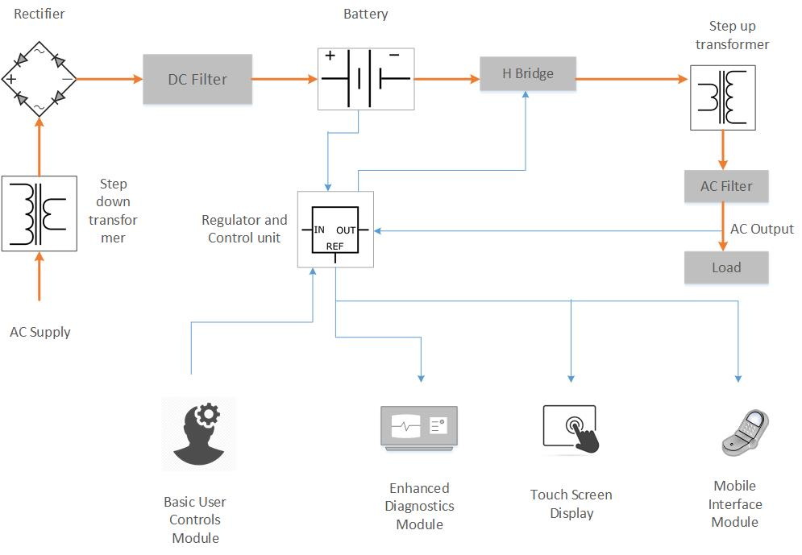
The Product
Block Diagram
Bill of Materials

Slide 6
Comparative Supplier Data
Supplier Mix = Supplier #1 (40% volume); Supplier #2 (33% volume); Supplier #3 (27% volume)

Slide 7

EOQ: Pillar #1 of Material / Inventory Planning
EOQ = Economic Order Quantity
Two prime cost components of Material / Inventory Strategy
  Ordering Costs (S)
  Holding Costs (H)
Too many orders of smaller qty reduce inventory hence Holding Costs (H) but increase per order transaction costs (Ordering Costs, S)
Too few orders of large qty reduce Ordering Costs (S) but increase inventory hence Holding Costs (H)
Strategy: Balance S & H so total inventory costs are minimum (excl. Material Costs)
H
S
EOQ

Slide 8
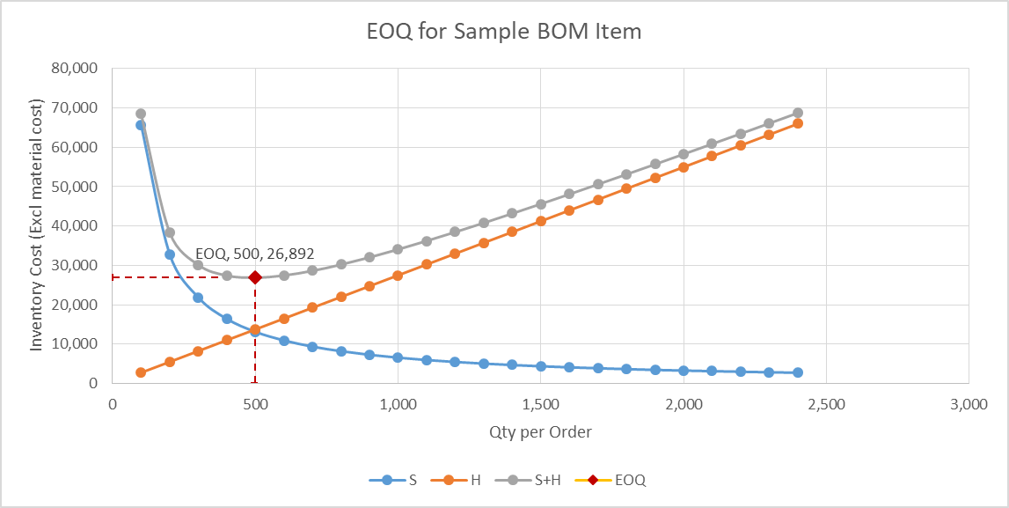
EOQ Simulation on a sample part
(Inverter Enclosure Assembly)
EOQ Mathematical Expression:
EOQ = (2 x Demand x Order Cost / Holding Cost) ^ ^{1/2}
EOQ can be used to simulate:
Supplier mix for various components in multi-vendor sourcing strategy
Inward goods rejection ratio from various suppliers
MOQs enforced by suppliers
and their impact on overall costs of materials operation and planning

Slide 9
EOQ Simulation w/ Multi-Supplier Mix
(Calculations & Data Table)

Slide 10
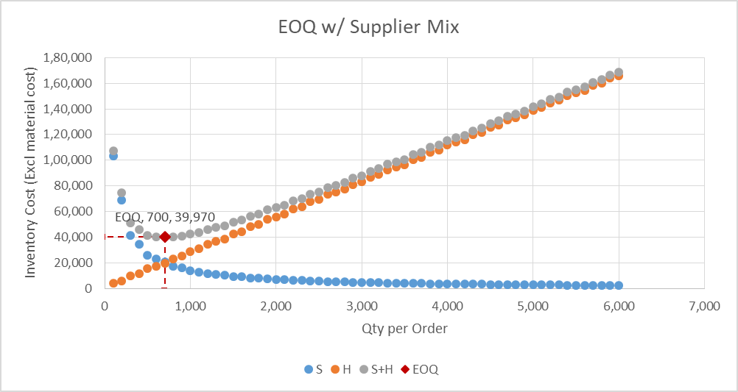
EOQ Simulation w/ Multi-Supplier Mix
(Chart with EOQ)

Slide 11
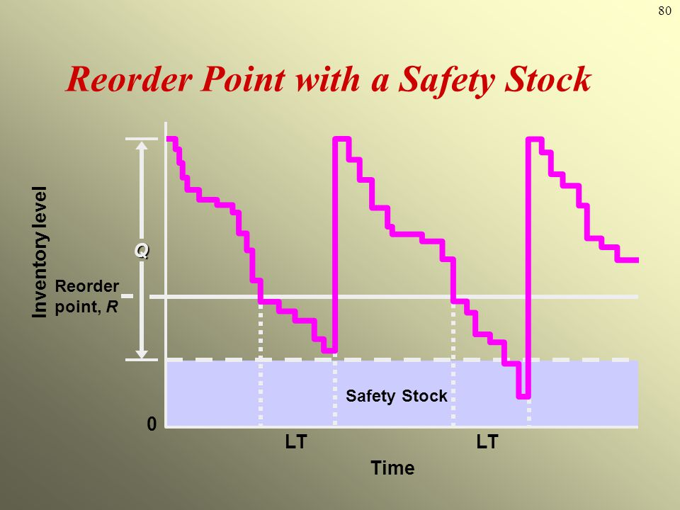
ROP: Pillar #2 of Material / Inventory Planning
(Re-Order Point)
ROP allows company to address demand fluctuation, variation / impact of lead times and need for safety stock to avoid stock-out situations as also abnormal input material rejections
Mathematical expression of ROP:
  ROP = Average usage per period x lead time + safety stock
ROP strategy can be adopted for single item or collection / combination of multiple items that are used in the product
MOQ & EOQ also affect ROP amongst other factors (e.g. rejection ratio)
ROP can be used to automatically generate & process order(s) to supplier(s)

Slide 12
ROP Calculation & Simulation Data Table
Table and the chart model variability of average LT and average demand
Other supplier parameters are assumed held constant
Base case parameters w/ safety stock level shown in adj table
Modelled for single supplier but can be extended to multi-supplier system

Slide 13
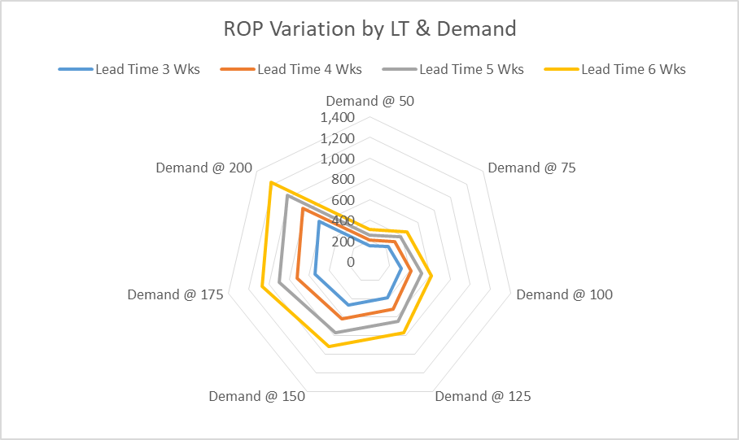
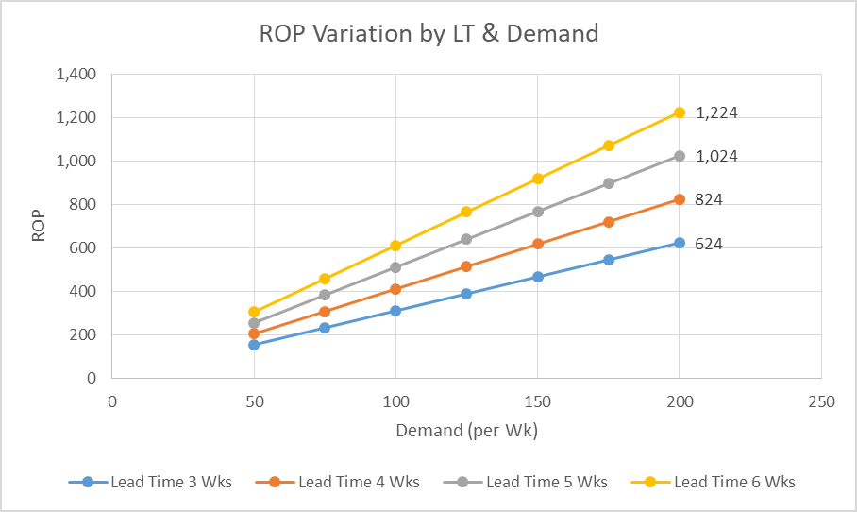
Simulation of ROP Variation w/ LT & Demand
Radar Chart
Scatter Chart

Slide 14
ABC Classification: Pillar #3 of Material Planning
Method in which inventory is divided into three categories, i.e. A, B, and C in descending value
‘A’ rank: High-value components with fewer manufacturers; ~80% of the annual inventory value
‘B’ rank: moderate criticality items; not as critical as rank ‘A’ items nor as trivial as rank ‘C’ items; ~10% to 15% of the annual inventory value
‘C’ rank: Commodity items w/ abundant suppliers at competitive price; ~5% to 10% of the annual inventory value

Slide 15
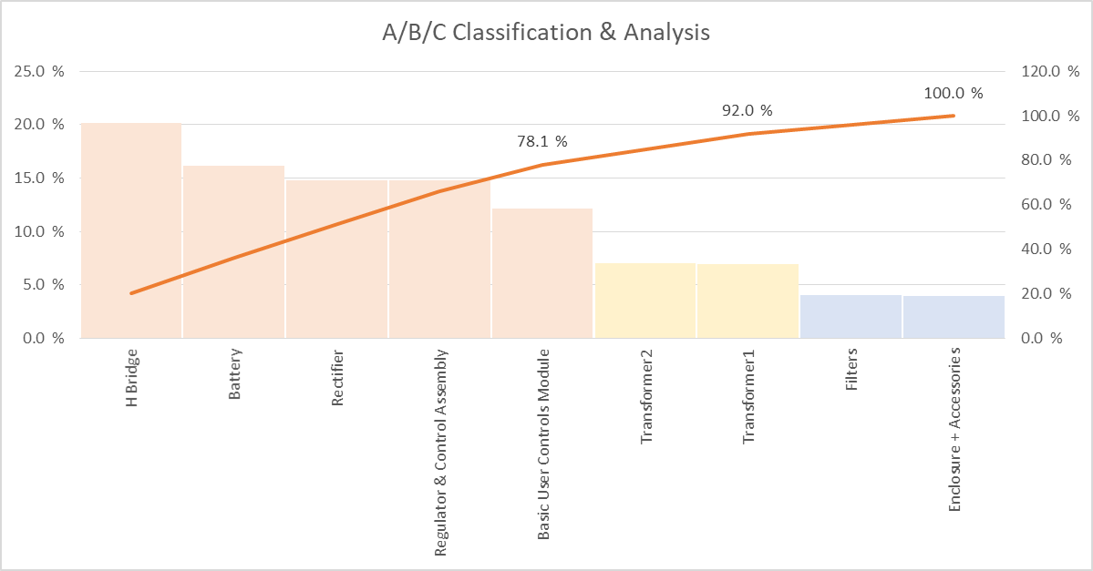
ABC Analysis: Pillar #3 of Material Planning

Slide 16
Conclusion
Advantages
Limitations
Data-driven models & simulations help map out best-case & worst-case scenarios that help organisations plan for operational consequences
This allows for far better approach than the ad-hoc materials planning
Much efficient & cost-effective
Eliminates / reduces human biases
Well-informed, rational decision-making
Simplicity if models managed well
Models & simulations rely on high-quality data; garbage in → garbage out
Models outline large variety of outcomes but not necessarily all
Model complexity grows with large number of variables
Requires skilled supply-chain analyst

Slide 17
Thank you for your attention
Happy to take any questions…

Slide 18
Reference Material
https://www.sciencedirect.com/science/article/pii/S0307904X15000773
https://www.zoho.com/in/inventory/economic-order-quantity/
https://nptel.ac.in/courses/110107141
https://www.datacamp.com/community/tutorials/inventory-model-simulation-with-spreadsheets
https://www.netsuite.com/portal/resource/articles/inventory-management/minimum-order-quantity-moq.shtml#:~:text=A%20minimum%20order%20quantity%20is,units%20%E2%80%94%20or%20at%20least%20%2410%2C000.
https://www.netsuite.com/portal/resource/articles/inventory-management/economic-order-quantity-eoq.shtml
https://www.zoho.com/inventory/guides/what-is-a-reorder-point.html#:~:text=To%20calculate%20a%20reorder%20point%20with%20safety%20stock%2C%20multiply%20the,of%20safety%20stock%20you%20keep
https://www.investopedia.com/terms/a/average-age-of-inventory.asp#:~:text=What%20Is%20the%20Average%20Age,sales%20in%20inventory%20(DSI)

