Slide 1
Introduction to D3.js
CPSC-473-front End Engineering
Instructor : Prof. Kenytt Avery
Presented By:
Aditi Patil – 893228023
Snehal Jadhav - 893557538

Slide 2
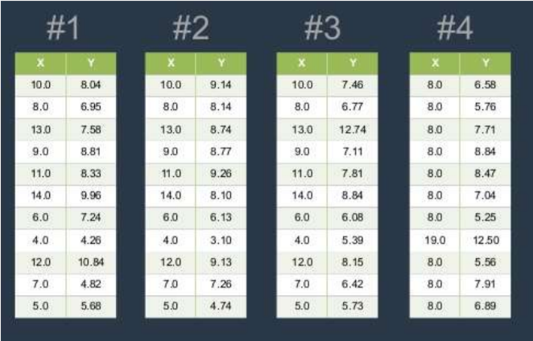
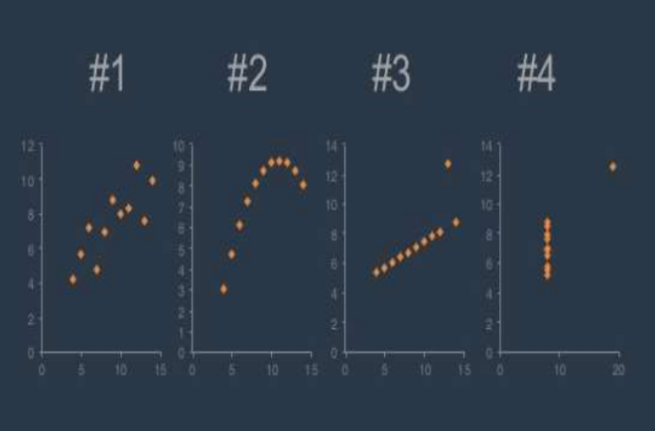
Data Visualization
Raw Data
Transformed Data

Slide 3

D3.js
Stands for Data-Driven Documents.
A JavaScript library for producing dynamic, interactive data visualizations in web browsers.
Uses HTML, CSS and SVG to provide a powerful, flexible library for manipulating the DOM and displaying data.
Allows you to bind arbitrary data to a Document Object Model (DOM), and then apply data-driven transformations to the document.
Supported in popular frameworks like EmberJS, AngularJS and React.

Slide 4
Installation:
ember install ember-d3
Requirements:
NPM >= 3
Node >= 8
Ember CLI >= 2.16

Slide 5
D3 Methods
select()
data()
enter()
append()
attr()
style()
……

Slide 6
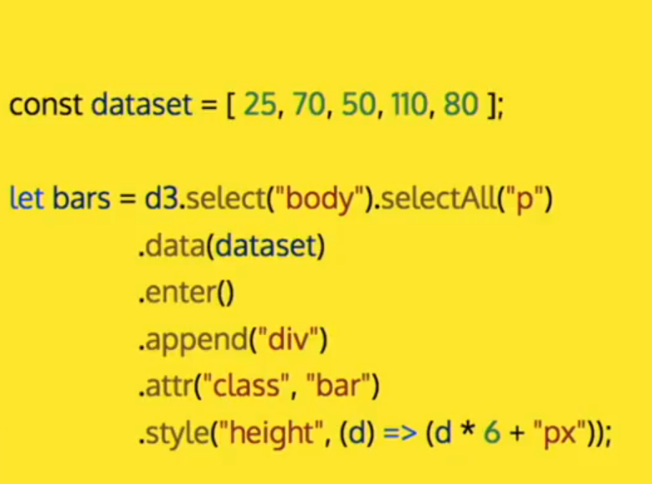

Example

Slide 7

Demo

Slide 8
Advantages
Minimal Overhead
1
Extremely fast
2
Supports dynamic behaviors for interaction and animation
5
Allows code reuse.
3
Supports large datasets
4

Slide 9

Applications
D3 contains several hundred functions, and they can be grouped into following logical units:
Selections
Transitions
Arrays
Math
Color
Scales
SVG
Time
Layouts
Geography
Geometry
Behaviors

Slide 10

Summary
D3.js (D3 for Data-Driven Documents) is a JavaScript library for creating dynamic data visualizations in the browser. It makes use of the widely implemented SVG, HTML5, and CSS standards with a data-driven approach to DOM manipulation to create interactive graphics . Various methods provided by the D3 allows you to bind data to a Document Object Model (DOM), and then apply data-driven transformations to the document. For example, you can use D3 to generate an HTML table from an array of numbers. Or, use the same data to create an interactive SVG bar chart with smooth transitions and interaction.

Slide 11
References
https://d3js.org/
https://en.wikipedia.org/wiki/D3.js
https://www.npmjs.com/package/ember-d3
http://www.thegreatcodeadventure.com/using-ember-charts-to-integrate-d3-with-ember/
https://www.youtube.com/watch?v=dL5dWNMGy5g

Slide 12
Thank you

