Slide 1

Project Title – Seasonal Agriculture Performance Analysis
Student Name - Aditi
College Name- Shoolini University
AICTE STU ID : (STU6a677e9dc6a441785167517)

Slide 2

PROBLEM STATEMENT
Agricultural activities are influenced by seasonal variations in environmental conditions, farming practices, resource availability and market conditions. As a result, agricultural performance may differ from one season to another. However, raw agricultural data does not clearly explain how agricultural performance changes across seasons or what patterns can be observed in different seasonal conditions. The problem is to analyze the given agricultural dataset and investigate seasonal differences in agricultural performance by identifying meaningful patterns, trends, relationships and variations within the available data.

Slide 3
Project Description This project analyzes agricultural data to study crop performance across different seasons. The analysis focuses on factors such as crop yield, production, rainfall, temperature, fertilizer and pesticide usage, and market price. Data cleaning, statistical analysis and visualization techniques are used to identify seasonal patterns, compare crop performance and generate useful insights for improving agricultural decision-making.

Slide 4

WHO ARE THE END USERS?
Farmers – to understand crop performance and improve farming decisions.
Agricultural Researchers – to study seasonal trends and crop productivity.
Government & Agricultural Departments – to support data-driven agricultural planning.
Agribusinesses – to understand production and market trends.

Slide 5

Technology Used
Python
Pandas
NumPy
Matplotlib
Google Colab

Slide 6
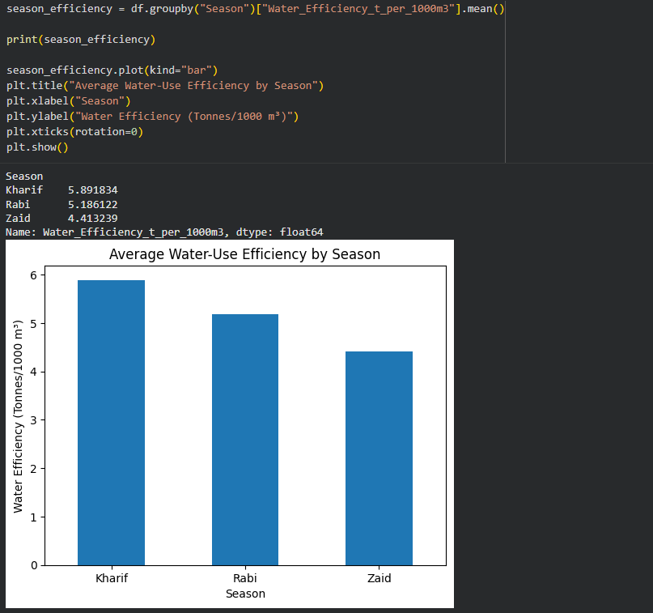
RESULTS
Key Finding: Kharif season shows the highest water-use efficiency, while Zaid shows the lowest.

Slide 7
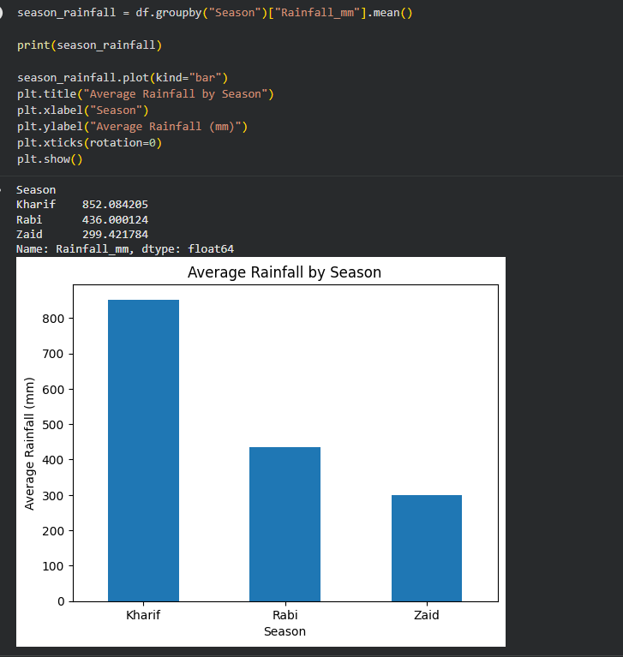
RESULTS
Key Finding: Kharif receives substantially higher average rainfall than Rabi and Zaid.

Slide 8
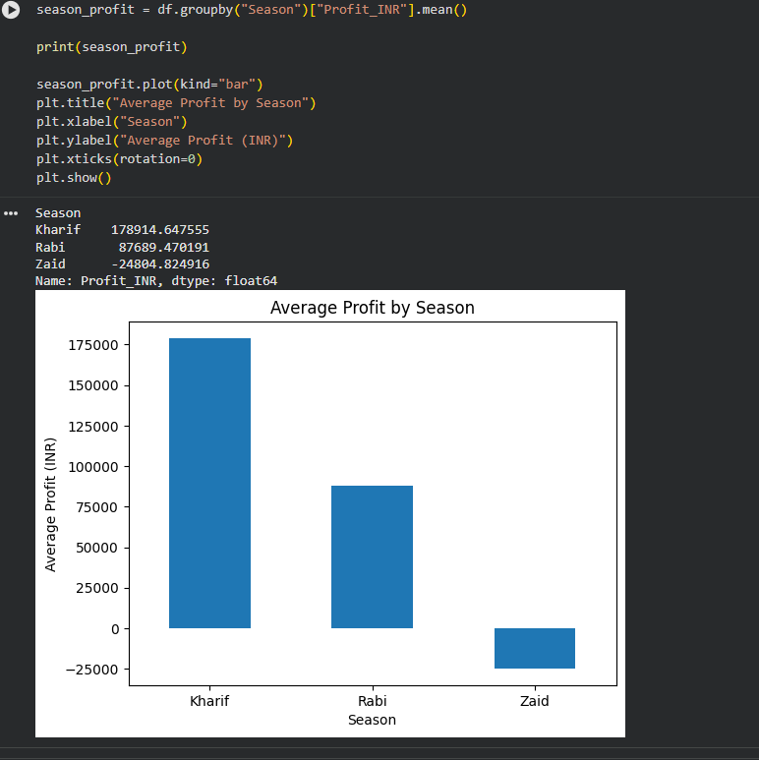
RESULTS
Key Finding: Kharif has the highest average profit, while Zaid shows an average loss.

Slide 9
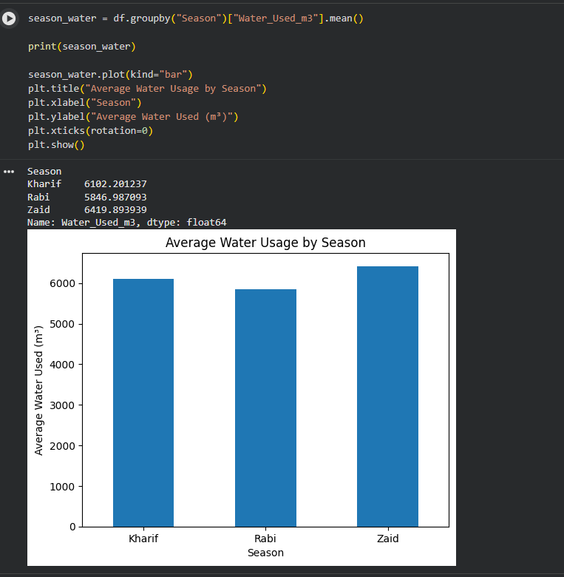
RESULTS
Key Finding: Zaid uses the highest average amount of water among the three seasons.

Slide 10
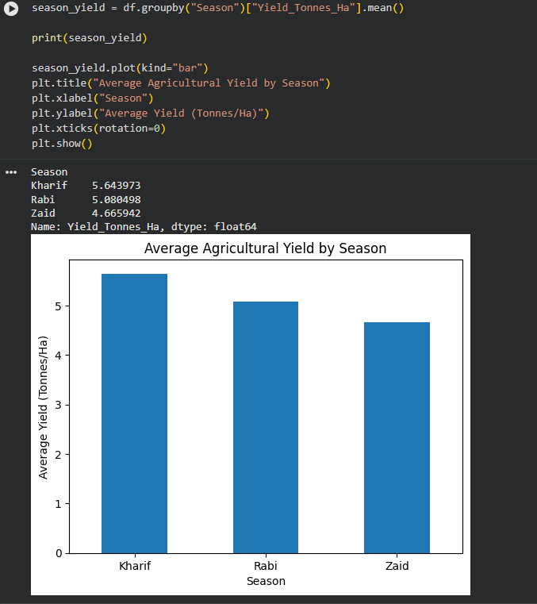
RESULTS
Key Finding: Kharif has the highest average crop yield, followed by Rabi and Zaid.

Slide 11
Future scope
* Develop predictive models to forecast crop yield and agricultural performance.
* Analyze weather and environmental data for better seasonal planning.
* Extend the analysis to more crops, regions and years.
* Develop a real-time agricultural dashboard for farmers and decision-makers.
* Use machine learning to provide data-driven crop and resource recommendations.

Slide 12
GitHub Link
https://github.com/aditipirta777/Seasonal-Agriculture-Performance-Analysis

Slide 13

VOIS Course completion certificate - Course name- Data Visualization

Slide 14
Thank you
.
.

