Slide 1
PREDICTIVE PROJECT
HOUSEHOLD CLEANERS
GROUP 10
BRAND
PINE SOL ALL PURPOSE CLEANER

Slide 2
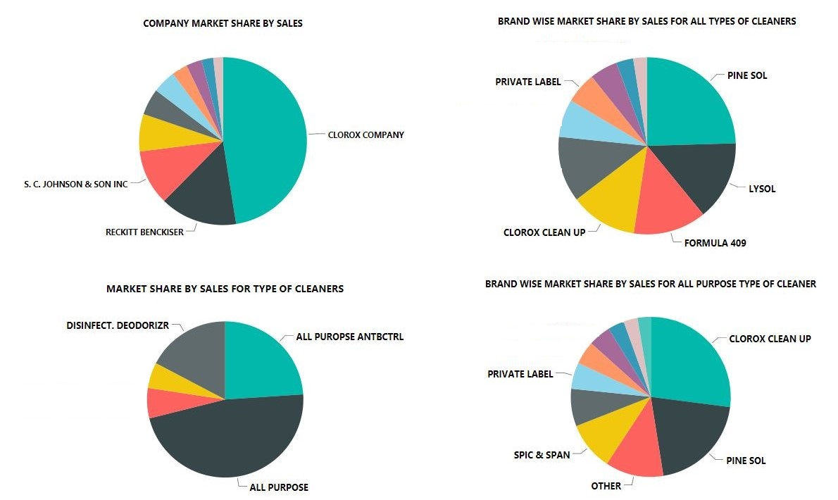
OVERVIEW

Slide 3
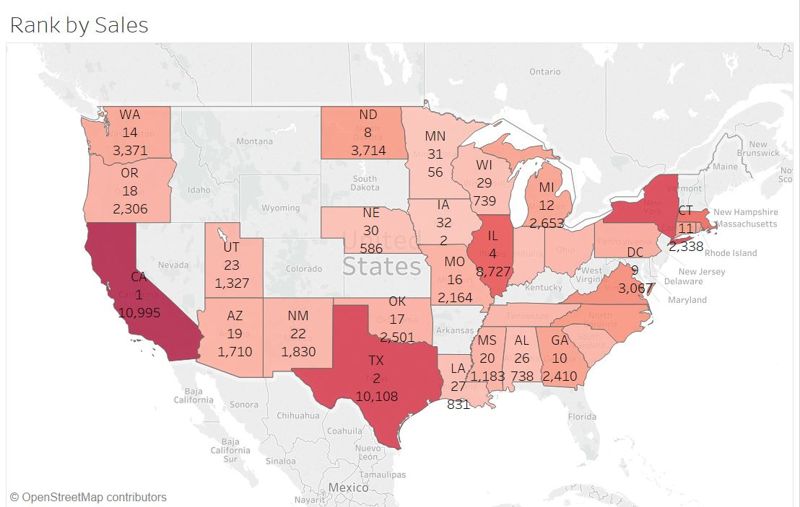
MARKET SHaRe BY SALES
NEW YORK
CALIFORNIA
TEXAS

Slide 4
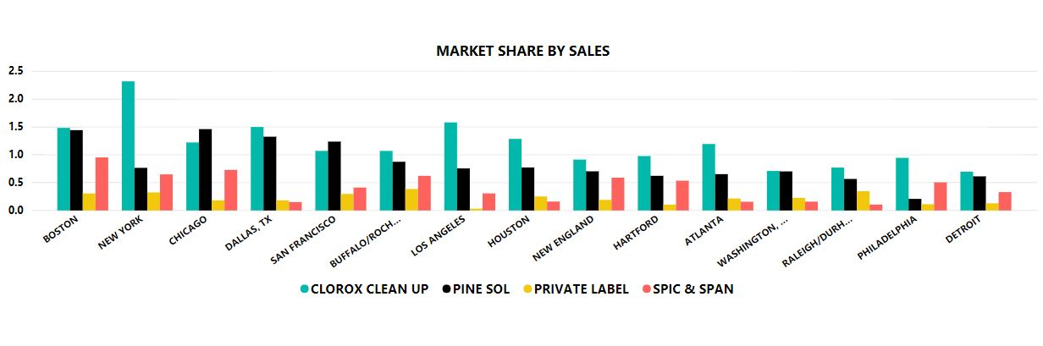
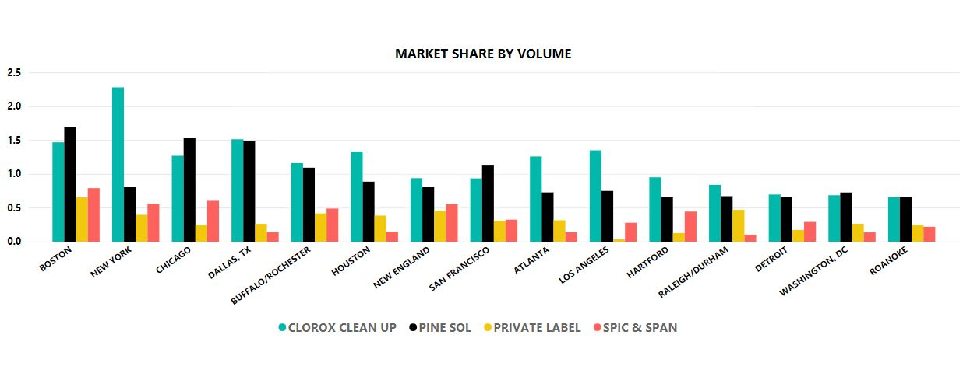
MARKET SHARE
Pine Sol Dominates
Pine Sol Lags

Slide 5
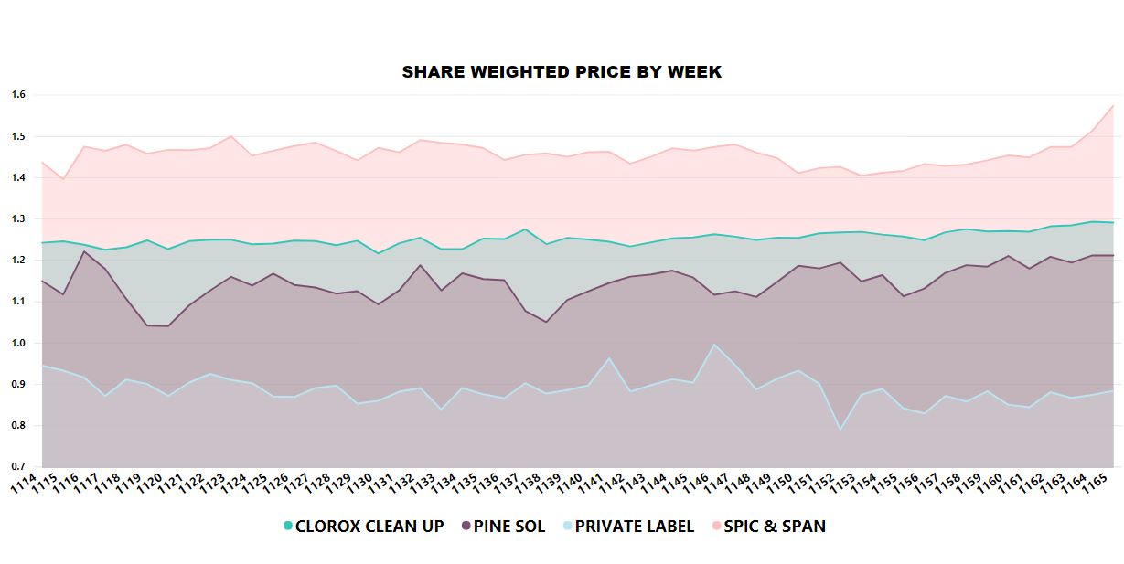
SHARE WEIGHTED PRICE BY WEEK
Out of the top 10 brands for all purpose cleaner, Pine Sol has the second lowest share weighted price.

Slide 6
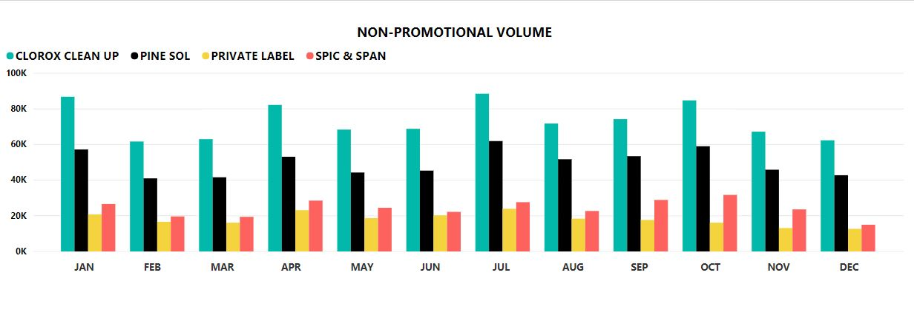
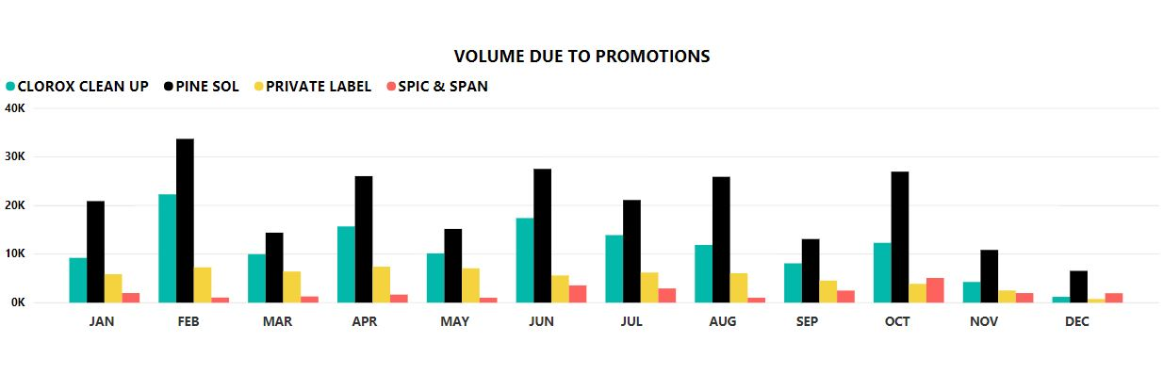
promotional & non-PROMOTIONAL VOLUMES
Higher for Clorox Clean Up
Higher for Clorox Clean Up
Higher for Pine Sol
Accounts for 29% of Pine Sol’s overall sales
& 14% of Clorox Clean Up’s overall sales

Slide 7
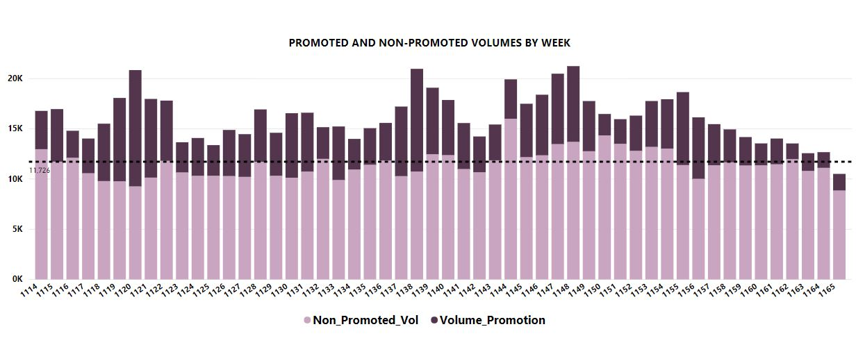
Promoted vs Non-Promoted Volume
Highest Promotional Week (Feb & June)
Least Sale & Promotions
(December)
Baseline Volume
(11726)
Baseline volume gives the estimated weekly sales without any promotions,
The volume sales above this line is the estimated sales due to promotions or seasonality, while the actual values are highlighted within the graph.
Notes:
Baseline volume gives us an estimated weekly sales without any promotions. This can help us in inventory management.
We see that Feb and June are the peak months for promotions while December seems to be the one with the least focus on promotions
We can see that whereever the sales are at border line in comparision to baseline volume the promotional volumes are high

Slide 8
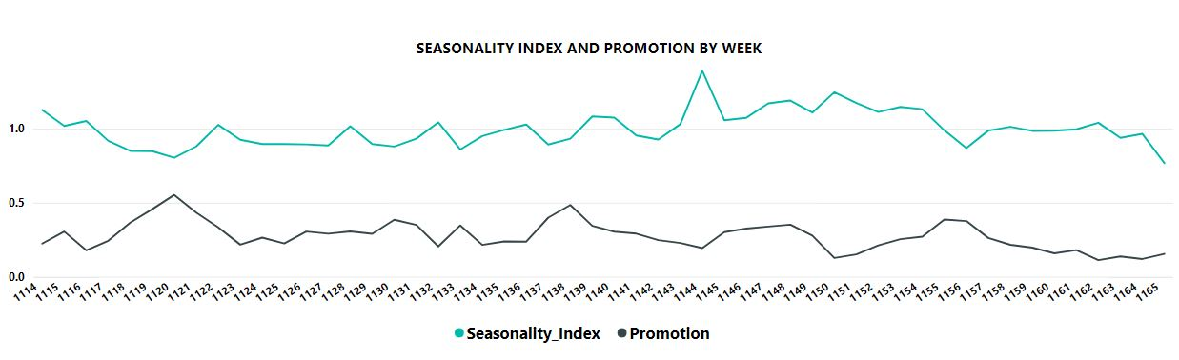
SEASONALITY INDEX
Peak Season
Week 1144 (July)
Peak Promotion
Week 1120 (Feb)
Drop in seasonality & promotions
Seasonality can help us predict weekly or monthly sales better
Notes:
As we can see July is the peak season for sales and we can relate this to the previous slide as well.
We see a trend here.. Whenever there is a high seasonality there are lesser promotions and during low seasonality we have high promotions
Exception: December – Need to work on this.

Slide 9
Factors that impact volume sales
Variable | Effect on volume in units
Medium Size Ad along with a Major Display | 45.3
Medium Size Ad along with a Minor Display | 44.5
Large Size Ad with a Minor Display | 31.1
Share weighted price | 16.2
Price Reduction | 5.43

Slide 10
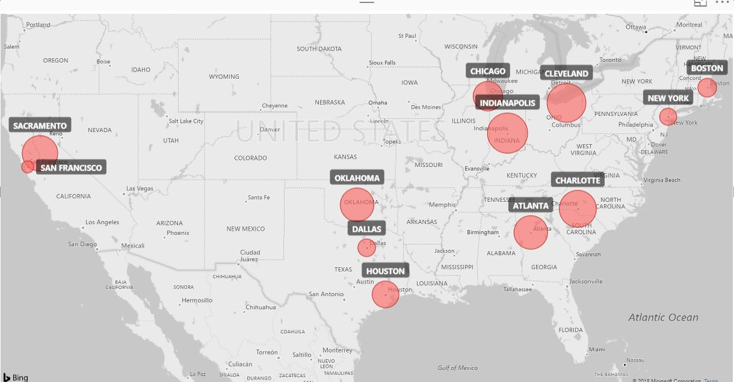
PRICE Elasticity IN cities – TARGET MARKET
Highest
Lowest

Slide 11
SEGMENTS
Champions ( 20%) : “Bought recently, buy often and spend the most!”
Loyal Customers ( 45% ): “Spend good money with us often”.
At Risk ( 20%) : “Spent big money and purchased often. But long time ago” .
Potential Loyalist (11%): “Recent customers with high frequency but have not spent large amount” .
Customer Needing Attention (4%): “Average recency, frequency and monetary values”.

Slide 12
COMPARISION BETWEEN SEGMENTS
"At Risk" & "Needs Attention" | "Champion" & "Loyal"
Households have no Pets | Households have Pets
Higher household Income | Lower Household income
More educated males in households | Less Educated Males in Households
Occupation Type = Professional or Technical | Occupation Type = Retired
COMMON CHARACTERISTICS White | Married | No children | Home owners | Non-Hispanic | Full time working females | The median Household age is 45 - 64 years | Median household income $20k - $55k | Full-time working male in 65% of households |

Slide 13
Targeting strategies
The high priced and new products can be marketed to the champion category customers as they are most likely to buy them.
The loyal customers should be kept engaged by asking for reviews and also recommend higher priced products.
The potential loyalist group show trends of loyal customers so they can be given loyalty programs and/or gift cards to increase their spending and frequency.
The at risk and needing attention category can be reactivated by providing limited time offers and sending personalized emails and discounts on next purchase.

Slide 14
OBSERVATIONS
The odds of buying Pine Sol All purpose cleaner increases by 78% for households with some high school education as compared households with post graduate work.
The odds of buying Pine Sol All purpose cleaner increases by 179% for households with children in 0-5 & 6-11 age groups as compared to households with no children.
The odds of buying Pine Sol All purpose cleaner increases by 179% for households with children in 0-5 & 6-11 age groups as compared to households with no children.
The odds of buying Pine Sol All purpose cleaner increases by 60% for households with an age group of 35-44 as compared to an age group of 65+.

Slide 15
THANK YOU

