Slide 1


Forschungsprojekt TK DA Wardriving
Team CodeChef: Supervised by:
Aditi Saini Christian Meurisch
Angeelina Rajkarnikar
Arpitha Nagaraja
Arun Kumar Naranahalli Anjanappa
Disha Anant Bhat
Preethini Vijay Kumar

Slide 2
Overview
Introduction
Objectives
Architecture
Used Technologies
Algorithm
Visualization
Statistics
Conclusion

Slide 3

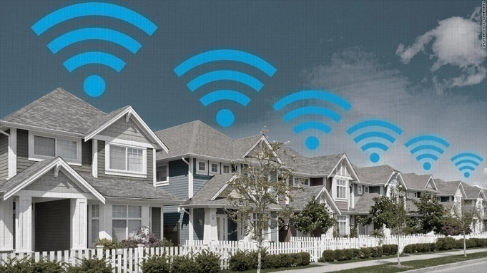

Introduction
Wardriving – Collection of Wifi access point details on the move.
Use Wi-Fi equipped device along with a GPS device.
Record the location of wireless networks.
Latitude: 49.8192
Longitude: 8.6449
Latitude : 48.8192
Longitude: 8.6449

Slide 4
Objectives
Collection of Access Points.
Determine the location of wireless routers by implementing Centroid Algorithm (multilateration).
Optimization of the above to improve accuracy.
Map Visualization.
Data upload into TK server.

Slide 5



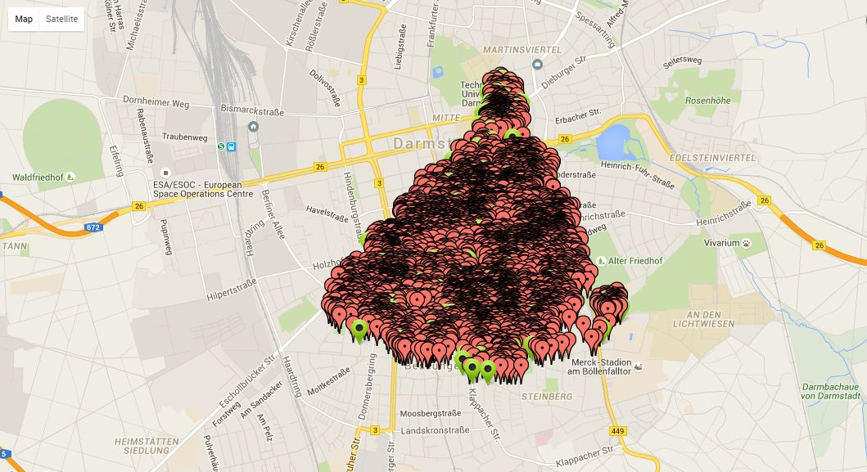
Architecture
Virtual Machine
BSSID
SSID
Crontab
Capabilities
CENTROID
LEVENBERG MARQUARDT
OPTIMIZER
RSSI
Local DB
TK Server
Visualization

Slide 6



Used Technologies

Slide 7
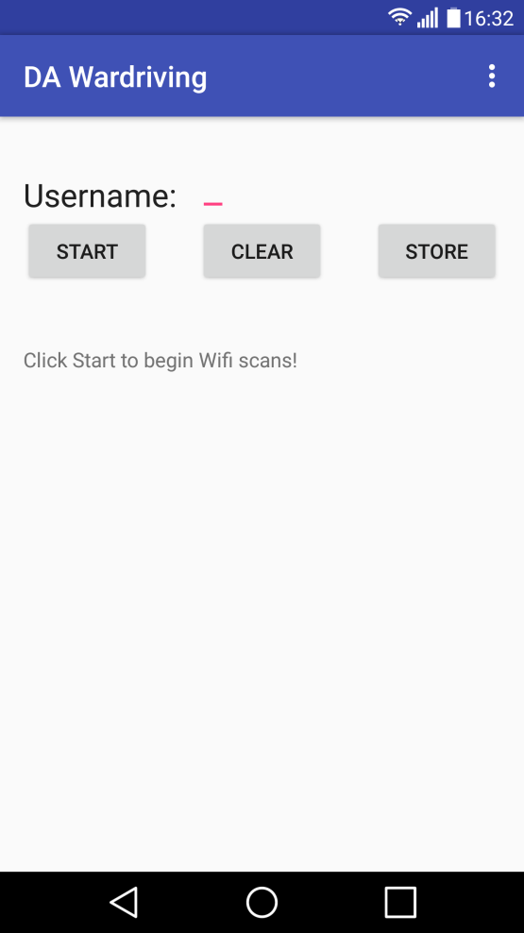
Client Side (Android)
Scan Wifi signals on the move.
Calculate distance using Path loss model.
Requirement: min 3 scans required.

Slide 8
Server Side - Algorithm
Start
Fetch scanned results from Database.
Distance < 100m && Limit 10
Convert to Cartesian coordinate
2D array of user’s location and distance
Jacobian function
Jacobian Matrix
Centroid calculation
Levenberg Marquardt Optimizer of Centroid
AP Location

Slide 9

Map Visualization
http://130.83.163.65/showAccessPoint.html
Protected
Open

Slide 10
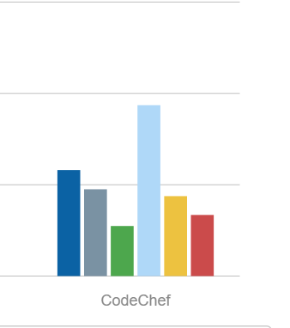
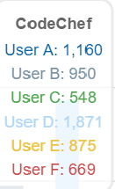
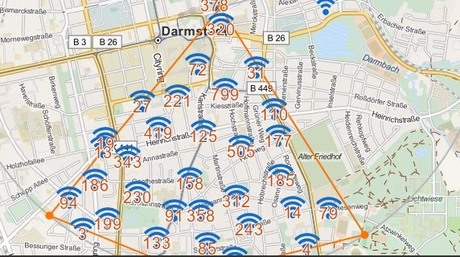
Statistics
Total number of Access Points collected is 6073.

Slide 11
Conclusion
The Centroid algorithm with Levenberg Marquardt Optimizer has given us the accurate location of Access Point.
Error rate upto 100m.

Slide 12


Slide 13
References
Kamill Panitzek, Immanuel Schweizer, Axel Schulz, Tobias Bonning, Gero Seipel, and Max Muhlhauser. “Can We Use Your Router, Please?: Benefits and Implications of an Emergency Switch for Wireless Routers”. International Journal of Information Systems for Crisis Response and Management, 4(4):59–70, 2012.
M.I.A. Lourakis, “A brief description of the Levenberg-Marquardt algorithm”, Institute of Computer Science, Foundation for Research and Technology- Hellas, 2005.
Scholastica .U, "Pathloss Prediction Model of a Wireless Sensor Network in an Indoor Environment", International Journal of Advanced Research in Electrical, Electronics and Instrumentation Engineering, Vol. 3, Issue 9, September 2014.
Math3-3.2 Jar: Demo Source and Support, “Download commons-math3-3.2-test-sources.jar : commons math3 « c « Jar File Download”. Retrieved December 20, 2015 from http://www.java2s.com/Code/Jar/c/Downloadcommonsmath332testsourcesjar.htm

Slide 14


