Slide 1


Cultivating Food Entrepreneurs

Slide 2
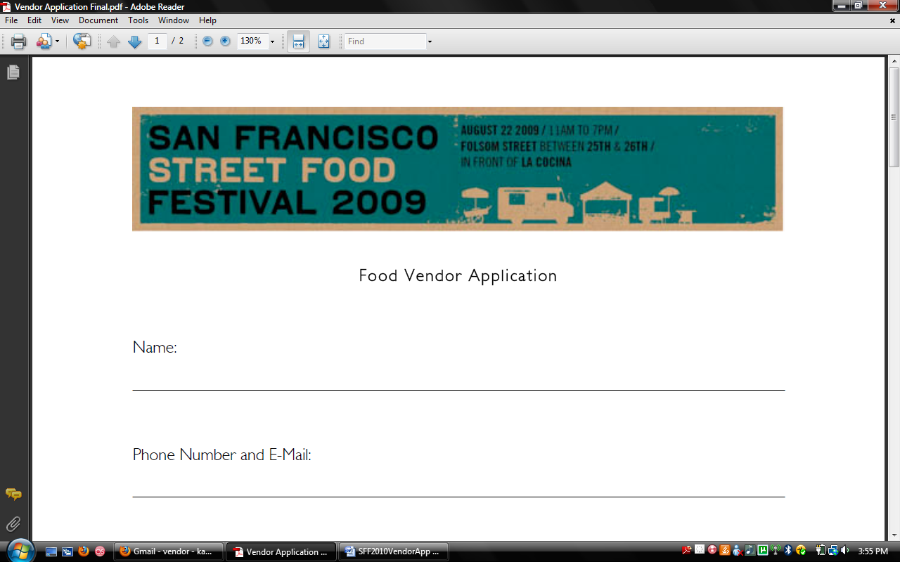
24th 26th
25 shottwell to treat
Treat 24th 26
All of Garfield park

