Slide 1
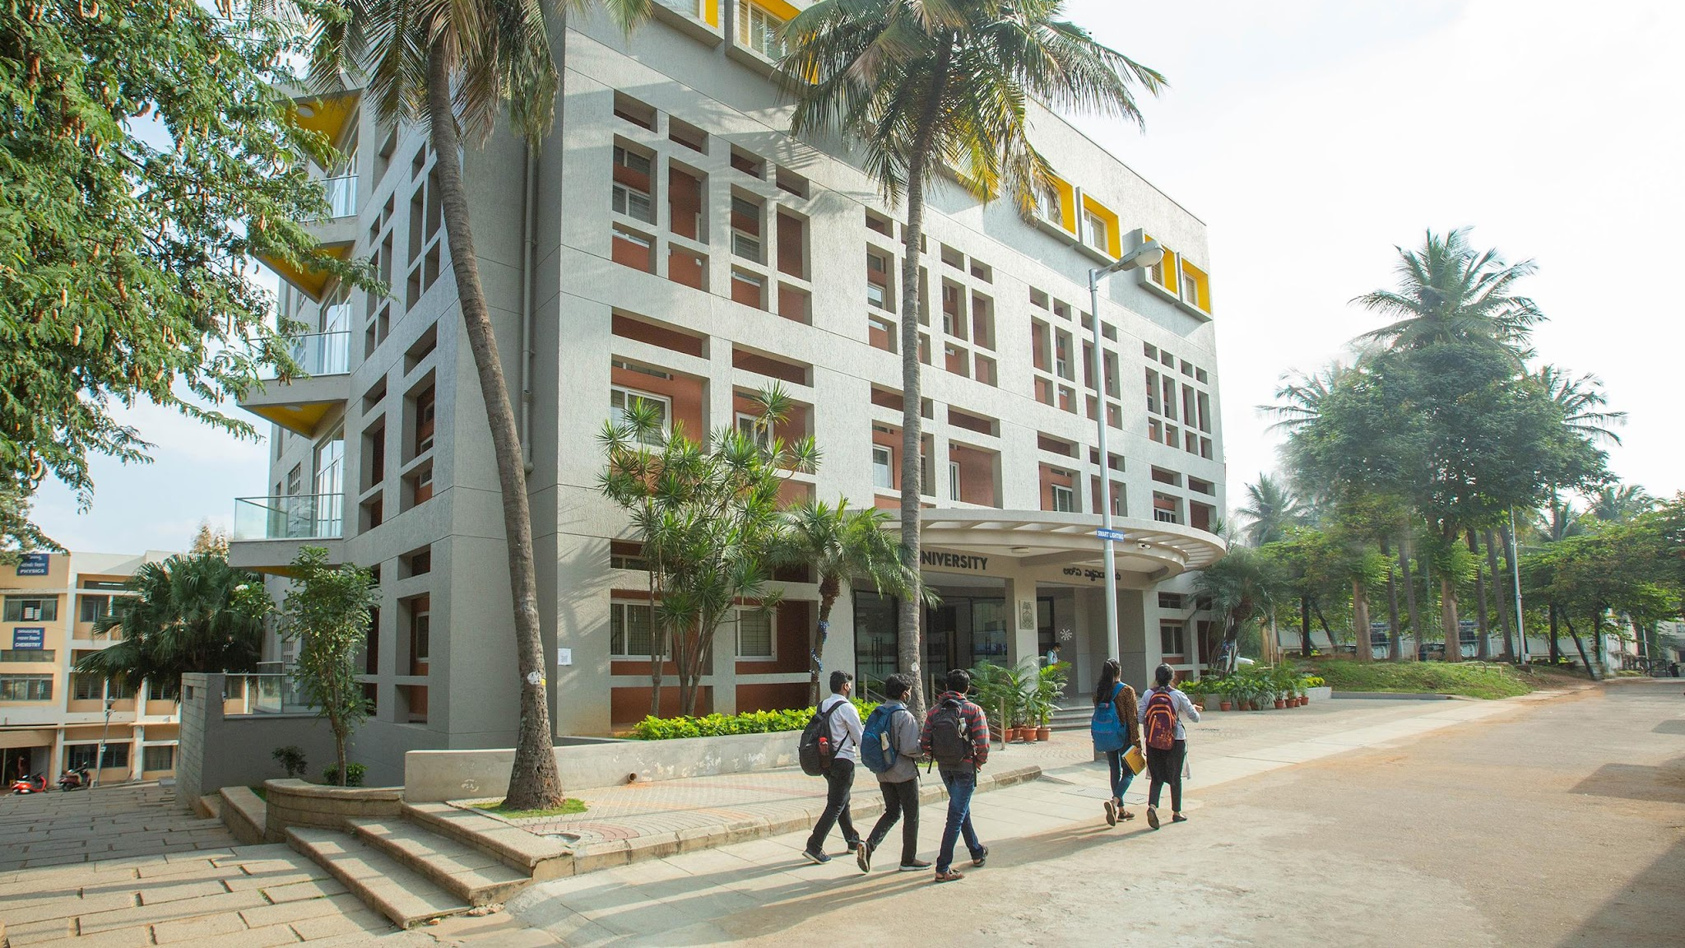

CS3301 FULL STACK DEVELOPMENT
CAMPUS SCOUT: WHAT'S AROUND YOU?
Aditi - 1RUASCS0004
Aryaman - 1RUASCS0013
Jeevitha - 1RUASCS0044
Krishnendu - 1RUASCS0052
5th Semester

Slide 2
1. Title and Problem definition
Core Problem Statement
Students moving to new campus environments face significant exploitation from rental middle-men, hidden utility charges, and online booking tricks because they lack a single, honest location-tracking guide.
Key Student Challenges
Broker Tricks and Fake Reviews: Rental prices are manipulated online, and third-party commercial platform ratings cannot be trusted by arriving students.
Hidden Fees and Secret Costs: Listed property rents hide steep mandatory charges for basic necessities like laundry machines, geysers, or Wi-Fi.
Online Scams and Fake Bookings: Malicious actors list fraudulent room photos to trick students into scanning QR codes or sending instant digital advances before physically inspecting a location.
Scattered Local Information: Essential daily student resources—including budget food joints, reliable electronics repair, and valid internship listings—are fragmented across multiple websites.

Slide 3
Introduction
Concept: A map-centric, community-driven discovery portal made by students, for students.
Tagline: “Real places. Honest reviews. Everything students need around wherever they study.”
Core Purpose: Simplifies life for students relocating to university hubs by mapping nearby resources like verified housing, student meals, repair services, and local internships.
Approach: Replaces complex real estate jargon and scattered search results with a single interactive spatial view of the neighborhood.

Slide 4
Objectives
Build an Interactive Campus Map: Create a spatial lookup web application focused tightly around campus perimeters.
Enable Honest Feedback Loops: Establish a secure community review system where students post authentic text experiences and give transparent ratings.
Deliver Real-Time Hazard Warning Zones: Implement visual alerts on map coordinates to flag locations with frequent user complaints or verified rental traps.
Consolidate Everyday Student Needs: Provide a single, integrated hub cataloging safe PGs, cheap daily food (like ₹99 meals), tech maintenance vendors, and micro-internships.

Slide 5
REQUIREMENT ANALYSIS
Functional Requirements
Secure Registration: Student onboarding containing campus identification filters, verified email sign-ups, and user credential tracking.
Interactive Map View: Dynamic map interface rendering categorized, filterable spatial markers for food, housing, and workspace spots.
Community Contribution Module: Form submissions allowing authenticated users to tag locations, write testimonials, and check trust-agreement flags.
Verified & Scam Flagging Indicators: Visual status tags displaying clear markers like “Honest Pick,” “Verified,” or “Avoid This Area.”
Non-Functional Requirements
Spatial Performance: Fast location rendering and card component loading transitions across desktop and mobile laptop browser displays.
Intuitive UI/UX Navigation: High-contrast minimal layouts prioritizing easy-to-read cards, custom icons, and front-loaded student metrics.
Data Integrity: Protection against review spamming or fraudulent account registrations through structured validation patterns.

Slide 6




SYSTEM ARCHITECTURE
Presentation Layer
Application Logic Layer
Integration Service Layer
Storage & Persistence Layer

Slide 7





USER FLOW
1. Land
2. Explore
3. Authenticate
4. Interact
5. Contribute

Slide 8
DATABASE SCHEMA
1. User Entity Profile
user_id (Primary Key), full_name, email_address (Unique), campus_area_association, password_hash, created_at
2. Location Pin Entity
pin_id (Primary Key), category_type (PG, Food, Repair, Scam Alert), title_name, latitude_coord, longitude_coord, average_rating, verification_status
3. Review & Verdict Entity
review_id (Primary Key), user_id (Foreign Key), pin_id (Foreign Key), verdict_text_content, has_hidden_fees (Boolean), scam_alert_reported (Boolean), timestamp

Slide 9
TECHNOLOGY USED
Frontend UI Layout Engine: HTML5, CSS framework modules, Vanilla JavaScript, responsive card grids, custom font toolkits, and dynamic rendering scripts.
Backend Runtime Environment: Secure asynchronous request routing engine built via contemporary modular application scripts.
Mapping Framework Interface: Specialized geolocation map renderers, coordinate boundary engines, custom pin graphics, and visual radius highlighting tools.
Data Storage System: Scalable relational query engine managing client data records, coordinate points, and community trust metrics.

Slide 10
IMPLIMENTATION
Phase 1 (Interface Construction): Setting up the high-contrast dashboard, map viewport alignment canvas, and account authorization signup panels.
Phase 2 (Spatial Operations Integration): Linking map frameworks with coordinate-query filters to dynamically render markers based on selected campus circles.
Phase 3 (Review System & Flagging Logic): Programming the background logic routines that automatically attach badge styling based on student review inputs.
Phase 4 (Validation & Security Testing): Enforcing input string sanitization across form controls and securing API routing endpoints to prevent unauthorized operations.

