Slide 1

Medical Image Computing
Unsupervised Learning for Cell-level Visual Representation in Histopathology Images with GANS
Submitted by:
Aakash Gupta (23B0953)
Aditi Singh (23B1053)
Guide:
Prof. Suyash Awate

Slide 2
Introduction
Motivation to the project:
Histopathological images crucial for diagnosing diseases
Used in many applications like classification, segmentation and counting
Lack of labelled data
High variability in morphology and inconsistent staining

Slide 3
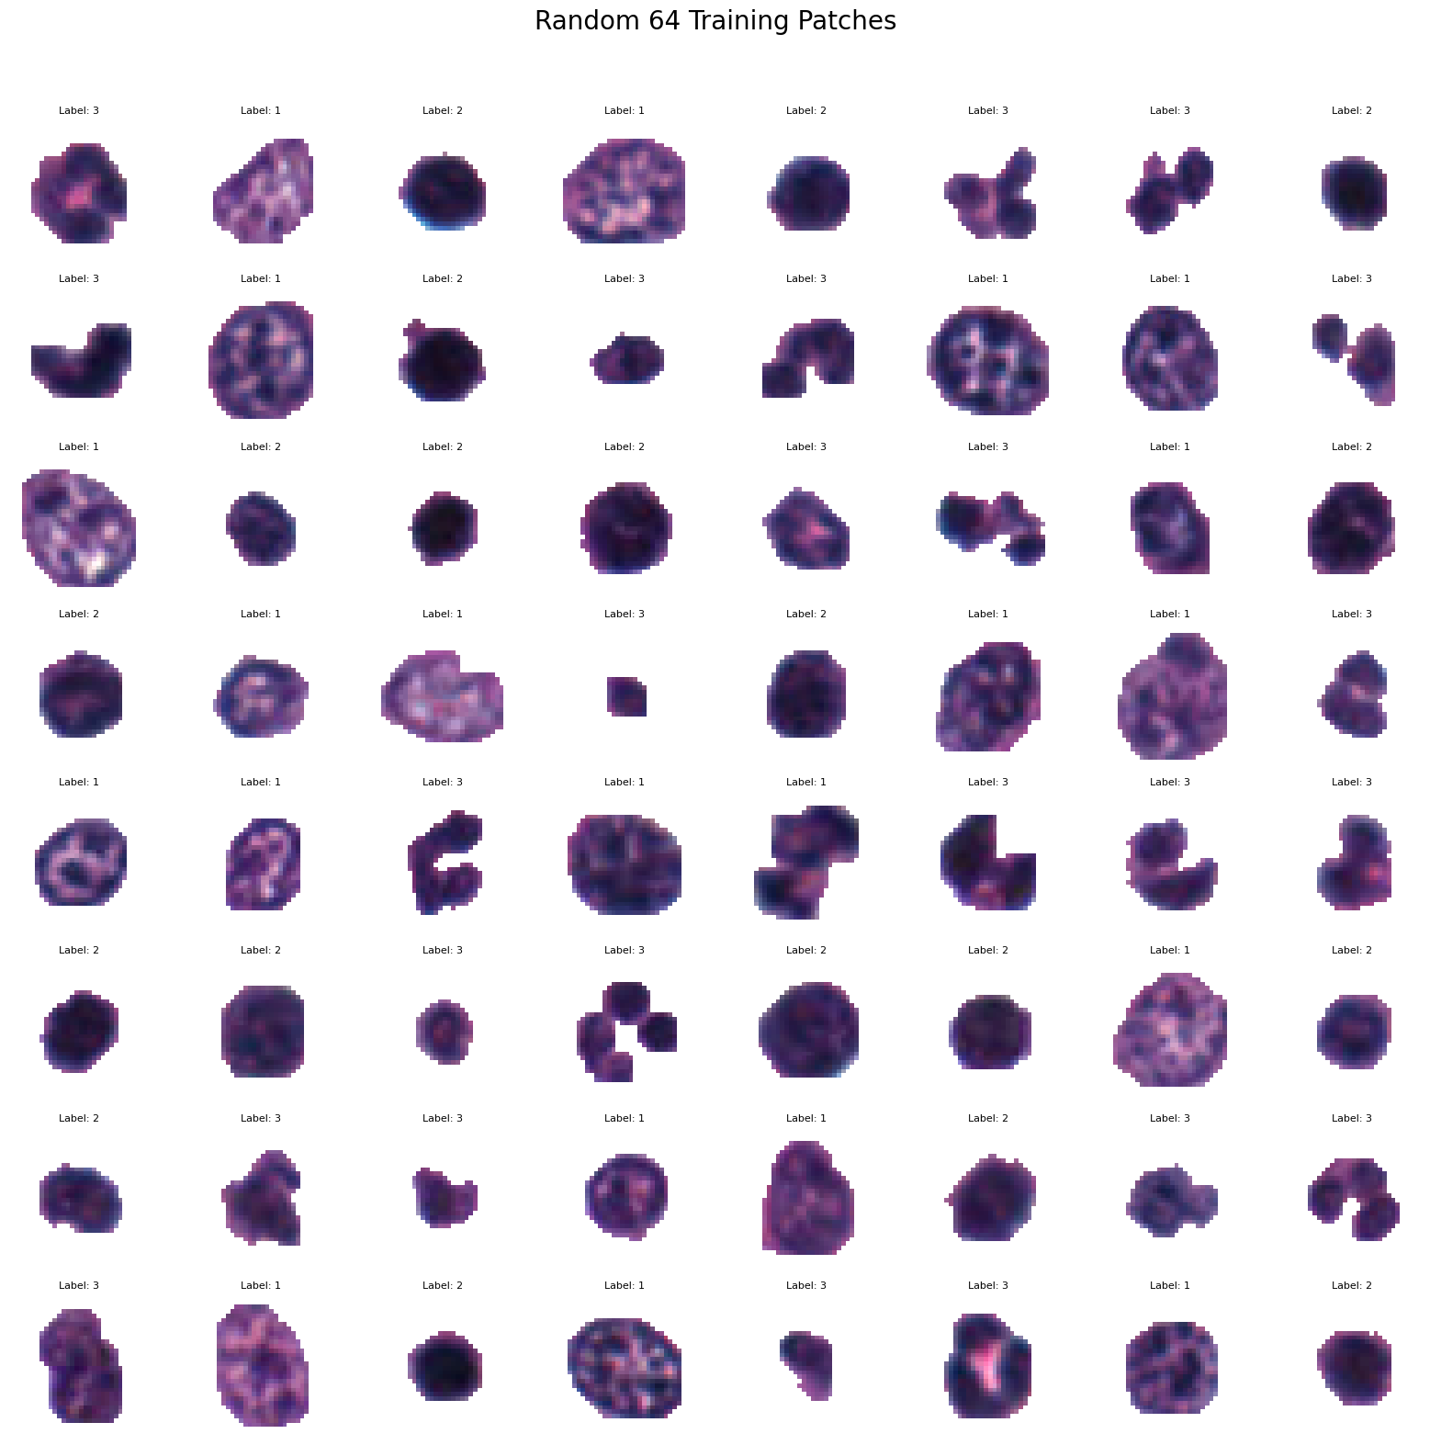
Problem statement
“Given unlabelled histopathological images with different variability, inconsistent staining and morphology, performing unsupervised cell level visual representation using generative adversarial network. “

Slide 4
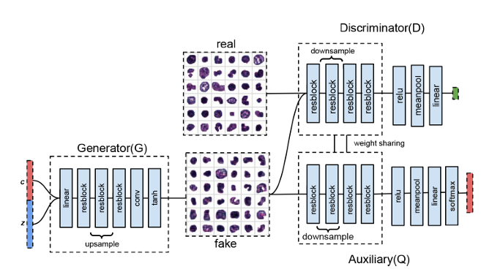
Approach 01 : USING GANS
Architecture of Generator (Blackbox-G):
Dense layer (128*8*8), relu activation
Dense layer (256), LeakyRelLU followed by Batch Normalisation(momemtum=0.8)
Dense layer (512), LeakyRelLU+ BatchNorm
Dense layer (1024), LeakyRelLU+ BatchNorm
Output layer (equal to pizel), tanh
Achitecture of Discriminator (Blackbox-D):
conv2D (128*8*8) Filters=32, kernels=3*3, strides=2,LeakyReLU
conv2D (128*8*8) Filters=64, kernels=3*3, strides=2,LeakyReLU + Dropout + BatchNorm
conv2D (128*8*8) Filters=128, kernels=3*3, strides=2,LeakyReLU + Dropout + BatchNorm
conv2D (128*8*8) Filters=256, kernels=3*3, strides=1,LeakyReLU + Dropout
Flatten
Output: num_classes+1,softmax/sigmoid activation
1
Blackbox
D
Blackbox
G
Blackbox
D

Slide 5
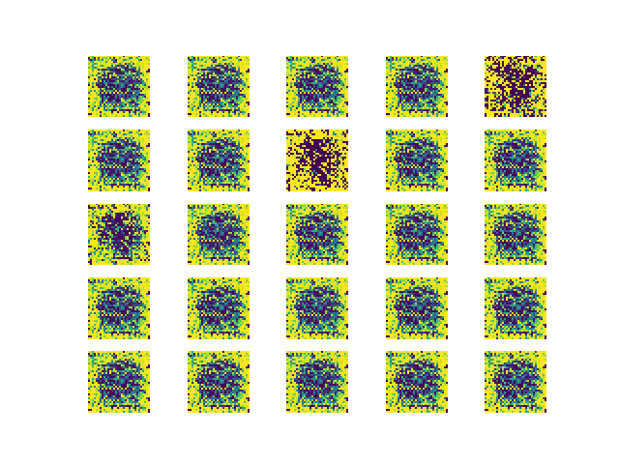
Results Obtained
(By GANS)

Slide 6
Approach
02 LSGANS
Why GANS are giving poor results?
Vanishing gradients due to binary cross entropy loss
What is the difference between GANS and LSGANS?
Uses least square loss function instead of BCE
Why should we use LSGANS?
Faster convergence
More realistic and high quality images
Stronger and more stable gradient

Slide 7
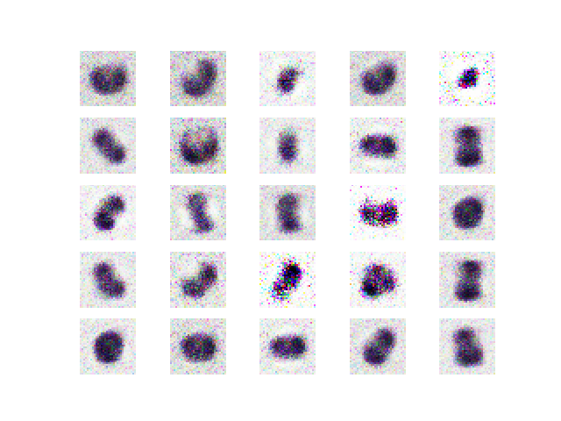
Results Obtained
(By LSGANS)

Slide 8
Approach
03 DCGANS to rescue
Why LSGANS are giving poor results?
Same with GAN architecture except the loss function
Not engineered for image generation
What is the difference between GANS and DCGANS?
Architecture of DCGANS uses transposed convolutions
The descriminator uses strided convulution
Why should we use LSGANS?
No fully connected layers
Specialised architecture for images
Better feature learning

Slide 9
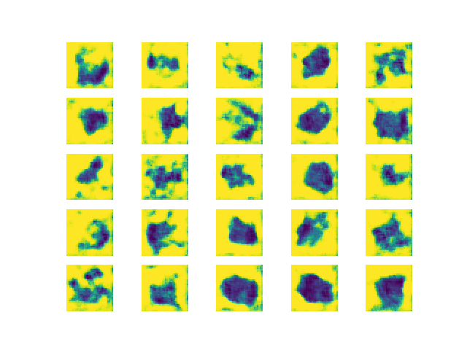
Results Obtained
(By DCGANS)

Slide 10
Optimization
How can we ensure stable gradient Decent?
Answer: using WGANS
What are WGANS?
Instead of classifying as real/fake, penalise how far are the two distributions (Earth mover distance)
Instead of descriminator, uses a critic which acts like

Slide 11

Mathematical Formulations
Wasserstein GAN (WGAN) Objective
Where:
Pr= probability of real data distribution
Pg= generator distribution
f = 1-Lipschitz function (approximated by the discriminator)
WGAN Adversarial Loss
Where z = the input noise from a prior
WGAN Gradient Penalty
Where:
x_bar = samples interpolated between real and generated data
lambda1 = gradient penalty coefficient

Slide 12
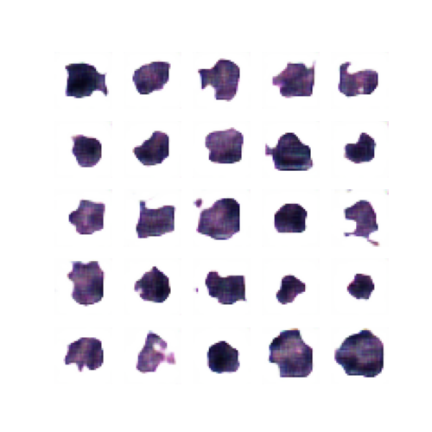
Results Obtained
(optimizations)

Slide 13
Future Challenges & Improvement
Training Efficiency: While WGANs successfully capture nuclear morphology and shape with high fidelity, gradient descent is computationally expensive and slow to converge. Future improvements could focus on optimizing training speed and resource efficiency without sacrificing quality.
Incorporating InfoGANs for Disentanglement: To address both convergence and interpretability, InfoGANs offer a promising direction. They enhance GANs by introducing latent code variables and mutual information maximization, allowing the model to learn interpretable and disentangled representations (e.g., shape, orientation, or texture of nuclei). This could lead to better controllable generation and biologically meaningful insights.

Slide 14
References
https://paperswithcode.com/paper/unsupervised-learning-for-cell-level-visual
Medical Image Computing (CS736) by Prof Suyash Awate, lecture Slides
Pattern Recognisation and Machine Learning by Bishop

Slide 15
THANK YOU !!

