Slide 1

PAWSOME Pet Sitting Database
Group 4
Authors: Aditi, David, Navya, Pooja, Yada

Slide 2
System Overview
Pet ownership is increasing
Dog ownership has increased from 38% to 45% since 2016
Rising need for efficient pet services
Owners need reliable care to keep pets happy and healthy
Sitters are provided an opportunity to gain additional income
Features
Scheduling
Booking
Transactions
Reviews

Slide 3
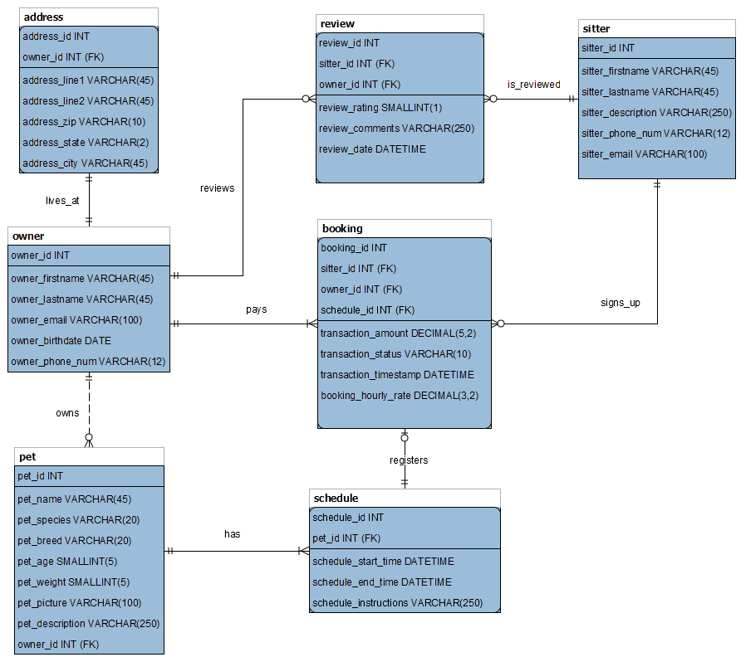
ER Model

Slide 4
ETL / CloverDX
Owner and Address Tables
Owner and Address were joined together into one table
Duplicate records were removed
Anyone under the age of 18 was removed
Corrected phone number format
Sitter Table
Removed duplicate sitters
Corrected phone number format
Pet Table
Duplicate pets were removed
Spaces around pet species were removed
Duplicate records were sent to spreadsheet for review

Slide 5
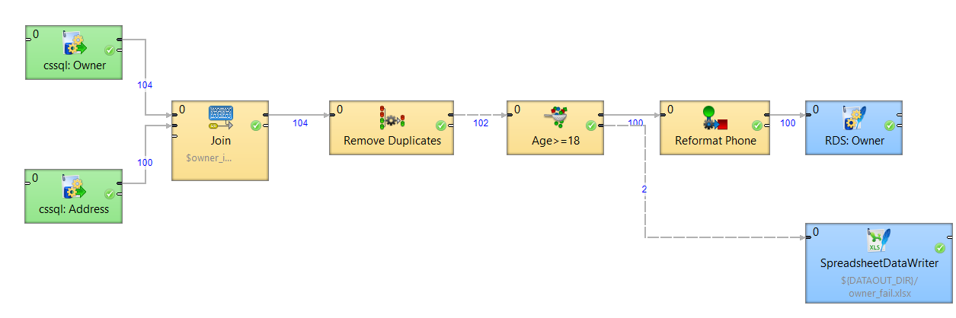
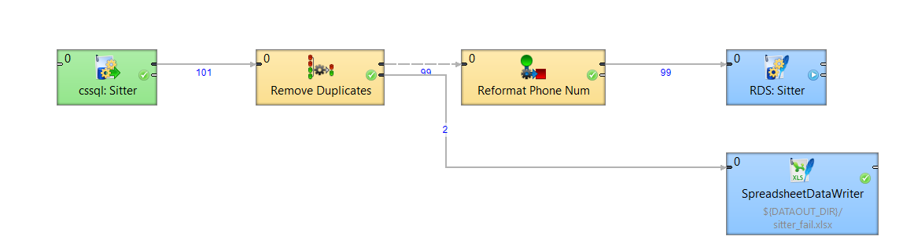
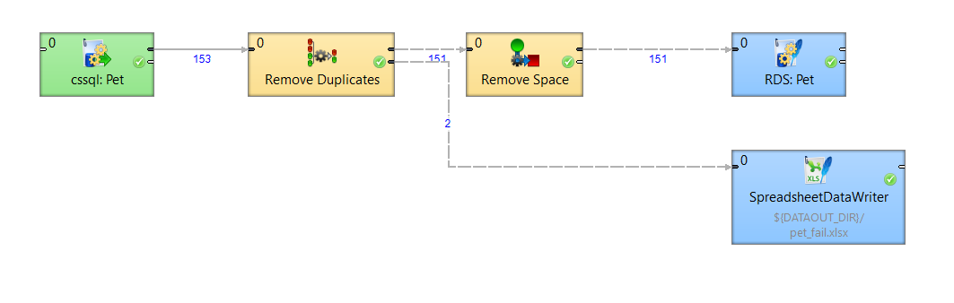
CloverDX Diagrams

Slide 6
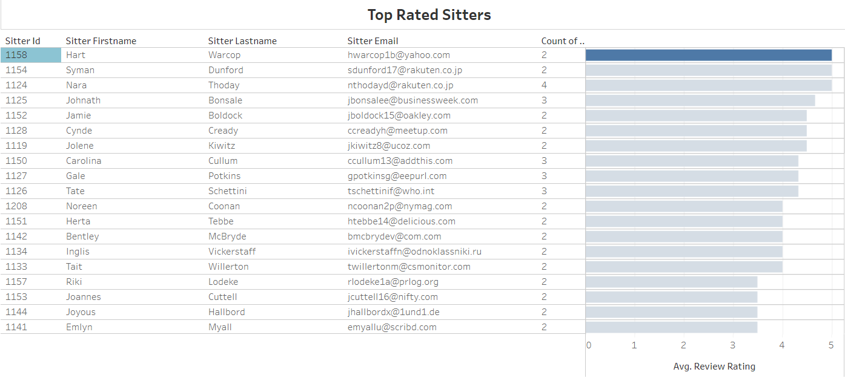
Highest Rated Sitter
Notes:
https://public.tableau.com/views/SitterRatings/TopRatedSitters?:language=en-US&publish=yes&:sid=&:display_count=n&:origin=viz_share_link

Slide 7
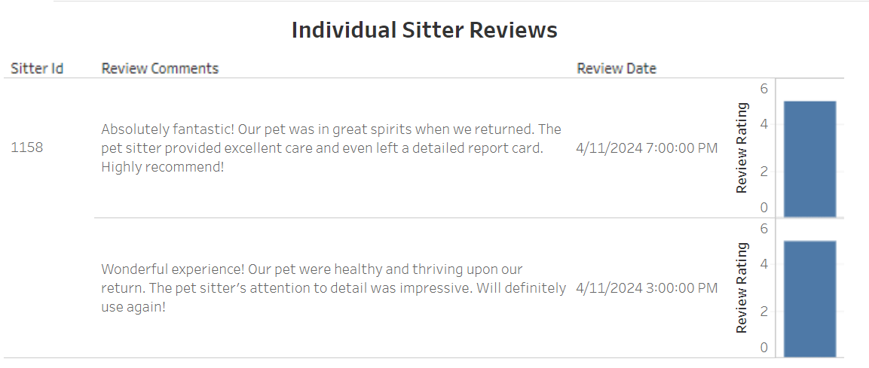
Highest Rated Sitter – Drill Down

Slide 8
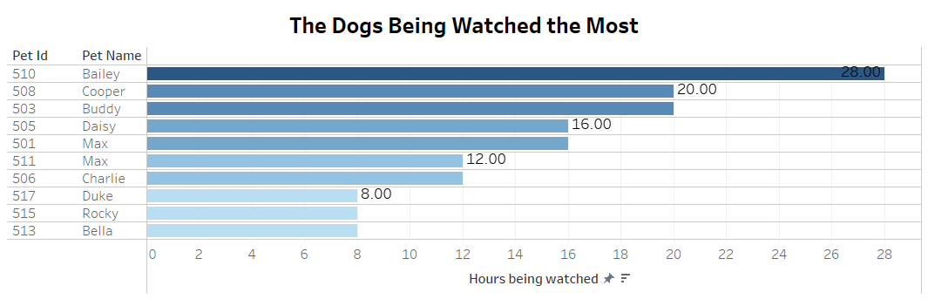
Dogs being watched the most
Notes:
https://public.tableau.com/app/profile/navya.gangadharappa.ramesh/viz/TheDogsBeingWatchedtheMost/Sheet1?publish=yes

Slide 9
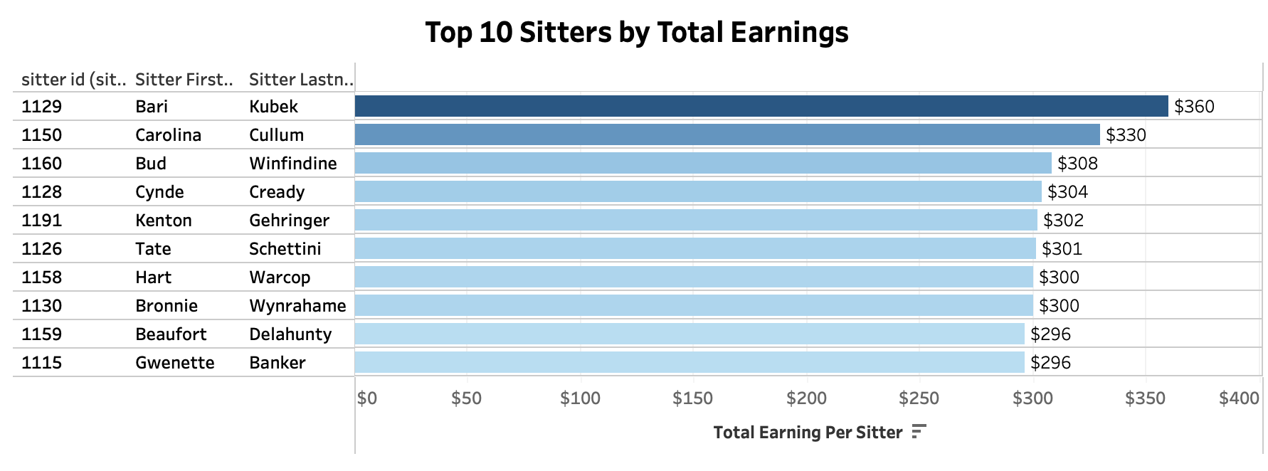
Top 10 Sitters by Total Earnings
Notes:
https://public.tableau.com/shared/6D9QG9ZBC?:display_count=n&:origin=viz_share_link

Slide 10

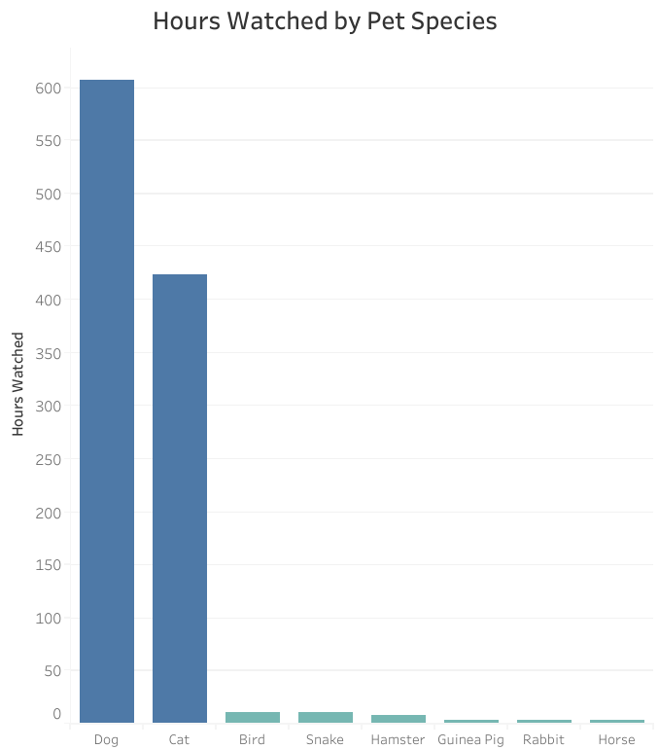
Hours Watched by Pet Species
Notes:
https://public.tableau.com/app/profile/yada.so5566/viz/Hourswatchedbyspecies/Sheet1?publish=yes

Slide 11
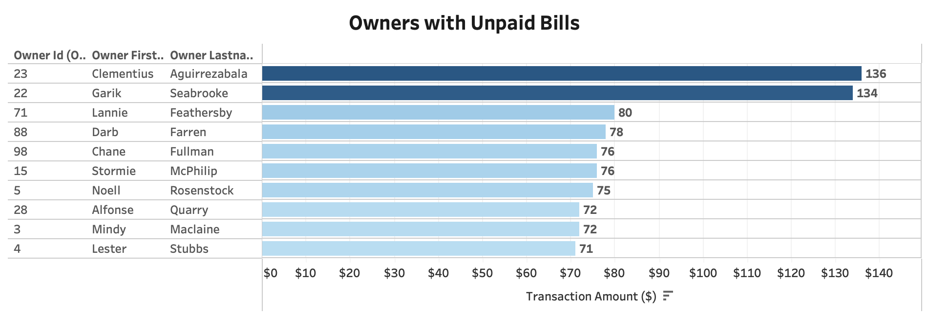
Owner with Unpaid Bills
Notes:
https://public.tableau.com/app/profile/aditisomani/viz/OwnerswithUnpaidBills/OwnerswithUnpaidBills?publish=yes

Slide 12
Conclusion/Recommendation
Pet Sitting system is designed to meet growing pet care needs
CloverDX was used to extract and transform the data into a data warehouse
BI Analytics
Tableau reports can provide business leaders with information to:
Find the best employees
Discover unpaid bills
Find new areas for growth

Slide 13

Thank you
Questions?

