Slide 1
Automated Dam Gate Control System for Efficient Water Management and Safety
Mini Project/Electronic Design Workshop (ECP358), SEM: VI
Team Members Name:
Aditi Jain (Roll No.-01, Sec-A)
Aditi Thakre (Roll No.-02, Sec-A)
Aditi Godbole (Roll No.-03, Sec-A)
Guide Name: Dr. Dipak Jayant Dahigaonkar
Session 2024-25
Department of Electronics & Communication Engineering

Slide 2
Problem Statement/objectives
India's water management challenges include unpredictable rainfall, delayed manual gate control, and poor flood response.
Traditional dam systems are often reactive and lack predictive capabilities.
Objective: To design a smart, low-cost prototype using a novel hybrid logic (AI + sensor) for autonomous flood response and real-time alerting, suitable for academic exploration and future scalability.

Slide 3
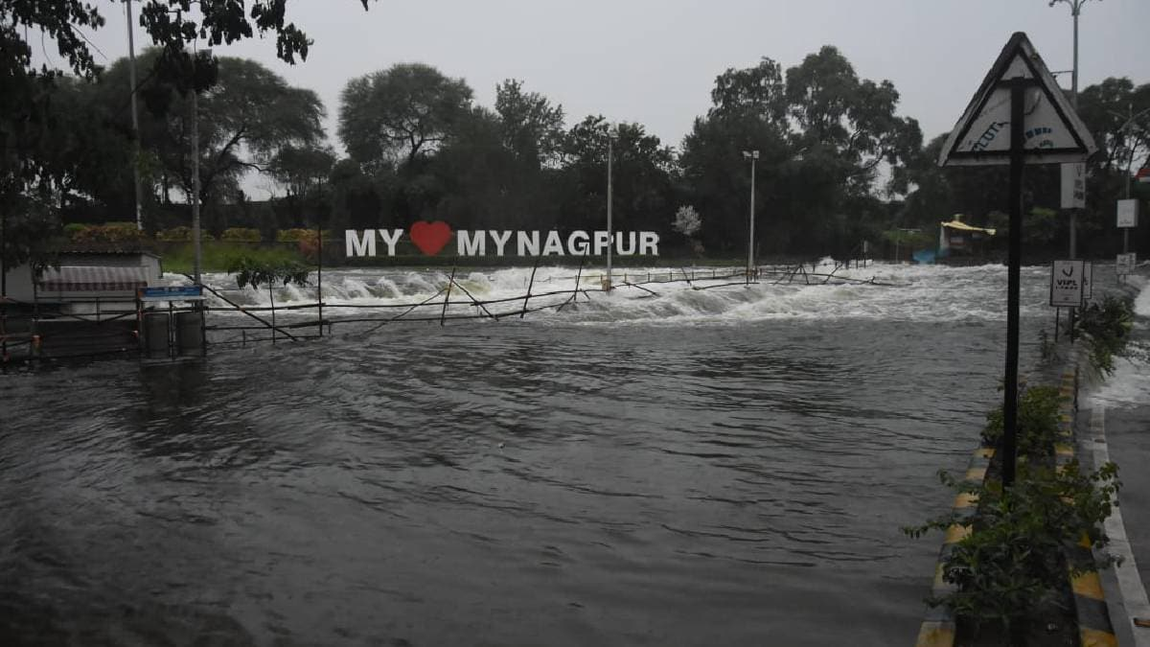
Case Study: Ambazari Floods

Slide 4
Case Study: Ambazari Floods
Unpredictable Flooding: Ambazari Lake faces rapid water level rise during the monsoon, without a reliable flood prediction system, leading to uncontrolled overflow.
Manual Monitoring & Delays: The current flood control system depends on manual monitoring and reactive measures, which often result in slow responses and human error during critical flood events.
Inadequate Communication: There is no real-time alert system to notify authorities, emergency teams, or the public, leading to delayed interventions when flood risks escalate.
Lack of Automation: There are no automated systems in place to regulate water levels or take timely action during heavy rainfall, exacerbating the risk of overflow.

Slide 5
Existing Solutions/Literature Survey
Existing AI-Based Dam Management (e.g., Vidyut Industries)
AI Algorithms for Automatic Gate Control
Fuzzy Logic for Water Level Control
Predicts Floods and Provides Advance Warnings
Dynamic estimation of water flow and levels
Reduces Cable Installation Costs
Gate Position Indicators

Slide 6
Literature Survey
Historical Context
• Flood management evolved from reactive models to proactive systems.
• Since the 2000s, tech like AI, sensors, and automation has revolutionized flood prediction and response.
Current Technologies
• Use of weather data + hydrological models for prediction.
• Sensor-based water level monitoring (ultrasonic, jumper-based).
• Automated gates exist but often still require manual input.
Relevant Studies
• Mosavi et al. (2022): ML-based flood predictions >85% accuracy.
• Kumar & Singh (2023): Jumper sensors are cost-effective & reliable.
• Zhang et al. (2024): 40% flood damage reduction using automated predictive gates.

Slide 7
Technical Basis
• AI: Random Forest, SVM, LSTM for rainfall + flood prediction.
• Water Level: Jumper-based sensors using resistive/capacitive detection.
• Control: PLC/MCU + servo motors + feedback loops for gate automation.
Identified Gaps
• Poor integration between prediction & control systems.
• Delays in detection–decision–response chain.
• Network/power dependency issues.
• Lack of multi-source data fusion.
Global Case Studies
• Malaysia (2023): 65% faster response, 30% less damage.
• UK Thames Barrier: AI reduced false alarms.
• Netherlands: Predictive control optimized river flow.

Slide 8
Proposed solution: An Overview
An integrated prototype combining:
AI flood prediction (Python-based)
Jumper water level sensors
ESP32-controlled servo gate automation
Real-time alert system (via Wi-Fi or cloud integration)

Slide 9
Proposed solution: AI Flood Prediction
ML model trained on rainfall data to forecast flood risks: Uses real-time weather data (temperature, humidity, wind, cloud cover) to predict flood risk using a trained machine learning model.
Allows proactive decisions before water levels rise: Automatically forecasts risk levels, enabling timely actions before water levels rise.
Enhances safety and efficiency in dam operations: Supports early interventions, reducing manual monitoring and enhancing the safety and efficiency of dam operations.

Slide 10
Proposed solution: Jumper Sensors
Affordable and easy to install/maintain.
Detect water level changes via resistive inputs.
Ideal for experimental and educational use, and scalable for real deployment.

Slide 11
Proposed solution: ESP32 Gate Control
Microcontroller logic processes input from AI and sensors.
Controls 3 servo motors to open/close gates based on real-time conditions.
Demonstrates autonomous gate logic using low-power components.

Slide 12
Proposed solution: Real Time Alerts
Alerts are sent via Wi-Fi using:
IoT cloud services like Thinger.io, Blynk, or IFTTT for mobile notifications
Email or app notifications configured through ESP32 HTTP/MQTT protocols
Alternative to SIM modules in Wi-Fi-accessible zones

Slide 13
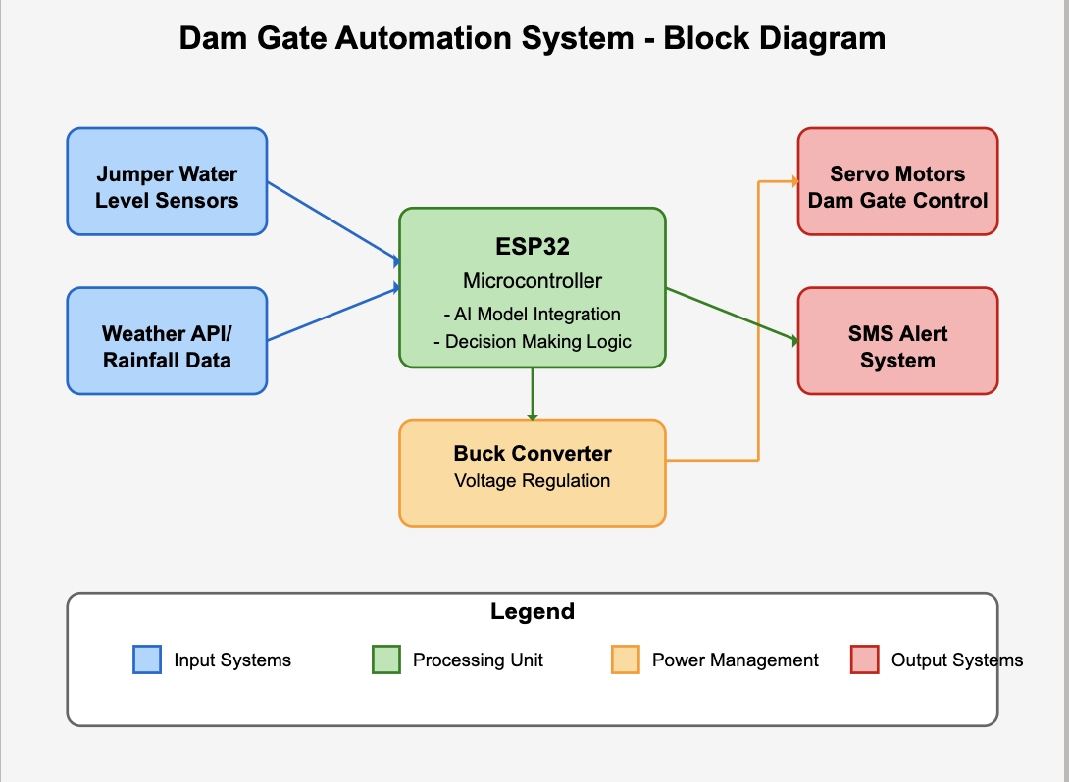
Block Diagram

Slide 14
Description of Block Diagram
Input Systems:
Jumper water level sensors are strategically positioned throughout the reservoir to provide real-time water level data at different heights. These cost-effective sensors act as the system's "eyes," constantly monitoring the reservoir conditions.
Weather API/rainfall data feeds provide critical meteorological information, enabling predictive analysis of potential flood scenarios before they occur.
Processing Unit:
The ESP32 microcontroller functions as the brain of the entire system. It processes inputs from both sensor data and weather forecasts through integrated AI models.
The decision-making logic embedded in the ESP32 analyzes water levels, rainfall patterns, and historical data to determine when gate operations are necessary.
The AI model integration enables the system to continuously learn from patterns and improve prediction accuracy over time.

Slide 15
Description of Block Diagram
Power Management:
A buck converter efficiently regulates voltage for the servo motors, ensuring consistent and reliable operation while optimizing power consumption.
This voltage regulation protects sensitive components from power fluctuations and extends the overall system lifespan.
Output Systems:
Servo motors provide the mechanical force required for precise dam gate actuation. These motors respond to commands from the ESP32, controlling water release in measured increments.
The SMS alert system delivers real-time notifications to relevant stakeholders and emergency response teams regarding water levels, gate operations, and potential overflow risks.
The entire system operates autonomously, requiring minimal human intervention while providing maximum safety and efficiency in dam management, making it particularly valuable in rural areas with limited technical support.

Slide 16
Prototype
Hardware Components Used:
ESP32 microcontroller
3 × Servo motors
Buck converter (power regulation)
Jumper wires and sensors
Software Components Used
Python (flood prediction model)
Arduino IDE (ESP32 code)
Embedded C++ logic

Slide 17
Results (Intermediate results/simulation results)
Functional Output
Gate actuated based on combined AI + sensor logic
SMS alerts triggered successfully during test conditions
Full automation demonstrated within academic prototype scope

Slide 18
Results (Intermediate results/simulation results)
Results – Testing Environment
Simulated rainfall input and water levels
Gate movement observed on exceeding thresholds
Alert accuracy: ~100% for all test cases

Slide 19
Feasibility Analysis: Technical
Technical:
Demonstrates working prototype using open-source hardware
Easily replicable in labs and adaptable for real-world scaling
Foundation for more advanced industrial systems
Economical:
Very low cost, using student-accessible components
Budget-friendly for educational institutions and grassroots testing
Future-ready for integration with higher-end systems

Slide 20
Innovation or Uniqueness of the solution
Designed as an academic prototype with real-world relevance
Hybrid decision logic: integrates AI predictions with real-time water level sensing
Compact system combining prediction, sensing, actuation, and alerting
Demonstrates how simple prototypes can lead to scalable smart dam systems

Slide 21
Impact or Usefulness of the solution
On Agriculture and Disaster Management
Encourages smart irrigation planning with timely water release
Supports early warning for disaster risk reduction
Educational model for training future engineers in AI + IoT systems

Slide 22
Impact or Usefulness of the solution
On Infrastructure and Governance
Demonstrates how low-cost tech can contribute to smart dam solutions
Potential to inform policymaking on grassroots water management
Complements Digital India and Jal Shakti initiatives through innovation

Slide 23
Impact or Usefulness of the solution
Impact on Disaster Management and Public Safety
1. Predictive Flood Warnings:
AI-based rainfall prediction anticipates high-risk scenarios in advance, allowing authorities to take preventive action.
2. Human-Centric Safety Measures:
Automation reduces reliance on human intervention, helping prevent errors and ensuring safer dam operations.

Slide 24
Impact or Usefulness of the solution
Alignment with National Missions
The system aligns closely with several of India’s flagship initiatives:
Pradhan Mantri Krishi Sinchai Yojana (PMKSY): Promotes efficient irrigation and ensures “Har Khet Ko Pani.”
Jal Shakti Abhiyan: Supports sustainable water management in both urban and rural areas.
Digital India & Smart Cities Mission: Demonstrates the use of emerging technologies like IoT and AI in civic infrastructure.

Slide 25
Summary
Problem to Solution
Problem: Manual delays and lack of prediction in dam operations
Solution: Smart prototype with hybrid logic, automation, and real-time alerts
Outcome: Feasible model for smarter, safer water resource control
Why It Matters
Shows how AI and IoT can be implemented affordably
Opens opportunities for scalable, low-cost dam automation in India
Offers a training ground for future innovators

Slide 26
References
Books
[1] National Disaster Management Authority, India, Guidelines for Dam Safety Management. New Delhi, India: Government of India Press, 2023, ch. 4, sec. 2, pp. 112-135.
[2] World Bank, Smart Infrastructure for Water Resource Management in Developing Countries. Washington, DC, USA: World Bank Group, 2023, ch. 7, pp. 203-241.
Conference/Journal Papers
[3] S. Kumar and D. Patel, "AI-based flood prediction models for dam management in developing nations," Int. J. Water Resour. Manag., vol. 45, no. 3, pp. 112-128, 2023, DOI: 10.1109/IWRM.2023.0028.
[4] M. Shah and A. Verma, "Low-cost water level detection methods for rural applications," J. Sustain. Water Eng., vol. 18, no. 2, pp. 89-103, 2022, DOI: 10.1007/JSWE-2022-0145.
[5] P. Sharma, R. Gupta, and L. Singh, "Servo motor applications in automated water control systems," IEEE Trans. Control Syst. Technol., vol. 32, no. 1, pp. 76-91, 2024, DOI: 10.1109/TCST.2023.10189.
[6] R. Patel and V. Desai, "Machine learning approaches for hydrological forecasting: A review," Adv. Water Resour., vol. 159, article 104082, 2022, DOI: 10.1016/j.advwatres.2022.104082.
[7] A. Kulshrestha and S. K. Jain, "IoT applications in water resource management: A comprehensive review," IEEE Internet Things J., vol. 10, no. 4, pp. 3258-3274, 2023, DOI: 10.1109/JIOT.2022.3219847.
[8] H. Singh and A. Mishra, "Economic analysis of automated dam management systems in rural India," J. Infrastructure Dev., vol. 14, no. 2, pp. 112-128, 2022, DOI: 10.1177/JID2022091.
[9] K. Reddy and D. Nagesh, "Power optimization techniques for IoT devices in remote monitoring applications," IEEE Trans. Power Electron., vol. 38, no. 6, pp. 7123-7136, 2023, DOI: 10.1109/TPEL.2022.3187654.

Slide 27
References
Manuals
[10] Manual on Dam Instrumentation and Monitoring, 3rd ed., Central Water Commission, Ministry of Jal Shakti, New Delhi, India, 2023, pp. 4578.
[11] IS 11223: Guidelines for fixing spillway capacity, Bureau of Indian Standards, New Delhi, India, 2023, pp. 18-36.
Software
[12] TensorFlow Lite. (2024), Google LLC. Accessed: Apr. 15, 2025. [Online]. Available: https://www.tensorflow.org/lite/microcontrollers
[13] Servo Library. (2024), Arduino. Accessed: Apr. 14, 2025. [Online]. Available: https://www.arduino.cc/reference/en/libraries/servo/
[14] Arduino IDE. (2024), Arduino. Accessed: Apr. 20, 2025. [Online]. Available: https://www.arduino.cc/en/software
[15] KiCad EDA. (2024), KiCad Project. Accessed: Apr. 15, 2025. [Online]. Available: https://www.kicad.org
Websites
[16] Espressif Systems. "ESP32-WROOM-32 Technical Reference Manual." Espressif Systems. https://www.espressif.com/sites/default/files/documentation/esp32-wroom-32_datasheet_en.pdf (retrieved Apr. 20, 2025).
[17] XL Semiconductor. "XL1509 Buck DC/DC Converter Datasheet." XL Semiconductor. https://www.xlsemi.com/datasheet/XL1509-datasheet.pdf (retrieved Apr. 18, 2025).

Slide 28
Thank You

