Slide 1
Data FOR good: Kids Help phone walkathon

Slide 2
Project description
This project was done over the course of a weekend during a Datathon organized by the Toronto chapter of Data for Good (DFG)
The data belongs to Kids Help Phone (KHP) , a not for profit organization. The objective was to help uncover key insights about past donors to the Walkathon initiative organized by KHP
The dataset included past donation transactional data for each donor, identified by a unique Donor_ID

Slide 3
Donor Analysis
Donation Cadence
Donor Retention
RFM Model

Slide 4
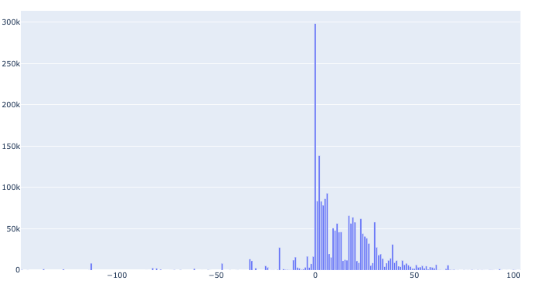
Donation Cadence
Amount Raised vs. Number of Days between Event Day and Donation Day for 2019
Most donations are made from March to April
A significant proportion of the amount raised each year is raised on the day of the event
Number of Donations
Number of Days between Event Day and Donation Day

Slide 5
Donation Cadence
Year | % Raised on Day of Event
2015 | 19%
2016 | 20%
2017 | 15%
2018 | 15%
2019 | 14%

Slide 6
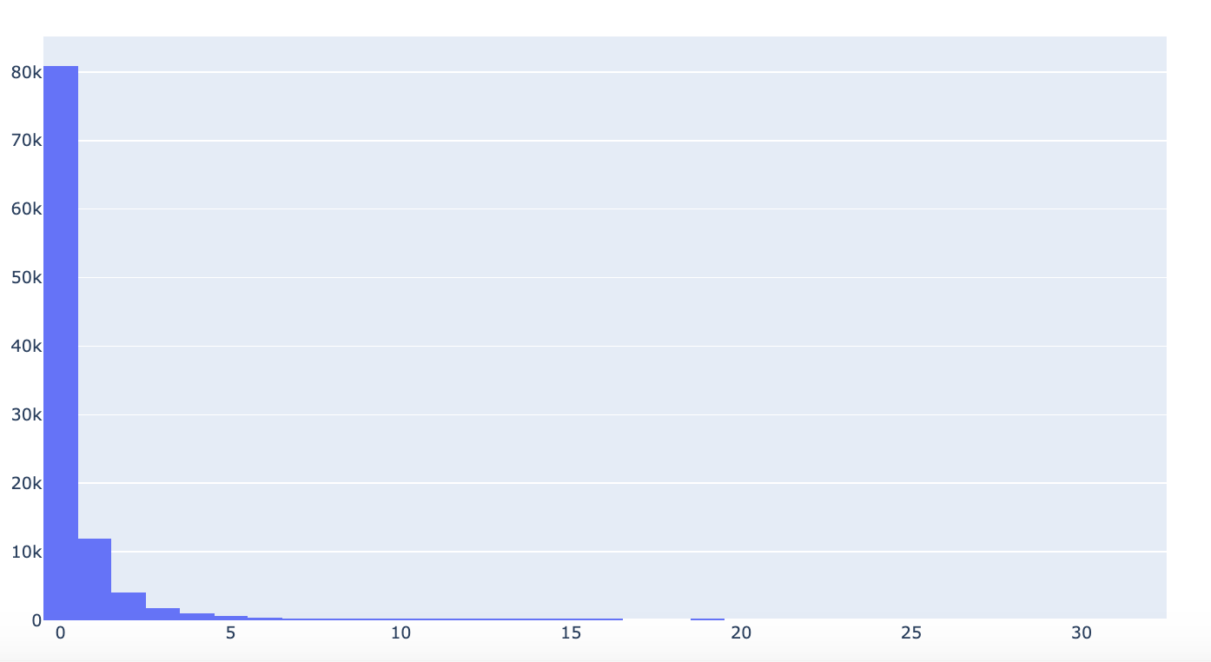
Donor retention
80% of Donors only donated once
Cohort analysis shows how many donors return each year
Count of Donors
Frequency of Donations

Slide 7
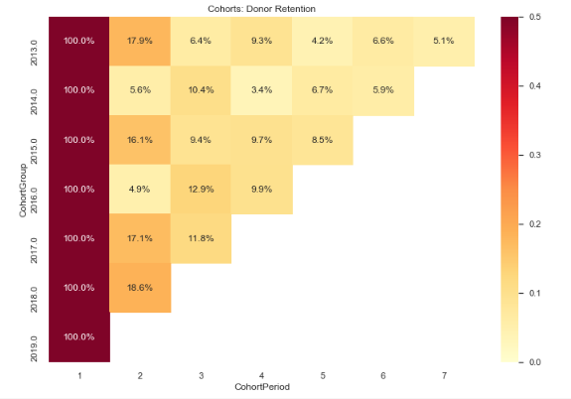
Donor Retention
2016, 2018 and 2019 saw a high percentage of previous donors return
2017 was a low performing year and saw fewer donors return

Slide 8
Donors that are likely to return
The RF plots maps a customer’s expected purchases by the next year and probability that they’re alive given the frequency / recency
tail

Slide 9
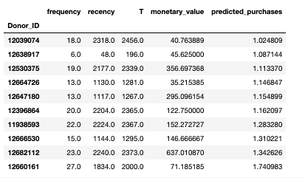
Top ranking donors
Top 10 Donors expected to donate in the next 6 months

Slide 10
Summary
Most donations are made in April-May, almost a quarter of the amount is raised on the day of the event
KHP Walkathon Donors show moderate retention YoY
Donors with a high chance of returning should be sent communications to encourage donations

