Slide 1
NextHikes IT Solutions
Exploratory Data Analysis of
Large-Scale Retail Transaction Data
Using Univariate, Bivariate, and Multivariate Statistical Techniques
Project by
Aditi Umale
NextHikes IT Solutions | Aditi Umale | 1

Slide 2
Objectives
Perform univariate, bivariate, and multivariate analysis
Detect and interpret outliers
Measure correlation between numerical variables
Analyze skewness and kurtosis
Extract statistically meaningful business insights
NextHikes IT Solutions | Aditi Umale | 2

Slide 3
Dataset Overview
Data
100,000
18
0
0
Rows / Transactions
Columns
Missing Values
Duplicate Rows
What the data contains
Primary outcome used in the analysis
• Customer attributes: age, gender, city, state, customer segment.
• Order & product details: order date, product category and subcategory.
• Commercial variables: product_price, quantity, discount_percentage, final_price.
• Operational variables: payment method, shipping type, delivery days and return status.
final_price
The notebook repeatedly uses final_price as the main spending / revenue outcome for distributions, relationships, outlier analysis and multivariate analysis.
Note: it is the primary analysis outcome here, not a supervised ML target.
NextHikes IT Solutions | Aditi Umale | 3

Slide 4
Data Quality & Variable Classification
Preparation
100%
7
12
1,095
Non-null records
Numerical variables
Categorical / object fields
Distinct order dates
Numerical
Categorical / object
age • product_price • quantity • discount_percentage • final_price • delivery_days • return_status_num
customer_id • gender • city • state • customer_segment • order_id • order_date • product_category • product_subcategory • payment_method • shipping_type • return_status
Quality checks in the notebook show no missing values and no duplicate rows.
NextHikes IT Solutions | Aditi Umale | 4

Slide 5
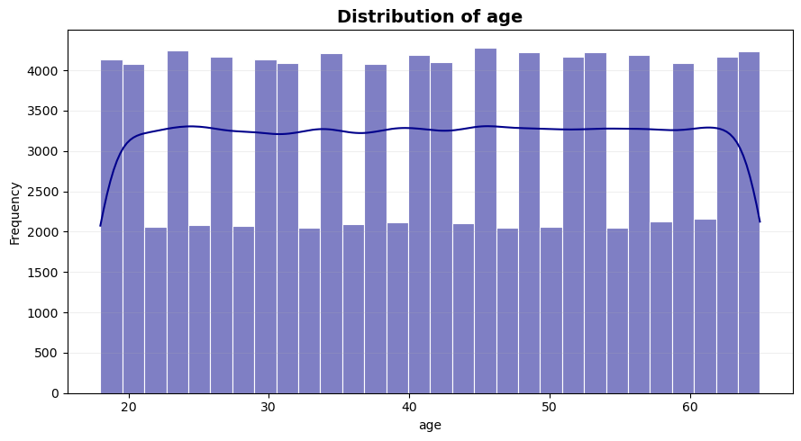
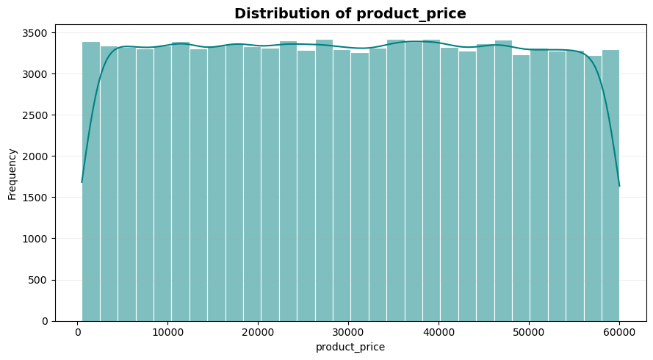
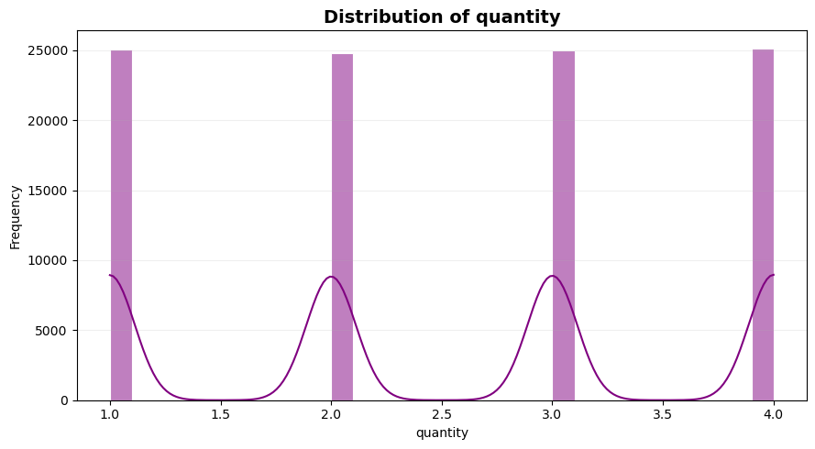
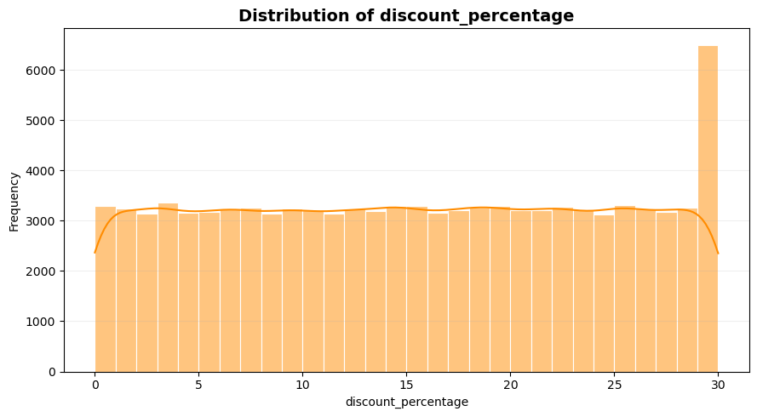
Univariate Analysis — Numerical Distributions
Univariate
Interpretation
• Age: approximately symmetric (skewness ≈ 0).
• Product price: approximately symmetric, with values spread across its range.
• Quantity: discrete values 1–4, roughly balanced across the allowed quantities.
• Discount percentage: approximately symmetric across 0–30%.
These charts show distribution shape; near-zero skewness indicates approximate symmetry, not proof of a normal distribution.
NextHikes IT Solutions | Aditi Umale | 5

Slide 6
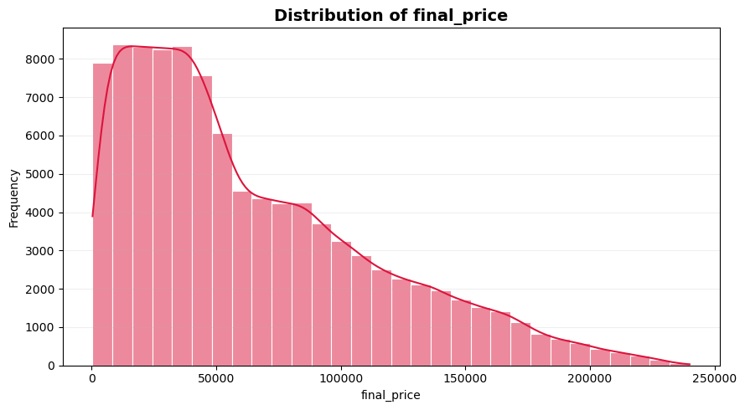
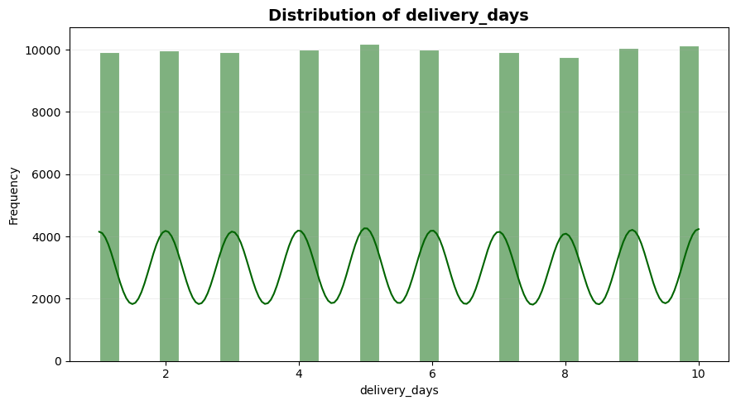
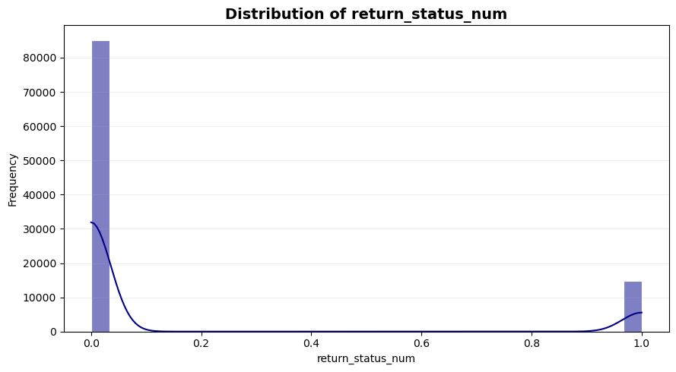
Univariate Analysis — Key Outcome & Operations
Univariate
Interpretation
• final_price: moderately positively skewed (0.93), indicating a longer right tail and some high-value purchases.
• delivery_days: approximately symmetric with skewness close to 0.
• return_status_num: highly positively skewed (1.98) because the Yes class is much smaller than No.
₹64,165.72
₹49,752.39
5.51 days
Mean final price
Median final price
Mean delivery
NextHikes IT Solutions | Aditi Umale | 6

Slide 7
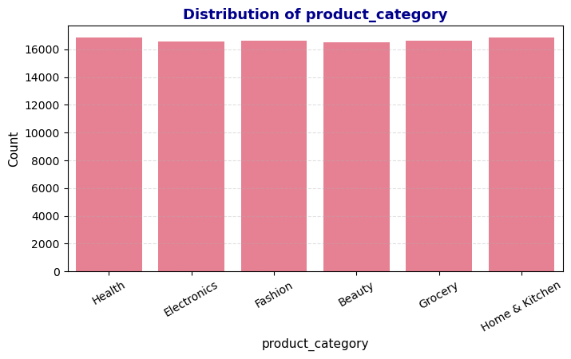
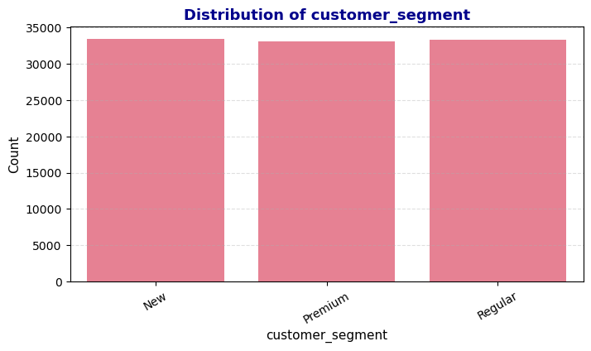
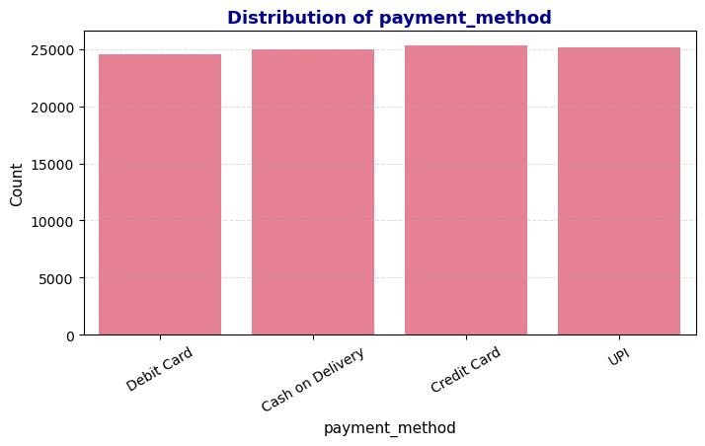
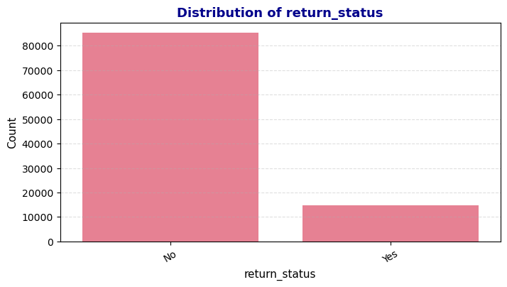
Univariate Analysis — Categorical Variables
Univariate
• Product category: Health has the highest count (16,858), while Beauty is lowest (16,513); the categories are very close in size.
• Customer segment: New is highest (33,488), followed by Regular (33,361) and Premium (33,151).
• Payment method: Credit Card is highest (25,307); Debit Card is lowest (24,560).
• Return status: No is dominant (85,189; 85.19%) and Yes is 14,811 (14.81%).
NextHikes IT Solutions | Aditi Umale | 7

Slide 8
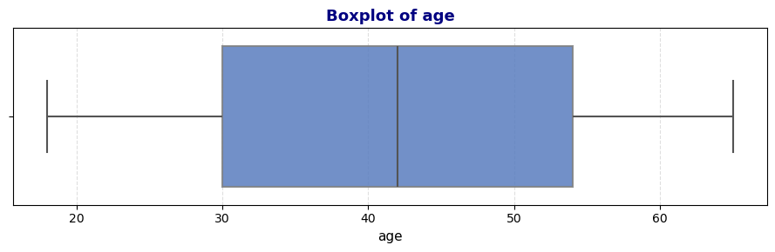
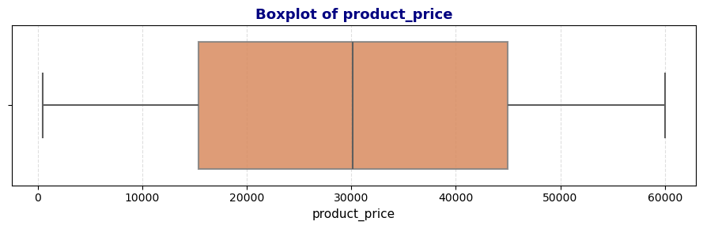
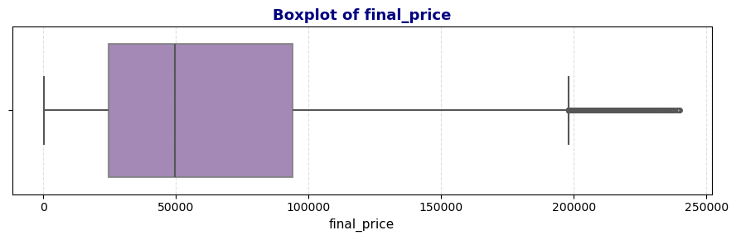
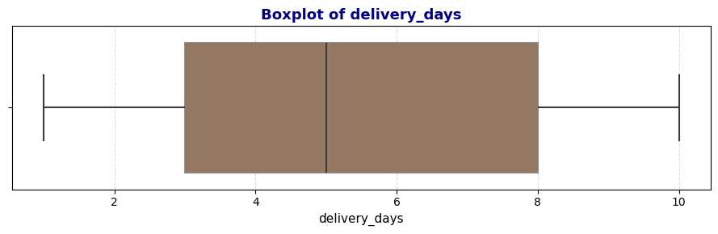
Outlier Detection — IQR & Boxplots
Outliers
1,335
0
0
0
final_price IQR outliers
product_price IQR outliers
age IQR outliers
delivery_days IQR outliers
• The IQR method was applied using Q1 − 1.5×IQR and Q3 + 1.5×IQR.
• The clearest outlier presence in the notebook is in final_price, consistent with the long right tail seen in its distribution.
• The provided notebook documents detection with IQR and boxplots; a cap/clip fixing step is not shown, so the presentation does not claim that capping was completed.
NextHikes IT Solutions | Aditi Umale | 8

Slide 9
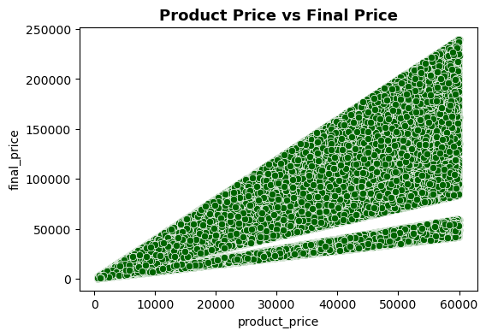
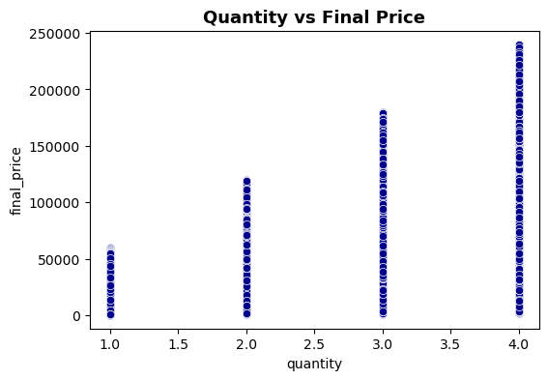
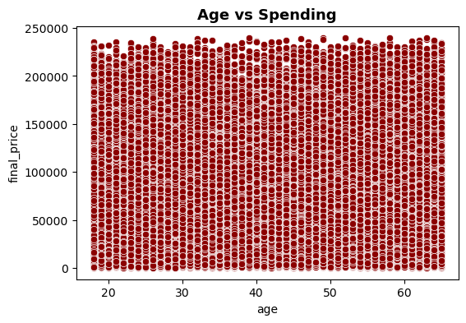
Bivariate Analysis — Numerical Relationships
Bivariate
Interpretation
• Product price vs final price: clear positive relationship; higher product prices generally correspond to higher final prices.
• Quantity vs final price: final price increases across quantity levels, with greater spread at higher quantities.
• Age vs spending: points are widely dispersed, so age alone does not show a strong linear relationship with final price.
NextHikes IT Solutions | Aditi Umale | 9

Slide 10
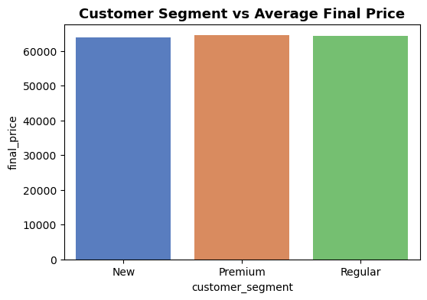
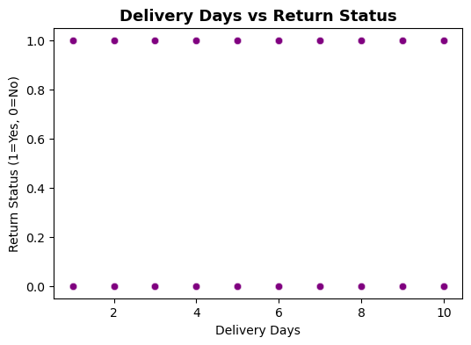
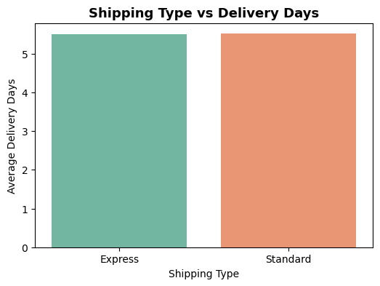
Bivariate Analysis — Customer, Shipping & Returns
Bivariate
• Customer segment vs average final price: the three segment averages are very close, with New / Premium / Regular clustered around the same level.
• Delivery days vs return probability: the notebook plots return status against delivery days after encoding return status as 0/1; the visible pattern is not a strong linear trend.
• Shipping type vs delivery days: Express and Standard show very similar average delivery times.
NextHikes IT Solutions | Aditi Umale | 10

Slide 11
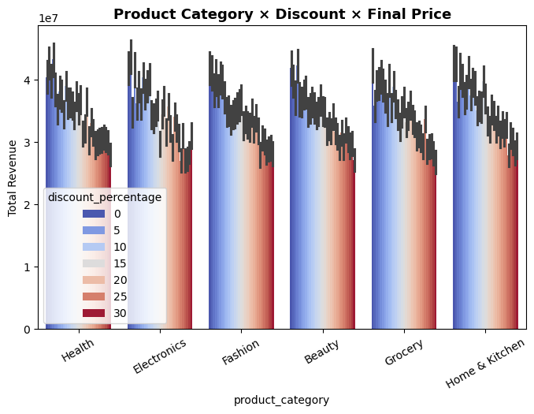
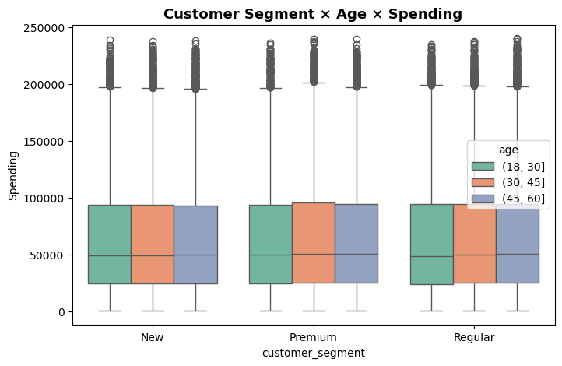
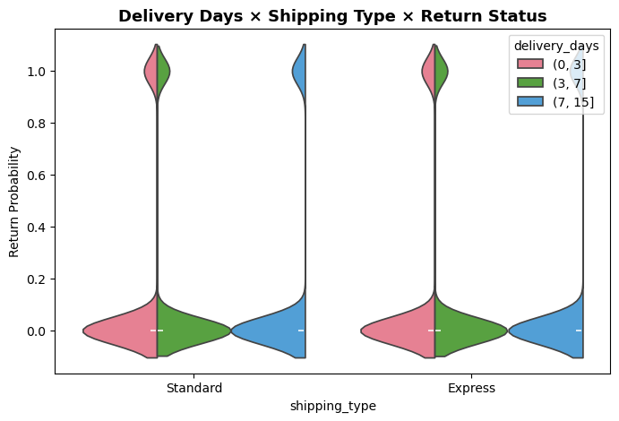
Multivariate Analysis
Multivariate
• Product Category × Discount × Final Price: compares total revenue patterns across categories and discount levels.
• Customer Segment × Age × Spending: examines spending distributions across age bands within each customer segment.
• Delivery Days × Shipping Type × Return Status: combines shipping type, delivery bands and return status in one view.
NextHikes IT Solutions | Aditi Umale | 11

Slide 12
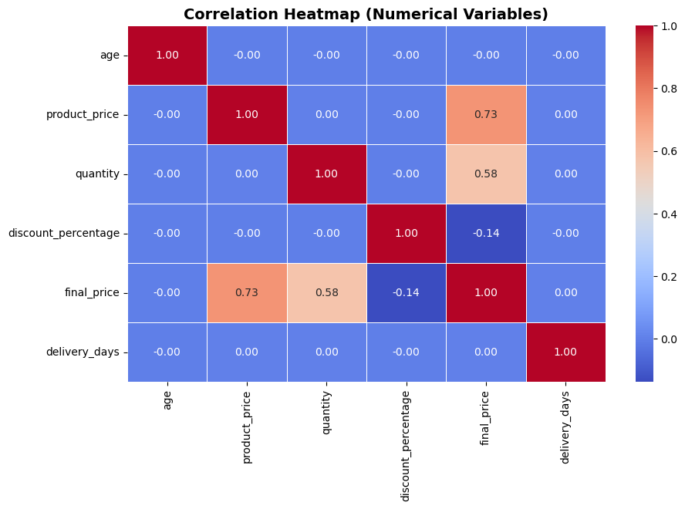
Correlation Matrix Analysis
Correlation
Key relationships
• product_price ↔ final_price: about +0.73, the strongest highlighted positive relationship.
• quantity ↔ final_price: about +0.58, also positively associated.
• discount_percentage ↔ final_price: small negative relationship in the matrix.
• return-related variables have weaker relationships with the main spending variables.
Pearson correlation was used for numerical variables.
NextHikes IT Solutions | Aditi Umale | 12

Slide 13
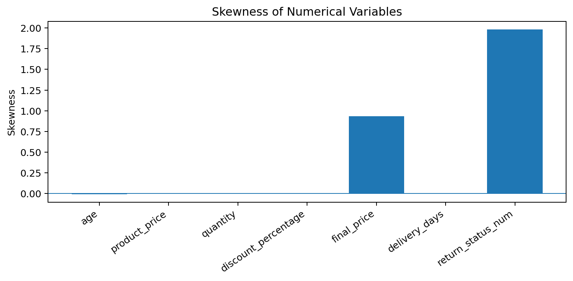
Skewness Analysis
Distribution Shape
Notebook interpretation
• Age, product_price, quantity, discount_percentage and delivery_days are approximately symmetric.
• final_price is moderately positively skewed (0.93).
• return_status_num is highly positively skewed (1.98), reflecting the imbalanced binary outcome.
0.9347
final_price skewness
NextHikes IT Solutions | Aditi Umale | 13

Slide 14
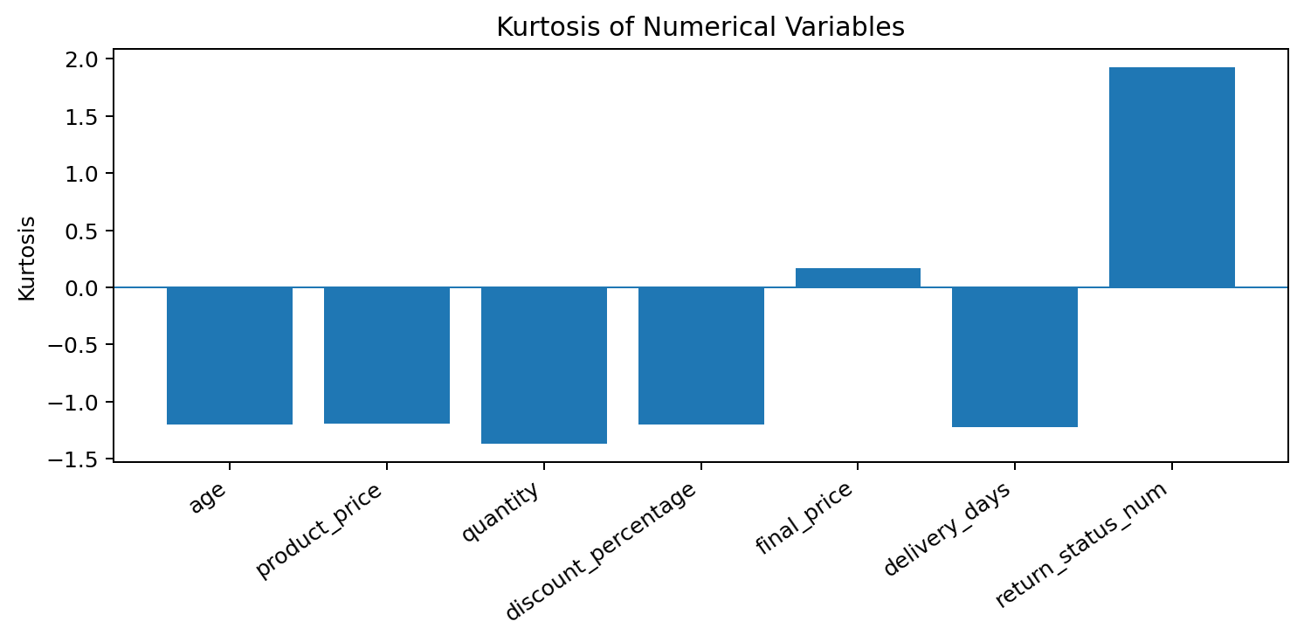
Kurtosis Analysis
Distribution Shape
Notebook interpretation
• All reported variables fall under the notebook's 'Normal-to-low kurtosis (thin tails)' rule because none exceed 3.
• final_price kurtosis is 0.17, indicating a relatively moderate tail measure despite its right skew.
• return_status_num kurtosis is 1.93; it remains below the notebook's heavy-tail threshold of 3.
0.1690
final_price kurtosis
NextHikes IT Solutions | Aditi Umale | 14

Slide 15
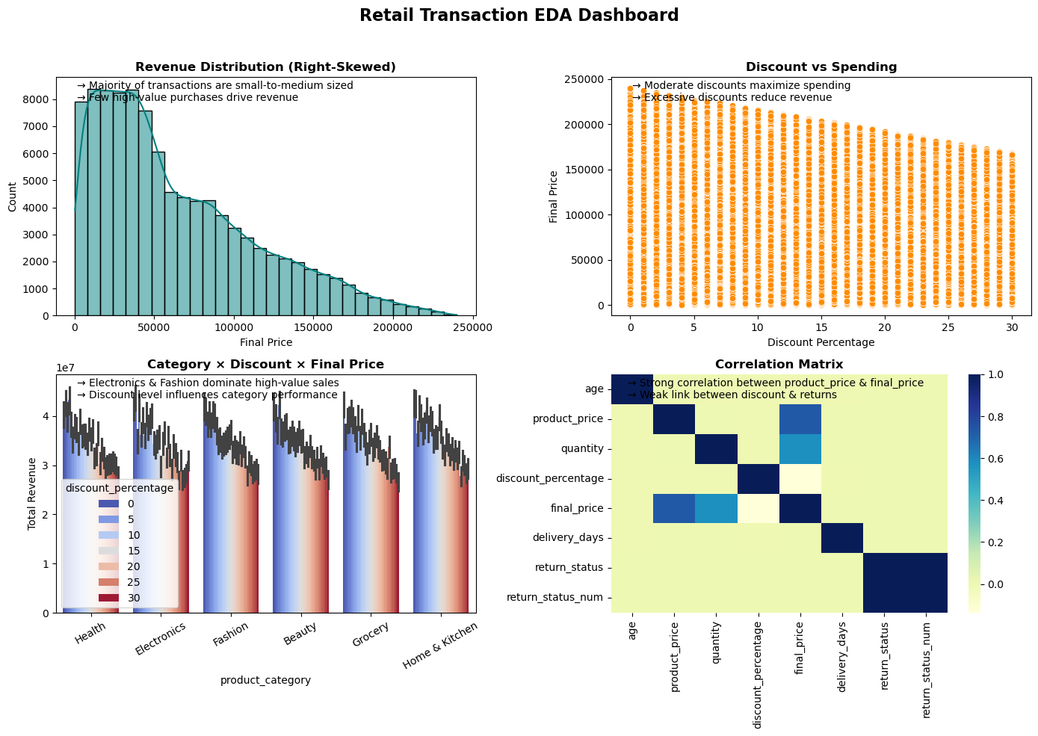
Retail Transaction EDA Dashboard
Visual Summary
NextHikes IT Solutions | Aditi Umale | 15

Slide 16
Conclusion — Key Findings
Findings
• The dataset contains 100,000 retail transactions across 18 variables with no missing values and no duplicate rows.
• Most numerical variables are approximately symmetric, while final_price is moderately right-skewed.
• Product price has the clearest relationship with final price; quantity also shows a positive association.
• Categorical distributions are fairly balanced for product category, customer segment and payment method, while returns are imbalanced (14.81% Yes).
• Outlier detection identifies 1,335 final_price observations under the IQR rule, highlighting a small set of high-value transactions.
• Multivariate views show how category, discount, age, shipping and delivery interact with spending and returns.
Overall: the EDA converts a large transaction table into interpretable distribution, relationship and interaction patterns.
NextHikes IT Solutions | Aditi Umale | 16

Slide 17
Tools & Techniques Used
Technical Stack
Python
Pandas
NumPy
Core programming and EDA environment
Loading, cleaning, grouping and statistics
Numerical computation
Matplotlib
Seaborn
Techniques
Plotting and chart layout
Statistical visualization
Univariate • Bivariate • Multivariate • Pearson correlation • IQR outlier detection • Skewness • Kurtosis
NextHikes IT Solutions | Aditi Umale | 17

Slide 18
Thank You
Exploratory Data Analysis of Large-Scale Retail Transaction Data
Aditi Umale
NextHikes IT Solutions
NextHikes IT Solutions | Aditi Umale | 18

