Slide 1


Analytics in Action: Energy Arbitrage Trading Strategy
Rachel Naveena Embate Joshua
Emily Foreman
Bindu Gangadharaiah
Aditi Sharma

Slide 2
Energia context
Energia’s Role in the Irish Energy Market
Supplies ~17% of the island of Ireland’s total electricity demand
Delivers ~20% of total wind power generation
Serves 800,000 homes and businesses
Operates through Energia and Power NI retail brands
Vision: Be a force for change toward greener, cleaner, smarter energy
Strategic Implications
Large market share → Significant exposure to wholesale price movements
High renewable penetration → Increased generation variability
Competitive retail market → Strong pressure on margin optimisation
Sustainability ambition → Need for smarter trading and technology-driven decisions
Energia’s scale, renewable portfolio, and retail exposure make efficient and intelligent market trading strategically critical.
Notes:
Rachel

Slide 3
Project Focus
Energia operates in volatile wholesale electricity markets where:
Prices fluctuate significantly between trading windows
Renewable generation increases unpredictability
Market inefficiencies create short-lived arbitrage opportunities
Poor timing increases exposure volatility and erodes margins
To protect profitability while remaining competitive, trading strategies must be both accurate and risk-aware.
This project investigates the profitability and risk profile of arbitrage trading between the Day-Ahead Market and IDA1, evaluating:
Profit and loss performance
Exposure volatility
Strategic trading efficiency
Notes:
Rachel

Slide 4
The Market Opportunity – Energy Arbitrage
What is Arbitrage Trading?
Buying power at a lower price in one market and selling it at a higher price in another market
Overview of ISEM Markets
DAM (Day-Ahead Market) – Main reference price, traded the day before delivery
IDA (Intraday Auctions) – Multiple re-pricing opportunities closer to real time
BM (Balancing Market) – Final adjustments near real time
Each auction can clear at a different price for the same delivery period.
Gate Closure, Timing & Forecasting
Each market has a strict gate closure time after which positions cannot be changed. Missing it means lost arbitrage opportunities or exposure to imbalance risk.
Profits depend on accurately forecasting prices, wind, demand and interconnector flows ahead of each auction. Because spreads are small, precise timing and disciplined execution are essential to protect margin.
Notes:
Rachel

Slide 5
The challenge
Short-term power prices in different markets are volatile and driven by weather, demand, and outages.
Traders exploit spreads between markets to lock in margin but face forecast and execution risk.
Predict direction or spread between two markets
Must use only information available at time of trading
Cannot shuffle time series data
Final key performance indicator: €/MWh profit
A data‑driven spread strategy can turn raw market and forecast data into systematic trading decisions instead of ad‑hoc judgment
Notes:
Rachel

Slide 6
The Dataset
2.5+ years of auction data across all major ISEM markets
Captures seasonality, volatility cycles and structural market behavior
Data Integrity
Strict 30-minute chronological ordering
Trade Date aligned to auction gate closure rules
Removed incomplete outage data prior to April 2023
Notes:
Emily
The dataset covers over two and a half years of market activity, with observations every 30 minutes across all major electricity auctions.
This depth allows us to capture seasonality and underlying structural market behavior – which is essential for training a predictive model.
Before modelling, we enforced strict chronological ordering, aligned trading days with auction gate closures, and removed incomplete records prior to April 2023.
This ensures the model reflects real trading conditions.

Slide 7
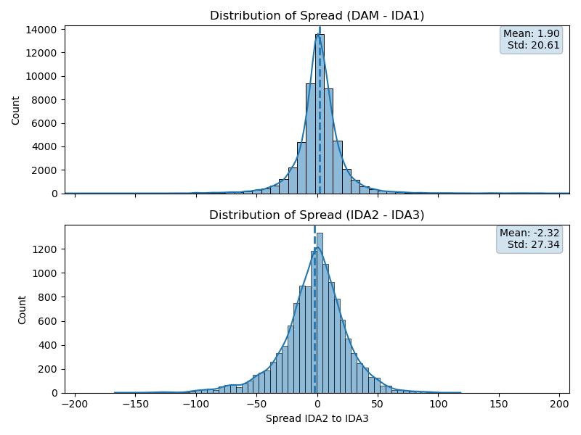
Choice of Market Spread
DAM – IDA1 offers a more stable risk reward profile than IDA2 - IDA3
Notes:
Emily
The first step was selecting the most commercially viable spread.
The spread between the Day Ahead Market and Intraday Auction 1 has a small positive average, indicating structural arbitrage opportunity, but with meaningful volatility.
This tells us that while opportunity exists, disciplined risk management is essential.
In contrast, the spread between Intraday Auctions 2 and 3 has a negative mean and greater dispersion, making it less stable and harder to predict.
Therefore, we focus on DAM-IDA1 spread as the more attractive risk-reward profile.

Slide 8
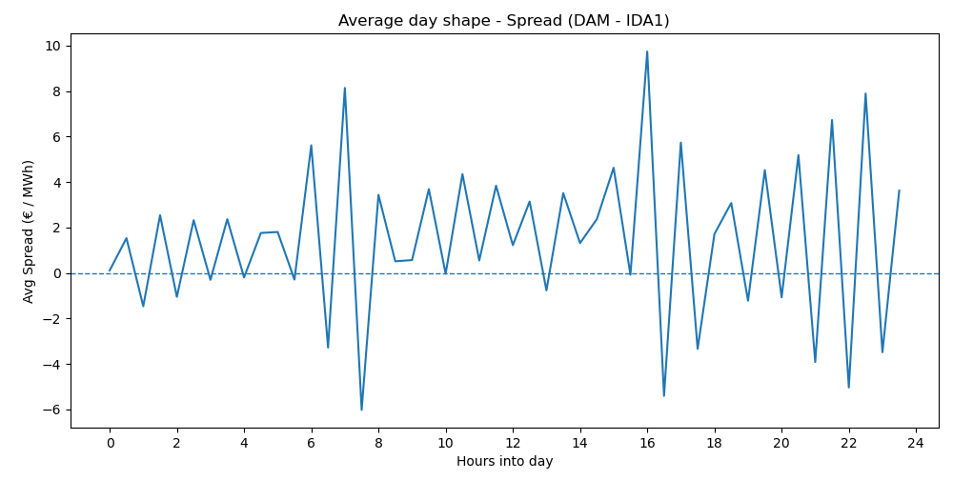
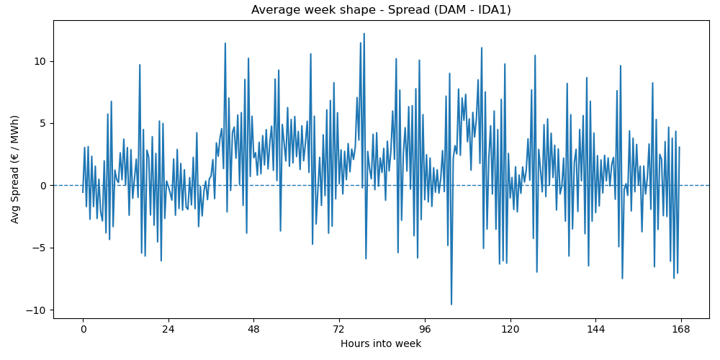
Market Behavior Over Time
Market spread has a periodic frequency that reflect auction timing
Some trading periods show stronger arbitrage opportunities
Notes:
Emily
We then examine how the spread behaves over time.
The left graph shows that certain intraday periods show relatively stable spreads, while others exhibit larger dispersion.
The weekly profile on the right indicates that spread behavior varies across days rather than remaining uniform.
Importantly, this shows that arbitrage behavior is systematic rather than random – but capturing it requires disciplined, data-driven execution.

Slide 9
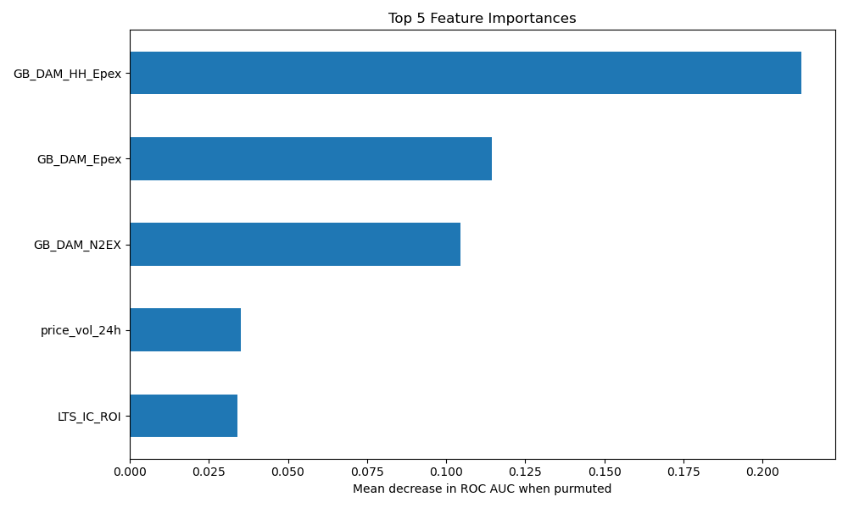
Feature Engineering – Turning Data into Signals
Net Demand = Demand – Wind
Average Wind Forecast to reduce noise
Total Plant Outages since reduced generation capacity increases price volatility and arbitrage opportunities
Notes:
Emily
To capture these arbitrage opportunities, we transformed raw operational data into economically meaningful trading signals.
A key feature is Net Demand, which captures the balance between electricity demand and renewable generation.
When net demand is high, the system is under supply pressure, which tends to increase price.
We average wind forecasts across providers to reduce noise and improve signal stability.
In addition, aggregate plant outages to capture supply constraints.
22 features used in the model. The bar chart shows the 5 most important features for modelling.
Together, these features capture some of the fundamental drivers of electricity price formation.

Slide 10
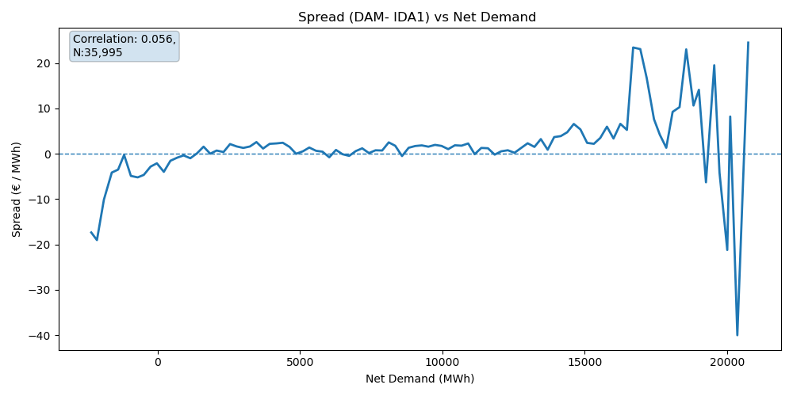
Market Spread and Net Demand
The spread becomes non-linear at extreme values of Net Demand
This supports the use of non-linear modelling techniques
Notes:
Emily
To illustrate the impact the engineered features, we examine the relationship between net demand and DAM-IDA1 spread.
While the overall linear correlation between net demand and spread is small, dispersion increases significantly at extreme imbalance levels.
This suggests spread behavior is regime dependent rather than purely linear.
That insight motivates the use of non-linear modelling techniques.

Slide 11
Modelling Approach: Framework
Why Classification?
Direction matters more than precision in energy trading
Predicts UP vs DOWN (not exact €/MWh values)
Probability outputs enable risk-based decision making
Binary Classification Framework
Binary classification on DAM and IDA1 price spread direction (up/down)
The decision is taken based on an engineered binary variable showing trading direction
Time-Series Data Integrity
30-minute intervals, chronologically ordered
Splits (no shuffling): Train data: 60% (~30k rows) , Validation data: 20% (~10k rows), Test data: 20% (~10k rows)
No leakage: Only uses data available at DAM gate closure
Notes:
Aditi

Slide 12
Modelling Approach: Systematic Model Evaluation
Ensemble Approach
RandomForest: Handles non-linear patterns
CatBoost: Optimized for categorical features
Combined via Stacking Ensemble (LogisticRegression meta-learner)
Metrics:
AUC: Model's ability to rank predictions correctly
€/MWh P&L: Real trading profitability per megawatt-hour
Process:
Individual model hyperparameter optimization
Cross-validation on time-series splits
Ensemble stacking for robustness
Threshold optimization for €/MWh maximization
Notes:
Aditi

Slide 13
Model Trading Strategy
Step 1: Model predicts price movement direction,
The model looks at market data and predicts whether Day-Ahead Market (DAM) prices will be
higher or IDA1 (Intraday) prices will be lower in the next 30 minutes.
Trading profits depend more on getting the direction right than predicting exact prices
If DAM > IDA1 → Buy DAM, sell IDA1
If IDA1 > DAM → Buy IDA1, sell DAM
Step 2: Prediction direction is decided based on price difference between DAM and IDA1
Positive difference (DAM > IDA1) → BUY (trade into DAM)
Negative difference (IDA1 > DAM) → SELL (trade into IDA1)
Step 3: Trading decision made based on thresholds of prediction probability,
Prediction Direction = DAM Price - IDA1 Price
If model confidence > 60% (BUY signal) → TRADE BUY
If model confidence < 30% (SELL signal) → TRADE SELL
Else → NO TRADE (sit out)
Notes:
Aditi

Slide 14
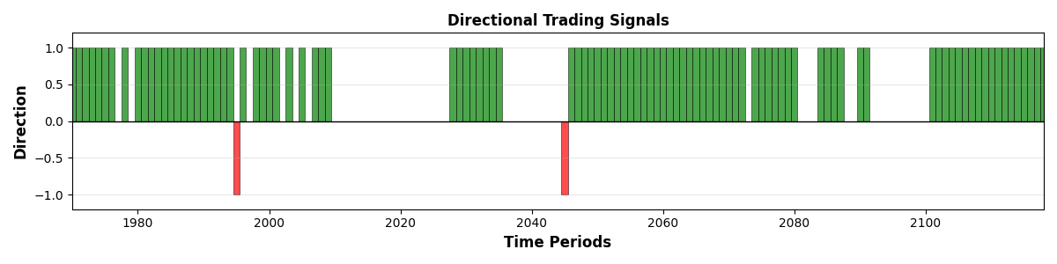
Model Trading Strategy: Visualization
Chart shows one trading day (~24 half-hour intervals)
Green bars UP = BUY signals
Red bars DOWN = SELL signals
No Bars = NO TRADE
Visual Example: ~24-Hour Trading Activity
Notes:
Aditi

Slide 15
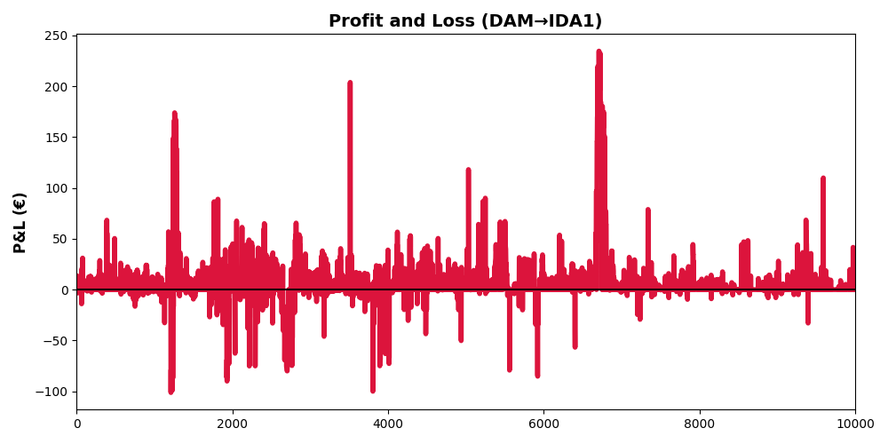
Performance Results
Total test period: 10,173 half-hour slots
Active trading: 3,658 periods (36% selective)
Model Accuracy: 72.2%
Profit per MWh: 13.34 €/MWh
Total Profit: €48800
Trading Results:
Based on model predictions 3658 trades were made from 10173 which results in trade percentage of more than 36%
Notes:
Aditi

Slide 16
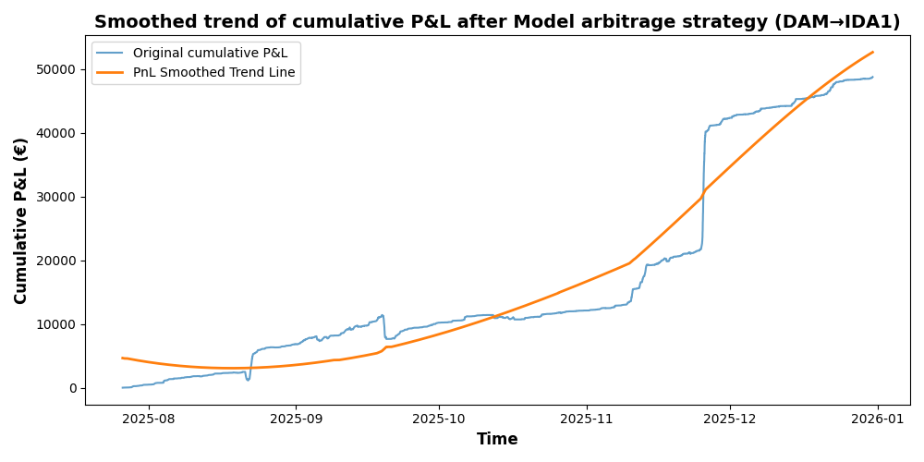
Performance Results: Cumulative P&L Chart
Notes:
Aditi

Slide 17
Conclusion: Data-Driven Energy Arbitrage Strategy
Identified and exploited DAM–IDA1 arbitrage opportunities using market fundamentals
Developed time-series safe binary classification models
Applied ensemble modelling with probability-based trade filtering
Results:
Strong directional prediction AUC ≈ 0.70
Generated €13.34 profit per MWh in out-of-sample testing
Controlled trade frequency through confidence thresholds
Stable cumulative P&L in out-of-sample testing

Slide 18
Strategic Insights
This framework provides:
Improved margin optimisation
Reduced discretionary trading bias
Scalable architecture for other market spreads
A foundation for live pilot deployment and integration into Energia’s trading development workflow
Data-driven arbitrage can systematically improve profitability while maintaining disciplined risk control.

Slide 19
Business Impact
For Energia, this framework:
Enhances wholesale trading margin optimisation
Reduces reliance on discretionary judgement
Improves exploitation of renewable-driven volatility
Provides scalable architecture for other market spreads
Can be integrated into automated trading support systems
Given Energia’s trading volume, even incremental €/MWh improvements can generate substantial annualised value.

Slide 20
Future Development & Deployment
While the backtested results demonstrate strong economic viability, the next phase involves:
Deploying a live pilot with controlled capital to validate real-time execution performance.
Incorporating regime detection mechanisms to adapt trading aggressiveness during structural market shifts
Further refining ensemble weighting and probability thresholds
Integrating the framework into Energia’s Trading Development workflow for scalable deployment
This ensures the strategy transitions from research validation to operational impact.

