Slide 1
Example of a Bad Color Scheme
Fonts in the same color family as the background do not show up well.
Here are some tips for good color combinations
Use the Design Templates
Go under the format menu and select Slide Design
Use the Standard Color schemes
You can’t go wrong with the dark blue background and yellow or white text

Slide 2
Another Bad Color Scheme
Dark text on dark background
Beware of shaded backgrounds
The dark text is harder to read down here

Slide 3
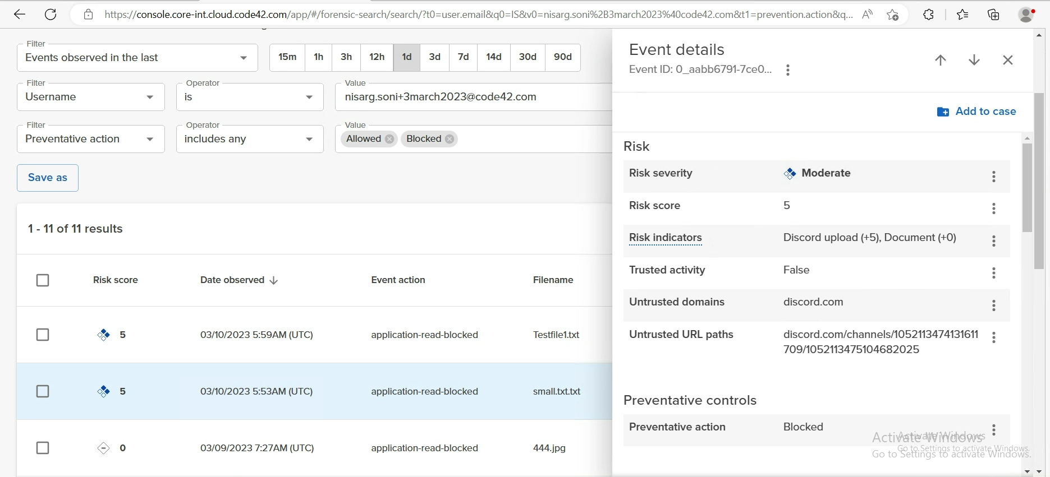
Another Bad Color Scheme
Dark text on dark background
Beware of shaded backgrounds
test
Test
The dark text is harder to read down here

