Slide 1


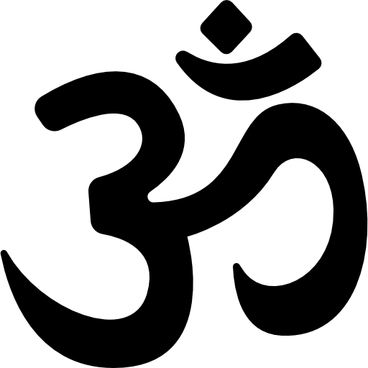



Hindu
Parsi
Christian
Buddhist
Jain
Sikh

