Slide 1
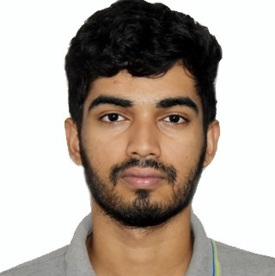



Aditya Bhowmick
Analyst/Software Engineer
Bachelor of Technology In Electronics and Electrical Engineering: 2018 - 2022
Skills
Mumbai
Java 8 /J2EE | Java Basics, OOPS, Generics, Collections, Arrays, Loops, Lambda Exp, Stream API Junit, Mockito, Servlets
Spring core | IOC & Dependency Injection, Autowire
Spring REST | REST controllers, Implementation of GET, POST, PUT & DELETE, Bean Validation & Exception Handling, Testing Services, Controller & Repository layer
Spring Data JPA | Implement DAO layer using spring Data repositories, Transaction Management
Spring Boot Microservices | Spring Boot Starters, annotations, Messaging Service, Sync/Async comms, Swagger API documents
Spring Cloud | Eureka, Netflix Ribbon, Feign Client, Netflix Hystrix, Netflix Zuul & Config Server
React | Components, Hooks, Event handling, Redux, Reducers, Testing using Jasmin & Karma
Database | MongoDB No Sql Basics My SQL RDS Basics
UI Tech | HTML 5 & CSS 3,JavaScript, ES6 & TypeScript Reusable templates, Optimized UI Designed
Tools | Git, Postman, Maven, IDE
Add On skills | Communications, Team management. Peer learning
@capgemini.com
+91 8017107588
A4
Full Stack Developer
Hands on experience in creating microservices with Springboot, Spring Security, Spring Cloud API Gateway, Eureka server,Hystrix, load balancing
Proficient in creating Single page Web Application in REACT with Authentication with route React Redux , React reactive forms, React routing, CSS, Bootstrap
Hands on experience in implementing polyglot architecture with spring boot & backend
Hands on experience with MongoDB and MYSQL
Experience in creating documentation with Java docs and swagger and in unit testing using Junit, Mockito
Pharmacy Management System Application
Completed end to end case study of Pharmacy Management System Application along with JWT authentication, Swagger , responsive UI with BootStrap4, Material UI and React used for user interface.
Car Rental System
Developed a car rental system using Spring Boot Applications.
Faculty Management System
Developed a Monolithic Application using Spring boot, ReactJS and PostgreSql with all CRUD operations working, along with responsive UI using BootStrap4.
Check out my work on GitHub & Video Profile

