Slide 1
Commanding the Command Line
Unit 2.2
Cybersecurity Boot Camp |

Slide 2
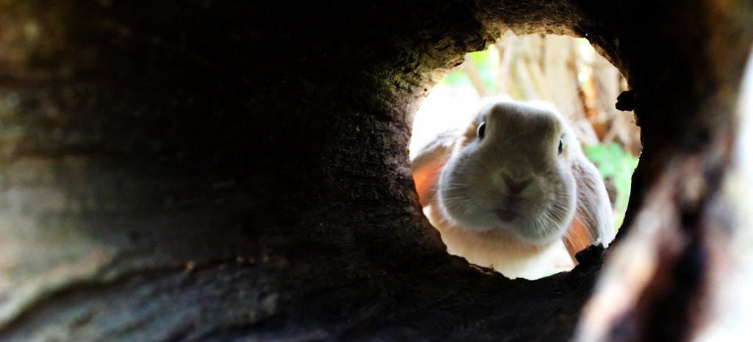
Today’s Class
Welcome Back!
Today, we’ll be diving deeper down the command-line rabbit hole.
Notes:
Review goals; address any questions.

Slide 3

The Glories of File Searching
Common tasks of an IT security professional often involve searching through file systems, sifting through logs, and finding signs of malicious intent.
Notes:
Review goals; address any questions.

Slide 4

The Glories of File Searching
Without proper technique, these tasks will feel like sifting
(and sorting) needles in a haystack.
Notes:
Review goals; address any questions.

Slide 5
Our Tools of the Trade
find
exec
grep
Today, we’ll be learning to use a series of powerful command-line techniques helpful in
speeding up the process.
Notes:
Review goals; address any questions.

Slide 6
Today’s Goals
By the end of class, you will be able to:
Articulate and parse the elements of a basic Unix command.
Utilize the find command to locate files based on various search parameters.
Use the exec command to perform basic bulk operations on files.
Use the grep command to search within the contents of files.
Utilize the wc command to count words and lines.
Devise strategies for combining multiple commands in sequence to accomplish more intermediate IT tasks.
$ grep ‘go’ ./
Notes:
Review goals; address any questions.

Slide 7
Let’s start with a warm-up.

Slide 8
Activity: Warm-Up Activity (10 min)
You've just been given a series of server logs from today. Your task is to use the command line to:
Create a folder called Archive.
Combine all of the logs contained in the TodaysLog folder into a single text file titled with today's date.
Move the file you created to the Archive folder.
Preview the file contents.
Bonus: If you finish early, try to recomplete the task in just four commands.

Slide 9
Breaking Down Commands

Slide 10
(Scary) Complex Commands
find . -exec grep -l -e 'myregex' {} \; >> outfile.txt
find "$DIR" -type f -atime +5 -exec rm {} \;
find . -type f -name "* *" | while read file
One thing that intimidates newcomers to the command line is the apparent complexity of
large commands. But . . .
Notes:
Review goals; address any questions.

Slide 11
Basic Command-Line Structure
command [-options] [arguments]
Every command follows a relatively
consistent structure.
Notes:
Review goals; address any questions.

Slide 12
Basic Command-Line Structure
command [-options] [arguments]
Command
Program that tells the Unix system to do something.
Commands are case-sensitive.
Examples: cd, mkdir, find, exec, tar
Notes:
Review goals; address any questions.

Slide 13
Basic Command-Line Structure
command [-options] [arguments]
Options
Options modify what the command will do.
They are not always required.
They are preceded by a hyphen (-).
Multiple options can be used in sequence with a space in between or if no argument is present back to back.
Examples: -f, -size, -cmin
Notes:
Review goals; address any questions.

Slide 14
Basic Command-Line Structure
command [-options] [arguments]
Arguments
Arguments are specific to the command or option.
They are not always required.
They can appear immediately after the command if they are inputs for the command or after an option if they are an input for the option.
They usually indicate on what file or folder the command will act, but can also be used to specify a parameter needed by the option.
Examples: My_Folder, 10b, *.docx
Notes:
Review goals; address any questions.

Slide 15
Basic Command-Line Structure (Example #1)
head -20 frank_1.txt
Which is the command?
Which are the arguments?
Which are the options?
Notes:
Review goals; address any questions.

Slide 16
Basic Command-Line Structure (Example #1)
Argument
head -20 frank_1.txt
Command
Option
Notes:
Review goals; address any questions.

Slide 17
Basic Command-Line Structure (Example #2)
mkdir My_Folder
Which is the command?
Which are the arguments?
Which are the options?
Notes:
Review goals; address any questions.

Slide 18
Basic Command-Line Structure (Example #2)
Argument
mkdir My_Folder
Command
Notes:
Review goals; address any questions.

Slide 19
Basic Command-Line Structure (Example #3)
find -type f -iname *.xlsx*
Which is the command?
Which are the arguments?
Which are the options?
Notes:
Review goals; address any questions.

Slide 20
Basic Command-Line Structure (Example #3)
Argument
Argument
find -type f -iname *.xlsx*
Command
Option
Option
Notes:
Review goals; address any questions.

Slide 21
command [-options] [arguments]
Don’t spend too much time overthinking it. Just keep this basic structure in the back of your mind.

Slide 22
Activity Time

Slide 23
find Command
Instructor Demo
Notes:
Review goals; address any questions.

Slide 24
Activity: PathFinder (12 min)
Time to revisit an old challenge! In this challenge, you will revisit the Terminal Mazes activity from last class. This time you get to use the find command to speed things up.
Use the find command to identify the location of the start.txt and Bonus.txt files and the End directory folder that is contained within the Mazes directory.
Use the provided path results to help you copy each of the start.txt and Bonus.txt files into their respective End folder.
Hint: You should be able to complete this task in 9–10 commands (including the Bonus.txt files).

Slide 25
find Options
Instructor Demo
Notes:
Review goals; address any questions.

Slide 26
Activity: Gibberish Finder (15 min)
You have just been given a set of deeply nested folders, along with a list of challenge questions.
Use your new knowledge of the find command to create search queries for each of the challenges sent to you.

Slide 27
exec Command
Instructor Demo
Notes:
Review goals; address any questions.

Slide 28
Activity: Executive Cleaner (15 min)
You've been tasked with sorting the Gibberish_Folder folder. Specifically, you've been asked to:
Create a folder called Sorted_Gibberish.
Create subfolders within this folder called Docs, Data, and Text.
Copy all Word documents into the Docs folder, Excel files into the Data folder, and Text files into the Text folder.
Bonus
Create a subfolder called LargeFiles in the Sorted_Gibberish folder.
Move all files that are larger than 200 KB into the LargeFiles folder.

Slide 29
grep Command
Instructor Demo
Notes:
Review goals; address any questions.

Slide 30
Activity: Grep Detective (15 min)
You've just been given a series of chat logs from April 2014. Your task is to use the grep command to identify the following:
The days for which the users power2all, glanzmann, gansbrest, and E1ven were active in the channel.
The log on and off times for these users.
Hint: When determining log on time, look for a string pattern that captures what you are specifically looking for.
Bonus: See the challenge sent to you by your instructor.

Slide 31
wc Command
Instructor Demo
Notes:
Review goals; address any questions.

Slide 32
Activity: Log Counter (10 min)
Use your knowledge of the wc -l command to answer the following questions:
Part I: Basic Counts
How many log files are included in the IRC_Logs folder?
How many log files exceed 100 KB in size?
Part II: Login Counter
How many times did the user glanzmann log in?
How many times did the user E1ven log in?
Part III: Chat Counter
How many times did the user glanzmann speak?
How many times did the user E1ven speak?

Slide 33
Lesson Recap

Slide 34
Quick Review!
What are the basic components of a command-line statement?
Notes:
Review goals; address any questions.

Slide 35
Quick Review!
What are the basic components of a command-line statement?
command [-options] [arguments]
Notes:
Review goals; address any questions.

Slide 36
Quick Review!
Which command would we use to identify all files in the current directory?
Notes:
Review goals; address any questions.

Slide 37
Quick Review!
Which command would we use to identify all files in the current directory?
find . –type f
Notes:
Review goals; address any questions.

Slide 38
Quick Review!
Which command would we use to identify all directories in the current directory?
Notes:
Review goals; address any questions.

Slide 39
Quick Review!
Which command would we use to identify all directories in the current directory?
find . –type d
Notes:
Review goals; address any questions.

Slide 40
Quick Review!
Which command would we use to find all text files in a folder named manuals?
Notes:
Review goals; address any questions.

Slide 41
Quick Review!
Which command would we use to find all text files in a folder named manuals?
find *.txt –type f manuals
Notes:
Review goals; address any questions.

Slide 42
Quick Review!
Which command would we use to find all .docx files and .pdf files?
Notes:
Review goals; address any questions.

Slide 43
Quick Review!
Which command would we use to find all .docx files and .pdf files?
find *.docx –o *.pdf –type f .
Notes:
Review goals; address any questions.

Slide 44
Quick Review!
Which does each element of the following statement signify?
find . -type f -exec cp {} My_Files \;
Notes:
Review goals; address any questions.

Slide 45
Quick Review!
Which does each element of the following statement signify?
find . -type f -exec cp {} My_Files \;
Specifies the
search condition
Copy file list
Command
close
Run subcommand
Destination
Notes:
Review goals; address any questions.

Slide 46
Quick Review!
Which command would we use to
search within files for instances of a certain text?
Notes:
Review goals; address any questions.

Slide 47
Quick Review!
Which command would we use to
search within files for instances of a certain text?
grep {text} .
Notes:
Review goals; address any questions.

Slide 48
Quick Review!
Which command would we use to
search within files for files containing a certain text?
Notes:
Review goals; address any questions.

Slide 49
Quick Review!
Which command would we use to
search within files for files containing a certain text?
grep –rli {text} .
Notes:
Review goals; address any questions.

Slide 50
Quick Review!
Which command would we use to count the number of search results?
Notes:
Review goals; address any questions.

Slide 51
Quick Review!
Which command would we use to count the number of search results?
{query} | wc -l
Notes:
Review goals; address any questions.

Slide 52
Today’s Summary
find {condition} {location} Finds all files based on provided conditions.
-type f / -type d: Searches for files or directories
-name / -iname: Searches file titles
-size: Searches file sizes
-cmin / -min: Searches creation or modified date
exec {command} {} {destination} \; Performs a bulk operation on multiple files.
grep Searches within the body of files for instances or files containing text
grep –i {text} {location}: Searches for instances of text
grep –rli {text}: Searches for files containing text
| wc -l Counts lines. Useful in counting the number of records
Notes:
Review goals; address any questions.

Slide 53
Today’s Summary
find {condition} {location} Finds all files based on provided conditions.
-type f / -type d: Searches for files or directories
-name / -iname: Searches file titles
-size: Searches file sizes
-cmin / -min: Searches creation or modified date
exec {command} {} {destination} \; Performs a bulk operation on multiple files
grep Searches within the body of files for instances or files containing text
grep –i {text} {location}: Searches for instances of text
grep –rli {text}: Searches for files containing text
| wc -l Counts lines. Useful in counting the number of records
Tip:
Begin working on your homework assignment! You have most of what you need.
Notes:
Review goals; address any questions.

Slide 54
Today’s Goals
By the end of class, you will:
Articulate and parse the elements of a basic Unix command.
Utilize the find to locate files based on various search parameters.
Use the exec command to perform basic bulk operations.
Use the grep command to search within contents of files.
Employ research and documentation to apply new commands in unfamiliar situations.
Devise strategies for using multiple commands in sequence to accomplish more sophisticated IT tasks.
$ grep ‘go’ ./
Notes:
Review goals; address any questions.

Slide 55
Next Class
ssh
scp
.sh
And a Lot More!

