Slide 1
Undercover Unix
Unit 2.3
Cybersecurity Boot Camp |

Slide 2

Today’s Class
We’ll be learning how to automate tasks through premade
shell scripts . . .
Notes:
Review goals; address any questions.

Slide 3
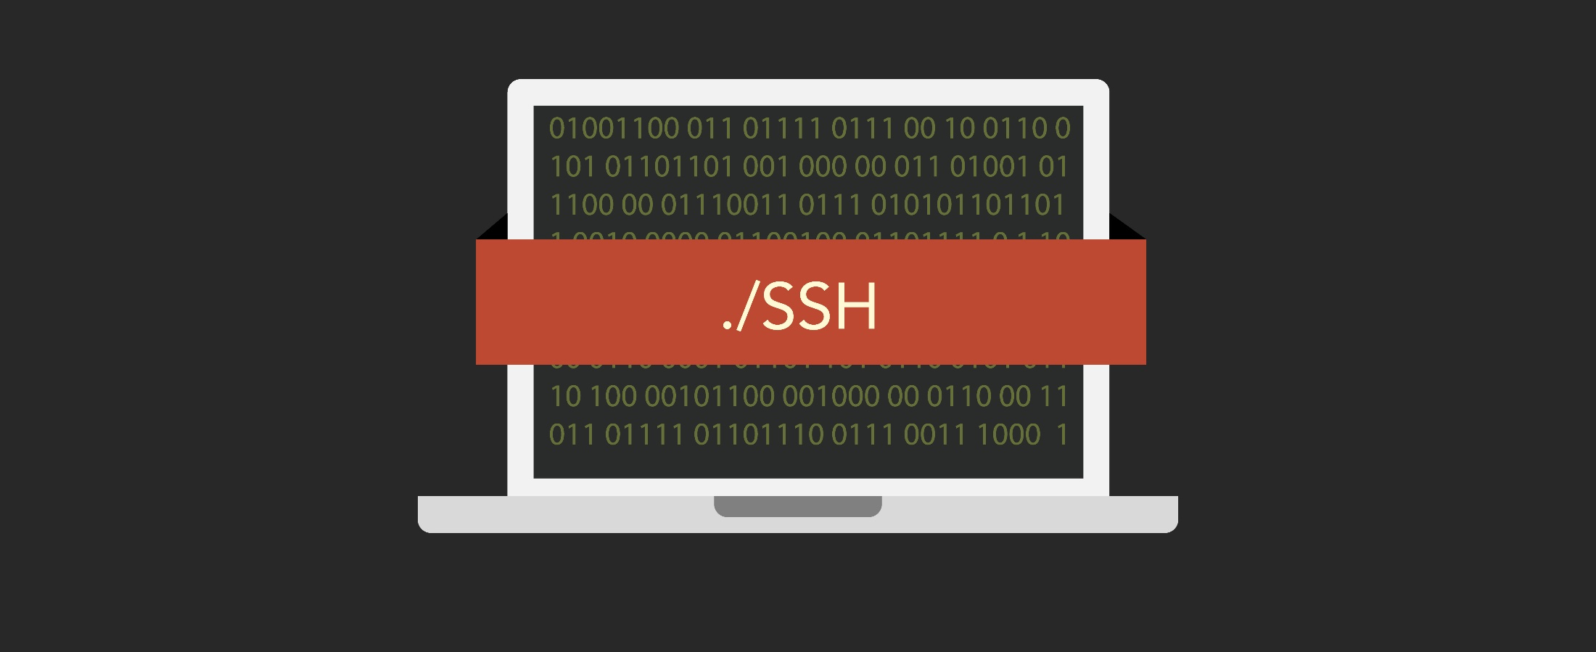
Today’s Class
And we’ll be learning how to use ssh and scp to take access of remote machines.
Notes:
Review goals; address any questions.

Slide 4
Today’s Goals
By the end of class, you will be able to:
Create and execute shell scripts using Unix commands.
Employ research and documentation to identify new commands for unfamiliar situations.
Devise strategies for combining multiple commands in sequence to accomplish advanced IT tasks.
Navigate file systems of virtual machines using the command line.
Use ssh to create a secure shell to remote machines.
Use scp to copy files from remote machines to local machines.
$ ssh @Time.To.Shell
Notes:
Review goals; address any questions.

Slide 5
Let’s start with a warm-up.

Slide 6
Activity: Warm-Up Activity (10 min)
You've just been given a folder filled with files from a user's personal machine. Your task is to use the command line to:
Create two subfolders within the Music folder: one called FLAC and the other called MP3.
Write a command that finds all .mp3 and .flac files and copies them into their respective subfolders.
Write a command to count the number of .mp3 and .flac files in each folder.
Hint: Make sure to avoid double counting for the final step.

Slide 7
Let’s Get Scripting!

Slide 8
Shell Scripts
Instructor Demo
Notes:
Review goals; address any questions.

Slide 9
Activity: My First Shell Script (7 mins)
Create (and execute) a shell script which accomplishes the following:
Creates a folder called Summary.
Combines all files in the Files folder into a single file called MySummary.txt.
Moves the MySummary.txt file into the Summary folder.
Previews the first ten lines of contents.
Hint: Consider solving this activity using the command line before writing your script. Start where you’re comfortable before transitioning to what's new.

Slide 10
Activity: Troubleshooting Scripts (12 mins)
You've just been given a shell script for interacting with Gibberish_Folder.zip. Your task is to identify and correct the errors included in the Unsolved.sh shell script to ensure that it works as designed.
When successful, your corrected shell script should:
Create a subfolder for document type (.docx, .xlsx, .txt).
Find and move all of each file type to its respective folder.
Count the number of incidences of each file type.
Hints:
Be sure to unzip Gibberish_Folder.zip before beginning this challenge.
Don't be afraid to run your shell script as you make changes. You can always unzip the original Gibberish_Folder.zip again if you need to restart.
This is a challenging activity! Debugging scripts can often be more frustrating than writing them in the first place.

Slide 11
Learning New Commands
Instructor Demo
Notes:
Review goals; address any questions.

Slide 12
Activity: Writing to a File (15 mins)
Using the Readings folder as a starting place, create a shell script that accomplishes the following:
Creates a new file called MyFile.txt. In the file, add the following line of text: "Hey there! This is my sentence”.
Clear the Pride.txt file and insert a line of replacement text.
Add a line of text to the bottom of the Alice.txt file.
Hint: This task will require you to research a new command and its various options.

Slide 13
Now time for a mega challenge.

Slide 14
Activity: Break-In Report (30 mins)
Using the instructions sent to you, your task is to create two reports on the frequency of break-in attempts on an authentication server.
This is a challenging exercise!
Work together in teams to accomplish this task.

Slide 15
Virtual Machines
Instructor Demo
Notes:
Review goals; address any questions.

Slide 16
Activity: My First Virtual Machine (10 mins)
It’s your turn to load a VM and work with it using Unix commands. Complete the following steps:
Load the virtual machine provided to you, start the machine, and log in. The credentials are: Username: poweruser Password: grep
While inside the virtual machine create a folder and text file within the folder using the command line.

Slide 17
ssh Command
Instructor Demo
Notes:
Review goals; address any questions.

Slide 18
Activity: ssh Command (15 mins)
You will connect your local machine to a VM and then run a series of commands to locate a set of password and financial files. Complete the following steps:
Use the ifconfig command to identify the IP address of your virtual machine.
Use ssh poweruser@ipaddress from your local machine to create a secure shell into the virtual machine.
Create a folder called Extract at the base directory of the virtual machine.
Use the find and exec commands to copy all files with the words password, finance, topsecret, and ost into the Extract folder.
Use the tar command to tar the Extract file.

Slide 19
scp Command
Instructor Demo
Notes:
Review goals; address any questions.

Slide 20
Activity: scp Practice (5 mins)
Use scp to send a packet of files from the remote machine back to your local machine. Complete the following steps:
Using the scp command, copy the Extract.tar file you created in the previous exercise to your local machine.
From your local machine, extract the .tar file to reveal its contents.

Slide 21
Lesson Recap

Slide 22
Quick Review!
Which is the command we would use to execute shell scripts?
Notes:
Review goals; address any questions.

Slide 23
Quick Review!
Which is the command we would use to execute shell scripts?
sh
Notes:
Review goals; address any questions.

Slide 24
Quick Review!
Which is the command we would use to
write to new files?
Notes:
Review goals; address any questions.

Slide 25
Quick Review!
Which is the command we would use to
write to new files?
echo “Text” > {File}
Notes:
Review goals; address any questions.

Slide 26
Quick Review!
Which is the command we would use to
append to files?
Notes:
Review goals; address any questions.

Slide 27
Quick Review!
Which is the command we would use to
append to files?
echo “Text” >> {File}
Notes:
Review goals; address any questions.

Slide 28
Quick Review!
What does SSH stand for?
Notes:
Review goals; address any questions.

Slide 29
Quick Review!
What does SSH stand for?
Secure Shell
Notes:
Review goals; address any questions.

Slide 30
Quick Review!
What does SCP stand for?
Notes:
Review goals; address any questions.

Slide 31
Quick Review!
What does SCP stand for?
Secure Copy
Notes:
Review goals; address any questions.

Slide 32
Today’s Goals
By the end of class, you will:
Create and execute shell scripts using UNIX commands.
Employ research and documentation to identify new commands for unfamiliar situations.
Devise strategies for combining multiple commands in sequence to accomplish advanced IT tasks.
Navigate file systems of virtual machines using the command line.
Use ssh to create a secure shell to remote machines.
Use scp to copy files from remote machines to local machines.
$ ssh @Time.To.Shell
Notes:
Review goals; address any questions.

Slide 33

Congratulations!
Mastering the Command Line is no trivial feat. And with this seemingly small skill—you’ve added a tremendous capability to your technical tool belt.

