Slide 1
Power of Python!
Unit 3.1
Cybersecurity Boot Camp |

Slide 2
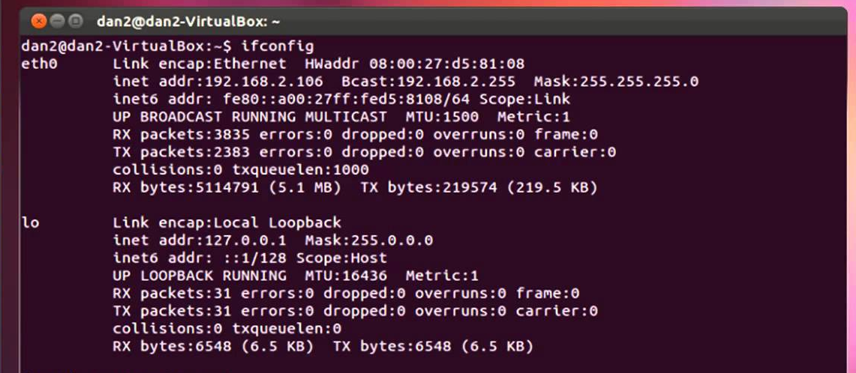
Last Week…
Last week, we got our hands dirty with the command line.
Notes:
Review goals; address any questions.

Slide 3

This Week: Enter Python
This week, we will expand our toolset by introducing the Python programming language.
Notes:
Review goals; address any questions.

Slide 4
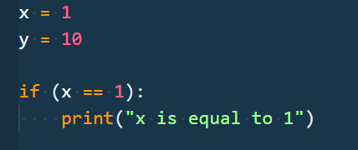
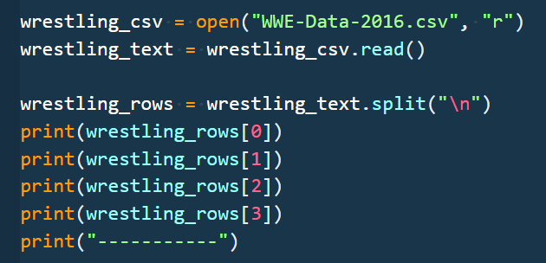
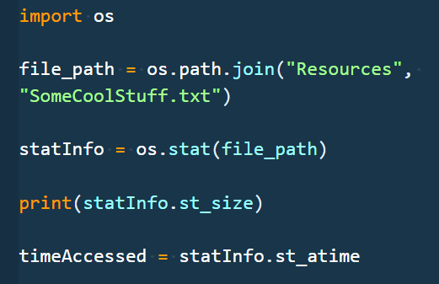
This Week’s Goals
Day 1
Understand the fundamentals of Python so that we can use this powerful tool to solve problems in the cybersecurity space.
Day 2
Use Python to work with sets of data and files so that we can automate repetitive tasks and interact with our filesystems.
Day 3
Use functions and modules (both internal and external) to reuse and deduplicate code to solve more complex problems using Python.
Notes:
Review this week’s unit goals; address any questions.

Slide 5
Today’s Goals
By the end of class, you will be able to:
Explain how and why Python is used in cybersecurity.
Utilize basic Python elements like variables and operators.
Employ the Python `input()` function to retrieve, store, and utilize user inputs.
Use Boolean logic within conditional statements.
Design a Python application using the above commands to address a real-world security problem.
$ python learn.py
Notes:
Review goals; address any questions.

Slide 6
Why Python?

Slide 7

Quick Fist to Five!
Raise a Fist If you’ve never worked with Python and barely know what it is.
Raise a Five If you work with Python on a daily basis.
Raise a One, Two, Three, or Four
If you fall somewhere in between.

Slide 8
Quick Fist to Five!
Story Time
For those of you who have used Python, where have you used it and what for?

Slide 9

What Is Python?
Python is a high-level, general purpose programming language used for a variety of applications.
It has an enormous community of developers.
It is used in a wide variety of industries and jobs.
Prioritizes readability for ease of use.
Notes:
Python forces you to follow certain rules to make the code readable. Well written code makes it easier for everyone to read, which makes team collaboration easier.

Slide 10


Bash vs Python
Bash/Shell Scripts/UNIX are great for OS-level interaction, dealing with processes, and interacting with the filesystem.
Python is great for simple or complex logic-based applications, and for automating complex tasks.
In reality, we’ll use both Python and Bash. Python allows us to write complex applications and do logic with relative ease, but the terminal is indispensable for OS and filesystem interaction.
Notes:
Review the differences between bash and Python, so students can best understand when to use bash and when to use Python.

Slide 11
Why Learn Python?
As security professionals, Python:
Can be used for a huge set of tasks. For example, automation of repetitive tasks, network emulation, cloud computing, cryptography, analytics, forensics, malware detection, visualization, and more.
Is often the simplest way to solve a problem. With powerful tools and syntax, Python can speed up processes that require significant manual effort. While the learning curve can be tough, it’s one of the simplest and well-supported programming languages.
Has tons of community support and already-written code. The Python community has shared a huge number of tools and modules that we can use to help us quickly solve complex problems.

Slide 12
Why Learn Python?
Learning Python is a huge competitive advantage for technically oriented cybersecurity jobs.
Skill | Number of Job Listings
Information Security | 151,470
Linux | 73,735
Project Management | 69,072
Network Security | 63,519
Cryptography | 53,997
Network Engineering | 47,651
SQL | 43,651
Unix | 40,945
Python | 40,750
Based on national job listings in the cybersecurity through 2017. (Source: Burning Glass)

Slide 13
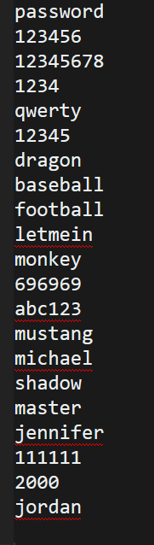
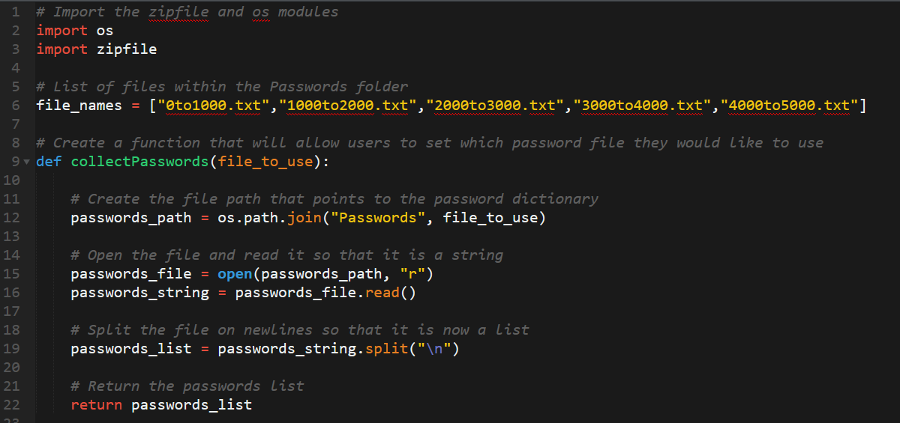
Example Application (HW): Password Cracker
We’ll learn to write Python code that breaks into password-encrypted files using a brute-force algorithm that checks tens of thousands of common passwords.

Slide 14
Today’s Goals
Let’s check-in on today’s goals! Any questions?
Explain how and why Python is used in cybersecurity.
Use basic Python tools such as variables and operators to solve problems with scripts.
Receive, store, and use user input in Python scripts.
Reference and store collections of data using lists.
Use Boolean logic with conditional statements.
$ python learn.py
Notes:
Review goals; address any questions.

Slide 15
Setup Time!

Slide 16

Python and VS Code
Python
VS Code
Python is the programming language.
VS Code is the editor in which we’ll write the code.

Slide 17
Activity: Install Python (7 min)
Take a few moments to confirm that you have Python installed. To do this:
Open a Terminal (or Git Bash) window.
Then enter the command: “python --version”
Confirm that you see the phrase “Python 3.X.X” as a response. (If you see the phrase Python 2.X.X, proceed to the steps below).
If you do not see this. Complete the following steps:
Navigate to the Python website and download the latest version. (https://www.python.org/downloads/)
Follow the default installation steps. (Windows users be sure to select the option to Add Python 3.7 to path).
Then re-open the Terminal (or Git Bash) window and run the commands:
Windows: echo "alias python=python3" >> ~/.bashrc
Mac: python3 (You will run python with this command going forward)
Notes:
You and your TAs should be ready to help students troubleshoot installation issues.
Some students may need to run the echo "alias python=python3" >> ~/.bashrc command and then restart the terminal (if they are getting a "The program 'python' is not installed" error).

Slide 18
Activity: Install VS Code (5 min)
Take a few moments to confirm that you have VS Code installed.
Follow these steps to install VS Code:
Go to this page https://code.visualstudio.com/ to download and install VS Code.
Then navigate to the Extensions section and search for the phrase “Python”. Download the first extension that appears.
Reference the following link if you get stuck: Getting Started with Python https://code.visualstudio.com/docs/python/python-tutorial
Notes:
You and your TAs should be ready to help students troubleshoot installation issues.
Some students may need to run the echo "alias python=python3" >> ~/.bashrc command and then restart the terminal (if they are getting a "The program 'python' is not installed" error).

Slide 19
Hello World!
Instructor Demo
Notes:
Instructor live-codes creating a variable and storing information to that variable.
Instructor also live-codes basic operator.

Slide 20
Programming Fundamentals

Slide 21
Data Types and Tools
Programming is just piecing logic together to solve larger problems and produce output.
All of programming is basically just manipulating data.
Programming can be broken into 10 primary building blocks, fundamentally data and logic:
Data
Numbers
Strings
Booleans
Lists
Dictionaries
Logic
Operators
Conditionals
Loops
Functions
Modules

Slide 22
Booleans
true
false
Booleans can only have the value TRUE or FALSE.

Slide 23
Strings
“Hello World!”
“13 peas, please.”
“#@$^!”
“Strings are any collection of characters.”

Slide 24

Numbers
49
6.38
5.7
Integers
Decimals
Negatives
There are many different types of numbers (floats, integers, etc.)

Slide 25
Variables and Operators

Slide 26
Variables
Variables are the means by which we can store and reference data. We assign values to variables in Python.
The assignment statement:
Variable Name
Assignment Operator
Value
name
=
“Fa Mulan”
The quotes (“”),
convey that “Fa Mulan” is a string.

Slide 27
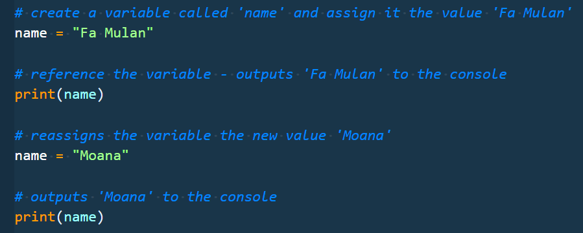
Variables
Variables that have been assigned can then be referenced and reassigned in the code later, as shown in the following image:
Notes:
Explain that print allows you to output something to the console.

Slide 28
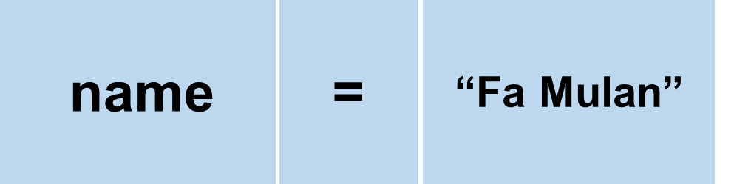
Operators
Operators are symbols that do something with data.
We’ve already seen an operation! The assignment operator = stores a value to a variable
There are many more! For example:
Arithmetic: +, -, *, /, etc.
Comparison: <, >, ==, !=, etc.
Logical: and, or, not
Too many to go into all of them right now!
Notes:
https://data-flair.training/blogs/python-operator/
https://docs.python.org/3/reference/expressions.html

Slide 29
Basic Variables
Instructor Demo
Notes:
Instructor live-codes creating a variable and storing information to that variable.
Instructor also live-codes basic operator.

Slide 30
Activity: Variable Dissection (8 min)
With a partner, open the Variables-Dissect.py file that was slacked out to you.
Follow these steps:
Update the code comments to identify the output of each statement. NOTE: Do not run the code at first. See if you can make informed guesses.
Once you have filled in all of the comments, run the file and compare the output to your guesses.
Fix any errors in your guesses, and research why your guesses differed from the result.
Hint: You may want to do some googling to understand some of the operators. Running the code and viewing the output also helps to understand the operations, so be sure to review after running.

Slide 31
Variable Dissection
Instructor Review

Slide 32
Activity: Variable Addresses (10 min)
In this activity, you will be creating some simple variables for a website and its daily hits in order to print out a summary of this information to the screen. Follow these steps:
Create a file called VariableAddress.py.
Create a variable called URL which will contain a URL in string form.
Create a variable called IP_address which will contain an IP address in string form.
Create a new variable for each day of the week and, using integers, set them equal to how many views the site got on those days. Note: You can choose to use any numbers you wish.
Create a variable called weekly_hits and set it equal to the sum of the hits on each day of the week.
Create a variable called average_hits which takes the weekly_hits and divides it by the number of weekdays in a week.
Print out each variable to the terminal.

Slide 33
Variable Addresses
Instructor Review

Slide 34
Today’s Goals
Let’s check-in on today’s goals! Any questions?
Explain how and why Python is used in cybersecurity.
Use basic Python tools such as variables and operators to solve problems with scripts.
Receive, store, and use user input in Python scripts.
Reference and store collections of data using lists.
Use Boolean logic with conditional statements.
$ python learn.py
Notes:
Review goals; address any questions.

Slide 35
User Input

Slide 36
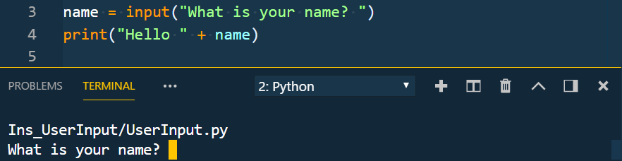
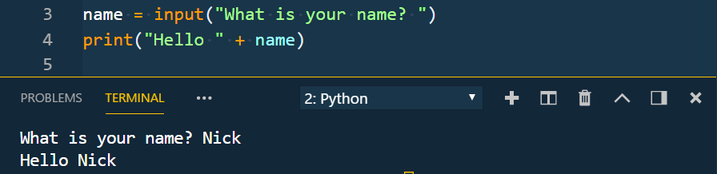
User Input
Often you’ll want information from the user to help guide your application on how it should run.
To get input from the user in Python, you use input() and store the result to a variable.
input waits to execute any code following it until after the user has entered a value.
The value always comes back as a string (so you may need to convert it).
Notes:
Review goals; address any questions.

Slide 37
Inputs and Prompts
Instructor Demo
Notes:
The instructor takes a moment or two to discuss the input() function and how it can be used to read in text from the terminal.

Slide 38
Activity: Down to Input (10 min)
Gather some information from your neighbor and then run some code.
Follow these steps:
Create two different variables that will take the input of your first name and your neighbor’s first name.
Create two more inputs that will ask how many months each of you have been coding.
Display a result with both your names and the total amount of months coding.
Example: “My name is Nick and my neighbor’s name is Jacob. Together we have been coding for 204 months!”
Notes:
Students should work alone. Have them get the user input from their neighbor and then proceed with the activity.

Slide 39
Down to Input
Instructor Review
Notes:
Review goals; address any questions.

Slide 40
Break!

Slide 41
Lists

Slide 42
Lists
List Name: zoo_animals
Zebra
Rhino
Giraffe
Owl
Index 0
Index 1
Index 2
Index 3
Notes:
Review goals; address any questions.

Slide 43

Lists
List Name: zoo_animals
Zebra
Rhino
Giraffe
Owl
Index 0
Index 1
Index 2
Index 3
Coded in Python using a List
Notes:
Review goals; address any questions.

Slide 44
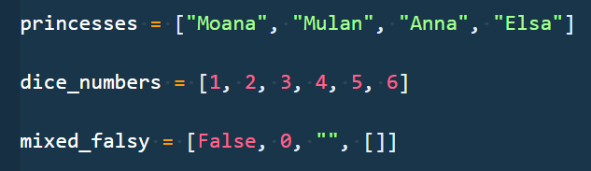
Lists
Lists are collections of data.
These collections can be made up of strings, numbers, Booleans, other arrays, dictionaries . . . anything.
They typically denote related data, e.g. student names, devices connected to network, etc.
Notes:
Review goals; address any questions.

Slide 45
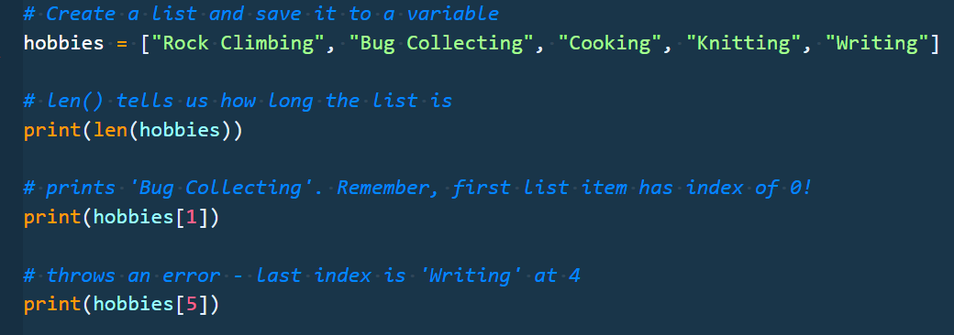
Lists
Each element of the array is marked by an index. Indexes always start at 0.
To reference the value at a specific index you include the name of the list with a square bracket [ ]. Inside the bracket you use the element’s index.
Notes:
Review goals; address any questions.

Slide 46
Basic Lists
Instructor Demo
Notes:
The instructor takes a moment or two to discuss the lists and how they can be used to read to store collections of data

Slide 47
Activity: Messy Lists (10 min)
In this activity, you have been given a large list of IP addresses. You’ll have to answer some questions based on its contents. Afterwards, you will have to modify the list using some common list functions.
Follow these steps:
Determine the length of the list and print this information out to the terminal.
Figure out what the index for the IPs "82.82.0.22" and "207.209.106.220" are and then print this information out to the terminal.
Add the following IP addresses to the list:
220.66.146.40
245.201.208.161
208.222.148.199
104.216.140.187
73.57.167.115
Remove the following IP addresses from the list:
53.239.114.76
65.136.121.223

Slide 48
Messy Lists
Instructor Review
Notes:
Review goals; address any questions.

Slide 49
Today’s Goals
Let’s check-in on today’s goals! Just one more to go!
Explain how and why Python is used in Cybersecurity.
Use basic Python tools such as variables and operators to solve problems with scripts.
Receive, store, and use user input in Python scripts.
Reference and store collections of data using lists.
Use Boolean logic with conditional statements.
$ python learn.py
Notes:
Review goals; address any questions.

Slide 50
Conditionals

Slide 51
Conditionals
Conditionals are used everywhere in code. They are used to only run certain code if some condition is met.
This is particularly helpful for things like user input. For example, if the user inputs X, run this block of code; otherwise, run this other code.
Condition to be tested
Parenthesis and colons are just syntax to let Python know you’re building a conditional statement
Keyword
if
(x == 1):
# code to run if condition is true
Notes:
Review goals; address any questions.

Slide 52
Conditionals
The condition inside of the parenthesis is evaluated.
If the result of the evaluation is true, then the code block will run!
If the result of the evaluation is false, the code skips the block statement associated with that if statement, and continues running through the code.
if
(x == 1):
# code to run if condition is true
Notes:
Review goals; address any questions.

Slide 53
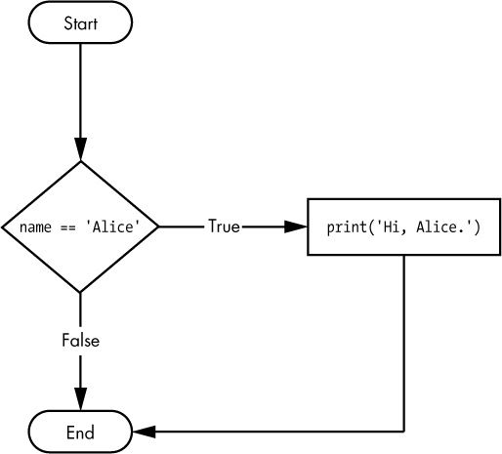
Conditionals
if
(name == “Alice”):
print(“Hi, Alice.”)
Assigning name == “Alice” before the if statement, this branch runs (print)
Assigning name == “Julia” before the if statement, this branch runs (no print)
Notes:
Review goals; address any questions.

Slide 54
Conditionals
IF statements get more complicated: IF…ELIF…ELSE
elif —if none of the above were true, and this is condition is, run this block of code.
else —if none of the above were true, run this block of code.
if
(x == 1):
# code to run if condition is true
elif
(x == 2):
# code to run if first condition is false, but this condition is true
else
# code to run if none of the above conditions are true
Notes:
Review goals; address any questions.

Slide 55
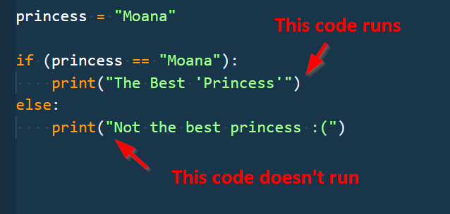
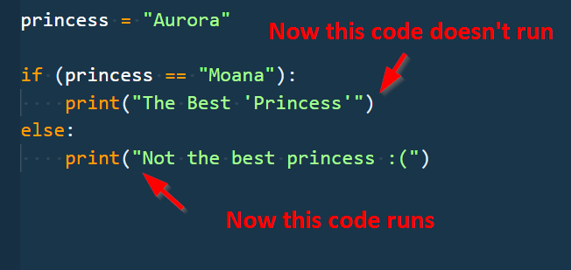
Conditionals
Notes:
Review goals; address any questions.

Slide 56
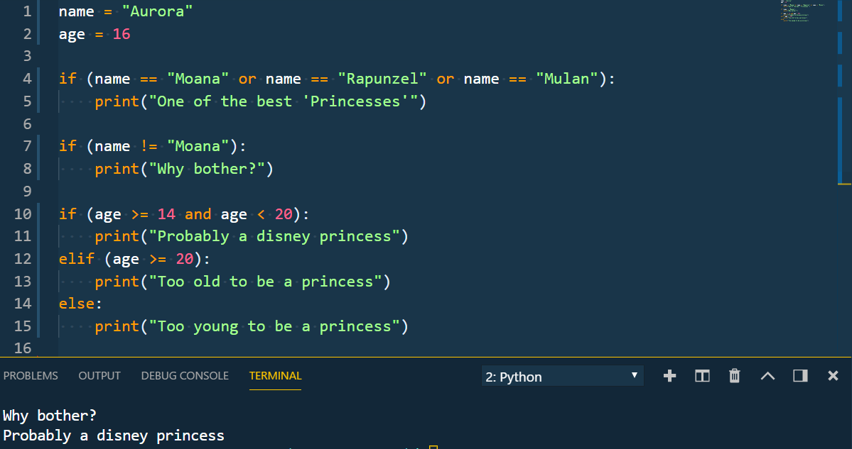
The Condition in Conditionals
Conditions in the if and elif statements can use a variety of operators, so long as they evaluate to true or false.
Notes:
Review goals; address any questions.

Slide 57
Basic Conditions
Instructor Demo
Notes:
The instructor takes a moment or two to discuss the input() function and how it can be used to read in text from the terminal.

Slide 58
Activity: Conditional Conundrum (10 min)
Use the ConditionalConundrum.py file that was sent to you and follow these steps:
Update the comments in the code to say which line will print from each block of conditionals. NOTE: Do not run the code at first! See if you can follow the flow control to make informed guesses.
When you've added your comments, run the code to see if you guessed correctly.
Fix any errors in your guesses, and research why your guesses differed from the result.
Bonus
Update the values of the variables to trigger the other conditions in each block.
Add elif statements to conditional blocks that don’t already have the elif statements to print something of your choosing.

Slide 59
Conditional Conundrum
Instructor Review

Slide 60
Today’s Goals
Let’s check-in on today’s goals. You’re going to need to use everything you’ve learned today for the challenge activity coming up next! Any questions?
Explain how and why Python is used in Cybersecurity.
Use basic Python tools such as variables and operators to solve problems with scripts.
Receive, store, and use user input in Python scripts.
Reference and store collections of data using lists.
Use Boolean logic with conditional statements.
$ python learn.py
Notes:
Review goals; address any questions.

Slide 61
Challenge Activity: Checking Input IPs (20 min)
Write code that checks to see if an IP address entered by the user is in the provided list (in the denied_connections.txt file provided for you).
If it’s in the list, print “IP Address X.X.X.X found in the list at index Y” (Y = index of IP).
Otherwise, print “IP Address X.X.X.X not found”.
Hints:
Don’t use a loop! Look into using the in operator.
We haven’t talked about getting a count of occurrences in a list yet. To the Internet!
Bonus:
If the IP Address is in the list, have the program print an extra line: “IP Address X.X.X.X was found Z times” (Z = # times IP Address occurs in list)
Add another initial prompt for action. It should allow for add or search actions. search behaves as above, whereas add instead adds the IP to the existing list and prints out the new list of IP addresses.
If something other than add or search is entered (for step 2), the program should error before asking for the IP address.
Notes:
Tell students it is time for the big challenge of the day! This will combine everything they've learned today to solve a realistic problem: Checking a user-provided IP address against an existing list of IPs.

Slide 62
IP Check
Instructor Review
Notes:
Review goals; address any questions.

Slide 63
Lesson Recap

Slide 64
Today’s Summary
Variable Assignment and Reference
name = “Nick”, print(name)
Data Types and Conversion (Number, String, Boolean)
str(), int()
Operators (Arithmetic, Comparison, etc.)
+, -, *, =, ==, !=, >, in, and, etc.
Lists
arr = [“a”, “b”, “c”]
arr[1]
len(), append(), etc.
Conditionals
IF…ELIF…ELSE
User Input
input()
Tip: We covered a lot today!
But there’s plenty more to come. Be sure to spend time before next class, redoing today’s exercises to build proficiency (and maybe attempting the bonuses!).
Notes:
Review goals; address any questions.

Slide 65
Today’s Summary
Data
Numbers
Strings
Booleans
Lists
Dictionaries
Logic
Operators
Conditionals
Loops
Functions
Modules
Notes:
We’ve addressed the crossed out items, we’llcover dictionaries, loops, functions, and modules later!

Slide 66
Today’s Goals
By the end of class, you will be able to:
Explain how and why Python is used in cybersecurity.
Use basic Python tools such as variables and operators to solve problems with scripts.
Receive, store, and use user input in Python scripts.
Reference and store collections of data using lists.
Use Boolean logic with conditional statements.
$ python learned.py
Notes:
Review goals; address any questions.

Slide 67
Python Learning Tips
Review Immediately We’ll be building on these concepts quickly. The firmer your grasp now, the better off you’ll be.
Redo the exercises from class Don’t just reread! Actually spend the time to redo the activities from scratch on your own.
Get Help Come to office hours. Ask conceptual questions. Ask specific questions. Just keep asking questions!
Don’t Be Afraid You will get this. It will take time, but you will get this. Keep at it. Patience will pay off.
Practice Practice Practice Only by doing will you learn how to code—reading code and reviewing helps, but writing code is the best way to succeed.
Notes:
What to work on at home before the next class!

Slide 68

Self Checkup?
If this is you . . . that’s okay!
Notes:
Review goals; address any questions.

Slide 69

Self Checkup?
If this is you . . . even better!
Notes:
Review goals; address any questions.

Slide 70
Self Checkup?
Tip: As with all skills, proficiency will build the more you practice increasingly challenging problems.
Just keep at it!
Notes:
Review goals; address any questions.

Slide 71
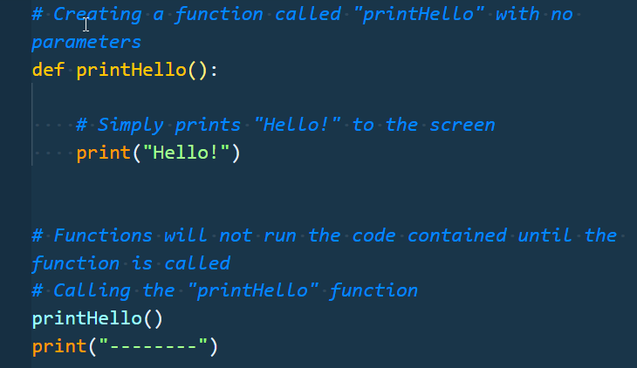
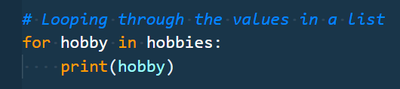
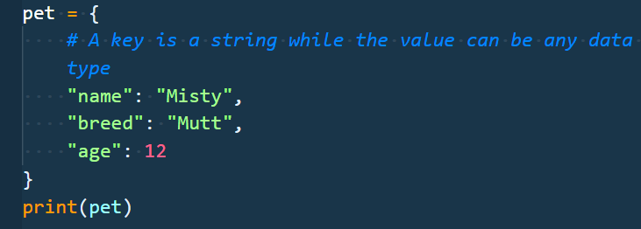
Next Class . . .
loops, dictionaries, functions . . .
And a Lot More!

