Slide 1
Picking Up The Python Pace
Unit 3.2
Cybersecurity Boot Camp |

Slide 2
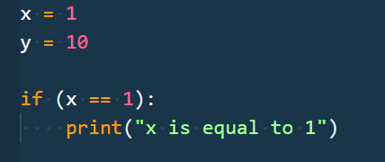
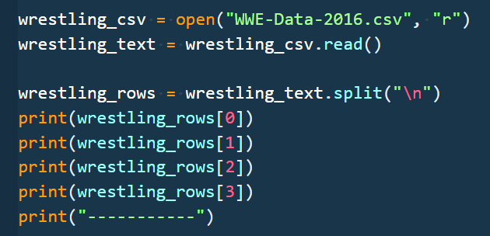
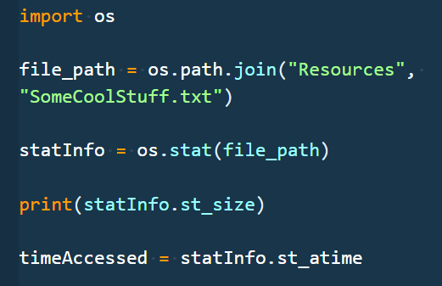
Unit Goals
Day 1:
Form basic understanding of the fundamentals of Python so that we can eventually use this powerful tool to solve problems in the Cybersecurity space.
Day 2:
Use Python to work with sets of data and files so that we can automate repetitive tasks and interact with our filesystems.
Day 3:
Use functions and modules (both internal and external) to reuse and deduplicate code to solve more complex problems using Python.
Notes:
Review goals; address any questions.

Slide 3
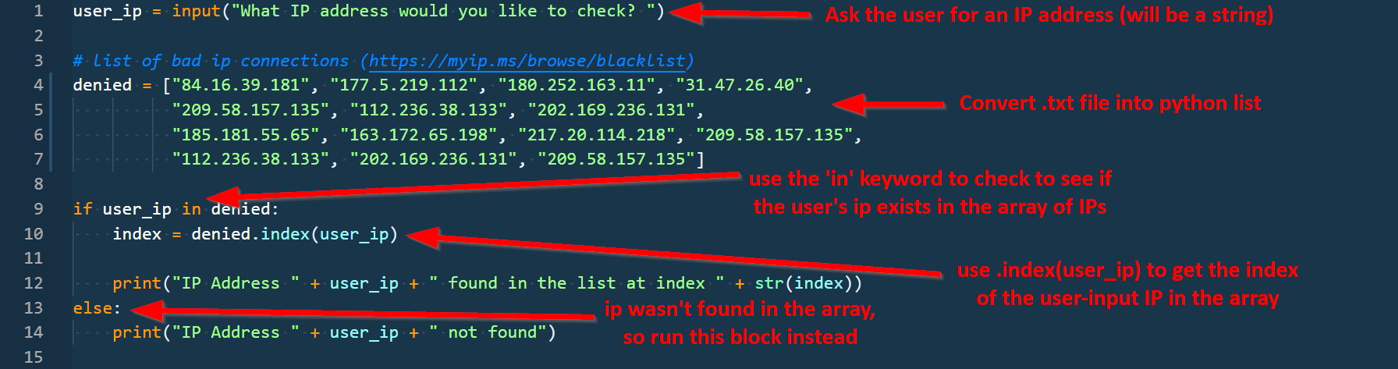
Yesterday
Conditionals
if user_ip in denied:
else:
User Input
user_ip = input(“…”)
Lists
denied = [“84.16.39.181”, “177.5.219.112”]
denied.index(), len(), etc.
Variable Assignment / Reference
name = “Peleke”
print(name)
Data Types and Conversion
str(), int(), etc.
Operators (Arithmetic, Comparison, etc.)
=, in, +, etc.
Notes:
Review goals; address any questions.

Slide 4
Today’s Summary
Data
Numbers
Strings
Booleans
Lists
Dictionaries
Logic
Operators
Conditionals
Loops
Functions
Modules
Notes:
Review goals; address any questions.

Slide 5
Today (Spoilers)
Data
Numbers
Strings
Booleans
Lists
Dictionaries
Logic
Operators
Conditionals
Loops
Functions
Modules
…plus more practice and application of what we’ve learned so far!
Notes:
Review goals; address any questions.

Slide 6
Today’s Goals
By the end of class, you will be able to:
Use loops to iterate through lists and dictionaries to perform basic operations on collections of data.
Create and reference data in dictionaries.
Work with lists of dictionaries to store and retrieve information.
Create and run functions to abstract repeatable tasks.
Read files from disk using Python and parse the information in those files.
$ python learn2.py
Notes:
Review goals; address any questions.

Slide 7
Loops

Slide 8

Back to The Zoo Pen
List Name: zoo_animals
Zebra
Rhino
Giraffe
Owl
Index 0
Index 1
Index 2
Index 3
Coded in Python using a List
Notes:
Review goals; address any questions.

Slide 9
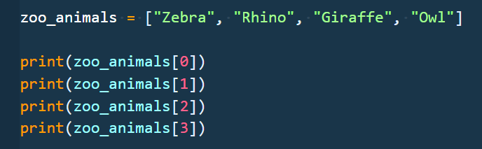
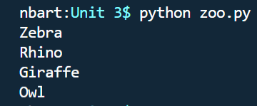
Back to The Zoo Pen (Logging)
List Name: zoo_animals
Zebra
Rhino
Giraffe
Owl
Index 0
Index 1
Index 2
Index 3

Slide 10
99 Loop Problem
What’s wrong here?

Slide 11
99 Loop Problem
Repeated Code!
We can be more efficient
Notes:
Imagine having to write all of that out for a list with 100 elements

Slide 12
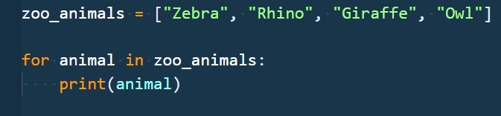
Enter the Loop
Loops are critical in programming.
Loops allow you to run a block of code multiple times.
Before:
After:

Slide 13
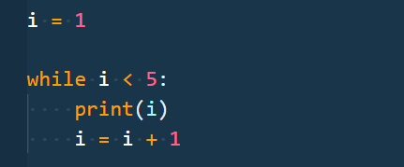
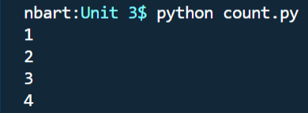
Loop Breakdown
There are two main types of loops: for and while
Loops allow you to run a block of code multiple times.

Slide 14
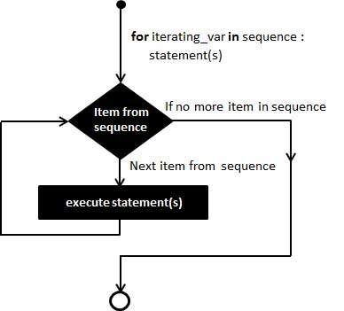
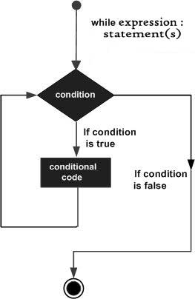
Loops
Code is typically sequentially executed: statement on line 1 is executed, then statement on line 2, etc.
Loops, like conditionals, allow us to change the flow of execution – changing the execution paths.
Conditionals let you skip; loops let you repeat.

Slide 15
For Loops

Slide 16
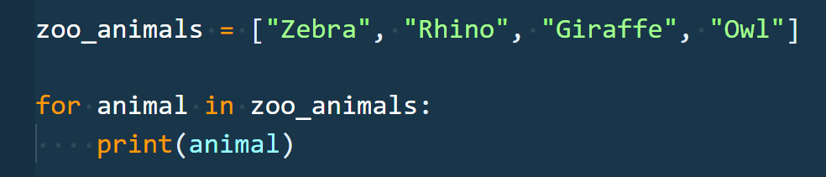
For Loop Breakdown
for loops are used to iterate over items of any sequence (e.g. list, string) in order.
For each iteration of the loop, the iteration variable (animal) gets set to the associated element in the list.
Code “inside” the for loop (indented) is the code block that gets executed once for each item in the sequence (4 times here).
Sequence
Block of Code
Iteration Variable

Slide 17
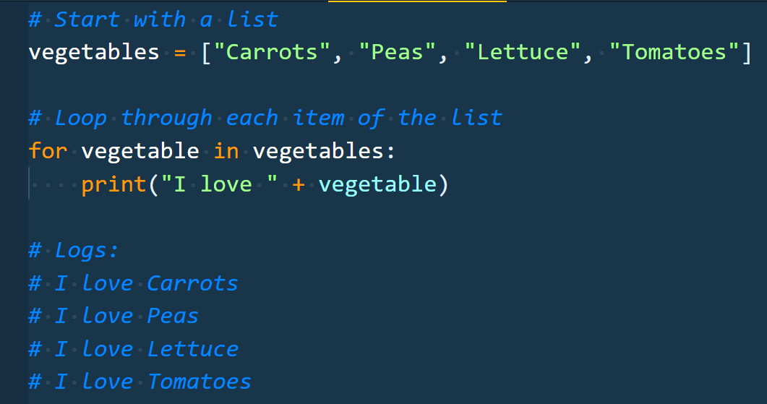
Enter the For-Loop
The indented code gets repeated for each item in the list

Slide 18
Enter the For-Loop
Running the code “loops” through and prints each item in the list.

Slide 19
Run That For Loop
For the first iteration, the loop sets vegetable = “Carrots”
Carrots
Peas
Lettuce
Tomatoes
Index 0
Index 1
Index 2
Index 3

Slide 20
Run That For Loop
For the first iteration, the loop sets vegetable = “Carrots”
So … print(“I love Carrots”)
Carrots
Peas
Lettuce
Tomatoes
Index 0
Index 1
Index 2
Index 3

Slide 21
Run That For Loop
For the second iteration, the loop sets vegetable = “Peas”
Carrots
Peas
Lettuce
Tomatoes
Index 0
Index 1
Index 2
Index 3

Slide 22
Run That For Loop
For the second iteration, the loop sets vegetable = “Peas”
So … print(“I love Peas”)
Carrots
Peas
Lettuce
Tomatoes
Index 0
Index 1
Index 2
Index 3

Slide 23
Run That For Loop
For the third iteration, the loop sets vegetable = “Lettuce”
Carrots
Peas
Lettuce
Tomatoes
Index 0
Index 1
Index 2
Index 3

Slide 24
Run That For Loop
For the third iteration, the loop sets vegetable = “Lettuce”
So … print(“I love Lettuce”)
Carrots
Peas
Lettuce
Tomatoes
Index 0
Index 1
Index 2
Index 3

Slide 25
Run That For Loop
For the fourth iteration, the loop sets vegetable = “Tomatoes”
Carrots
Peas
Lettuce
Tomatoes
Index 0
Index 1
Index 2
Index 3

Slide 26
Run That For Loop
For the fourth iteration, the loop sets vegetable = “Tomatoes”
So … print(“I love Tomatoes”)
Carrots
Peas
Lettuce
Tomatoes
Index 0
Index 1
Index 2
Index 3

Slide 27
Run That For Loop
We’ve now looped through the entire sequence.
Carrots
Peas
Lettuce
Tomatoes
Index 0
Index 1
Index 2
Index 3

Slide 28
Run That For Loop
We’ve now looped through the entire sequence. So the code skips forward to continue running code after the for loop.
Carrots
Peas
Lettuce
Tomatoes
Index 0
Index 1
Index 2
Index 3

Slide 29
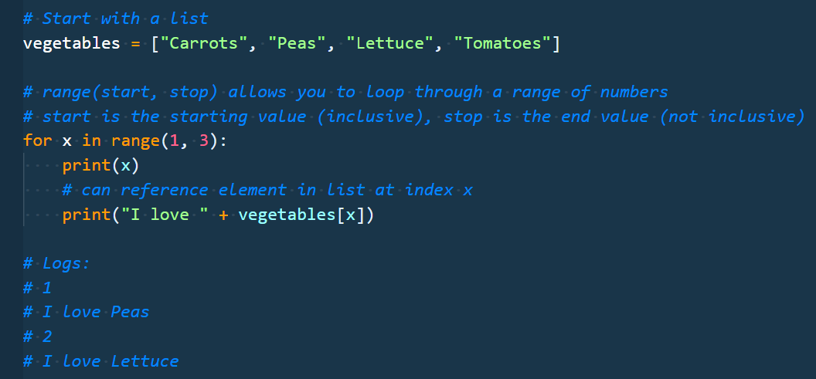
Range
The range function allows you to loop through a sequence of numbers. This is similar to running for x in [1, 2]:
This loop runs twice, first with x = 1, then with x = 2.
Notes:
Explain that range is useful if you don’t want to loop through the whole list.

Slide 30
While Loops

Slide 31
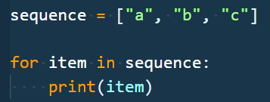

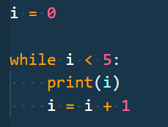

For vs While
For loops allow you run a block of code for each item in a sequence.
While loops allow you to run while some condition is true

Slide 32
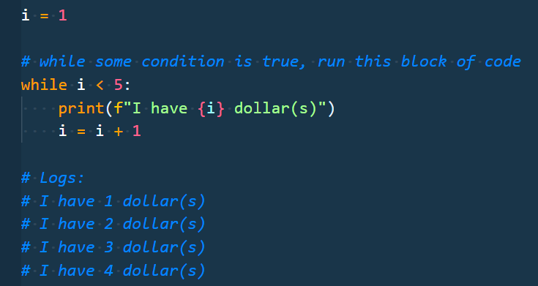
Run That While Loop
i = 1
i starts at 1

Slide 33

Run That While Loop
i = 1
1 < 5 - >True
We check the condition to see if the block of code will run.
Because i < 5 (i is 1), we will run the block of code

Slide 34
Run That While Loop
i = 1
1 < 5 - > True
print
The block of code prints and then increments our iterator variable i

Slide 35
Run That While Loop
i = 1
1 < 5 - > True
print
i = i + 1 -> 2
The block of code prints and then increments our iterator variable i

Slide 36
Run That While Loop
i = 1
1 < 5 - >True
print
i = 2
At the end of the code block, we go back to the top of the while loop.

Slide 37
Run That While Loop
i = 2
2 < 5 - >True
print
i = 3
Now i is 2, which is still less than 5, so the code block gets executed again and i is incremented to 3.
This process continues until the condition is False, i.e. when i >= 5

Slide 38
Run That While Loop
i = 2
2 < 5 - >True
print
i = 3
Now i is 2, which is still less than 5, so the code block gets executed again and i is incremented to 3.
This process continues until the condition is False, i.e. when i >= 5

Slide 39
Run That While Loop
i = 3
3 < 5 - >True
print
i = 4
This process continues until the condition is False, i.e. when i >= 5

Slide 40
Run That While Loop
i = 3
3 < 5 - >True
print
i = 4
This continues until the condition is False, i.e. when i >= 5

Slide 41
Run That While Loop
i = 4
4 < 5 - >True
print
i = 5
This continues until the condition is False, i.e. when i >= 5

Slide 42
Run That While Loop
i = 4
4 < 5 - >True
print
i = 5
At the end of this loop iteration, i will be 5.

Slide 43

Run That While Loop
i = 5
5 < 5 - > False
Now i is 5, which is not less than 5, so the code block in the while loop won’t get executed again.
At this point, the code would continue running any code after the while loop and our loop iteration is finished.

Slide 44
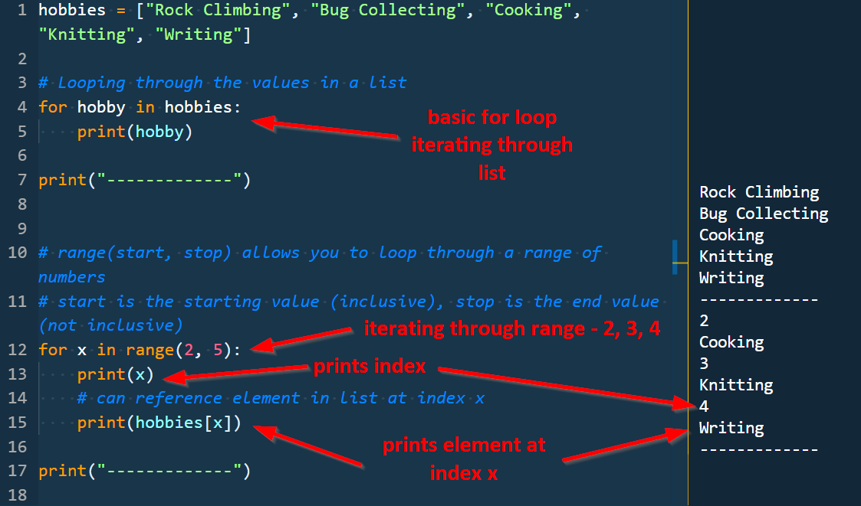
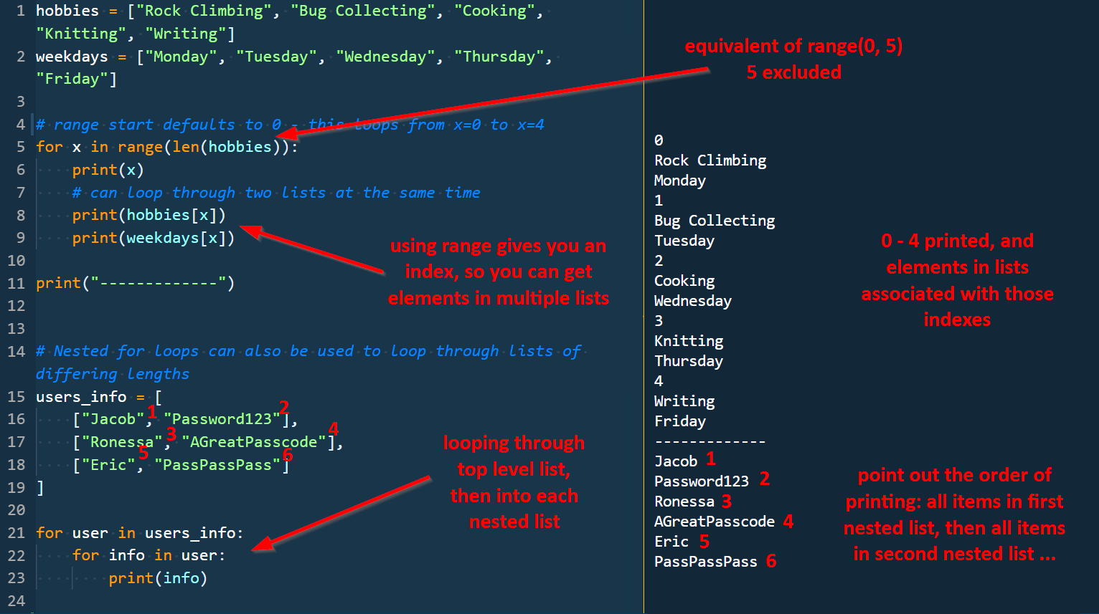
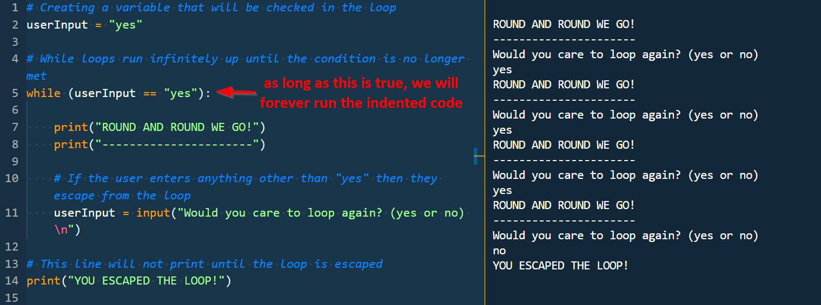
Loops
Instructor Demo

Slide 45
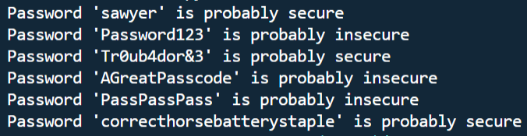
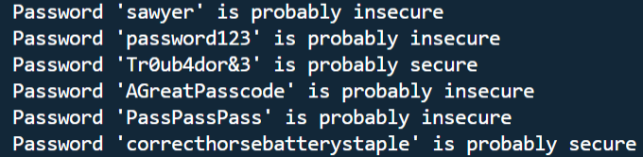
Activity: Loopy Conditionals (5 min)
Instructions:
Open up the `Unsolved/PassCheck.py` file.
Add a for loop to loop through the list of passwords.
Check if each password is secure. If the password contains `Pass`, you should mark it insecure.
For each password, print out a string if it is secure/insecure:
e.g. `Password 'Password123' is probably insecure`
e.g. `Password 'correcthorsebatterystaple' is probably secure`
Bonuses:
Add a check: the password is insecure if it contains the lowercase `pass` as well.
Add a check: the password is insecure if it is fewer than 8 characters.
Assign the condition check to a separate variable for readability, and use that variable in the if statement.
Write your code such that there is only one `print` statement. Try checking out the `+=` operator.
Hint: Use the `in` operator to check if a substring is in a string.

Slide 46
Loopy Conditionals
Instructor Review
Notes:
Review goals; address any questions.

Slide 47
Dictionaries

Slide 48


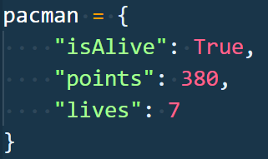
Dictionaries vs Lists
Lists are for collections of items.
Dictionaries are used to define properties of something.
isAlive: True
points: 380
lives: 7
Notes:
Review goals; address any questions.

Slide 49
Dictionaries - Creation
A dictionary is a mapping of keys to values.
You use curly braces to construct the dictionary.
Values can be any Python value
Keys are more limited and are typically strings.
Values (booleans, numbers, strings, etc.)
keys (strings)
Notes:
Review goals; address any questions.

Slide 50
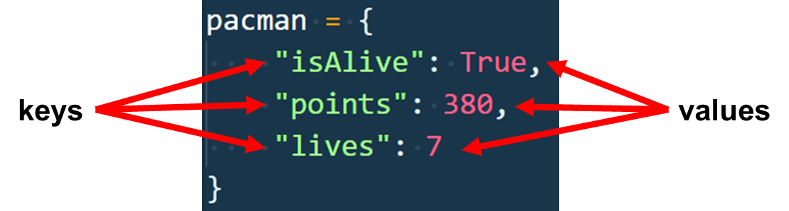
Dictionaries – Referencing and Modifying
Referencing values in a dictionary is similar to lists. Instead of using a number index, you use the key value. Both use square brackets:
pacman[“isAlive”] evaluates to True
pacman[“points”] evaluates to 380
Modifying and adding values involves assigning a new value to a key
pacman[“lives”] = 6
pacman[“color”] = “yellow”
Deleting values is done using del dict[key]
del pacman[“color”]
Notes:
Review goals; address any questions.

Slide 51
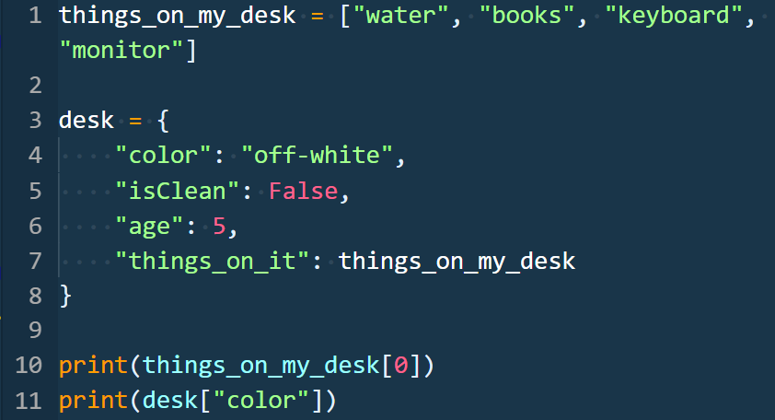
Dictionaries vs Lists
Lists are for loosely related items:
“I have these 10 things on my desk”
Dictionaries define properties: “My desk is white, clean, 5 years old, and has these things on it.”
Notes:
While lists are for loosely-related items, dictionaries are typically used for defining properties of an item. E.g. “I have these 10 things on my desk”, vs. “I have a white desk that is clean, 5 years old, and has a bunch of things on it”

Slide 52
Defining Dictionaries
Instructor Demo
Notes:
Instructor live-codes creating a variable and storing information to that variable.
Instructor also live-codes basic operator.

Slide 53
Activity: Hobby Book Dictionary (08 min)
Instructions:
Create a dictionary that will store the following:
Your name
Your age
A list of a few of your hobbies
A dictionary of the times you wake up on weekdays and weekends.
Print out your name, age, how many hobbies you have, and the time you get up on weekends.
Bonuses:
Add and delete fields of your choice to the dictionary.
Use f-strings to print. [f-string examples](https://cito.github.io/blog/f-strings/#some-examples)

Slide 54
Hobby Book Dictionary
Instructor Review
Notes:
Review goals; address any questions.

Slide 55
Activity: DNS Dictionary (10 min)
Instructions:
Open up the Unsolved/DNSDictionary.py file.
Update the sections of the file labelled <YOUR CODE HERE> to:
Use a for loop to create a dictionary mapping the provider names to their IPs. Use the dictionary to print Hurricane Electric's IP.
Use a for loop to create a list of dictionaries with the associated information. Use the list to print the total number of providers.
Bonuses:
Use a for loop to update your dictionary from part 1 with the new IPs. The IPs should be in the form of an array of IPs. Then, use the dictionary to print Google's IPs
Use nested for loops to update the list from part 2 with a "secondary_server" key.
Super bonus: use the `pprint` module to print objects and lists more elegantly. This will take a lot of research!.
Notes:
Instructor should demo the file running before starting the activity

Slide 56
DNS Dictionary
Instructor Review
Notes:
Review goals; address any questions.

Slide 57
Today’s Goals
By the end of class, you will be able to:
Use loops to iterate through lists and dictionaries to perform basic operations on collections of data.
Create and reference data in dictionaries.
Work with lists of dictionaries to store and retrieve information.
Create and run functions to abstract repeatable tasks.
Read files from disk using Python and parse the information in those files.
$ python learn2.py
Notes:
Review goals; address any questions.

Slide 58
Break! (15 minutes)

Slide 59
Today (Spoilers)
Data
Numbers
Strings
Booleans
Lists
Dictionaries
Logic
Operators
Conditionals
Loops
Functions
Modules
Notes:
Review goals; address any questions.

Slide 60
Functions

Slide 61
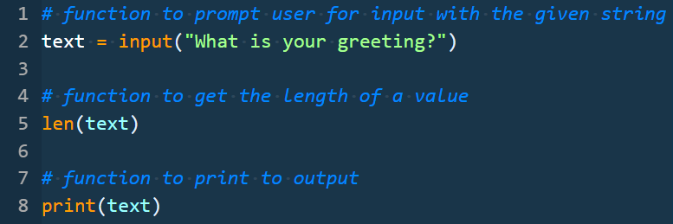
Functions
A function is used to utilize code in multiple places in a program.
We’ve actually already seen and used functions! Python has many built-in functions: print, len, str, input, and more…
Notes:
Print, len, etc. are all blocks of code being run in the background, code we didn’t have to write but that we can take advantage of.

Slide 62
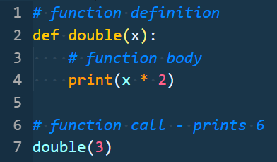
Functions
Functions give a name to a block of code that you can reference later to run that code.
This function is named double; it takes values and prints out the double of them.
Functions often take a value (x) and do something with them
Referencing the name of the function later in the code
Notes:
Review goals; address any questions.

Slide 63
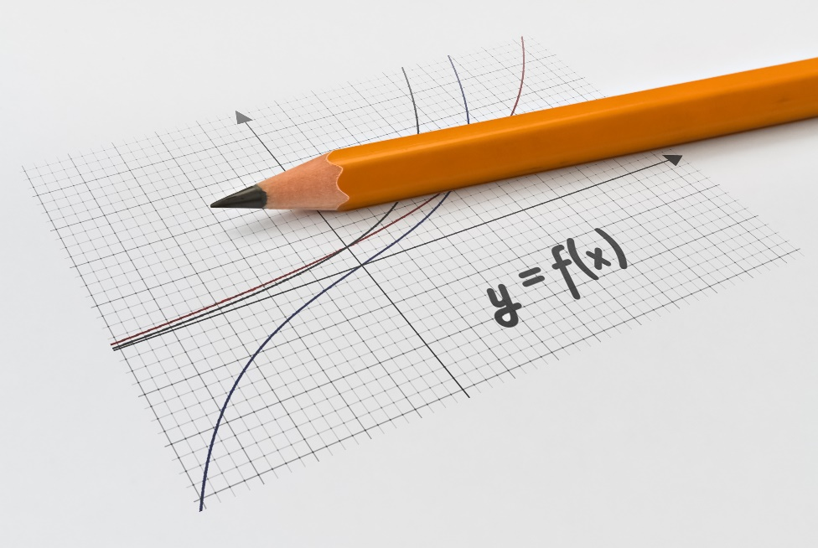
Math vs. Code Functions
Functions in code vs. functions in math?
y = f(x)
y is the output
f is the name of the function
x is the input
f(x) means ‘calling’ the function with input x
Examples:
y = double(3) = 6
y = sum(5, 6) = 11
Functions in math are similar to functions in code – you pass in values and get values back
Notes:
Review goals; address any questions.

Slide 64
Python Functions – Defining
Write a function that will sum any two numbers
keyword to start function definition
function name
identifier
syntax
parameters
def
sum
(x, y)
:
print(x + y)
code block which runs when the function is called
You can use any valid name, any number of parameters, and run whatever code you want to in the code block
Notes:
Review goals; address any questions.

Slide 65
Functions
But … just defining our function doesn’t do anything!
To run the function we’ve defined, we have to call it.
Notes:
Review goals; address any questions.

Slide 66
Python Functions – Calling
Definition
:
def
sum
(x, y)
Call
print(x + y)
sum
(2, 4)
You can think of a function call as assigning values to x and y:
x = 2
y = 4
print(x + y)
sum
(2, 4)
Notes:
Review goals; address any questions.

Slide 67
Python Functions – Calling
Call the Function
reference the function name
arguments: pass in values
sum
(2, 4)
Prints the value 6
syntax
Calling involves referencing the function name and passing in arguments, or values that will be assigned to the parameters when the function is executed.
Notes:
Review goals; address any questions.

Slide 68
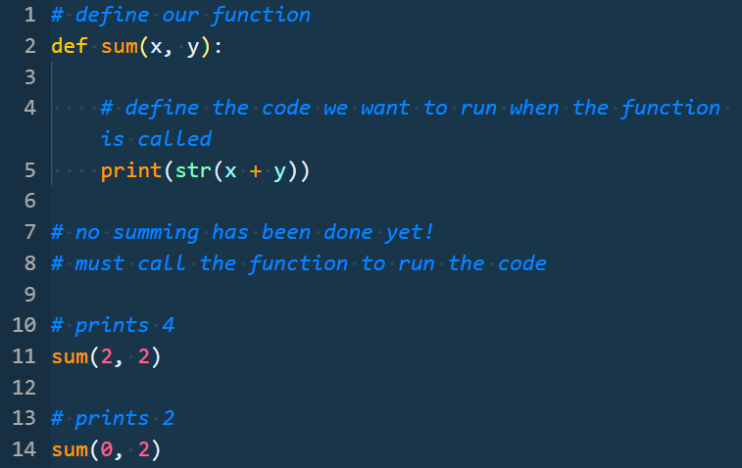
Python Functions – Calling
Call our sum function with two arguments
sum(2, 2) prints 4
sum(0, 2) prints 2
sum(-1, 4) prints 3
etc.
Notice we only have to write the logic once
Notes:
Review goals; address any questions.

Slide 69
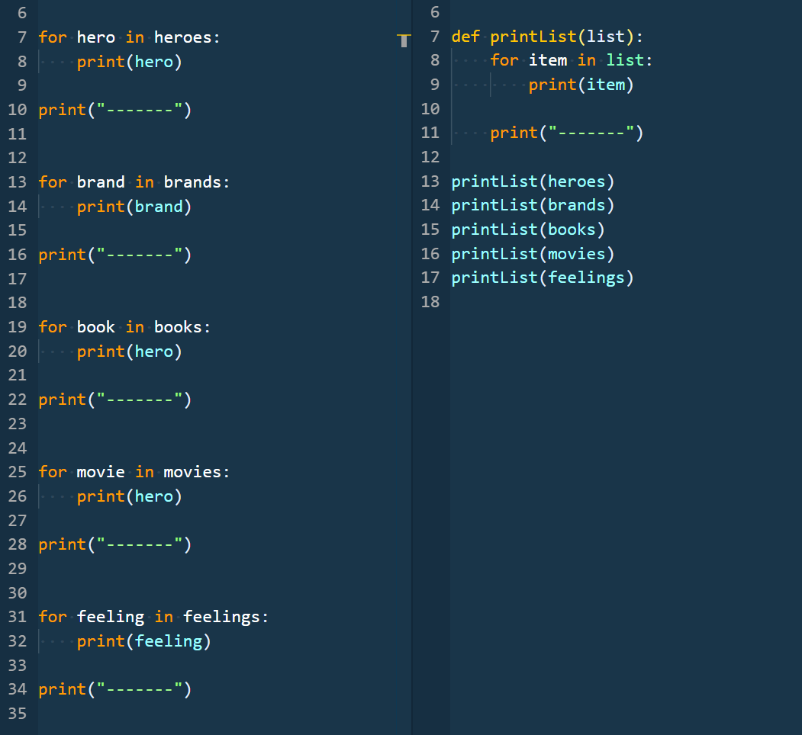
Functions and DRY
Functions are also very useful for helping to DRY up your code.
DRY = Don’t Repeat yourself. De-duplicating code makes your code easier to read and make changes to.
Count the number of lines you’d have to touch to change the separator from ‘-’ characters to ‘#’ characters.
Without a function:
With a function:
Notes:
5 lines. Only one line in the right code would need to be changed.

Slide 70
Python Functions - Returning
You can also return values from a function. This allows you to store the value when you call it to use it later
keyword to start function definition
function name
identifier
syntax
parameters
def
sum
(x, y)
:
return x + y
when run, this function will return this value back to the caller
return keyword
Notes:
Instead of just running a block of code, you can also return values.

Slide 71
Python Functions – Returning
Our sum function returns!
reference the function name
output variable to store return value
arguments: pass in values
value
=
sum
(3, 4)
Evaluates to the value 7
parenthesis syntax for call
On the next line of code, value would now equal 7.
Notes:
Review goals; address any questions.

Slide 72
Python Functions – Calling
value
=
sum
(3, 4)
x = 3
y = 4
def
sum
(x, y)
:
return x + y
return 7
Notes:
Review goals; address any questions.

Slide 73
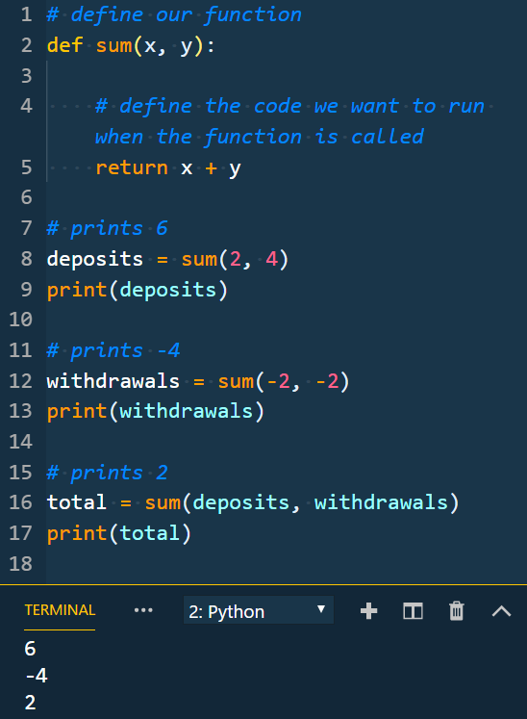
Example! Python Functions
Here we use the return values in future logic, calculating a total using multiple function calls
deposits = sum(2, 4)
deposits = 6
withdrawals = sum(-2, -2)
withdrawals = -4
total = sum(deposits, withdrawals)
total = sum(6, -4)
total = 2
Notes:
You can then use those return values in future logic/code!

Slide 74
Python Functions
sum = function(x, y)
x = None
y = None
deposits = None
withdrawals = None
total = None
Notes:
Walk through step by step, pointing out the changes to the values on the right.

Slide 75
Python Functions
sum = function(x, y)
x = None
y = None
deposits = None
withdrawals = None
total = None
Notes:
Review goals; address any questions.

Slide 76
Python Functions
sum = function(x, y)
x = 2
y = 4
deposits = None
withdrawals = None
total = None
Notes:
Review goals; address any questions.

Slide 77
Python Functions
sum = function(x, y)
x = 2
y = 4
deposits = None
withdrawals = None
total = None
Notes:
Review goals; address any questions.

Slide 78
Python Functions
sum = function(x, y)
x = None
y = None
deposits = 6
withdrawals = None
total = None
Notes:
Review goals; address any questions.

Slide 79
Python Functions
sum = function(x, y)
x = None
y = None
deposits = 6
withdrawals = None
total = None
Notes:
Review goals; address any questions.

Slide 80
Python Functions
sum = function(x, y)
x = None
y = None
deposits = 6
withdrawals = None
total = None
Notes:
Review goals; address any questions.

Slide 81
Python Functions
sum = function(x, y)
x = -2
y = -2
deposits = 6
withdrawals = None
total = None
Notes:
Review goals; address any questions.

Slide 82
Python Functions
sum = function(x, y)
x = -2
y = -2
deposits = 6
withdrawals = None
total = None
Notes:
Review goals; address any questions.

Slide 83
Python Functions
sum = function(x, y)
x = None
y = None
deposits = 6
withdrawals = -4
total = None
Notes:
Review goals; address any questions.

Slide 84
Python Functions
sum = function(x, y)
x = None
y = None
deposits = 6
withdrawals = -4
total = None
Notes:
Review goals; address any questions.

Slide 85
Python Functions
sum = function(x, y)
x = None
y = None
deposits = 6
withdrawals = -4
total = None
Notes:
Review goals; address any questions.

Slide 86
Python Functions
sum = function(x, y)
x = 6
y = -4
deposits = 6
withdrawals = -4
total = None
Notes:
Review goals; address any questions.

Slide 87
Python Functions
sum = function(x, y)
x = 6
y = -4
deposits = 6
withdrawals = -4
total = None
Notes:
Review goals; address any questions.

Slide 88
Python Functions
sum = function(x, y)
x = 6
y = -4
deposits = 6
withdrawals = -4
total = 2
Notes:
Review goals; address any questions.

Slide 89
Python Functions
sum = function(x, y)
x = 6
y = -4
deposits = 6
withdrawals = -4
total = 2
Notes:
Review goals; address any questions.

Slide 90
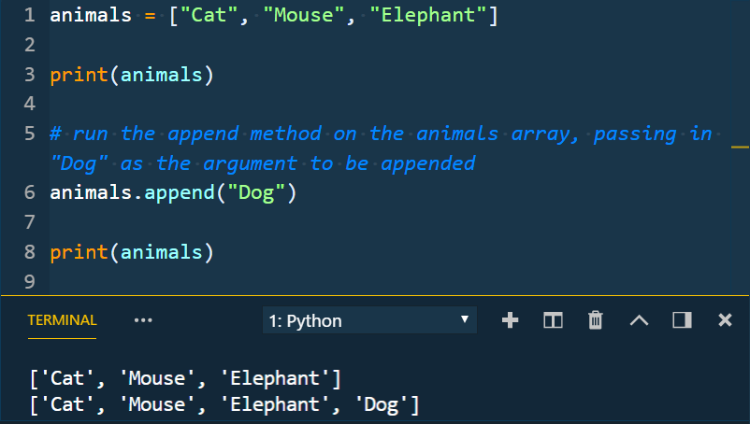
Methods
Methods are essentially functions associated with a specific object.
Examples:
.keys()
.items()
.index()
.append(x)
etc.
animals.append(“Dog”) runs a block of code (in a function built into Python) that adds the string “Dog” to the list animals
.items() returns a dictionary’s key-value pairs
Notes:
There are a ton of these! We won’t cover them all today, or ever really. You’ll find them as you need them when searching.

Slide 91
Functions
Instructor Demo
Notes:
The instructor takes a moment or two to discuss the lists and how they can be used to read to store collections of data

Slide 92
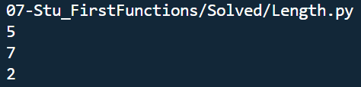
Activity: First Function (10 min)
Instructions:
Create a function called length with one parameter. When called with a string or array, this function should give back a value equal to the length of the item
Example Input:
"hello“, "goodbye“, ["hello", "goodbye"]
Bonuses:
Make another function called `last` which gives back the element at the last index in the item (e.g. last("hello") -> "o"). It should use your length function.
Add a check that the item is of type str or list before counting the length; if not have the function give back the value None (https://docs.python.org/3/library/constants.html#None).
e.g. an input of the int 4 should return None instead of the length
Make 2) a separate function named lengthable that gets called inside of your length function.
Example Output:

Slide 93
First Functions
Instructor Review
Notes:
Review goals; address any questions.

Slide 94
Activity: Partners Admin Login (15 min)
In this activity, you'll fill in the code to build a user login system.
Instructions:
Open up Unsolved/UserAdmin.py.
Read through all of the comments in the file to understand what is trying to be accomplished.
Fill in the code on each line where the <YOUR CODE HERE> markers are, using the comments as a guide to get the file working. Run the code often as you write and test individual functions to make sure you're on the right path!

Slide 95
Admin Login
Instructor Review
Notes:
Review goals; address any questions.

Slide 96
File Interaction: Reading

Slide 97
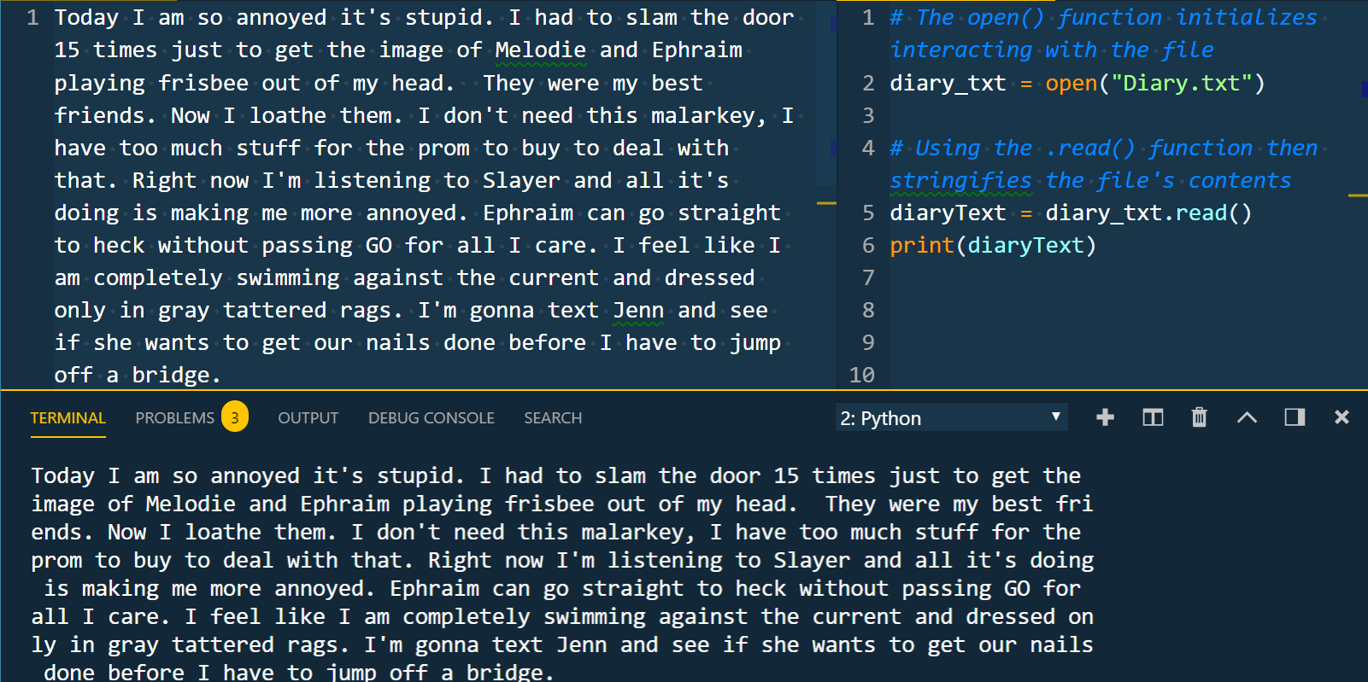
Reading Files
Python has built in ability to read files
Use the open function and read method to get the file contents:
Notes:
Review goals; address any questions.

Slide 98
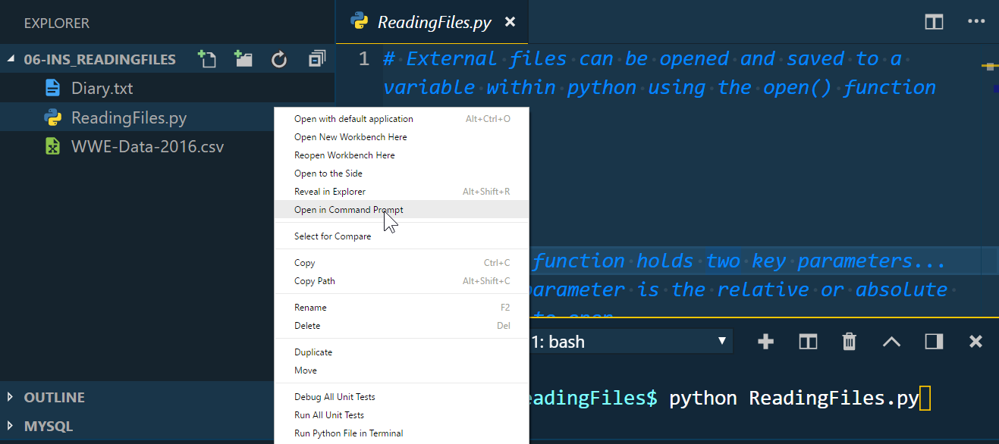
Reading Files – Relative Paths
Note: You must navigate to the right directory to run the file if it is referencing other files! If you don’t, Python won’t be able to find the file you’re trying to read.
Right-click the file and choose “Open in Command Prompt”
Then, in the terminal run `python <filename.py>`
Notes:
Review goals; address any questions.

Slide 99
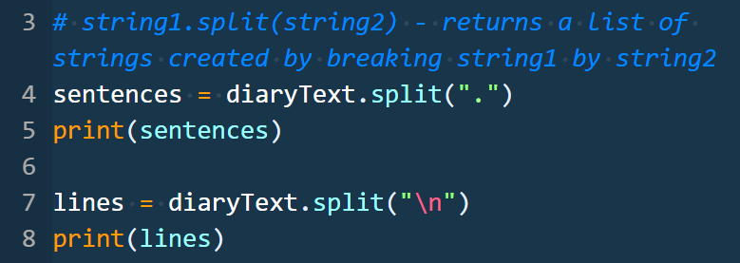
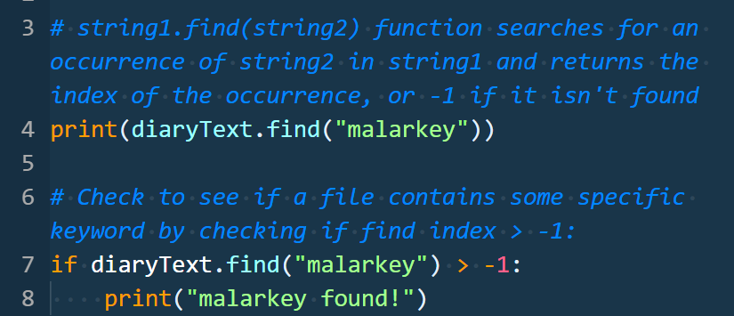
Additional String Functions
String methods can help you effectively parse files. Two commonly used methods:
.split(separator) –
method that splits a given string by the specified separator
returns a list of strings created by the split
.find(searchString)
method that searches the given string for a substring
returns the index of any occurrence of the substring searchString it finds, or -1 if not found
Notes:
Review goals; address any questions.

Slide 100
Reading Files
Instructor Demo

Slide 101
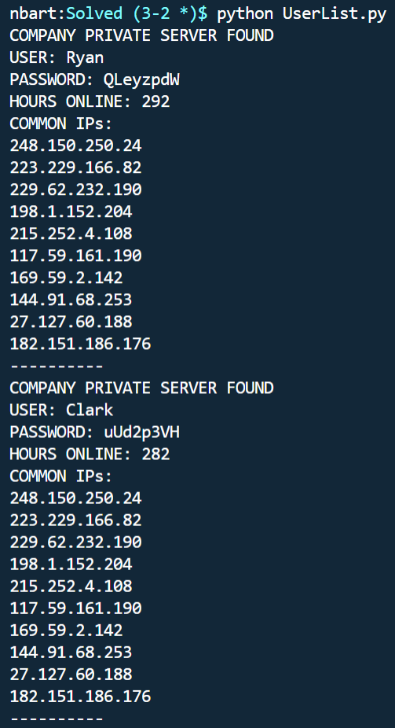
Activity: Challenge – User List (25 min)
Instructions:
No starter file this time! Use the previous files from class for guidance and inspiration.
Write a Python script that prints information about users who have connected.
Given the CSV file, your script should read from the file, parse it, and print out relevant info for users using the format shown in the image.
You should only print the info of users who have connected to your company’s private server (i.e. they have 229.62.232.190 in their list of IPs).
Bonus
Update your code to allow for searching by user or ip based on user input. For example, if I search by name for 'Taco', I should get Taco's information (but not Lisa's).

Slide 102
User List
Instructor Review
Notes:
Review goals; address any questions.

Slide 103
Lesson Recap

Slide 104
Today’s Summary
Loops
for … in, range, while, nested loops
Dictionaries
language = {“name”: “python”, “proficiency”: “medium”}
language[“proficiency”] = “yuge”
.keys(), .values(), .items()
Functions
def printHello():
def printGreeting(greeting):
return
sum = add(2, 3)
Reading Files
diary_txt = open(“Diary.txt”)
diaryText = diary_txt.read()
New String Functions
.find(“word”), .split(“,”)
Helpful Tip:
We covered a lot over the past two days!
Be sure to spend time before next class, re-doing exercises to build proficiency (and maybe attempting the bonuses!).
Notes:
Review goals; address any questions.

Slide 105
Today’s Summary
Data
Numbers
Strings
Booleans
Lists
Dictionaries
Logic
Operators
Conditionals
Loops
Functions
Modules
Notes:
Review goals; address any questions.

Slide 106
Today’s Goals
By the end of class, you will be able to:
Use loops to iterate through lists and dictionaries to perform basic operations on collections of data.
Create and reference data in dictionaries.
Work with lists of dictionaries to store and retrieve information.
Create and run functions to abstract repeatable tasks.
Read files from disk using Python and parse the information in those files.
$ python learned2.py
Notes:
Review goals; address any questions.

Slide 107

Python Learning Tips
Always Be Coding
The more you practice, the better off you’ll be.
Notes:
Review goals; address any questions.

Slide 108



Python Practice
Want More Practice?
http://learnpython.org/
https://www.hackerrank.com/domains/python
Be sure to choose Python 3 when writing out solutions
https://codesignal.com/
There’s a lot that we haven’t covered as well – it can take years to truly master Python. We know enough to be dangerous now.
Notes:
Review goals; address any questions.

Slide 109

Self-Check Up?
Stick around for office hours (or come early next class) if you have any questions or concerns!
We’re here to enable you to learn this stuff.
Remember: Learning can feel a lot like frustration!
Notes:
Review goals; address any questions.

Slide 110

Self-Check Up?
We want you here and happy!
Notes:
Review goals; address any questions.

Slide 111

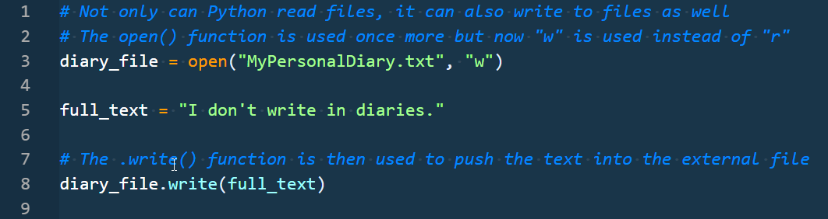
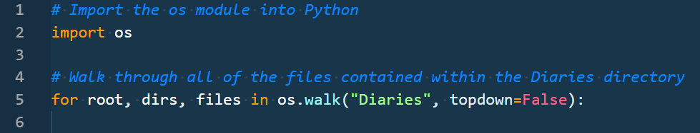
Next Class…
Writing to Files, Modules, and More!

