Slide 1
Picking Up The Python Pace
Unit 3.3
Cybersecurity Boot Camp |

Slide 2
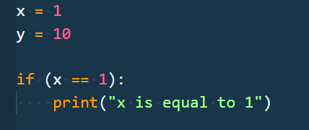
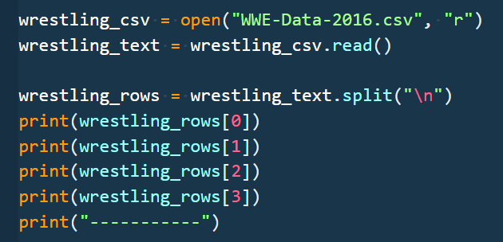
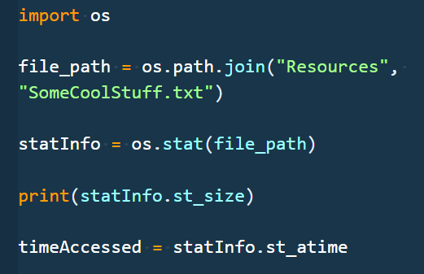
Unit Goals
Day 1:
Form basic understanding of the fundamentals of Python so that we can eventually use this powerful tool to solve problems in the Cybersecurity space.
Day 2:
Use Python to work with sets of data and files so that we can automate repetitive tasks and interact with our filesystems.
Day 3:
Use functions and modules (both internal and external) to reuse and deduplicate code to solve more complex problems using Python.
Notes:
Review goals; address any questions.

Slide 3
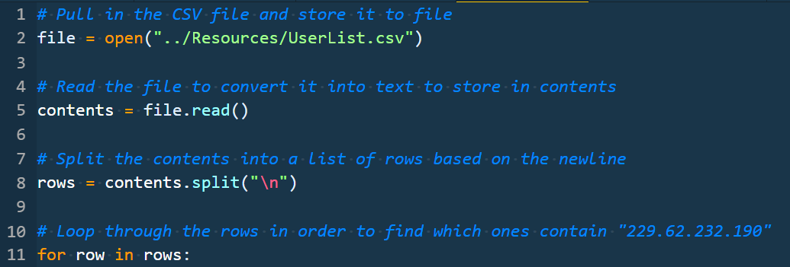
Yesterday
Loops
for … in, range, while, nested loops
Dictionaries
language = {“name”: “python”, “proficiency”: “medium”}
language[“proficiency”] = “yuge”
.keys(), .values(), .items()
Functions
def printHello():
def printGreeting(greeting):
return
sum = add(2, 3)
Reading Files
diary_txt = open(“Diary.txt”)
diaryText = diary_txt.read()
New String Functions
.find(“word”), .split(“,”)
Notes:
Review goals; address any questions.

Slide 4
The Story So Far
Data
Numbers
Strings
Booleans
Lists
Dictionaries
Logic
Operators
Conditionals
Loops
Functions
Modules
Notes:
Review goals; address any questions.

Slide 5
Today’s Summary
Data
Numbers
Strings
Booleans
Lists
Dictionaries
Logic
Operators
Conditionals
Loops
Functions
Modules
…plus more practice and application of what we’ve learned so far!
Notes:
Review goals; address any questions.

Slide 6
Today’s Goals
By the end of class, you will be able to:
Use modules to complete more complex operations with Python.
Search and reference documentation to learn of and use necessary functions.
Read and write files using Python.
Walk through directories effectively using the `os` module.
Use the datetime module for date management.
$ python learn3.py
Notes:
Review goals; address any questions.

Slide 7
Modules

Slide 8




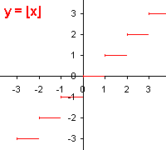
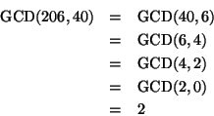
Module
A module is a file containing a set of definitions which can be used in another script.
Python has many built-in modules for dealing with all kinds of tasks: math, os, csv, datetime, and more.
Notes:
Review goals; address any questions.

Slide 9
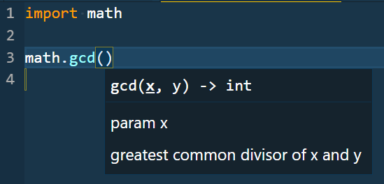
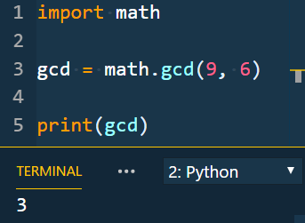
Modules
Modules expose functions and values which can be used in other files
Modules are included in a script using a process called importing.
You then reference a module later in the code to accomplish some task, similarly to functions.
Referencing the gcd function of the math module
Importing the math module
Notes:
For example, here we have the “Greatest Common Divisor” method, as provided by the math module.

Slide 10
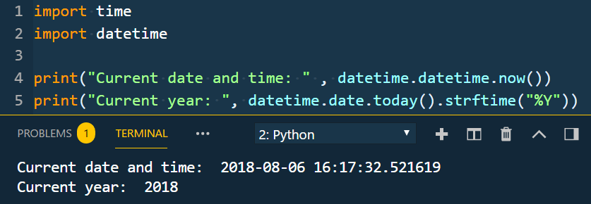
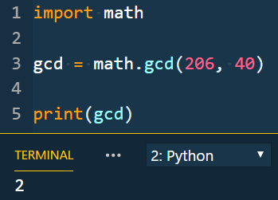
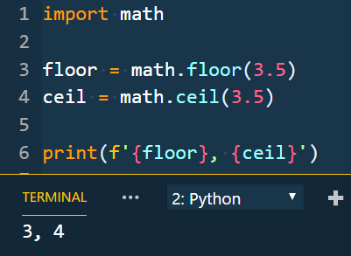
Modules - Examples
Notes:
Point out

Slide 11
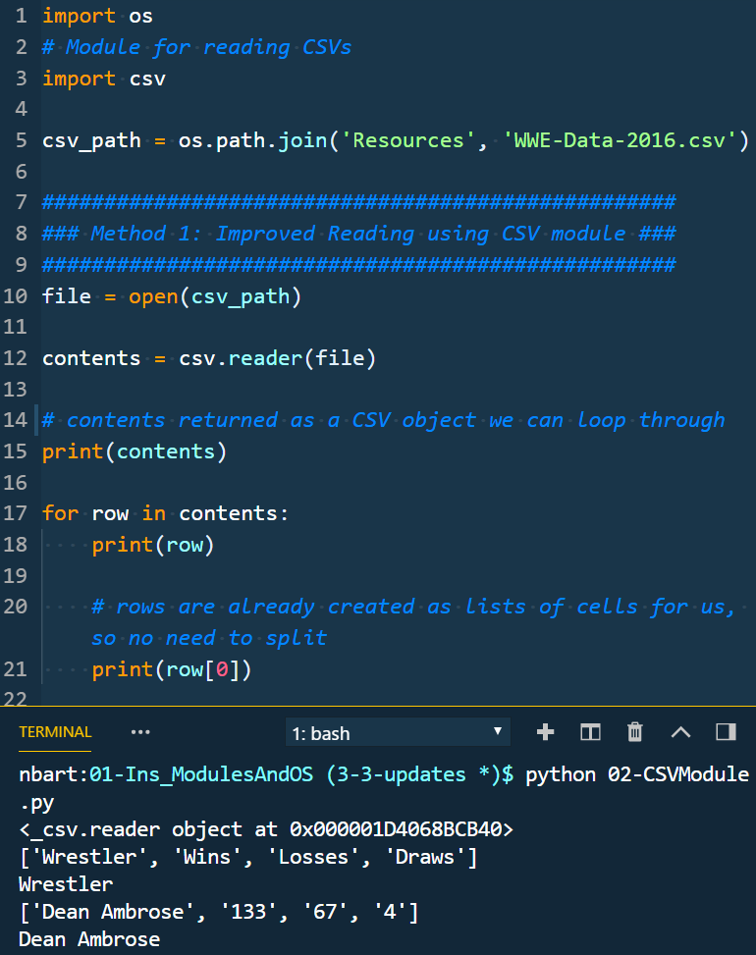
CSV and OS Modules
Instructor Demo

Slide 12
Activity: User List Revisit (10 min)
In this activity, you're going to take some code that we built previously and incorporate some modules to make it more functional. This is good practice in refactoring code!
Instructions:
Open up the Unsolved/UserList.py file. Run it to ensure it is reading from the file correctly and outputting as expected.
Convert the file to use the os and csv modules. This will require:
Importing the appropriate modules
Updating the way the file is opened and read
Removing some unnecessary string management code
Updating the way the code manages the data inside of the for loop
If working correctly, the new file should output the exact same thing as the old file when run. However, you can now trust that this script will run successfully on any OS! On top of that, you are doing much less string manipulation, which helps to simplify your code.
Bonuses:
Update the code as necessary so that it uses the `in` operator to check for the IP in the list instead of `.find` and `> -1`.

Slide 13
User List Revisit
Instructor Review
Notes:
Review goals; address any questions.

Slide 14
Writing Files

Slide 15
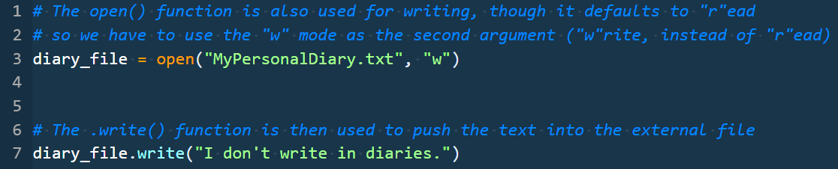
Writing Files
Instructor Demo

Slide 16
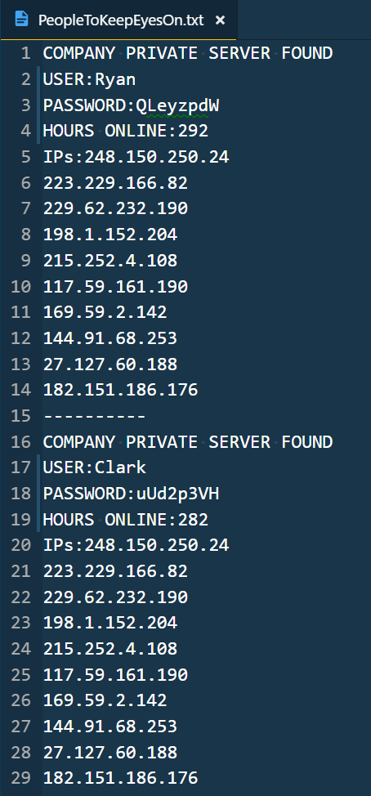
Activity: User Summary File (15 min)
Building off of the previous activity, we will now create a new file which contains a summary report on each of the flagged users from the user list.
Instructions:
Open up the Solved/UserList.py file from the previous activity.
Run the file to ensure it is reading from the file correctly and outputting to the console as expected.
Update the script to write the output to a file named PeopleToKeepEyesOn.txt
The file contents should look similar to what was output to the console after running the file initially.

Slide 17
User Summary File
Instructor Review
Notes:
Review goals; address any questions.

Slide 18
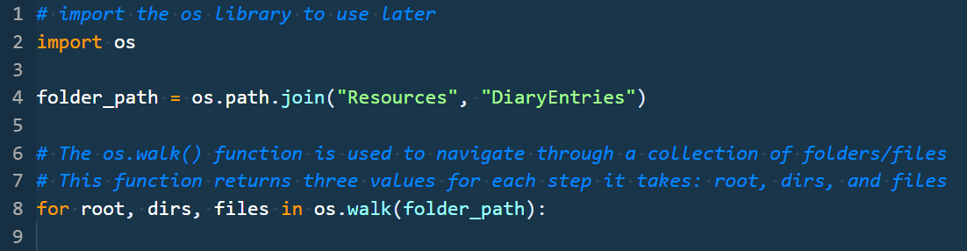
os.walk
Instructor Demo

Slide 19
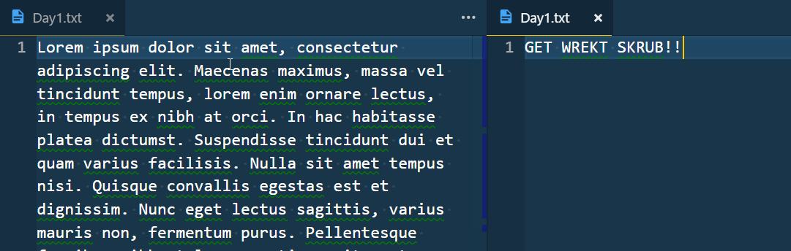
Activity: GET WREKT SCRUB (20 min)
Time to write a Python script from scratch!
Instructions:
Write a script which loops through all of the files in the Diaries folder and writes the string “GET WREKT SKRUB” to those files, deleting all of the content.
Bonus: Write a separate script which only modifies files in the week1 and week3 folders.

Slide 20
GET WREKT SCRUB
Instructor Review
Notes:
Review goals; address any questions.

Slide 21
Break

Slide 22
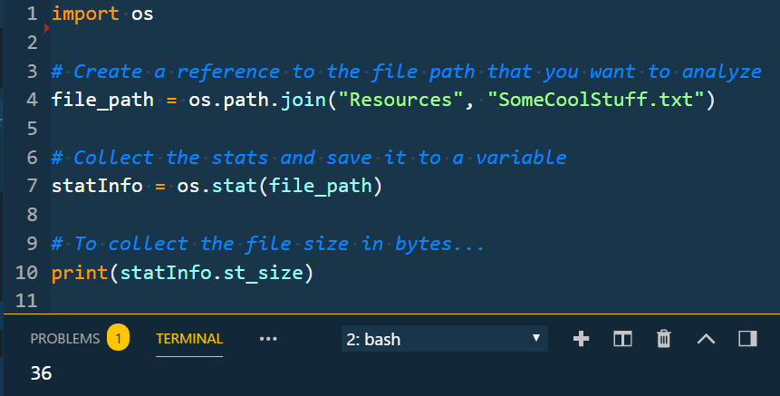
OS File Stats
Instructor Demo

Slide 23
Activity: Searching the Red Flag Sea (25 min)
In this activity, you're going to write a script that searches a folder for any files that seem out of place. All of the files should be the same size and have been modified around the same time ... but there are some that stand out.
Instructions:
Write a Python script that reads through all of the files in the `Text` folder. The script should print out a line that looks like the following for each file:
`File Name, File Size, Last Modified Date`. For example:
`Text\zrJ1cdXhuZOB, 100, Sun Jul 29 10:55:57 2018`
Bonuses
Use a try/catch statement so that your program keeps running if it encounters an error with any of the files.
Use Python f-strings in outputting the file data.
Write a report to a csv file with the file data.

Slide 24
GET WREKT SCRUB
Instructor Review
Notes:
Review goals; address any questions.

Slide 25
Activity: Cleaning the Red Flag Sea (25 min)
In this activity, you're going to build on the last script to delete any “stand out” files.
Instructions:
Option 1: Normal (Recommended to do this first)
Update your Python script to ask the user if they'd like to delete any "stand out" files.
If they say yes, delete any files that are not the expected file size (100 bytes)
Bonus:
Update your deletion condition to also delete any files which don't have the expected "last modified" date.
Option 2: Challenge (If you're feeling confident and/or have finished Option 1)
Have your Python script report the number of files, the folder size, and the average file size
After reporting, your Python script should ask the user if they'd like to delete any "stand out" files.
If they say yes, delete all of the files above the average size of the files in the folder.

Slide 26
GET WREKT SCRUB
Instructor Review
Notes:
Review goals; address any questions.

Slide 27
Lesson Recap

Slide 28
Week Summary – We did it!
Data
Numbers
Strings
Booleans
Lists
Dictionaries
Logic
Operators
Conditionals
Loops
Functions
Modules
Notes:
Review goals; address any questions.

Slide 29
Today’s Goals
By the end of class, you will be able to:
Use modules to complete more complex operations with Python.
Search and reference documentation to learn of and use necessary functions.
Read and write files using Python.
Walk through directories effectively using the `os` module.
Use the datetime module for date management.
$ python learned3.py
Notes:
Review goals; address any questions.

Slide 30

Python Learning Tips
Always Be Coding
The more you practice, the better off you’ll be.
Notes:
Review goals; address any questions.

Slide 31



Python Practice
Want More Practice?
http://learnpython.org/
https://www.hackerrank.com/domains/python
Be sure to choose Python 3 when writing out solutions
https://codesignal.com/
There’s a lot that we haven’t covered as well – it can take years to truly master Python. We know enough to be dangerous now.
Notes:
Review goals; address any questions.

Slide 32

Self-Check Up?
Stick around for office hours (or come early next class) if you have any questions or concerns!
We’re here to enable you to learn this stuff.
Remember: Learning can feel a lot like frustration!
Notes:
Review goals; address any questions.

Slide 33

Self-Check Up?
We want you here and happy!
Notes:
Review goals; address any questions.

Slide 34

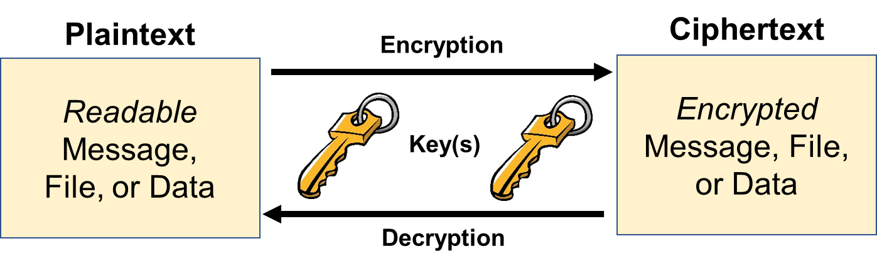

Next Class…
Cryptography!

Slide 35
Homework – Get Crackin’

Slide 36
Bonus Activity: Password Hunt (30 min)
In this activity, you’re given a series of diary entries and must navigate through them to attempt to uncover which entries may include password information.
Instructions:
Write a script from scratch that searches the files in the directory for information regarding passwords.
Have the script search for specific keywords in the files and print whether or not those keywords were found in each file.
No starter file or guidance here! You’re going to have to do some internet searches and look at previous examples for how to loop through files, find text in the file, and more.

Slide 37
Password Hunt
Instructor Review
Notes:
Review goals; address any questions.

