Slide 1
Packet (Trace) Players
Unit 6.2
Cybersecurity Boot Camp |
August 30, 2018

Slide 2
Today’s Class

Slide 3
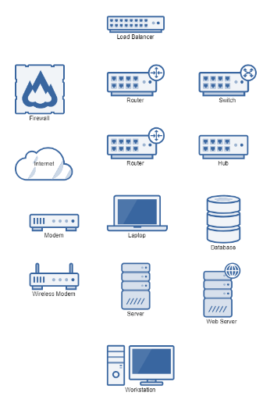
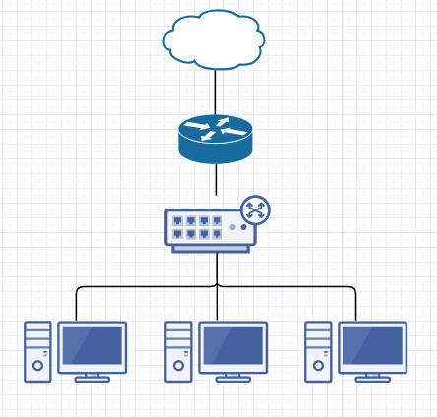
Last Week – Network Devices and Designs
Network Elements
Simple Network Diagram
Notes:
Review goals; address any questions.

Slide 4
Quick Warm-Up
Router
Switch (and Hubs)
Bridge
Firewall
Network Interface Cards
Wireless Access Point
Modem
Wifi Router
Servers (HTTP, DHCP, FTP)
Define Each Term
Take a minute to define each of the terms listed here.
Notes:
Review goals; address any questions.

Slide 5
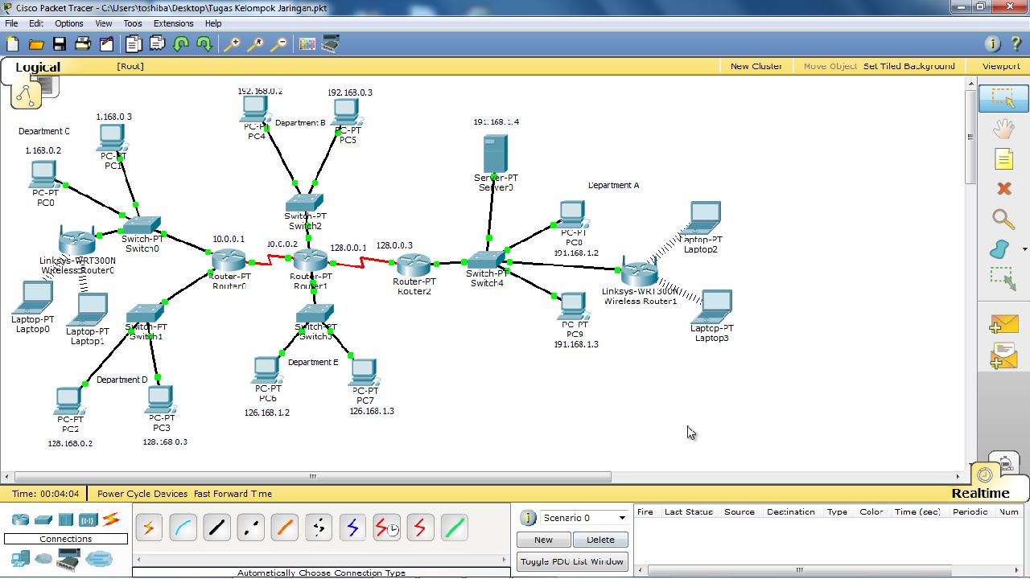
Today’s Class: Packet Tracer!
We’ll play a bit with Cisco Packet Tracer, a powerful tool for simulating real-world networks.
Notes:
Review goals; address any questions.

Slide 6
Articles

Slide 7
Intro to Packet Tracer

Slide 8
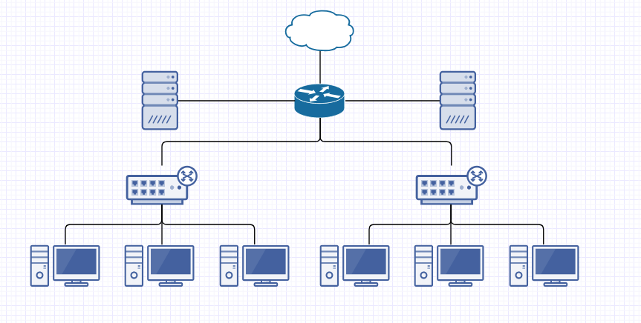
Beyond Simple Network Diagramming
While platforms like Gliffy are great for illustrating quick network schematics as abstractions, they aren’t useful for much else.
Notes:
Review goals; address any questions.

Slide 9
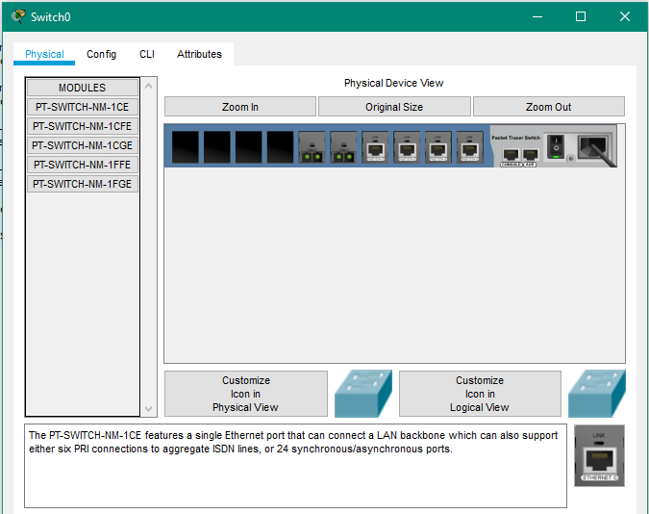
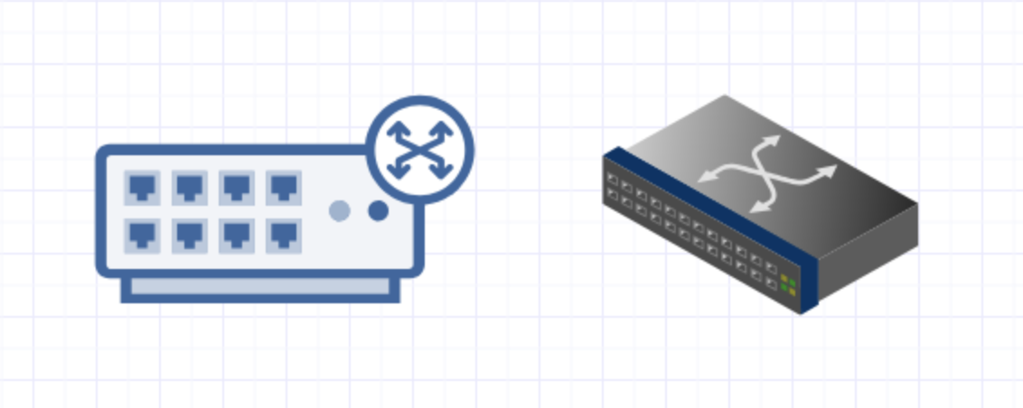
Packet Tracer: Real-World Devices
Switches
In contrast, Packet Tracer includes a whole host of real-world devices each with extensive customizability.
Notes:
Review goals; address any questions.

Slide 10
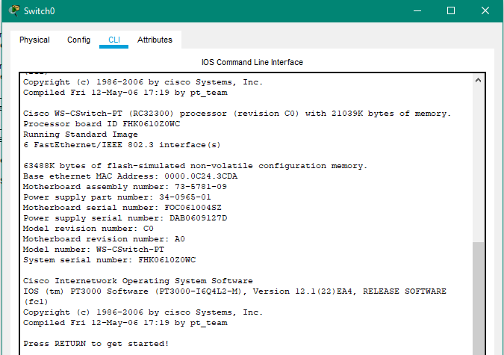
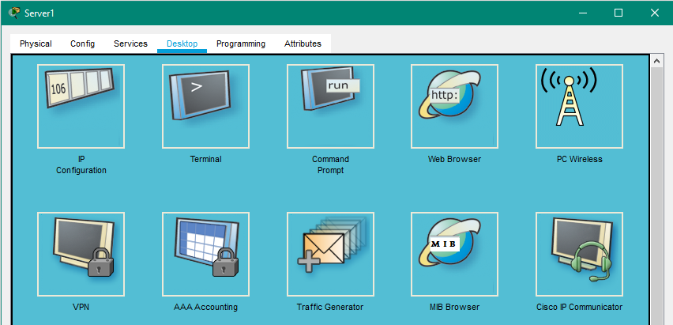
Packet Tracer: Command Line Interactivity
Not only can devices be deployed in a schematic, but they can also be assigned IP addresses, configured, and “programmed” in ways similar to real devices.
Notes:
Review goals; address any questions.

Slide 11
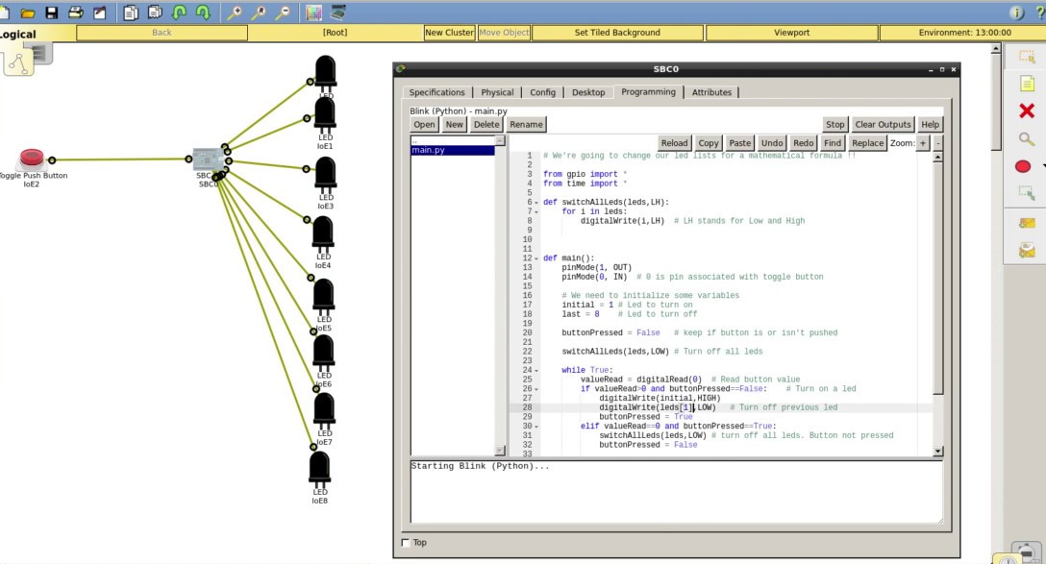
Packet Tracer: Scripting and Web Browsing
This even extends to the idea of running Python code, loading HTML web pages off simulated server instances, and more.
Notes:
Review goals; address any questions.

Slide 12
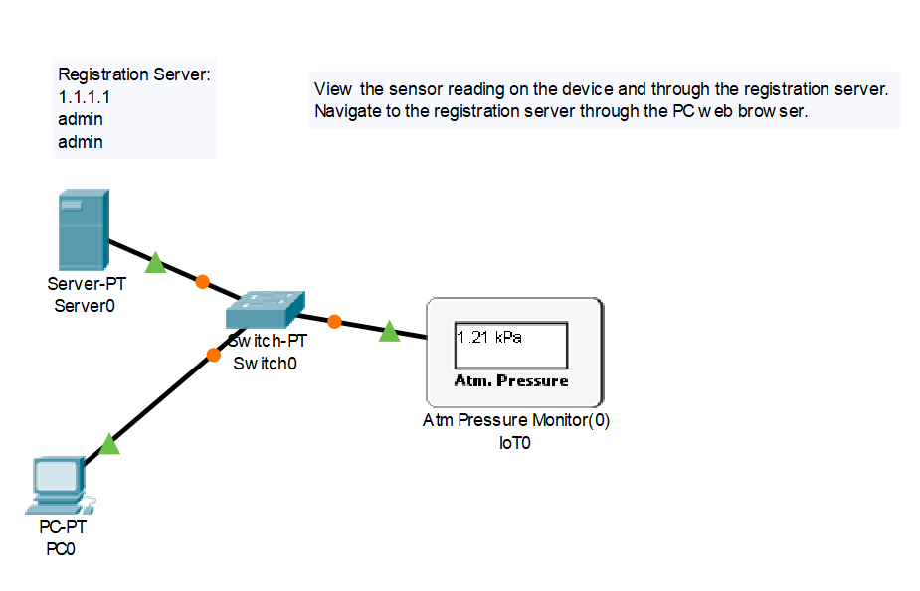
Packet Tracer: IoT Devices
Packet Tracer’s latest version also includes a whole host of IoT devices (sensors and home devices) that can be “programmed” to engage and respond with entire networks.
Notes:
Review goals; address any questions.

Slide 13
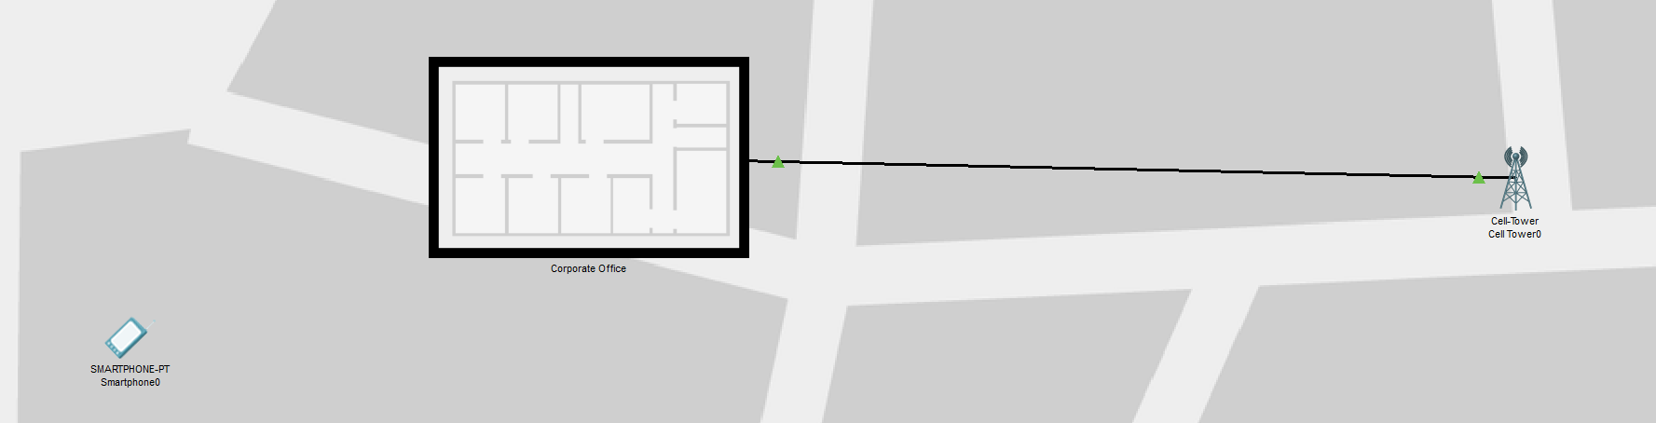
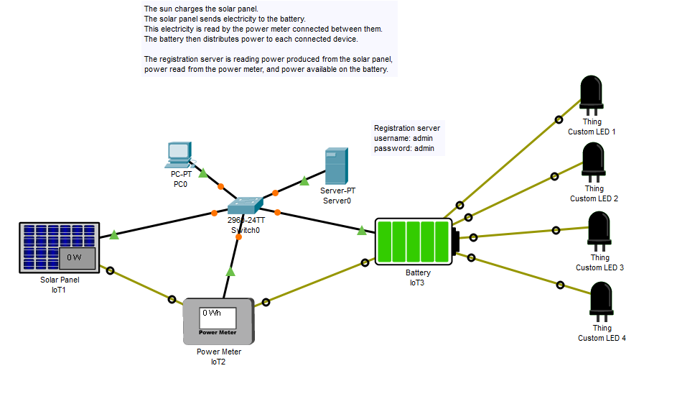
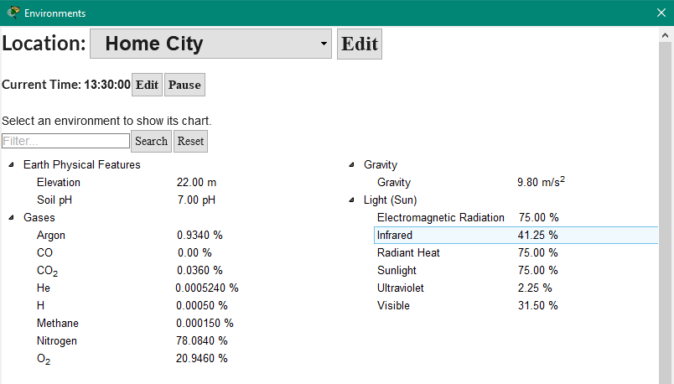
Packet Tracer: Physical and Environmental Considerations
Packet Tracer also makes it possible to view how devices in the network may respond to being spread across geographic distances and into environments with various conditions.
Notes:
Review goals; address any questions.

Slide 14
Installation

Slide 15
Activity: Packet Tracer Download / Setup (20 Minutes)
Instructions:
Windows Users (Easy)
Create an account on the Cisco Net Academy Website (https://www.netacad.com/).
Then scroll to the bottom under the section titled Resources and click on Packet Tracer. Download the Windows Desktop Version of Packet Tracer (64 Bit).
Install the application.
Open it once installed to confirm. Experiment with the layout by dragging a router or switch onto the design window.
Mac Users (Ugh):
There is no native version of Packet Tracer available for Macs.
We’ve instead arranged for you to use a Windows Virtual Machine to play with instead.
First create an account on the Cisco Net Academy Website.
Then load this first Virtual Machine (Virtual Box) into your machine. Attempt to drag a router or switch onto the design window. (If you experience major lag, call on your instructor for an alternative VM).

Slide 16
Toe Dipping

Slide 17
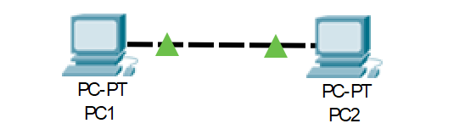
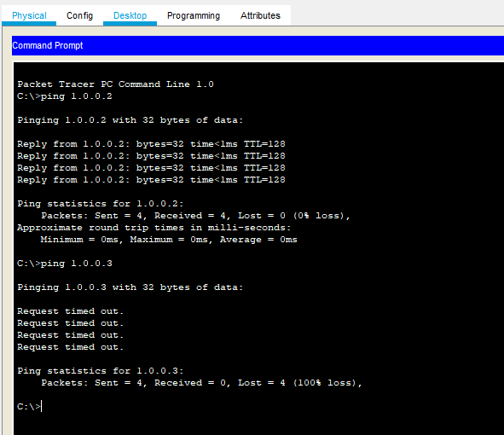
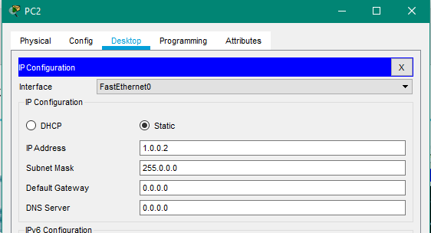
Basic P2P Configuration
Step 1: Server Diagram
Step 3: Ping Test
Step 2: IP Assignment”
Instructor Demo
Notes:
Review goals; address any questions.

Slide 18
Activity: Ping This! Ping That! (15 mins)
Take a few moments to experiment creating the following networks:
Single PC connected to another PC (P2P Connection)
Trio of PCs connected to a Switch
Six PCs connected to Switches that are Connected to one Another
Bonus
3 PCs Connected to a Switch and 3 Laptops Connected to a Wireless Router (Hint: This will take some research)
Notes:
For each of these labs, confirm through ping that data is flowing across your networks as expected.

Slide 19
Network Topologies (15 mins)
Take a few moments to build any two of the below network topologies.
Bus
Tree
Ring
Mesh
Hybrid
As with the previous example test to confirm that this network works as expected.

Slide 20
Network Games

Slide 21
For the next set of exercises, join a group of three. Then, working together, take a stab at completing as many of the following labs as you can. You may go in any order you like!
Spread out! Find spaces across the building! Instructors and TAs will wander across groups and help you to solve each task.

Slide 22
Network Challenge #1 – Smoke and Signals (40 mins)
Open the Packet Tracer Sample lab found in IoT > IoT_Devices > Co2_Detector.
In this lab, your assignment is as follows:
Spend a few moments dissecting how this lab works. (First start by trying to trigger the Co2 Sensor. See if you can login to the server from the PC).
Then, attempt to re-build this server network from scratch. Feel free to compare and contrast with the pre-existing lab, but take the effort of identifying how your network should be configured to achieve the result.
Once you complete this task, take things to the next level by incorporating an additional “trigger.” Perhaps, add a light switch that changes from On to Off as the CO2 sensor rises and falls.
Turn to your instructors and Tas often for assistance.

Slide 23
Network Challenge #2 – Nest Thermostat (40 mins)
Open the Packet Tracer Sample lab found in IoT > IoT_Devices > Temperature_Monitor
In this lab, your assignment is as follows:
Spend a few moments dissecting how this lab works. (First start by trying to trigger the thermostat into changing the temperature)
Then, attempt to re-build this server network from scratch. Feel free to compare and contrast with the pre-existing lab, but take the effort of identifying how your network should be configured to achieve the result.
Once you complete this task, take things to the next level by incorporating an additional “trigger.” Perhaps, add a speaker that plays music when the temperature reaches a certain level.
Turn to your instructors and Tas often for assistance.

Slide 24
Network Challenge #3 – You’ve Got Mail (40 mins)
Open the Packet Tracer Sample lab found in Server > Mail
In this lab, your assignment is as follows:
Spend a few moments dissecting how this lab works. (First start by trying to send mail across the network to other the other user).
Then, attempt to re-build this server network from scratch. Feel free to compare and contrast with the pre-existing lab, but take the effort of identifying how your network should be configured to achieve the result.
Once you complete this task, take things to the next level by adding additional users on each mail server and perhaps an additional mail server altogether.
Turn to your instructors and Tas often for assistance.

Slide 25
Network Challenge #4 – Can You Hear Me Now (40 mins)
Open the Packet Tracer lab found in Wireless > Cell and Wireless Path
In this lab, your assignment is as follows:
Spend a few moments dissecting how this lab works. (First start by moving the smartphone in the Physical environment. Move it inside the office building and around the city. Note how this changes the networks the smartphone connects to).
Then, attempt to re-build this server network from scratch. Feel free to compare and contrast with the pre-existing lab, but take the effort of identifying how your network should be configured to achieve the result.
Once you complete this task, take things to the next level by adding a different cell tower completely. See if you can make the smartphone connect to the nearest cell-tower.
Turn to your instructors and Tas often for assistance.

Slide 26
IoT Security Implications

Slide 27
Discussion

