Slide 1
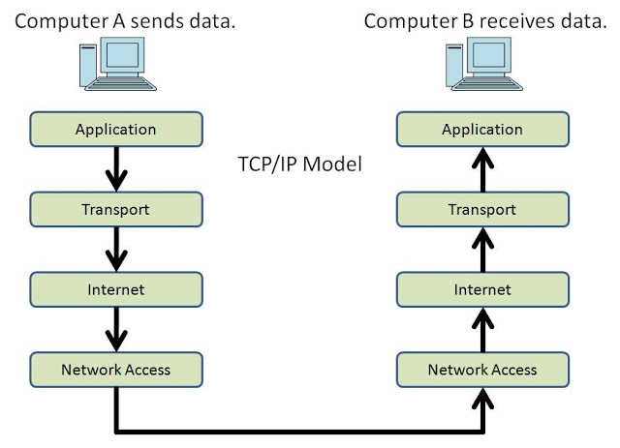
Protocols and the TCP/IP Model
® 2017 / Trilogy Education Services
Notes:
We’ve seen a lot of packets carrying data for a lot of protocols.
We know that HTTP is a protocol for sending web data. FTP is a protocol for sending file data. TCP is a protocol for sending raw data.
But we haven’t talked about exactly what protocols are.
A little more context will prepare us for some of the more challenging packet analysis we’ll do later today, like hunting for malware in data streams.
In this section, we’ll set the stage by discussing how protocols are defined, and ways to categorize them.

Slide 2
Table of Contents
Objectives
Explain the purpose of protocols
Identify important network protocols
Name the four layers of the TCP/IP model
® 2017 / Trilogy Education Services

Slide 3
Protocols & Layered Models
Protocols
Protocols are rules for how devices should:
Connect to each other
Format messages
Deal with errors
End connections
® 2017 | Trilogy Education Services
Notes:
Protocols are essentially rules for how devices should talk to each other.
We use different protocols for different purposes. For example, SMTP is for email, and HTTPS is for encrypted web traffic.
Since these are different applications, it makes sense there would be different rules for sending the data.
But many protocols have a lot in common. Most define specific rules for how devices should:
Open connections. Protocols specify how devices should request and negotiate connections with new devices. This process is often called handshaking.
Configure the connection. Protocols specify if the device should encrypt data; If so, how are keys traded; etc.
Format data. Protocols define very specific data formats. Devices communicating under a certain protocol expect to receive messages adhering to the specification.
Handle errors. Protocols specify how devices should handle situations such as corrupt data, dropped connections, etc.
Terminate connections. Protocols specify how devices should end the connection between them.

Slide 4
Protocols & Layered Models
Protocols
Different situations use different protocols
Encrypted web apps use HTTPS
Real-time chat apps WebSockets
TCP sends app data to target machines
DNS turns IP addresses into domain names
® 2017 | Trilogy Education Services

Slide 5
Protocols & Layered Models
HTTP Protocol
® 2017 / Trilogy Education Services
Notes:
Explain that we’ll take a brief look at how the HTTP protocol specifies how to initiate requests and format data.

Slide 6
Protocols & Layered Models
“A client sends an HTTP request to a server in the form of a request message, beginning with a request-line that includes a method, URI, and protocol version…, followed by header fields containing request modifiers, client information, and representation metadata…, an empty line to indicate the end of the header section, and finally a message body containing the payload body.”.
— RFC 7230
Notes:
This excerpt from RFC 7230 (https://tools.ietf.org/html/rfc7230), which defines Message Syntax for the HTTP protocol, gives a flavor of what defining a protocol entails.
Note that it defines how devices initiate connections (in the form of a request message), and the data format.

Slide 7
Protocols & Layered Models
GET /hello.txt HTTP/1.1
User-Agent: curl/7.16.3 libcurl/7.16.3 OpenSSL/0.9.7l zlib/1.2.3
Host: www.example.com
Accept-Language: en, mi
Example HTTP Request
Notes:
Explain that this example request implements the description from before.

Slide 8
Protocols & Layered Models
[Method] /[Resource URI] HTTP/[Version]
Header Name: Value
Header Name: Value
Header Name: Value
<Empty Line>
HTTP Request Anatomy
Notes:
This slide maps the description onto the example request. Note that GET is a method; /hello.txt is the URI; 1.1 is the version; etc.

Slide 9
Protocols & Layered Models
GET /hello.txt HTTP/1.1
User-Agent: curl/7.16.3 libcurl/7.16.3 OpenSSL/0.9.7l zlib/1.2.3
Host: www.example.com
Accept-Language: en, mi
Example HTTP Request
Notes:
When the target server receives this request, it will respond with the resource (or a 404 error).
We’ll take a closer look at Response formats when we investigate HTTP later in the course.

Slide 10
Protocols & Layered Models
The TCP/IP Model
® 2017 / Trilogy Education Services
Notes:
A few examples of different protocols for different purposes.
Emphasize that this is a very small subsample.
Wireshark recognizes over 1,000 protocols by default, and new ones are added all the time.
Fortunately, these 1,000+ protocols don’t serve 1,000+ purposes. Many do similar jobs in different situations.
For example, TCP sends raw data between computers. UDP also sends raw data between devices. They do it a bit differently, but they serve a similar purpose.
Thinking hard about similarities and differences between protocols leads us to powerful models for categorizing different protocols.
The TCP/IP model is the one that best describes the Internet, and provides a powerful way to group protocols based on what they do.

Slide 11

Protocols & the OSI Model
The TCP/IP Model organizes protocols into four layers
® 2017 / Trilogy Education Services
Notes:
The TCP/IP model organizes protocols into four layers.
At the top are protocols that are used to let user-facing applications request to send/receive data on the network. This is the application layer.
Just below this are protocols that actually handle sending that data to other applications. These live in the transport layer.
Below this are protocols that figure out which computer to send the data to next. These are internet layer protocols. Routers are devices that live at this leve.
At the very bottom are protocols that turn physical signals from a wire into data a computer can understand. These live in the network access layer.

Slide 12
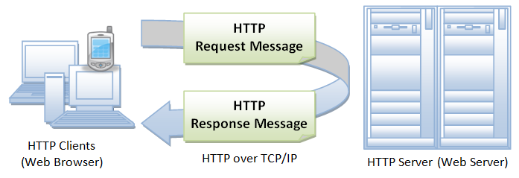
Protocols & Layered Models
Application Layer
Lets user-facing apps request to use the network
Web browsers (HTTP/S)
File transfer (FTP)
Email (SMTP)
® 2017 | Trilogy Education Services
Notes:
Explain that the application layer is responsible for representing data in a way the consuming application can understand.
For web apps, this means HTTP (or HTTPS, which is the encrypted version).
Remind students of the HTTP request from before.
For email applications, this would be a different protocol, called SMTP.
Emphasize that, at this level, data is formatted for user-facing applications to consume.

Slide 13
Protocols & Layered Models
Transport Layer
Sends data to/from user applications
Breaks data into manageable chunks
Controls how much bandwidth apps use up
Handles dropped data, etc.
® 2017 | Trilogy Education Services
Notes:
The transport layer is responsible for actually transmitting data across the network. In other words, it’s the layer that puts the data onto the network.
For example, when a user tries to send a message with an email app, the email app will wrap up their message, attachments, the subject line, etc., into a package that the recipient’s email application can understand. This is, e.g., the SMTP protocol.
This package is a bunch of data, which the recipient’s computer could understand…If it ever received the data.
To actually get SMTP data from computer to computer, we need to use a different set of rules/protocols. Those are the transport protocols, which actually transport application data between devices.

Slide 14
Protocols & Layered Models
Internet Layer
Ensures data gets to the right networks
Figures out which device to send data to next
Routers pass data from network to network
® 2017 | Trilogy Education Services
Notes:
The Internet layer is responsible for routing data through physical networks.
The Internet layer ensures data gets to the correct destination.
Internet-layer devices use IP address to identify target networks.
nternet-layer devices use a protocol called ARP, or Address Resolution Protocol, to map IP addresses to hardware addresses.
This allows network hardware to map an IP address to an real, physical machine.
We’ll discuss this process in greater detail when we discuss switches.
Routers are examples of Internet-layer devices.

Slide 15
Protocols & Layered Models
Network Access Layer
Gets data out of the wire and into the computer
DSL gets data from phone lines into computer
Ethernet moves data across physical wires
® 2017 | Trilogy Education Services
Notes:
The network access layer is responsible for converting packets into data that can be sent along physical wires or fibers to target devices. In other words, this is the layer that puts TCP/IP packets onto the network.
This typically involves data being fed to a network adapter (e.g., a network card).
Each physical network adapter is assigned an IP Address so that it can connect to the network
This network adapter is responsible for packaging data from the computer’s physical hardware and passing it to a router for further transport along the network.

Slide 16
Protocols & Layered Models
Data flows down to get sent…
® 2017 / Trilogy Education Services
Notes:
When a computer sends data, it flows down these layers, from the application to the physical layer…

Slide 17
Protocols & Layered Models
…And up to be received
® 2017 / Trilogy Education Services
Notes:
…And then through the network, and up on the other side.

Slide 18
Checking Connectivity
Questions
® 2017 / Trilogy Education Services

